Slide 1
WWII Rise of Dictators

Slide 2
Dictator Graphic Organizer
Complete each box as outlined on the top of the graphic organizer.

Slide 3
Rise of Dictators
Many democratic nations of Europe turned to dictatorships
Causes
Economic Chaos- Great Depression, Inflation from WWI
Upset over World War I
Peace Settlements
Nations turned to 1 strong leader to guide the nation through troubled times- Totalitarian State
Nationalism strong, little personal freedoms
Notes:
Discovering history: 20th century bios wwii political leaders

Slide 4
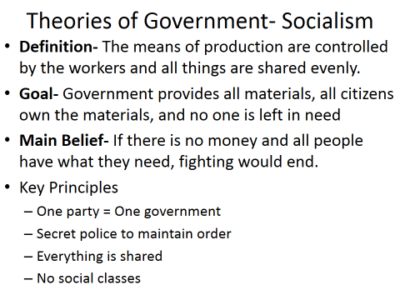

Slide 5
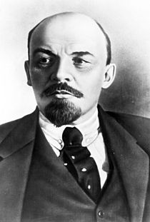
Vladimir Lenin
Founder of the Bolshevik Party- “Peace, Land, Bread”
Became a Marxist follower in college and led the way for Marxism in Russia
No capitalism, economic equality among the people
Took over the Russian government in November of 1917 by capturing the Czar and the royal family.

Slide 6
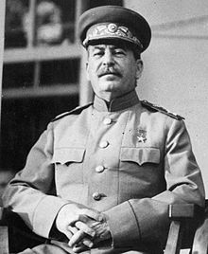
Joseph Stalin
Lenin died in 1924, leaving leadership open
Wished to make the Soviet Union an industrial power
Created the Five Year Plan (create an industrial nation completely controlled by the government = collectivization)

Slide 8
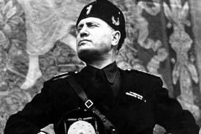
Benito Mussolini
Background- came from a middle class family, hated all organizations of religion, government, and social classes
Formed the Fascist Party- after WWI
Extreme Nationalists who wished to bring back Italy to the glory of the Roman Empire

Slide 9
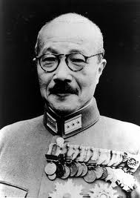
Hideko Tojo
Japan was ruled by a Monarchy prior to WWI
Military became more powerful than the government
Used military to grow economy through invasions
Emperor = figure head of government
Real power resided in most powerful military leader Tojo

Slide 10
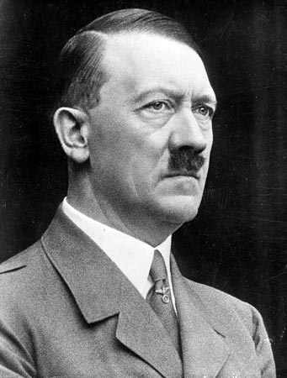
Adolf Hitler
1932- largest political party in Germany
1933- Hitler named Chancellor of Germany
1934- Germany became a 1 party nation
Member of the German army during WWI.
Was recovering in a hospital when Germany surrendered- very upset by WWI’s end
Blamed Jewish government leaders for the loss of WWI, felt they “stabbed Germany in the back”
Joined Nazi party in 1919, became leader in 1921
Characteristics of Nazi Party
Violent Nationalism
Anti-Semitic (hatred of Jewish people and culture)
Extreme hatred of communism
Extreme hatred of German Republic
Armed “thugs”

