Slide 1
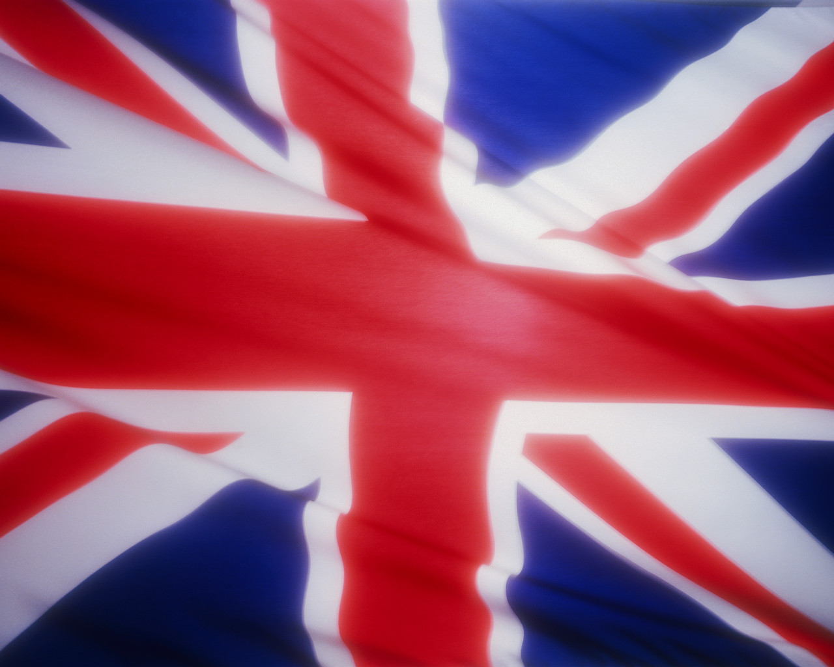
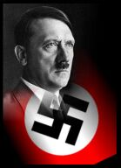
World at War
...again
Revenge
of the
Germans

Slide 2
The European Theater
Treaty of Versailles ends WWI
Germany was blamed for causing World War I and had to pay $33 million in war damages called reparations.
As a result of WWI, there was a rise of social and economic problems. A great Depression swept through Europe
This depression lead to the rise of Dictators throughout Europe
The Treaty of Versailles was supposed to keep Germany’s
military force small, but Hitler refused to obey it.

Slide 3
The European Theater
Hitler (GERMANY) annexed Austria & demanded the Sudetenland (W. Czech)
England and France practiced a Policy of Appeasement toward Germany.
They were hesitant to get into another World War
March 1939: Germany took rest of Czechoslovakia (appeasement failed)
France & Britain pledged war if aggression continued
1939: Hitler & Stalin signed a “Non-Aggression Pact”

Slide 4
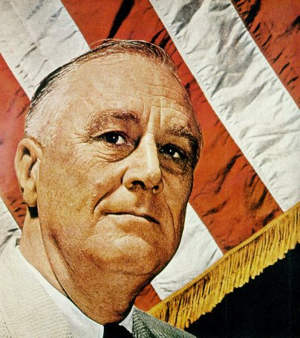
The European Theater
United States’ reaction to foreign aggression
1935: passed Neutrality Act – no arms to warring nations
1939: “Cash-n-Carry” policy (purpose to aid the Allies)

Slide 5
The European Theater
War in Europe (Early Period)
Sept. 1, 1939: Germany invaded Poland with blitzkrieg (lightning war) attack (WWII begins)
France & Great Britain declare war the next day
The Holocaust intensifies
Germany was hard hit by the Great Depression and Hitler blamed the Jews for their problems.
Neutral nations fell quickly ---> Denmark, Netherlands, Belgium, Norway
France fell to Hitler in late June 1940
That same year, Italy joined the war in support of Germany.

Slide 6
The European Theater
June, 1941: Hitler double crossed Stalin and invaded Russia through Poland
Big Mistake! Stalin used Scorched Earth military tactic
Harsh winter and lack of useable supplies resulted in over 1 million Nazi loses

Slide 7
The European Theater
Appeasement was ineffective when dealing with Hitler
Sept 1940: Germany, Italy, and Japan signed the Tripartite Pact (Axis Powers)
U.S. Neutrality? Biased?
1940: WWI destroyers given for bases deal with Great Britain
1941: Lend-Lease Act --> U.S. became the “Arsenal of Democracy”
1941: FDR and W. Churchill (Britain) agreed to the Atlantic Charter
The Japanese attacked Pearl Harbor on December 7, 1941, prompting the United States to enter the war.

Slide 8
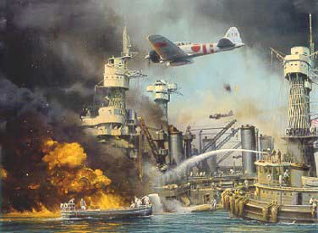
Japanese Attack Pearl Harbor

Slide 9
The European Theater
December 7th, 1941: Japanese Attack on Pearl Harbor
U.S. Pacific Fleet was based at Pearl Harbor in Hawaii
Attack was meant to cripple U.S. fleet so couldn’t interfere with Japan
Six aircraft carriers and 353 Japanese planes attacked in two waves
2,403 died (1,177 killed on the U.S.S. Arizona)
U.S. declared war on Japan the next day “…Date that will live in Infamy…”
Germany & Italy declared war on the U.S. on Dec 8, 1941 (Tripartite Pact)
The U.S. was officially in the war! (Isolationism was over)

Slide 10
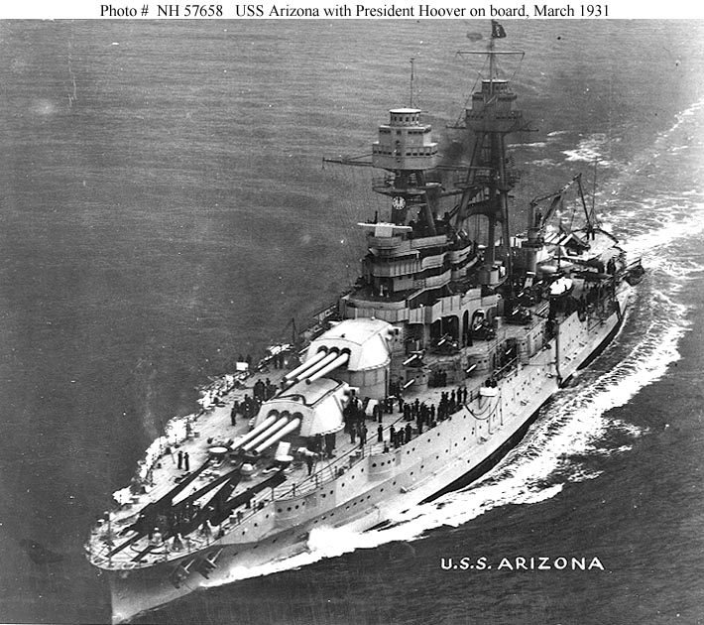
U.S.S. Arizona

Slide 11
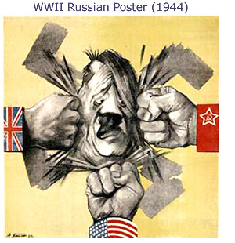
The European Theater
Key Nations at War
Allies: Great Britain, France, Soviet Union, United States
Axis: Germany, Italy, Japan

Slide 12
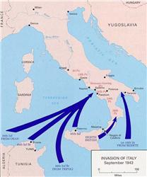
The European Theater
European Theater
Name given to the fighting that took place in Europe
1942: Britain stood alone against Axis
Gen. Dwight Eisenhower = Supreme Allied Commander of the European Theater
Allies first invaded through Sicily and up into Italy
Mussolini was overthrown and killed

Slide 13
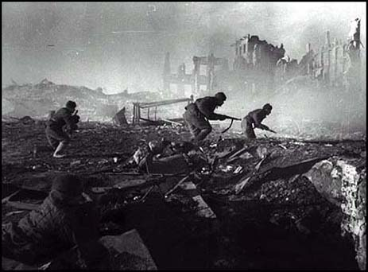
The European Theater
Eastern Front: Stalingrad
The Nazis were fighting the Russians in Stalingrad (Aug 1942-Feb 1943)
One of the bloodiest battles in the history of warfare
Nazis are defeated; turning point of the war for the Allies

Slide 14
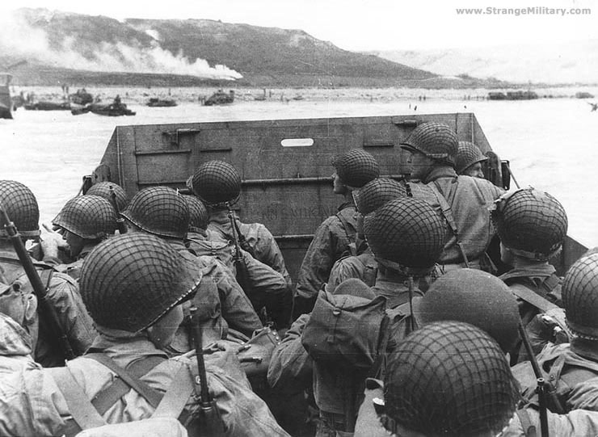
D-Day

Slide 15
The European Theater
Western Front: D-Day
General Eisenhower planned D-Day for June 6, 1944
Allied invasion across English Channel into Normandy, France
Largest military invasion in history
Allies success allowed them to push further into France

Slide 16
The European Theater
Battle of the Bulge
Hitler’s last major offensive
Allies were pushing from the West (from France), South through Italy, and from the East (Soviets)
Germany was surrounded

Slide 17
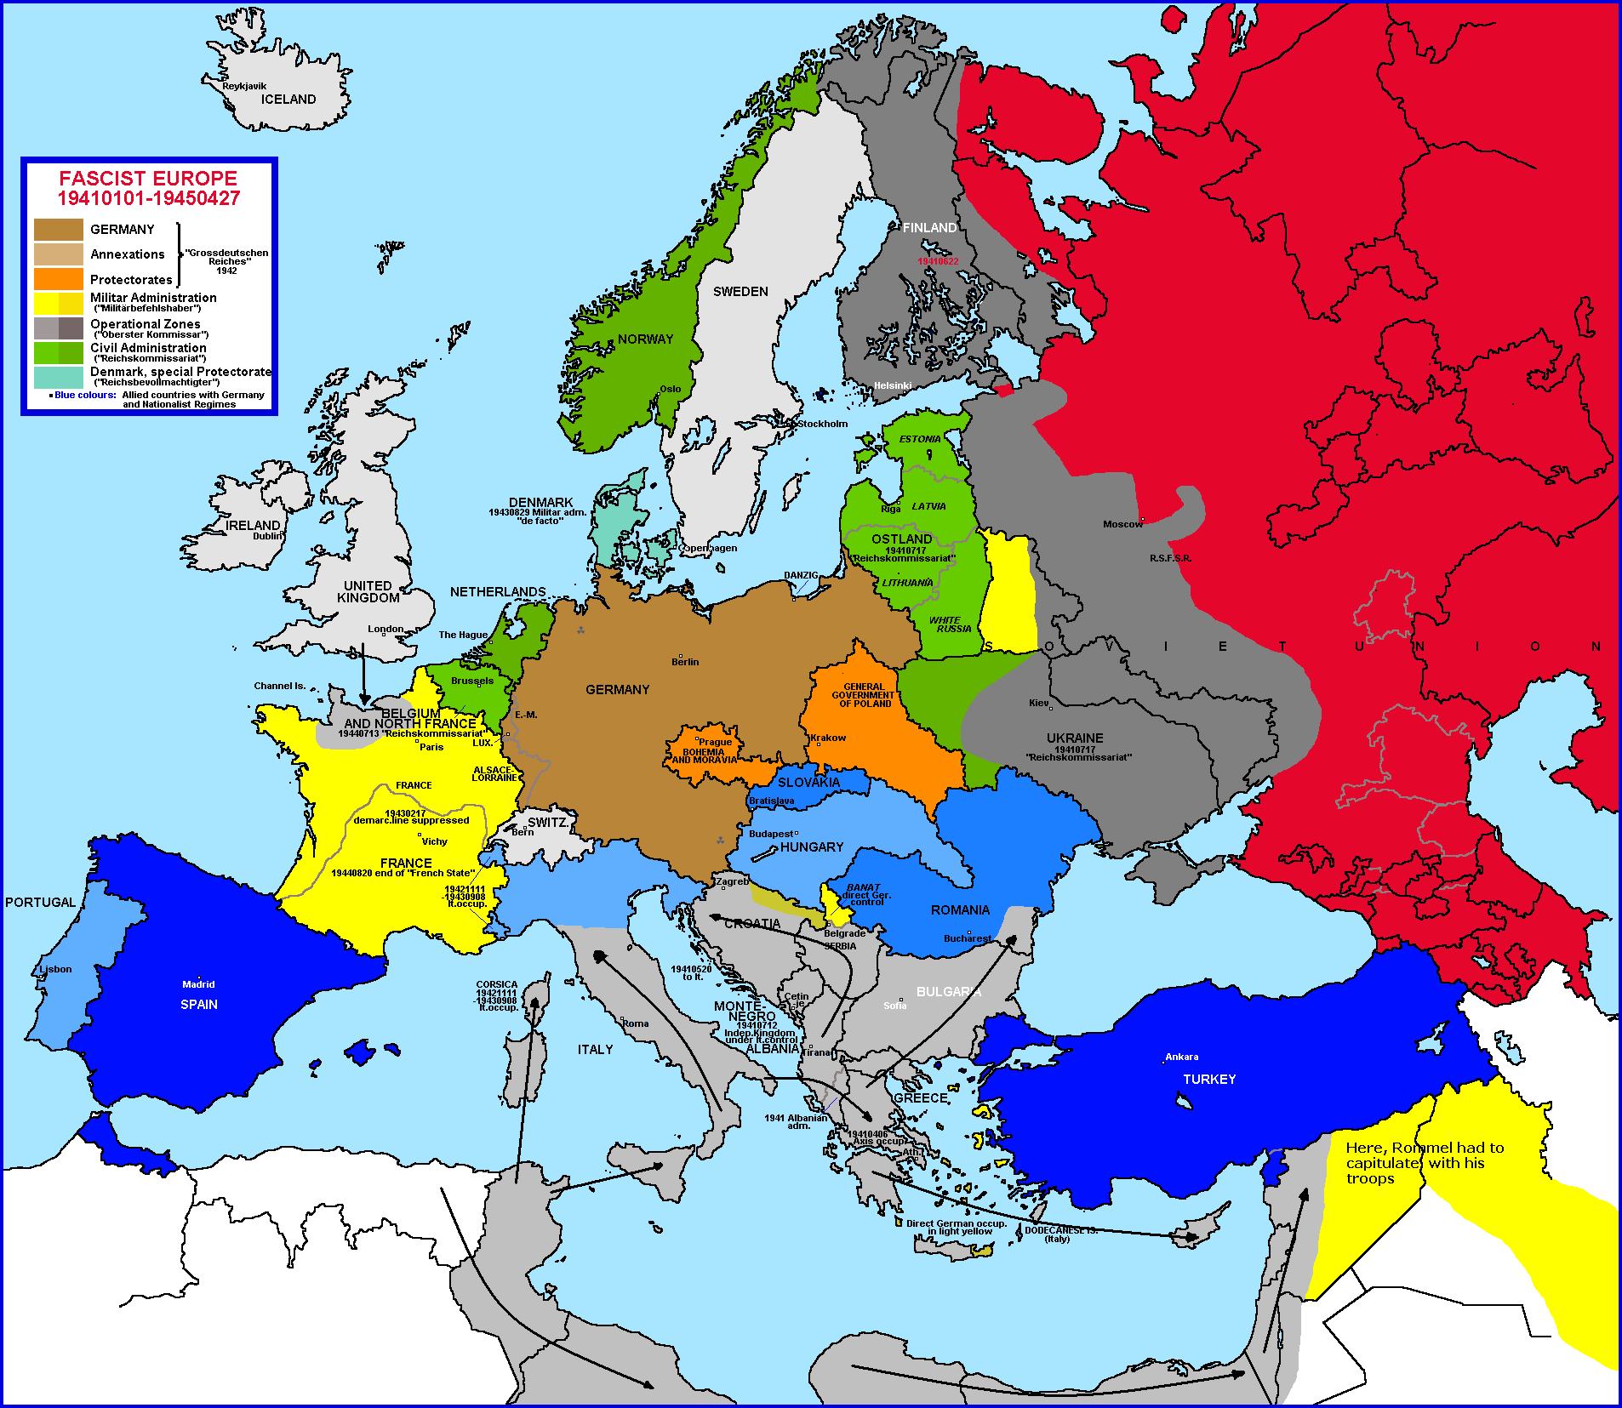

Slide 18
The European Theater
German Surrender
Hitler committed suicide before he could be captured
Germany officially surrendered on May 7, 1945; following day is known as VE Day
Now the Allies had to figure out how to defeat Japan
In August of 1945, the US dropped two Atomic Bombs on Japan to finally end World War II.
Hiroshima
Nagasaki
At the end of WWII the United Nations was formed.

