Slide 1
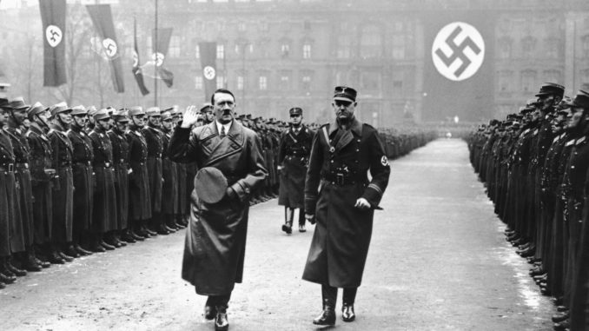
World War II

Slide 2
Causes for World War II
Treaty of Versailles
Hitler's Actions
Failure of Appeasement
Failure of the League of Nations

Slide 3
1. Treaty of Versailles
- Germany should accept the blame for starting World War One
Reparations -($5 billion in cash immediately, and $33 billion in gold over the next 66 years)
Disarmament - Germany was only allowed to have a small army and six naval ships.
Territorial Clauses: French troops would be stationed in part of Germany for 15 years.
Germany lost territory and all overseas colonies

Slide 4
2. Hitler's Actions
Hitler also made two important alliances during 1936.
Rome-Berlin Axis Pact and allied Hitler's Germany with Mussolini's Italy.
The second was an Alliance with Japan.
In March 1938, German troops marched into Austria. Taking back the land that had been taken away from Germany.

Slide 5
3. Failure of Appeasement
During the 1930s, politicians in both Britain and France came to see that the terms of the Treaty of Versailles had placed restrictions on Germany that were unfair.
Appeasement- Nations allowed Germany to do what they wished in order to avoid another war.
Munich Agreement of September 1938
the leaders of Germany, Britain, France and Italy, agreed that the Sudetenland would be returned to Germany and that no further territorial claims would be made by Germany.

Slide 6
4. Failure of the League of Nations
Not all countries joined the League (No U.S.)
The League had no power
The League had no army
Unable to act quickly
Think About :
Why was the League of Nations created?
Why didn’t the United States join the League of Nations?

