Slide 1
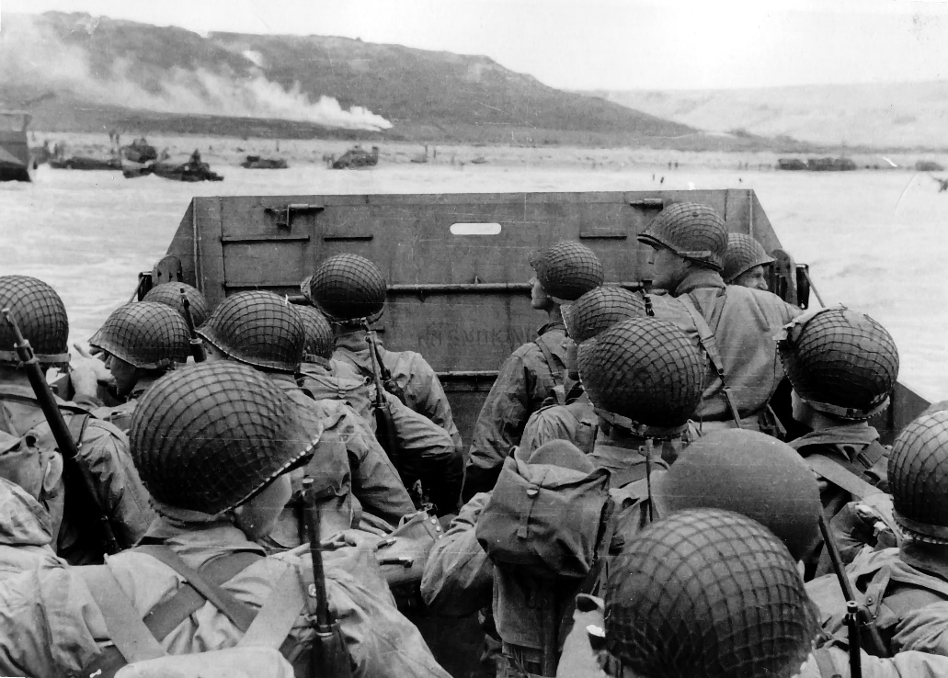
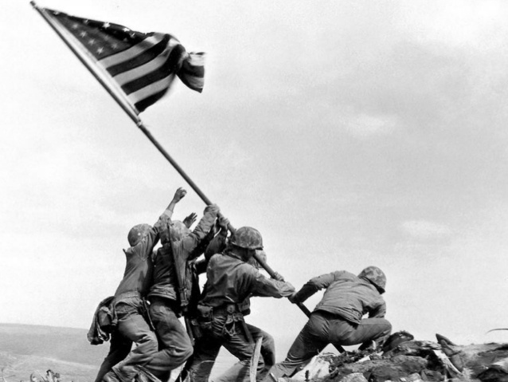
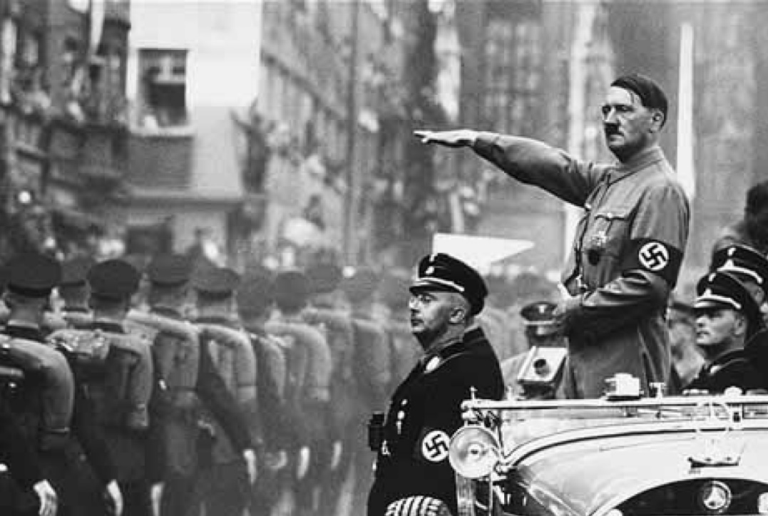
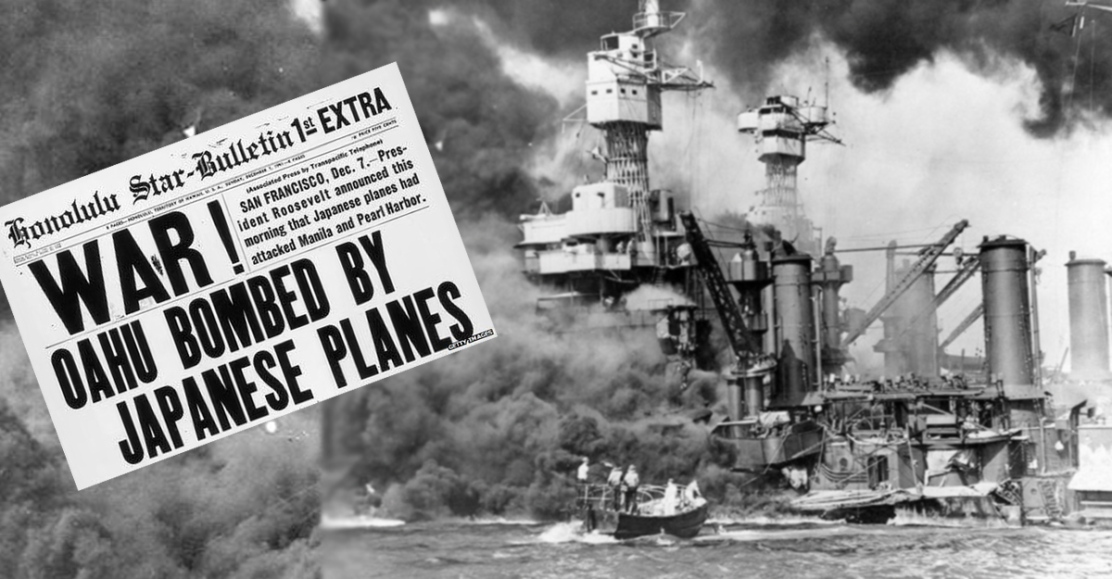
World War II
1939-1945

Slide 2
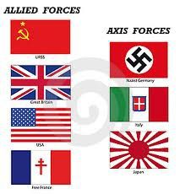
Allied Powers vs Axis Powers
Allied Powers (good Guys)
France
England
United States (eventually)
Axis Powers (bad guys)
Germany
Italy
Japan
Russia (kind of ….. For now …)

Slide 3
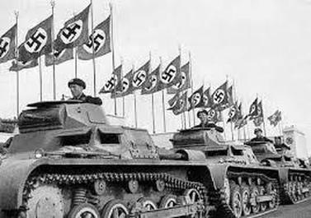
Prelude to war…
European countries policy of appeasement quickly goes away
Nazi German/ Soviet Non-Aggression Pact
Agree to not attack each other
Remember, Germany also has alliances with Italy and Japan
Germany attacks Poland …. Sept 1939
Poland tries to resists, but…
Nazi attack so fast and devastating, called blitzkrieg
Lightning-fast warfare
USSR attacks Poland on other side
Poland is divided up between German and Russia
War is inevitable now

Slide 4
Europe falls to Hitler
April 1940- Hitler unleashes blitzkrieg again
By May… Hitler controls most of Europe
Nazi Germany and Italy declare war on France
Italy Attacks France from south
Nazi troops take Paris, and France surrenders
By July, England was the only country not Controlled by the Axis powers
New Brit PM, Winston Churchill vows to “fight on,” and “never surrender!”
Hitler forced to give up plans of attacking Britain across English Channel
Britain remained, but Hitler controlled rest of Europe!

Slide 5
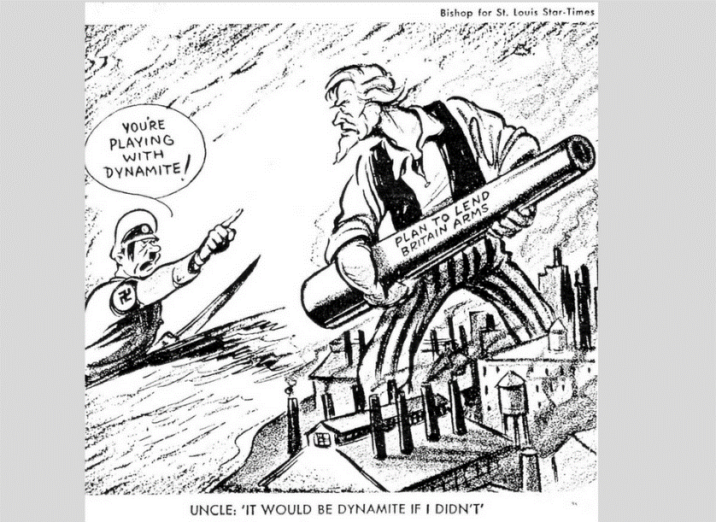
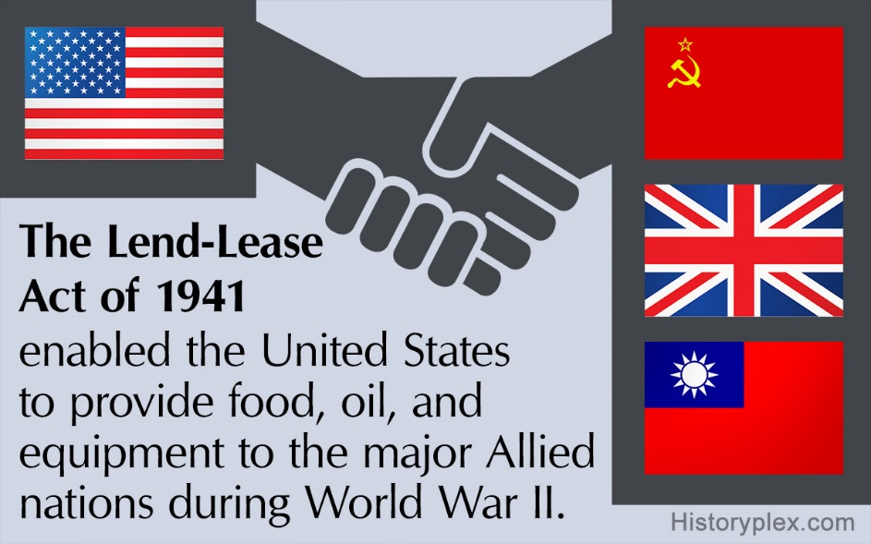
United States policy early on
Isolationism strong in US, but…
FDR convinced have to help Allies
asks Americans to stay neutral even if can’t in heart
FDR gets congress to allow US to sell arms to allies
Also pushes through the Lend-Lease Act in 1941
Said US could lend or lease raw materials, equip, soldiers, and weapons
sent $50 billion worth of war goods to Allies

Slide 6
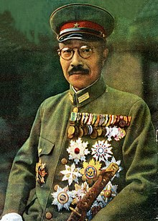
Japans’ role in WWII
1937- Japan declared all-out war on China
1940- Japan sees opportunity to expand further when France falls
Sept 1940- Japan joins Axis of Evil
Immediately invade French Indochina (modern-day Vietnam)
FDR tries to get them to stop by places embargo on Japan
Forbids any trade of US goods to Japan… including oil!
Doesn’t work…
Japan invades oil-rich Dutch East Indies
New military gov’t controlled by Gen. Hideki Tojo
Japanese strategists know only one who can stop Japan is US Navy
To guarantee success… must destroy US Pacific Fleet at Pearl Harbor in Hawaii

Slide 7
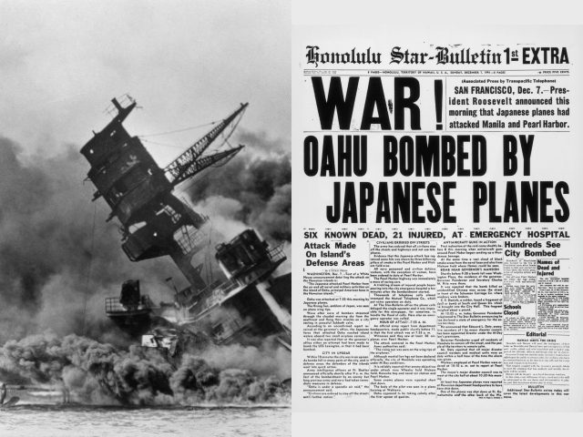
December 7th, 1941
Morning of 7 Dec 1941
Japan launch all-out attack on US Navy base at Pearl Harbor, Hawaii
2,400 sailors die
Most planes & ships destroyed
FDR reports this to Congress
Calls for Congress to declare war on Japan
11 Dec 1941-
Hitler & Mussolini declare war on USA to support their ally Japan
USA finally pulled in to WW2!
US rushes to prepare for war
FDR & Churchill plan strategy
Agree to concentrate on Europe first, then take on Japan
Also agree to bring in another…
USSR

Slide 8
Hitler crosses Russia
When Hitler couldn’t take Britain…
22 June 1941- Turns toward USSR
By December, freezing Russian winter grinds Nazi’s to halt
Only 18 miles from capital, Moscow!!!
Nazi’s spend 2.5 years trying to take Leningrad (Russia)
1 million+ die (mostly starvation though), but…
City never falls!
1943- USSR defeats Nazi’s in largest ever tank battle
Signals failure of Hitler to take USSR
Allies helped by sending supplies constantly
Wanted Hitler busy on east while they attack on the west

Slide 9
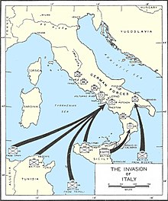
Meanwhile in Africa and southern Europe …
While Germans dealt w/ USSR, Britain & US turn toward North Africa
Jump-off point to attack Nazi-controlled Europe from south
May 1942-
Allies control N. Africa
Summer 1943-
Allies take Sicily & invade Italy
Italy soon collapses
Nazi’s forced to turn attention to help Italy
While Germany turns to help Italy…
Allies plan another invasion of Europe

Slide 10
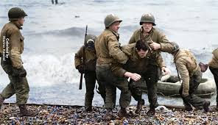
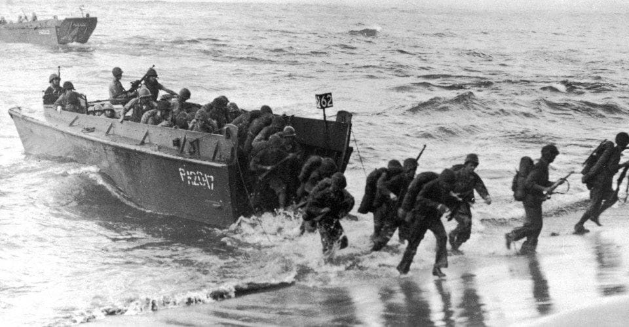
D-Day
6 June 1944-
5,000 Allied ships , 130,000 soldiers cross English Channel to coast of France.
Largest sea invasion in history!!!
Code-named… D-Day
10,000+ died when landed but…
By end of the day they had the beaches and could move inland
By July… 850,000 Allied troops had arrived
25 Aug 1944- Allied troops freed Paris from Nazi control
Allied forces push Nazi in from west
USSR pushing Nazi in from east
Allied troops pushing Nazi in from south through Italy
Battle of Bulge caught Allies by surprise, but quickly regrouped and defeated the Nazi force again
Feb 1945- Nazi’s retreating everywhere

Slide 11
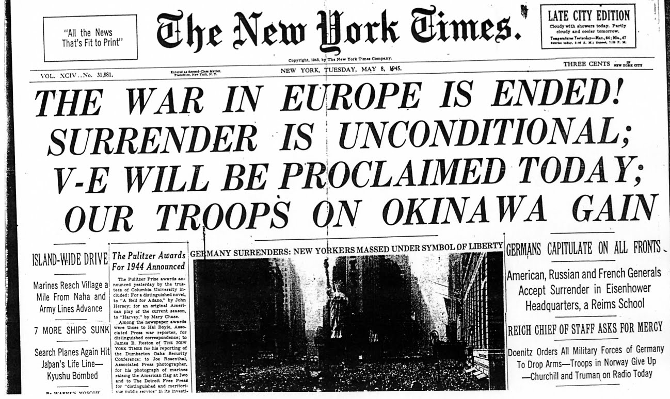
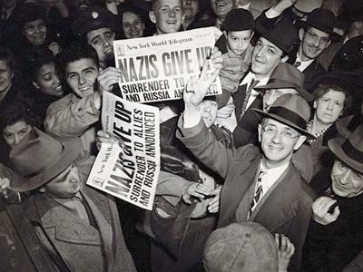
V-E Day
April 1945- FDR dies
VP Harry S. Truman takes over
Truman quickly picks up war effort
Late April- Soviets reached Berlin, the German capital
Hitler hid in under-ground bunker and…
30 April 1945- Hitler commits suicide
2 May 1945-
USSR takes Berlin
7 May 1945-
Nazi leaders sign unconditional surrender @ Eisenhower’s HQ in France
8 May 1945-
Declared V-E Day!!!
Victory in Europe Day
War in Europe finally over!!!

Slide 12
War in the Pacific (Asia)

Slide 13
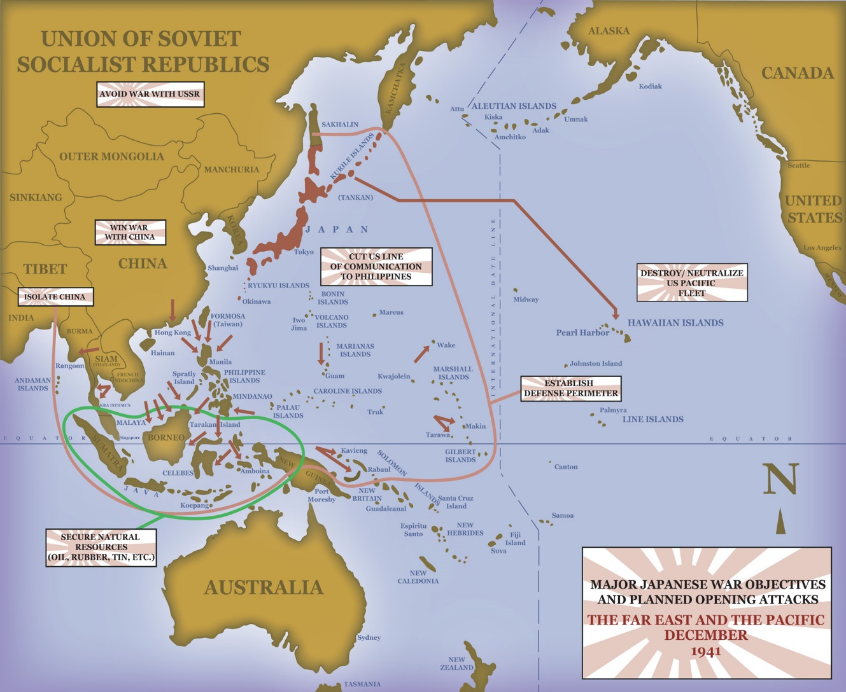
War in the Philippines
same time of Pearl Harbor…
Japanese also attacked allied territories in Pacific
By spring 1942-
Japanese troops had taken most of Asia
Also invaded Philippines
FDR feared Japanese attack Australia
Ordered MacArthur to go set up Australia
He does, but vows, “I shall return.”
April 1942-
70,000 Filipino & US troops forced to surrender after MacArthur leaves
Japanese march soldiers 60 miles to prison camp
10,000+ die on the way from shootings, beating, beheadings, or starvation
Known as Bataan Death March

Slide 14
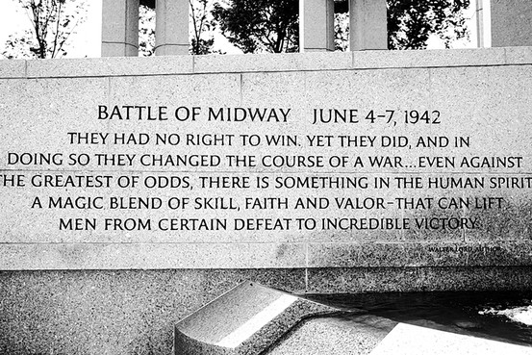
Battle of Midway
Despite fall of Philippines…
Allies starting to turn the tide
May 1942-
US Navy able to block Japanese advance on Australia
June 1942-
US Navy gains decisive victory over Japanese fleet threatening Hawaii
Called the Battle of Midway
w/ Hawaii safe…
Now Allies can go on the attack!

Slide 15
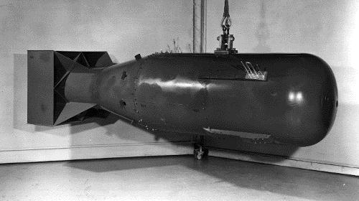
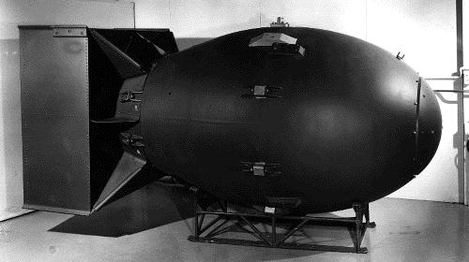
The Manhattan Project
*Started in late 1941 with the goal of
developing an atomic bomb before Germany
*In Truman’s presidency, the purpose expanded to forcing Japan’s surrender and having control over postwar policy
Little Man
Fat Boy

Slide 16
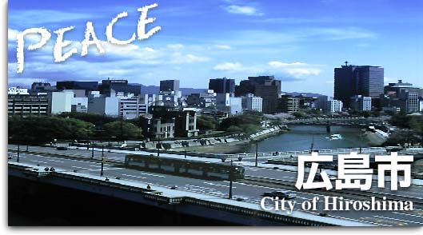
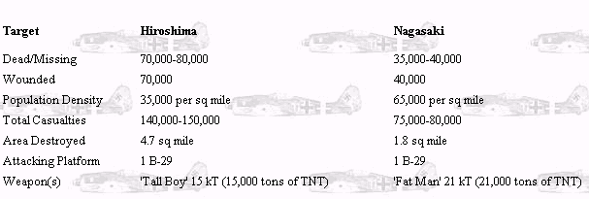
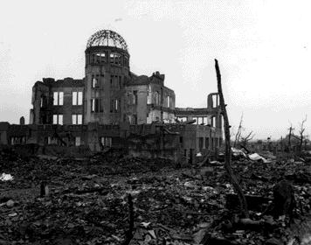
Hiroshima & Nagasaki
Hiroshima : Aug 6, 1945
Nagasaki : Aug 9, 1945

