Slide 1
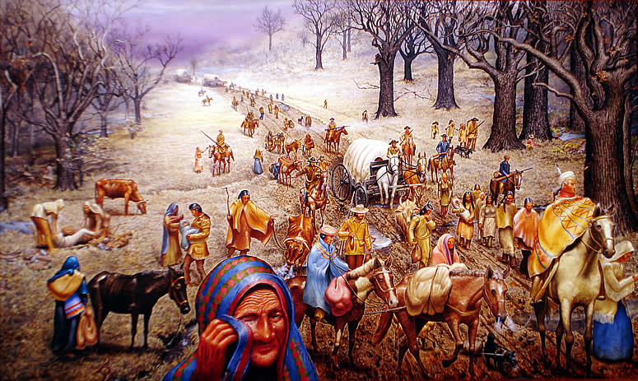
Trail of Tears
1831-1838

Slide 2
A Quote from Andrew Jackson
"My friends, circumstances render it impossible that you can flourish in the midst of a civilized community. You have but one remedy within your reach, and that is to remove to the west. And the sooner you do this, the sooner you will commence your career of improvement and prosperity."

Slide 3
“Cherokees! The President of the United States has sent me with a powerful army, to cause you, in obedience to the treaty of 1835 [the Treaty of New Echota], to join that part of your people who have already established in prosperity on the other side of the Mississippi.”
-General Winfield Scott

Slide 4
Indian Removal Act
As people moved west, conflicts with Native Americans were increasing.
President Andrew Jackson was known as a strong president who believed Americans had a right to their land.
In 1830, he signed the Indian Removal Act. This statement stated that Native Americans in the south had to move west towards the Mississippi River.
They would be relocated to the Indian Territory.

Slide 5
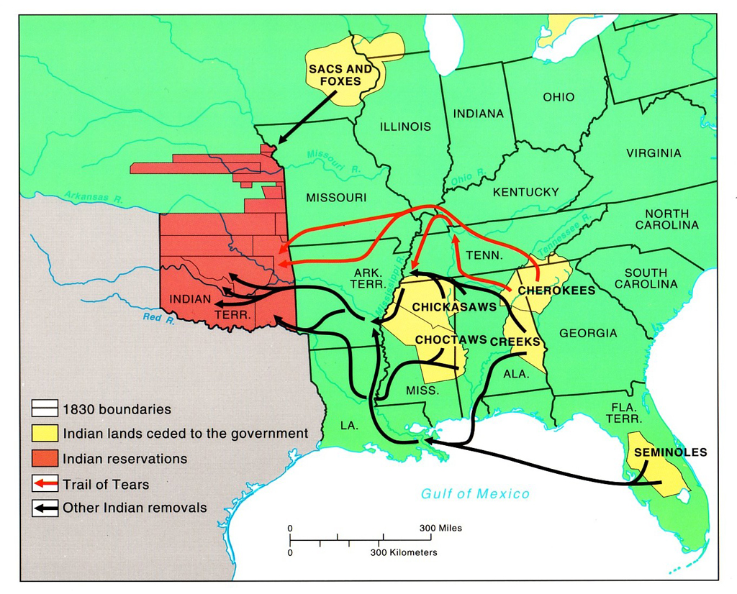
Relocation of the Five Tribes

Slide 6
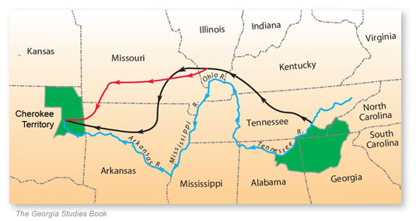
Cherokee Relocation
Notice the size difference between their original land and their new territory.

Slide 7
" Long time we travel on way to new land. People feel bad when they leave Old Nation. Womens cry and make sad wails. Children cry and many men cry...but they say nothing and just put heads down and keep on go towards West. Many days pass and people die very much."
-Quatie Ross, A Cherokee Survivor of the Trial of Tears

Slide 8
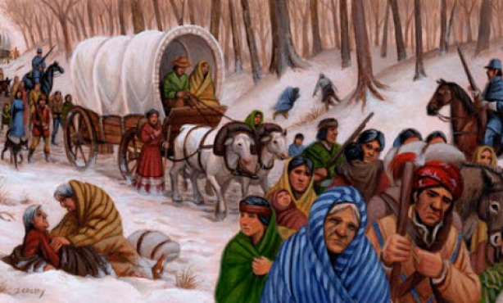

Slide 9
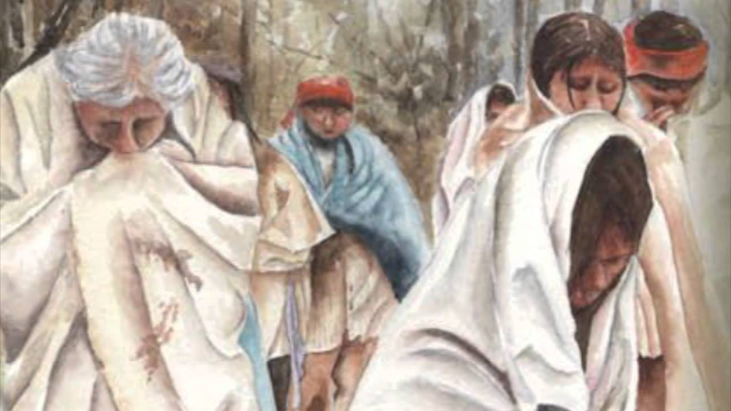

Slide 10
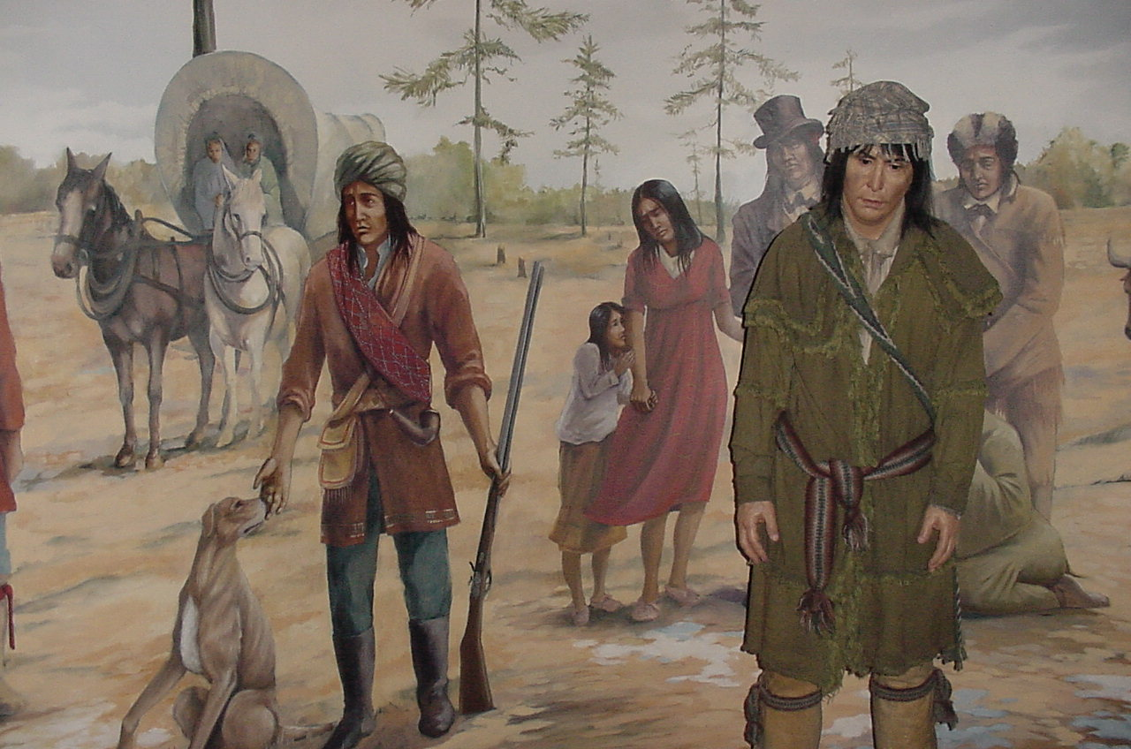

Slide 11
Trail of Tears- The Story of Us
(2:11)
Click Here

