Slide 1
The French Revolution and Rise of Napoleon

Slide 2
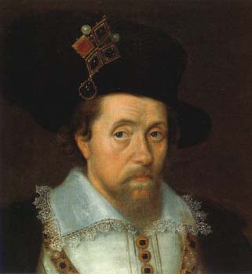
Absolutism
Absolute monarchs didn’t share power with a counsel or parliament
“Divine Right of Kings”
Similar to the modern idea of Dictatorship
King James I of England
Notes:
The period lasting roughly from 1600 to 1800 is often referred to as the Age of Absolutism. Monarchs during this time exercised complete authority and did not share power with a council or cabinet.
Absolutism was tied to the concept of “Divine Right of Kings”—the idea that monarchs had been appointed by God and were responsible only to God. Thus, no one could question their judgment. Historians often identify James I of England as one of the first absolutist rulers. Not only did James believe that monarchs should hold total power (a belief that led him to clash with Parliament on several occasions), but he also wrote extensively about the Divine Right of Kings. In his work The True Law of Free Monarchies, he stated that “Kings are called gods…because they sit upon God his throne in the earth and have the count of their administration to give unto him.”

Slide 3
How did the French Revolution begin?
The French were inspired by the American Revolution.
Enlightenment ideas

Slide 4
CAUSES of the French Revolution
In 1789, the French government was bankrupt.
The result, was increased taxes for French citizens.

Slide 5
CAUSES of the French Revolution
This created a cycle of low wages, high prices and great inequality among French social classes.
Approximately 2% of the population controlled 99%

Slide 6
Financial Difficulties
Need for tax reform
Nobles didn’t want to pay taxes. They never had to before.
Peasants and bourgeoisie were upset because they paid all the taxes
Government had large debts with heavy interest
Extravagant spending on courts
Over ambitious wars

Slide 7
French Society
Three Estates: Society was divided into three classes of people; The First, Second, and Third Estates.

Slide 8
The First Estate
Made up of the Clergy, operated schools and hospitals, and helped the poor .
They paid no taxes.

Slide 9
The Second Estate
Made up of the nobility, highest positions in the Church, military and government.
Also did not have to pay taxes.

Slide 10
The Third Estate
The “Bourgeoisie,” which is French for “middle class.” (Even though it was the lowest class in French society).
Made up of peasants, artisans and commoners.
Paid 100% of the taxes in France.

Slide 11
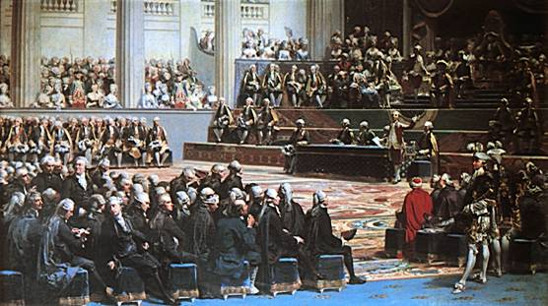
The Estates General
One vote per estate
Clergy and nobility usually joined together to outvote the Third Estate
Met in Versailles in May 1789
Voting controversy
A meeting of the Estates General
Notes:
Each estate had one vote in the Estates General, despite the fact that the First and Second Estates only represented three percent of the population of France. In addition, since the first two estates always voted together, if the Third Estate disagreed with them there was little it could do with its single vote.
When the Estates General convened in Versailles in May 1789, the First and Second Estates had about 300 delegates each, while the Third Estate had about 600 delegates. A controversy over voting arose almost immediately, as the Third Estate demanded that rather than having one vote per estate, each delegate be given a vote. This would have allowed the Third Estate the opportunity to gain a majority. The king, however, rejected this proposal.

Slide 12
The National Assembly
Louis XVI restored the National Assembly and gave the Third Estate a say in government, but no real power.

Slide 13
Storming the Bastille
The people were upset with the King.
On July 14, 1789 they stormed the Bastille, which was a prison that held hundreds of political dissidents captive.
The Bastille was destroyed, and the people continued to fight against the absolute monarchy of Louis VXI.
The French Revolution had begun.

Slide 14
Phase I of the French Revolution
1789: Declaration of the Rights of Man – Document that declares France a democracy and emphasizes liberty, brotherhood, and equality for all citizens.

Slide 15
Phase I of the French Revolution
1791 – The French constitution is written.
This document includes arrangements for a limited monarchy and a government for the people, however does not include an “elastic clause.”
The original constitution only lasted until 1792 because the people wanted more change.

Slide 16
New Political Groups
France had three political groups: Conservatives, moderates and radicals.
Conservatives favored the monarchy and wanted few changes.
Moderates wanted minor changes

Slide 17
New Political Groups
Radicals opposed the idea of monarchy and wanted many changes.
The majority of people in France supported the Radicals.

Slide 18
The Rise of Robespierre
1793: Maximilien Robespierre- Leader of the Jacobins.
Jacobins: Radical group who wanted to rebuild France.
Radical changes called for the execution of the King and Queen.
Robespierre and the Jacobins created the French Republic

Slide 19
The Reign of Terror
Robespierre was the chief architect of the Reign of Terror: Radical campaign of executing all who were against the Revolution (Conservatives, Moderates).
He was referred to by the people as “the uncorruptable.”
Used the Guillotine and beheaded approximately 40,000 people.

Slide 20
Execution of Louis XVI and Marie Antoinette
In January of 1793, Louis XVI was put on trial for being a traitor to France.
He was sentenced to death with a single vote and swiftly beheaded by guillotine on a foggy morning.
His last words were drowned out by the screams from the crowd.
In the same fashion, his wife, Marie Antoinette was executed in October of that year.

Slide 21
The Reign of Terror
By 1795, members of Robespierre’s political party were afraid that the Reign of Terror was taken too far. They were afraid for their own lives.
Robespierre was arrested and put on trial for the Reign of Terror. He was executed by more moderate members of his own party.
In 1795, a new constitution was written. A small group made up of 5 men called “The Directory” would stabilize and rebuild France.

Slide 22
The Rise of Napoleon
What led to the Rise of Napoleon?

Slide 23
France 1796-1799
France was ruled under the Directory (5 man government)
In 1799, Napoleon staged a coup d’état (sudden takeover of the government)

Slide 24
Napoleon’s Achievements
Napoleon created a French empire that encompassed Austria, Prussia, Spain, Portugal and Italy (all of which conquered by his army).
Sold the Louisiana Territory to the United States.

Slide 25
Napoleon’s Achievements
Napoleon was crowned emperor in 1804
Napoleonic Code: System of Law used as a model today (Equality to men and fair tax code)
Created National bank, common currency and public high schools.
His rule was based on Nationalism

Slide 26
The Fall of Napoleon
Napoleon made several mistakes brought on by his thirst for power and territory:
Invasion of Russia: Led 600,000 soldiers and 50,000 horses into Russia in 1812.
Russians retreated, burning all of their own crops and taking all food from their villages along the way. This is called the “scorched Earth” strategy.
Thousands of French soldiers starved to death and/or froze during the winter. Result- French defeat.

Slide 27
The Fall of Napoleon
After the French were defeated by the Russians, Napoleon was forced into exile on the island of Elba.
With Napoleon in captivity, Louis XVIII took the throne of France in 1814.
The government and economy under Louis declined, and Napoleon saw his chance to return. He escapes Elba and returns to Paris.

Slide 28
The Final Defeat of Napoleon
After 11 months in exile, in 1815, Napoleon returned to France to rebuild an Empire.
That same year, he led an army against the Allied Armies (Great Britain under the command of the Duke of Wellington, and Prussia)

Slide 29
Battle of Waterloo
The allied armies (Britain and Prussia) defeat France. Napoleon is once again exiled to island called St. Helena, where he dies in 1821.
The Battle of Waterloo was a defeat for France.

Slide 30
The Congress of Vienna
Leaders from Austria, Russia, England and France gathered in 1814 to think of ways of fixing Europe’s problems.
The Prince of Austria, Klemens Wenzel von Metternich, presided over the meeting.

Slide 31
Goals of the Congress of Vienna
Create a lasting peace; establish the balance of power
Re-draw the map of Europe and surround France with strong countries.
All land conquered by Napoleon is returned.
Britain gains colonial territories in Africa and control of the seas.
Restoring Monarchs to power in France and Spain.

Slide 32
Problems after the Congress
Re-drew map of Europe without concern for common cultures.
Nations split.
Increase in European Nationalism which eventually led to more revolutions.

