Slide 1
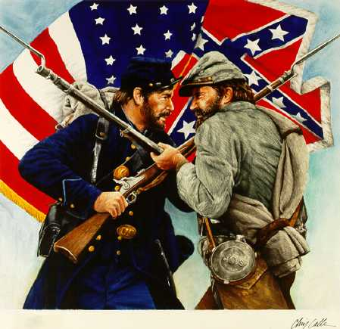
The civil war 1861-1865

Slide 3
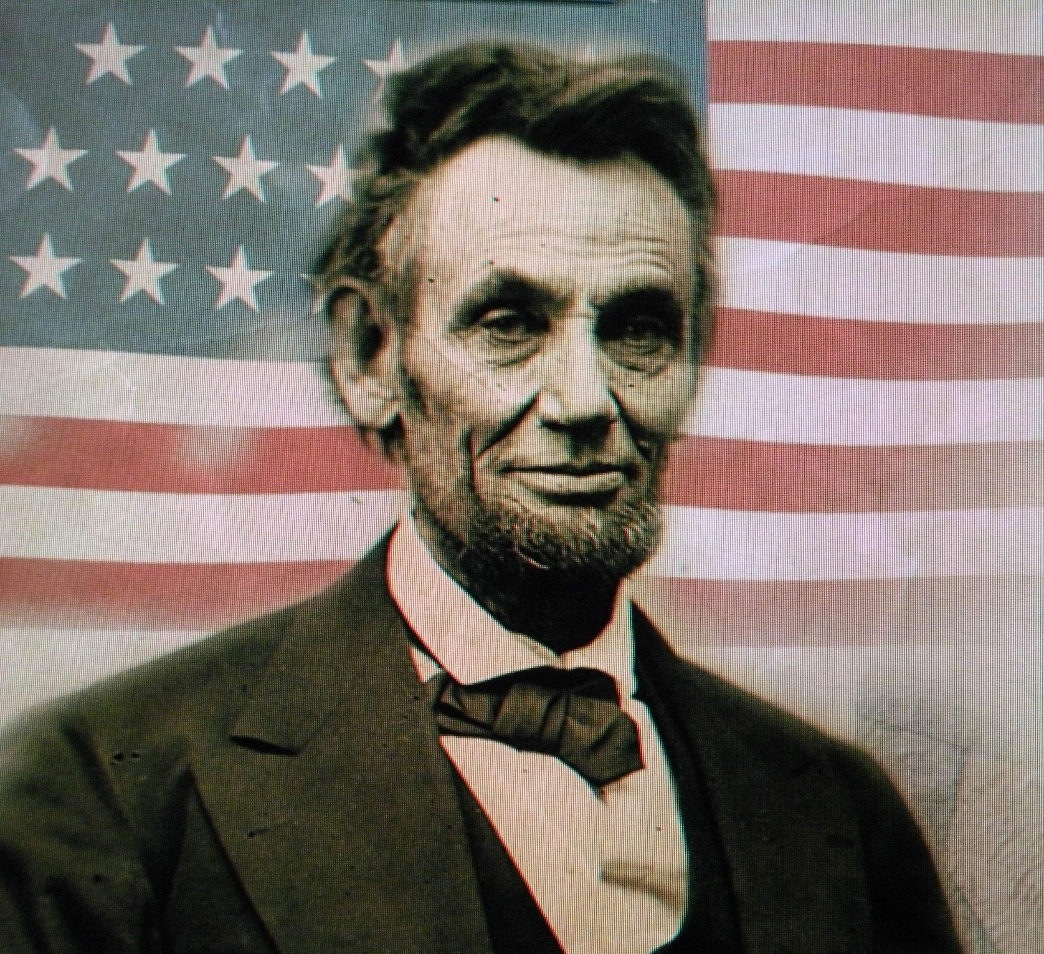
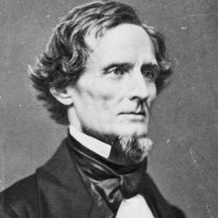
The two sides
The North
AKA the UNION
AKA The Yankees
AKA the Blue team
Abraham Lincoln
The South
AKA the Confederate States of America (CSA)
AKA the Rebels
AKA the Grey team
Jefferson Davis

Slide 4
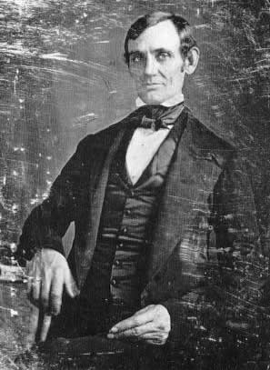
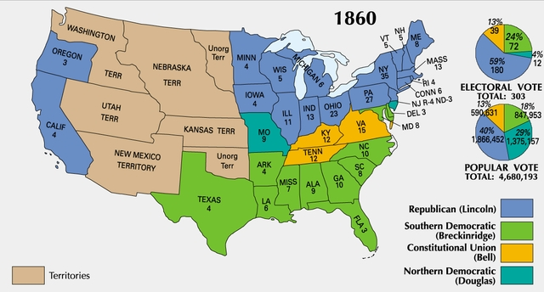
The Election of 1860
In 1860, the election of Abraham Lincoln united the North against slavery, as he vowed to prevent its expansion.
Many southern states refused to recognize Lincoln as the president.
Southerners viewed the election of Lincoln as the last straw.

Slide 5
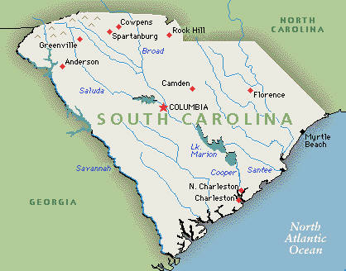
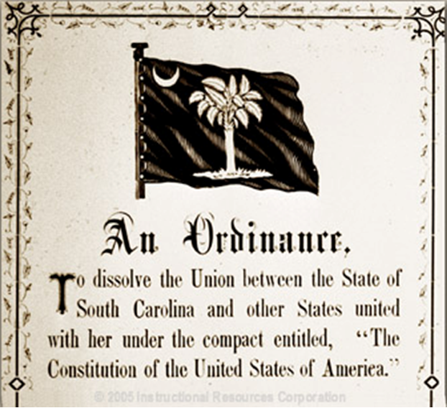
South Carolina Secedes
The most dependent and deeply rooted in slavery, South Carolina responded immediately after Lincoln’s election by formally seceding from the Union in December of 1860.

Slide 6
Reaction to Secession
Most Southerners welcomed secession!
People rang church bells for every state that left, shot canons and guns off, cheering in the streets
Some not so sure
Hated seeing the destruction of the Union
N. Abolitionists said good riddance!
If Union only saved by compromising on slavery, then let it die!
Most Northerners believed Union had to be saved
Lincoln asked whether the minority had the right to destroy the gov’t if they chose?
Not on his watch!!!

Slide 7
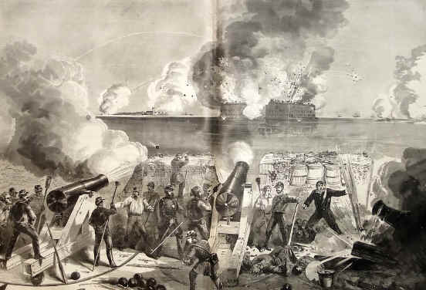
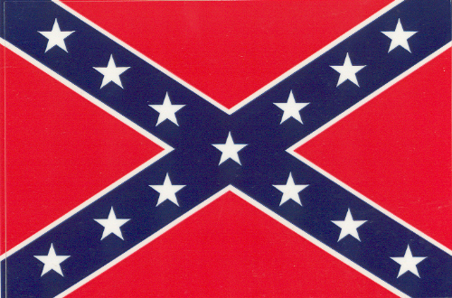
Fort Sumter
Confederate forces seized US forts within their states
Lincoln didn’t want a war but…
He couldn’t let their aggression go unmatched
5 March 1861-
Lincoln receives word that Fort Sumter in Charleston Harbor was low on supplies & the Confederates were demanding their surrender!

Slide 8
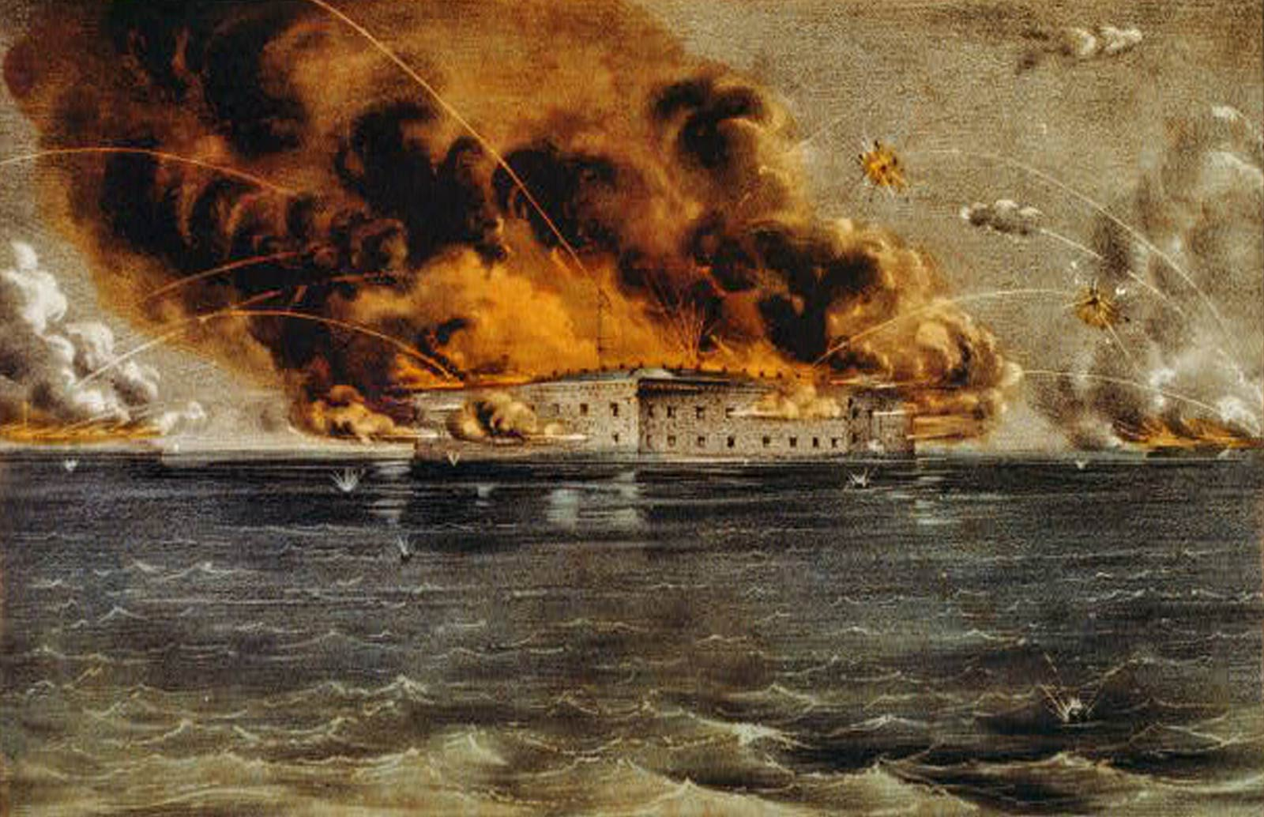
The War Begins
Lincoln sends message to SC Gov. Francis Pickens
he was sending unarmed expedition w/ supplies to Fort Sumter
Promised that Union forces would not do anything unless they were fired upon
Confederate President Jefferson Davis makes fateful decision!
Orders confederate forces to attack Sumter
12 April 1861
Confederate guns began to fire on Fort Sumter
14 April 1861-
Union forces surrender Fort Sumter
1,000’s of shots fired but no deaths on either side!!!
News of attack unites the North
Notes:
The Battle of Fort Sumter
5:05
Ken burns- on explosion

Slide 9
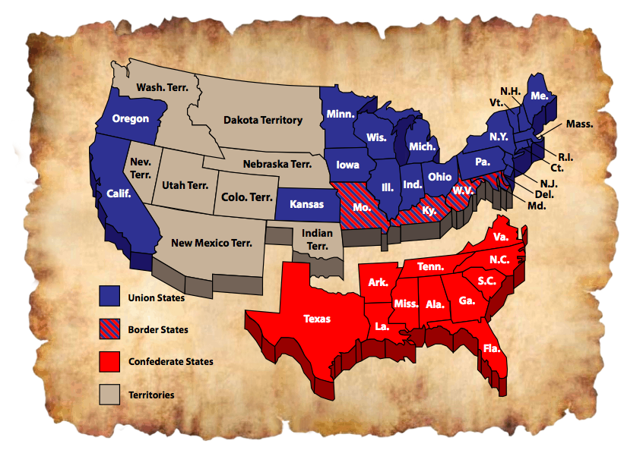
Remaining w/ the Union
Lincoln had to move cautiously
Can’t upset border states
If announces end of slavery…
Groups may take state out of Union
Had to be careful
Suspends some freedoms
Border states stayed with the Union But…Many of their citizens joined Confederate Army

Slide 10
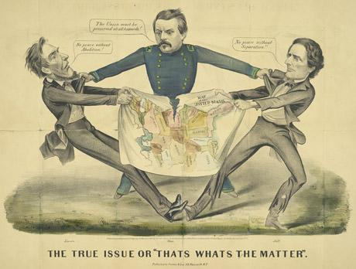
CIVIL WAR = American vs. American
WHAT MAKES THIS WAR UNIQUE…
Not just war b/t states, often…
brother vs. brother
parents vs. children
neighbor vs. neighbor
Lincoln’s wife had family in the Confederate Army
Sen. John Crittenden, KT
Sons became generals…
1 on each side!
Officers all schooled, fought, and served w/ each other
Never dreamed command forces against one another!
Every person that died in this war was an AMERICAN
Notes:
Civil War Life 1/3 (8:53)

Slide 11
Comparing North and South
The North – Wash DC (capitol)
The South - Richmond, VA (capitol)
Advantages
Larger population (22 million people)
More industry
More national resources
More ships and kept almost whole navy!
Controlled most of the railways
Disadvantages
Have to invade and hold south to bring them back
Southern support was much stronger 4 going to war
Advantages
Stronger support across as a whole
Familiar territory
Pride
Defending home, land, way of life… lot to fight for
Better military leadership
Disadvantages
Smaller population (9 million people)
Few factories
Farms were cash crop… not food farms
Little rail control
Can’t get supplies where you need them

Slide 12
Goals at the start of the war
NORTH - UNION
SOUTH - CONFEDERACY
At the start of war both sides had simple goals
Bring South back into the Union
Slavery not major goal at first, but…was as war goes on
win right to be independent nation
Keep own way of life
BOTH SIDES THOUGHT THIS WOULD BE EASY AND A QUICK WIN!

Slide 13
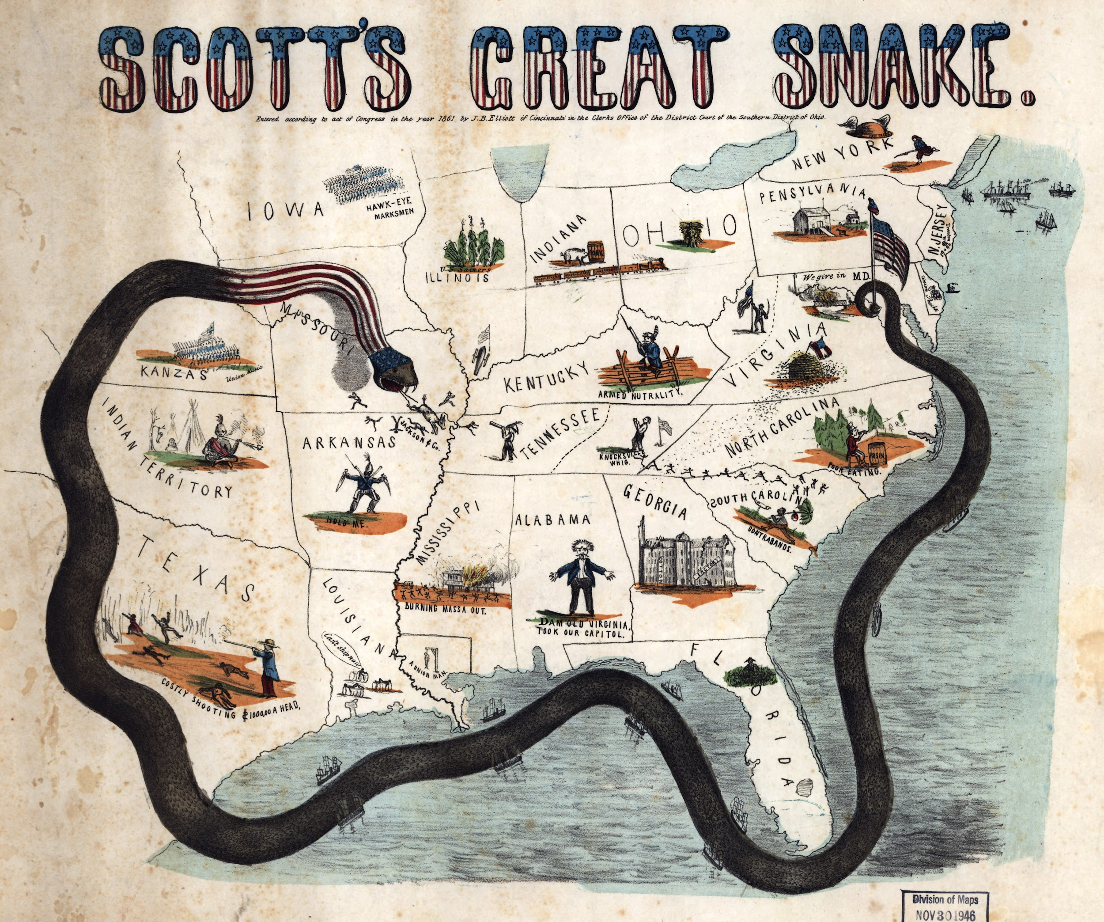
Strategies to win the war
North
3 part Plan know as the ANACONDA PLAN
Naval Blockade of southern ports
(no supplies or $ in or out)
2. Gain control of Miss. R.
Cut of supply lines and split the Confederacy
3. Capture capital
Cut off the head of the lion

Slide 14
Strategies to win the war
SOUTH
defensive strategy
Defend homeland
Hold territory until North tired of fighting
Expected Britain and France who imported huge amounts of cotton to convince North to end it
KING COTTON
Without the firing of a gun, without drawing a sword, should they [Northerners] make war upon us [Southerners], we could bring the whole world to our feet. What would happen if no cotton was furnished for three years? . . England would topple headlong and carry the whole civilized world with her. No, you dare not make war on cotton! No power on earth dares make war upon it. Cotton is King."

Slide 15
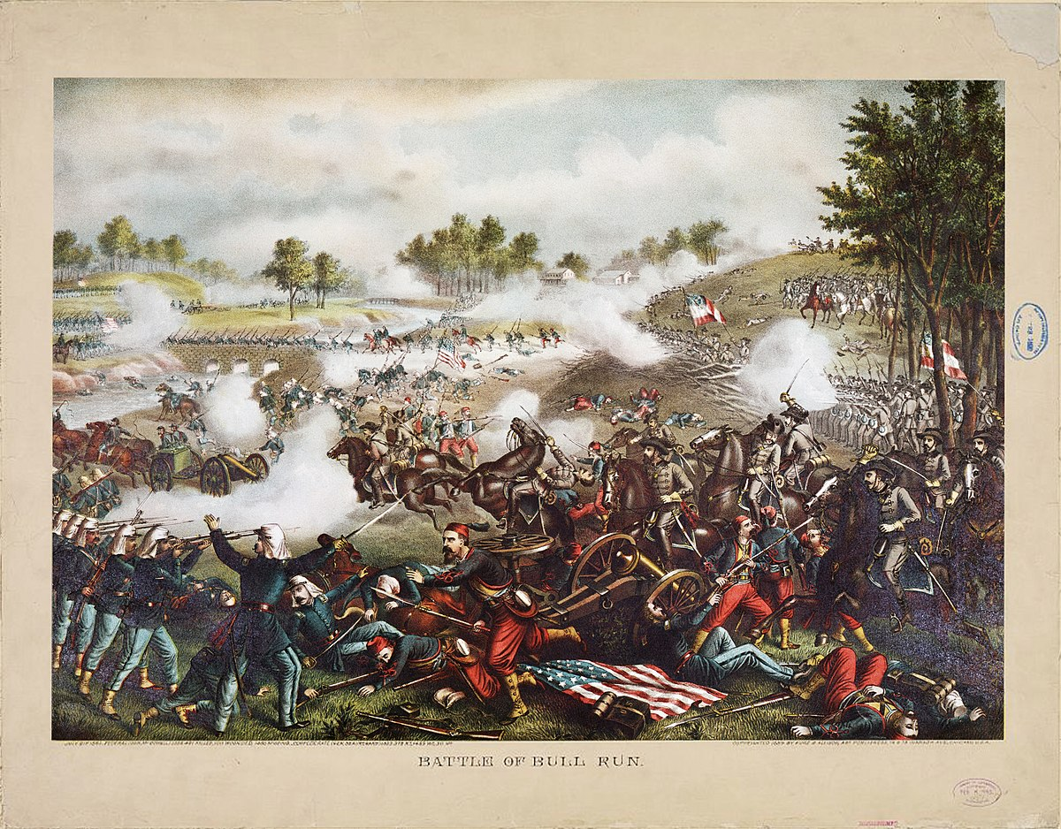
The First Battle of Bull Run (Manassas)
July 1861
Citizens and families ride the 25 miles from DC to picnic and watch the 1st Major Battle
Fought in N. Virginia
35,000 inexperienced Yankee soldiers
20,000 inexperienced Rebels
Yankees attack
Drove the rebels at first, but…
Rebels rallied
Reinforcements lead by Gen. Thomas Jackson arrive
Jackson’s rebels seen holding out heroically “like a stone wall”
General Thomas “Stonewall” Jackson
Confederates counter attack & break the Yankee lines
Rebel yell
Terrified, Yankees drop everything & ran… right into the fleeing civilians!
THIS BATTLE PROVED TO THE UNION THAT THIS WAS NOT GOING TO BE EASY
This was going to be a long and bloody war!!

Slide 16
War at Sea – REMEMBER THE ANACONDA PLAN?
Enforcing the Blockade
The MONITOR vs. the MERRIMACK
Lincoln ordered the blockade
Prevent South from exporting goods & importing aid or supplies
Blockade Runners were Reb ships that could run in and out of the blockade (North Carolina was very good at this)
North built more ships to complete blockade
Reduced 2/3rds of confederates trade
Rebels couldn’t let blockade go unchallenged
Took old ship called Merrimack and covered it w/ iron plates
March 1862- Merrimack attacks US ships
Union wooden ships no match for Ironclad
Shells bounced of its’ sides!!!
Union builds 1st real iron ship called, Monitor
March 1862- the two ships face off!
Neither could sink the other, but…
Union able to keep Merrimack in harbor so can’t get other US ships
Marked beginning of new type of navel warfare

Slide 17
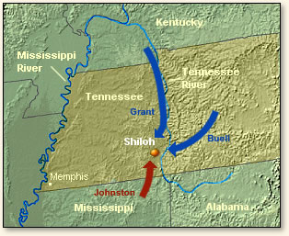
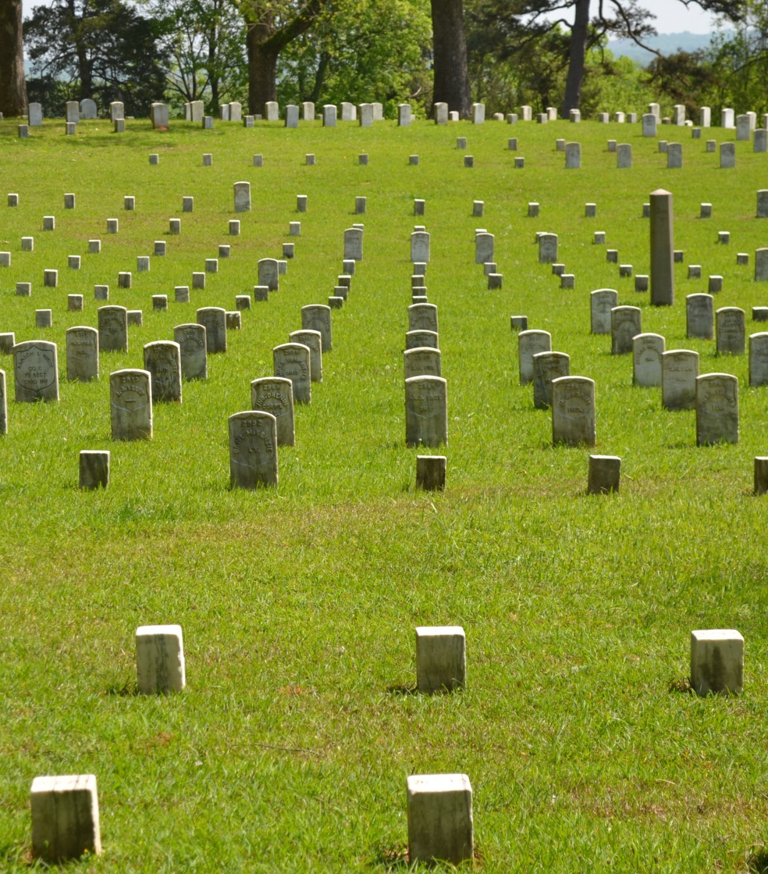
The Battle of Shiloh
Even though only 2 days…
Losses for both sides extremely high!
Total 20,000 men died at Shiloh Church
1 of bloodiest battles in the war!
North well on way of controlling Miss. River
The losses at Shiloh were enormous. Together the two armies suffered 20,000 casualties!
“that was too shocking… too horrible to bear.”
~unnamed Confederate Soldier

Slide 18
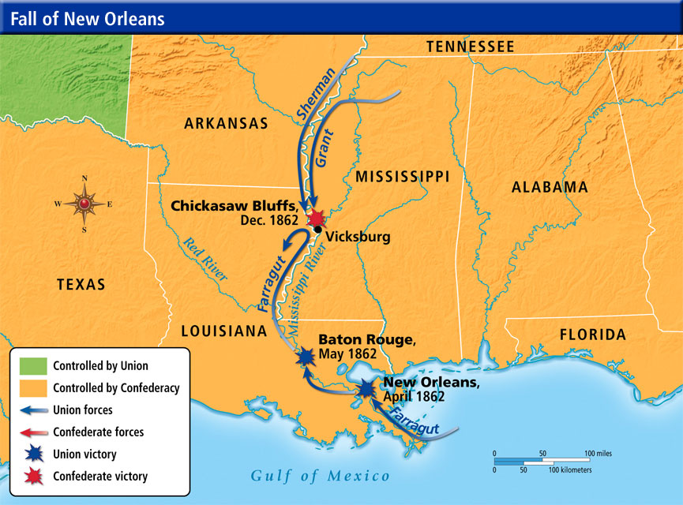
Battle of New Orleans
April 1862- North another important win
US Navy under Farragut capture New Orleans, LA
Largest city in the South!
The people of New Orleans did not take kindly to the capture
New Orleans important because…
at mouth of Miss. River
South can no longer carry goods to sea anymore
No $$$
No $$$ = No supplies
Farragut and Grant’s victories gave Union control of almost entire Mississippi River!!!

Slide 19
Battle of Antietam
Sept. 1862- Lee marches into Maryland
McClellan & 80,000 Yanks followed
Battle of Antietam
17 Sept. 1862- Yanks and Rebs meet
Single bloodiest day in the entire war!!!
At end, 6,000 dead and 17,000 seriously wounded
Day after the battle, Lee withdraws to VA
Yanks win!!!
McClellan ordered by Lincoln to follow and destroy, but doesn’t
Lincoln disgusted… could have ended the war right then!!!
Lincoln replaces McClellan with Gen. Ambrose Burnside as Commander of Union Army
Now war would rage on for 3 more years
Notes:
Ken Burns (45-)

Slide 20
Emancipation Proclamation – Freeing the slaves
The Battle of Antietam provided the necessary Union victory to issue the Emancipation Proclamation.
until September 1862, the main focus of the war was to preserve the Union. With the Emancipation Proclamation freedom for slaves now became a priority
over 200,000 African-Americans would serve in the Union army and navy.
Lincoln considered the Emancipation Proclamation the crowning achievement of his presidency.
“I never, in my life, felt more certain that I was doing right, than I do in signing this paper,” he declared. “If my name ever goes into history it will be for this act, and my whole soul is in it.“
This was thought to be a WIN/WIN for Lincoln. Free the slaves, and get them to fight for the Union against the Confederacy.

Slide 21
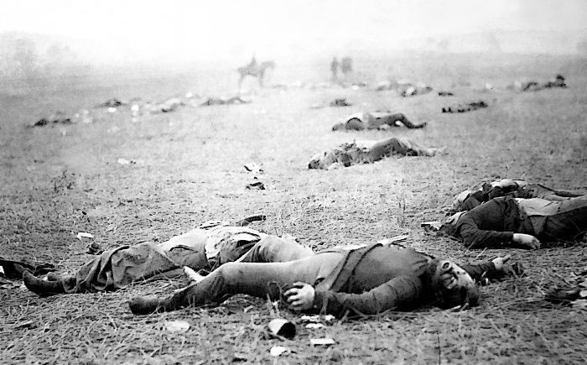
Battle of Gettysburg – TURNING POINT OF WAR
Confederates invades North- Only time a battle was fought in the North
July 1863- 2 armies meet by accident while looking for shoes and supplies @ Gettysburg, PA
3 day battle ensues
On July 3rd, Lee attacked the Union center on Cemetery Ridge
Union fought back in what is now known as Pickett’s Charge.
Lee's second invasion of the North had failed, and had resulted in heavy casualties on both sides. An estimated 51,000 soldiers were killed, wounded, captured, or listed as missing after the Battle of Gettysburg.
If the south had captured Gettysburg, many thought they would win
Notes:
Chamberlain's Charge at Battle of Gettysburg (5:06)
The Civil War in Four Minutes: The Battle of Gettysburg (5:00)
On word art: ken burns gettsburg- start at 10:55 (32:30 for 3rd day)

Slide 22
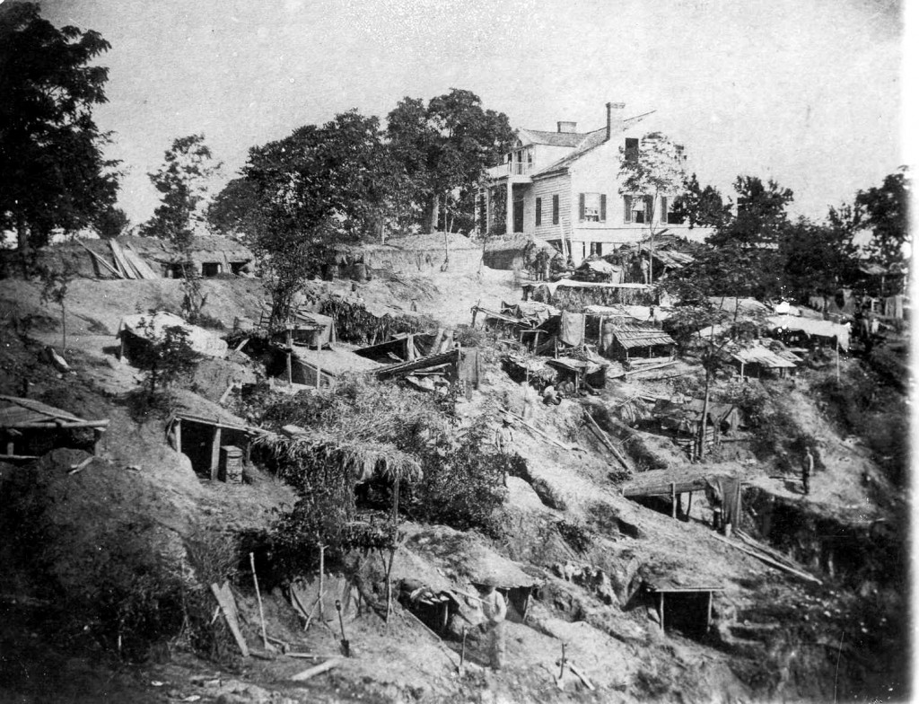
Victory at Vicksburg
At same time…
Another great battle raging in Vicksburg, MS
Union needs this to take control of Miss River
1 of 3 major goals for Yanks
July 1863- Vicksburg surrenders to Grant
Grant refused to accept surrender on the 3rd
w/ this win North now controls entire Miss. River!!!
Now TX, LA, AK cut off from Confederacy!!!
Vicksburg and Gettysburg begin the turning point for Yanks
Drove Rebs out of North and cut off the west
Cut South in 2
War con’t for 2 more years

Slide 23
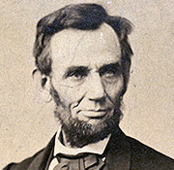
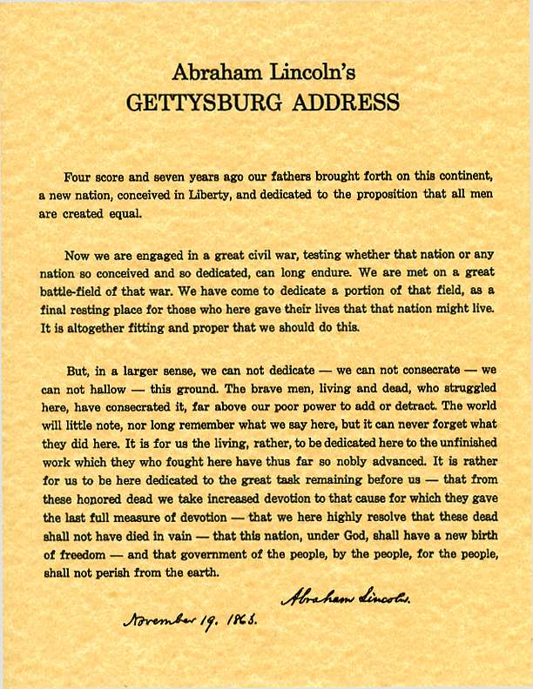
Gettysburg Address
Nov. 1863
Lincoln Returns to Gettysburg
Ceremony dedicating a cemetery @ Gettysburg on field of battle
Lincoln gets up and gives a 2-minute speech that will last a lifetime
Gettysburg Address
Meant to motivate the Union and lift their spirits
Helped war-weary citizens look past the battlefields and death back to goals of morality
Notes:
Ken Burns (6:00) Pix; Gettysburg Address (2:49) Doc

Slide 24
"Fourscore and seven years ago our fathers brought forth, on this continent, a new nation, conceived in liberty, and dedicated to the proposition that all men are created equal.
Now we are engaged in a great civil war, testing whether that nation, or any nation so conceived, and so dedicated, can long endure.
We are met on a great battle-field of that war. We have come to dedicate a portion of that field, as a final resting-place for those who here gave their lives, that that nation might live. It is altogether fitting and proper that we should do this.
But, in a larger sense, we cannot dedicate, we cannot consecrate—we cannot hallow—this ground. The brave men, living and dead, who struggled here, have consecrated it far above our poor power to add or detract.
The world will little note, nor long remember what we say here, but it can never forget what they did here. It is for us the living, rather, to be dedicated here to the unfinished work which they who fought here have thus far so nobly advanced.
It is rather for us to be here dedicated to the great task remaining before us—that from these honored dead we take increased devotion to that cause for which they here gave the last full measure of devotion—that we here highly resolve that these dead shall not have died in vain—that this nation, under God, shall have a new birth of freedom, and that government of the people, by the people, for the people, shall not perish from the earth."

Slide 25
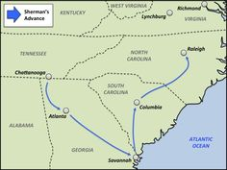
The end is near – Sherman March to the SEA
The UNION concentrated there attack in two areas
General Grant would take the North (Richmond, VA), and head south
Sherman would take the south and meet Grant
After Sherman leaves Atlanta in ruins…
Convinces Grant to let him “March to the Sea”
Want to take Savannah, GA
Army would march, living off land, and taking what ever they needed
Stole, tore-up rail lines, destroyed fields, killed livestock, destroyed everything useful
Cut path of destruction 50 miles wide and running all the way from Atlanta to Savannah
Method known as, “Total War”
After taking Savannah, turns north doing the same to SC intending to con’t until meets Grant in VA

Slide 26
Victory for the North
Surrender at Appomattox Court House
Results of the War
Confederates try to retreat to west of Richmond
Lee realizes no other options
“…there is nothing left for me to do but go and see General Grant, and I would rather die a thousand deaths.”
April 1865- Lee surrenders @ Appomattox Courthouse, VA
Grant’s terms were generous
Lee and men lay down arms
Then could go home
Take horses, so could farm later
Even given 3 days worth of food for the trip
Confederate President Jefferson Davis captured in GA on 10 May 1865
Civil War now over!!!
Most devastating war in American History
Consequences
600,000+ casualties
Billions in damages!!!
Mostly in the South
Created bitter feelings still lasting today
North’s victory saved the Union
Federal gov’t now clearly more powerful than states’
Freed millions of African Americans
How they would be treated now remained to be seen!
Notes:
Blood and Glory: The Civil War in Color: Lee's Reluctant Surrender | History (1:52) – on burst

