Slide 1
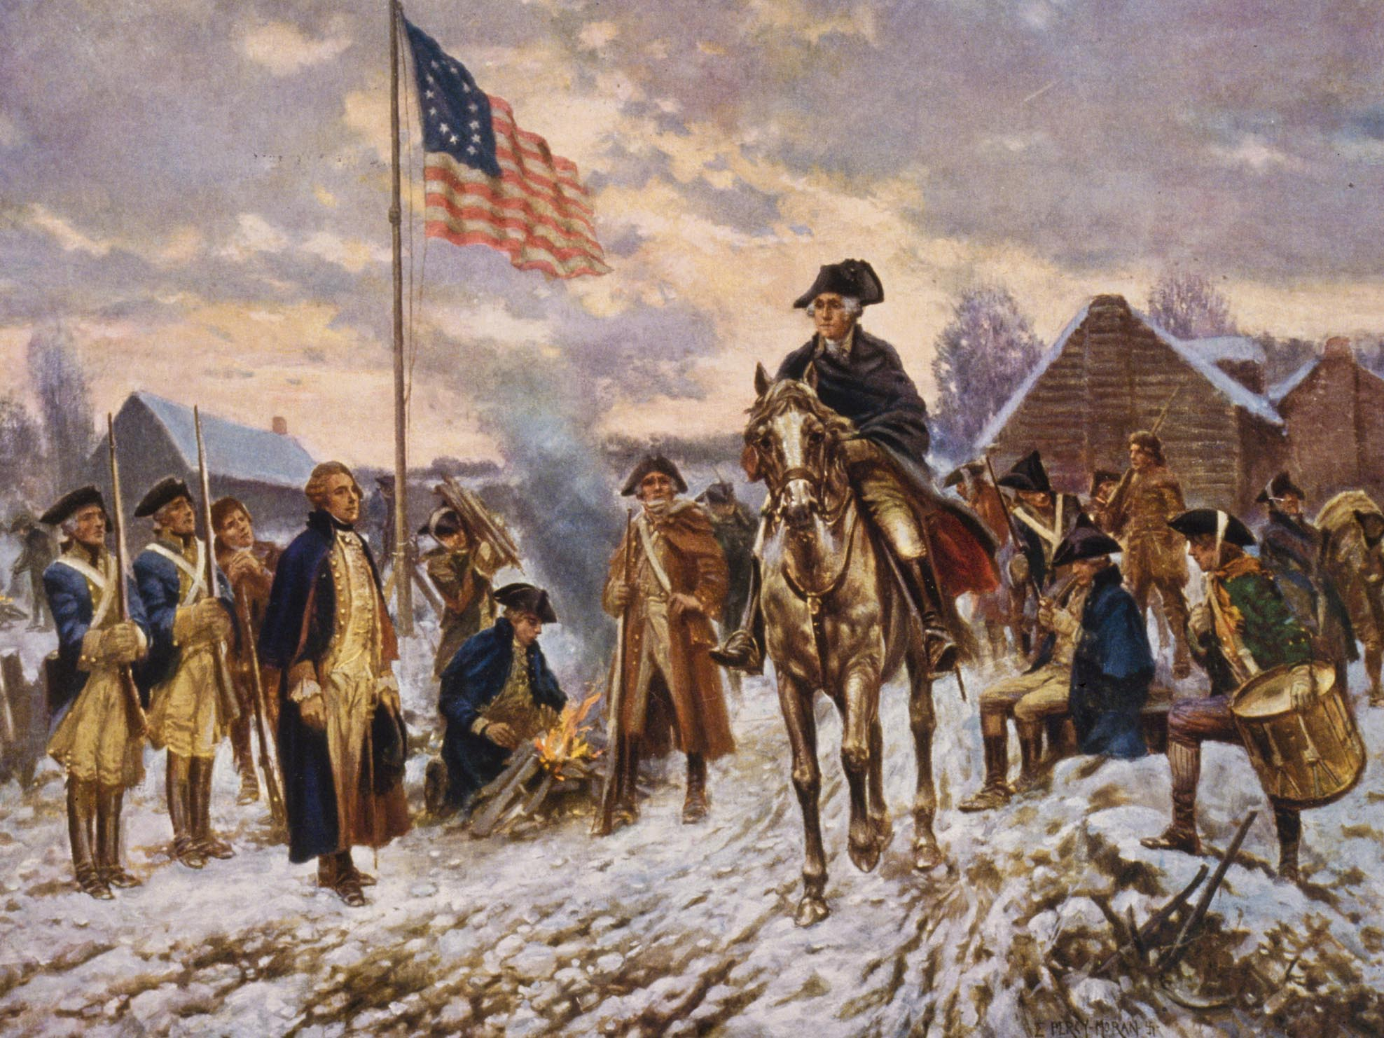
The American Revolution
1775 - 1783
COLONISTS
VS
BRITISH

Slide 2
Setting the stage for Rebellion
Proclamation of 1763
British acts (1765 - )
Boston Massacre (1770)
Boston Tea Party (1773)
Boycots
Protests
The colonists put up with the harsh mistreatment for 15 years until they finally decided that they had enough and were ready to fight back!

Slide 3
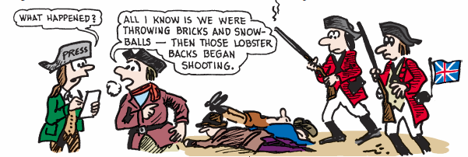
The Boston Massacre
occurred on March 5, 1770
British troops are sent to Boston in 1768 to “keep the peace”
It happened as tensions between colonists and redcoats peaked
Townspeople pushed to the customs house and the British guard called for help as colonists were crowding
The crowd of colonists began to throw stones, wood, etc. at the soldiers, and several soldiers were knocked down.
They fired shots at the crowd, and several colonists were killed.
The riot was used as propaganda by the colonists.

Slide 4
The Bloody Massacre Perpetrated in King Street
Notes:
"The Bloody Massacre Perpetrated in King Street" by Paul Revere
Intent was to highlight British tyranny and stir up anti-British sentiment among his fellow colonists.
Revere's historic engraving is big on political propaganda and short on accuracy
Notice the color of red used for the British soldiers and the color of the blood…same shade of red. Bonus question: Why is this important?
OPTIC
O – overview (brief)
P – parts (parts of the picture; read all labels; note important elements or details)
T – title (what is the title)
I – interrelationships (use title and parts to specify the interrelationships in graphic)
C – conclusion (what does the visual mean/why is it important/what is its purpose)

Slide 5
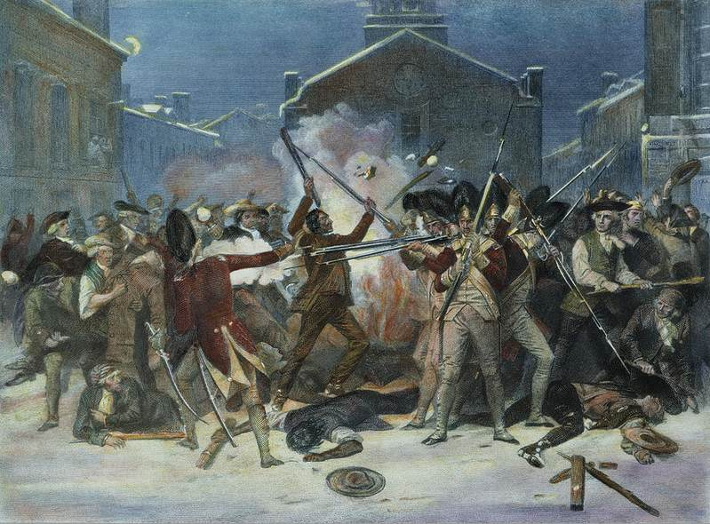
A different perspective …
What is the bias in the two different pictures?

Slide 6
Fallout from the Boston Massacre
Crispus Attucks was the first colonist killed. He was of African-American descent.
The British soldiers were put on trial in Boston. They were defended by John Adams.
Adams argued that the shootings occurred as a result of self-defense, and they were found to be innocent.

Slide 7
Loyalists VS PATRIOTS
During this time of unrest and anger people started to choose sides
Two major groups of people emerged:
The Loyalists - also known as the Tories. This group wanted to stay a part of England and not seek independence. About 20-30% of the colonists
The Patriots – Lead by the sons of liberty. These were the people who wanted idependence and war
  Colonists Faced a major decision Loyalist or Patriot?
Loyalists:
colonials who wanted to stay loyal to crown. Did not consider unfair taxes and poor laws reason enough to break away. Also Brits best army in world. Going to win, why end up hanged as a traitor?
Patriots: colonials wanted freedom and independence from the crown. Felt these taxes and unfair laws were just the beginning and would stop at nothing to be treated as free, independent men.

Slide 8
IN YOUR GROUP COMPLETE THE SECTION OF YOUR NEWSPAPER LABELED:
“British American tension seen as cause of war”

Slide 9
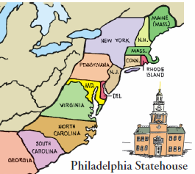
The First Continental Congress
September 5 – October 26, 1774
Philadelphia
55 men met and represented the colonies
It was a political body to represent American interests
No Georgia
Notes:
The 1st Continental Congress met in Philadelphia. Bonus question: What was the nickname given to the city of Philadelphia by the Quakers? (Answer: City of Brotherly Love)
All of the colonies were represented by Georgia. Where was Georgia? Georgians were doing their own thing…remember, it was established as a colony for debtors and prisoners, and was still a royal colony owned by the king. They didn’t have much of a voice.
The idea behind the Congress was to have all of the colonies unite as one voice…one united voice can be louder than multiple individual voices.

Slide 10
The First Continental Congress September 5 – October 26, 1774
  Major players include…
    Samuel and John Adams, Patrick Henry, John Jay, Richard Henry Lee, George Washington, John Hancock
  Draft letter to Parliament
    Demand repeal of all “Acts”
    Ban all trade w/ Britain until they comply
    All colonies to form militias (colonial volunteer armies)
    Set date for May to meet again if demands not met

Slide 11
Patrick Henry’s famous speech
March, 1775
Gentlemen may cry, “Peace! Peace!”—but there is no peace. The war is actually begun! The next gale that sweeps from the north will bring to our ears the clash of resounding arms! Our brethren are already in the field! Why stand we here idle? What is it that gentlemen wish? What would they have? Is life so dear, or peace so sweet, as to be purchased at the price of chains and slavery? Forbid it, Almighty God! I know not what course others may take; but as for me, give me liberty, or give me death!
What is he saying?
What is he telling his friends to do?
What is his mood?
The distinctions between Virginians, Pennsylvanians, New Yorkers, and New Englanders are no more…I am not a Virginian, but an American”

Slide 12
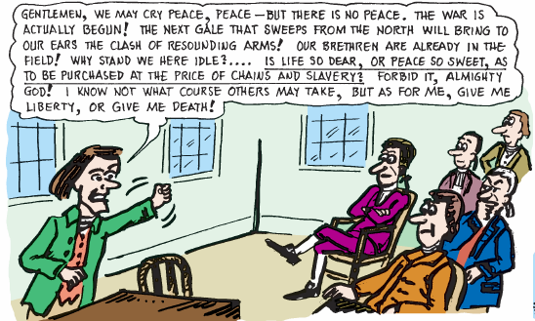
Notes:
Passage from the “Give me liberty or give me death!” speech

Slide 13
Things are about to get REAL…
Conflict over Intolerable Acts turns Massachusetts into armed camp
  Both Groups (militia and British)
    Mass. colonial militia call themselves “Minutemen” b/c ready in minute’s notice
Parliament sends General Thomas Gage and 6,000 “Redcoats” to occupy Boston
  His instructions were to take weapons from militia and arrest leaders
  Learns colonials storing guns and ammo in Concord (20 miles NW of Boston)
18 April 1775
  Dr. Joseph Warren walks streets of Boston to observe the acts of the Redcoats
    Redcoats form and march north out of the city
  Warren rushes to alert Paul Revere and William Dawes (Sons of Liberty)
Revere, Dawes and others ride to Lexington and Concord to warm the colonials
  Sam Adams and John Hancock are to be arrested in Lexington
Moonlit ride they gallop off yelling “the regulars are out!” to every home along the way
  Revere caught and arrested
  Dawes and others get the message out

Slide 14
Lexington and Concord
April 1775
18 April 1775
  British send 700 Redcoats to Concord to “seize and destroy all artillery and ammunition you can find.”
Redcoats arrive in Lexington @ dawn. 70 “Minutemen” meet them in center of city ready to fight
Standoff ensues….Suddenly…
    Someone fires- no one knows who, or what side. 1st shot of the Revolutionary War
When smoke clears
  8 Minutemen lay dead
  1 Redcoat wounded
The Shot Heard Round the World

Slide 15
Lexington and Concord
April 1775
Redcoats continue their march to Concord
  Found not much left, turned back for Boston
Outside of Concord, Minutemen were Hiding in bushes waiting for Redcoats
  As passed, showered the Redcoats with bullets
1,000’s soon joined in grabbing their muskets and running toward the gunfire all the way back to Boston
  By time reached Boston, 174 Redcoats were wounded and 73 killed

Slide 16
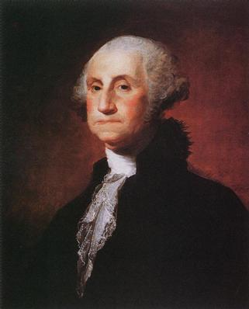
Second Continental Congress
May 1775
When the Second Continental Congress came together on May 10, 1775 it was, in effect, a reconvening of the First Continental Congress. Many of the same 56 delegates who attended the first meeting were in attendance at the second
The 2nd Continental Congress established a Continental Army that was commanded by George Washington
This organized the militia into an official army
Extended an Olive Branch Petition to King George.
  Wanted a peaceful end to the hostility
  King Refused and called the colonists rebels
Notes:
The Americans needed an actual army (minutemen weren’t really the best plan of action), and they named George Washington as commander. He had become a war hero during the French and Indian War, and he was very respected by all of the colonial leaders.

Slide 17
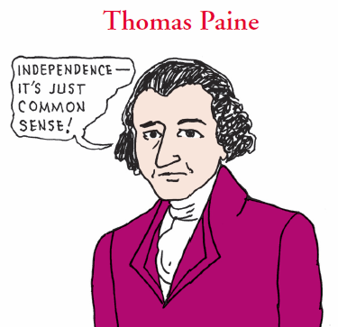
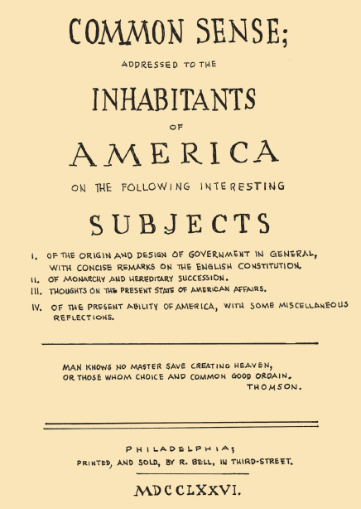
Thomas Paine
Was a revolutionary writer & philosopher who wrote “Common Sense”
It said all Americans should support independence
He said it was crazy for an island to rule a continent!
Thomas Paine gave all profits from his books to the war!
Notes:
By this time, it was pretty clear that peace wasn’t going to happen. Thomas Paine wrote two pamphlets…The Crisis and Common Sense.
Common Sense encouraged all Americans to support fighting for independence…it was like, DUH!
He said it was ridiculous to think that a small country like England could rule a large continent at all, much less from an ocean away. It only made sense (DUH!) to fight for freedom.

Slide 18
Mecklenburg Resolves
According to North Carolinian lore, some citizens of Mecklenburg County gathered in Charlotte on May 20, 1775 and signed a declaration of independence from Britain — the first such move in the American colonies.
the Mecklenburg Resolves or the Charlotte Town Resolves, they provided for the following:
All laws originating from the king or Parliament were voided
The actions of royal military and civil officials was suspended
A call was put out to the other colonies to begin governing themselves through provincial congresses
Royal officials who continued in their duties in North Carolina were to be arrested.

Slide 19
Halifax Resolves
April 12, 1776
Recommended that North Carolina declare independence and urged the colonies to do as well
Were read and discussed at the Continental Congress
The Halifax Resolves influenced other colonial assemblies to draft similar resolutions.
The document’s importance is still remembered. The current North Carolina state flag includes the date that the Resolves were passed, April 12, 1776. And every year on April 12, the Historic Halifax State Historic Site celebrates Halifax Day.

Slide 20
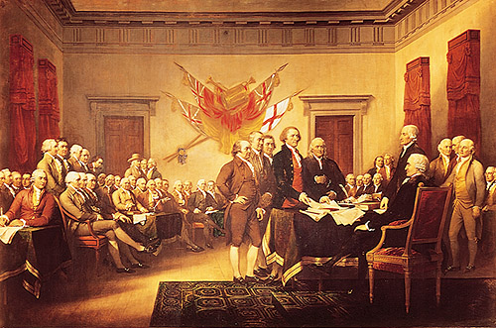
Declaration of Independence
What is a Declaration?

Slide 21
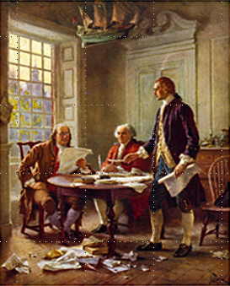
The Declaration of Independence
drafted by Ben Franklin, John Adams and Thomas Jefferson
The main author was Jefferson, and he actually wrote the 1st copy.
Declaring independence in 1776 was not easy for the colonists. They discussed it for 1 month
The Declaration of Independence was signed on July 4, 1776
13 states unanimously approved, and the United States of America was born!
This was treason in the eyes of the king!

Slide 22
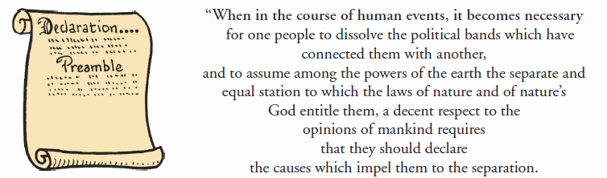
D of I – Section I
The introduction to the Declaration of Independence explains why colonists want to separate from Britain
It is called the Preamble

Slide 23
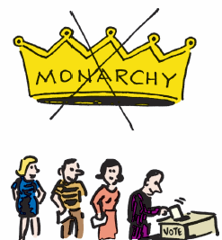
D of I – Section II
The 2nd section of the D of I “We hold these truths… happiness” says that:
  governments are formed to protect the rights of the people
  that if the government ignores the rights of the people, then a new government can be created
  Established the concept that “all men are created equal” and are given “certain unalienable rights:
  life, liberty, and the pursuit of happiness”

Slide 24
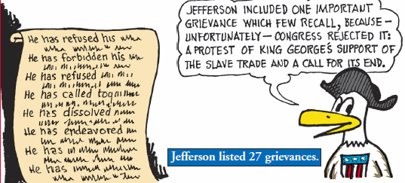
D of I – Section III
The 3rd section of the Declaration of Independence lists the 27 grievances the colonists have with King George
They are upset with his actions and they call him a tyrant!

Slide 25
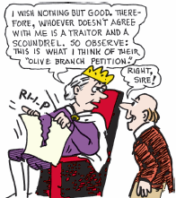
D of I – Section IV
Section 4 of the Declaration of Independence pointed out that King George III ignored the colonists when they reached out to him with the
Olive Branch Petition

Slide 26
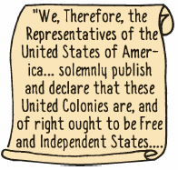
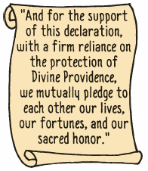
D of I – Section V
Section 5 of the Declaration of Independence was the actual section in which the colonies declare INDEPENDENCE

Slide 27
IN YOUR GROUP COMPLETE THE FOLLOWING SECTIONS OF YOUR NEWSPAPER LABELED:
“The Declaration of Independence and Articles of Confederation”

Slide 28
AMERICAN REVOLUTION DBQ
Now that we are learned everything that lead up to the Colonists declaring independence from England
We studied the Declaration of Independence, and now it is GAME ON!
Your task over the next two days is to complete the DBQ titled
  “Causes of the Revolutionary War” – Were the American colonists justified in waging war and breaking away from Britian?
  Work through the documents, answer the text dependent questions, and then write a well supported essay.
  You will have two days in class to work on this DBQ

Slide 29

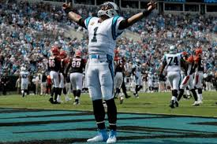
Let’s look at the competing sides
VS

Slide 30
The Opposing Sides
After D of I, war for independence was unavoidable
Both sides thought war would be short
  Brits thought would crush Patriots. Patriots thought Brits would give up after few losses
British Advantage:
Nicknamed ‘The Red Coats”
Best navy in world
Experienced, well-trained army
Much larger population
Brits: 8+ million
Colonists: 2.5 million
Wealth of a worldwide empire
Patriots Disadvantage:
Lacked regular army
Most militia (volunteers)
No navy
Lacked experience, guns, and ammo
Not all colonists supported the cause
Some were neutral
Some were Loyalists

Slide 31
The Opposing Sides
Patriots Advantage:
  Fought on own ground
  Knew the terrain It was theirs!
  Great determination; personal stake in the result
  Greatest advantage was their leader… George Washington
British Disadvantage:
  Brits mostly hired army, and mercenaries…
    Hessian Mercenaries
      German soldiers for hire
  They don’t really care about cause; just money
  Forced to fight in far away land
  Forced to ship soldiers and supplies 1,000’s of miles

Slide 32
Washington vs Cornwallis
Today we have Two Biographies on George Washington and Charles Cornwallis
We will do a close reading together and then you will complete a Venn Diagram on the two Generals

Slide 33
IN YOUR GROUP COMPLETE THE FOLLOWING SECTIONS OF YOUR NEWSPAPER LABELED:
“George Washington, Our great leader
                And
  “Continental Army vs British Redcoats”

Slide 34
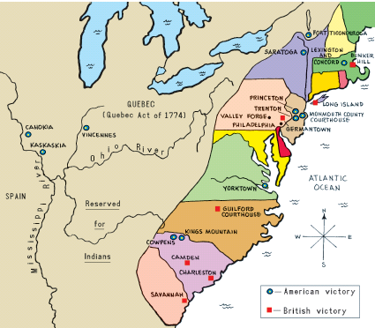
MAJOR BATTLEGROUNDS

Slide 35
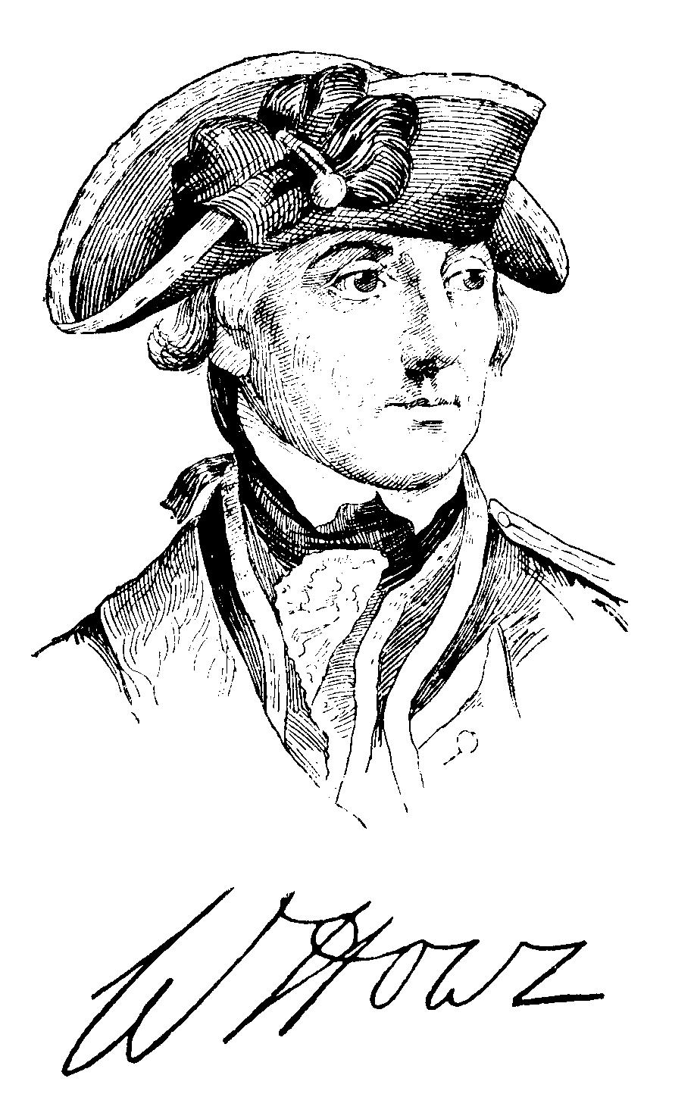
Early Fighting
British thought this would be easy and didn’t send many troops early on
  Bunker Hill
    Brits- 2,200 men
    Patriots- 1,200 men
Because the militia was low on ammunition, they were told, “Don’t fire until you see the whites of their eyes”
British commander General William Howe
  Thought he could scare and bully the Patriots with the size of the British army

Slide 36
The Battle of Long Island
Aug. 1776- Battle of Long Island
  Outnumbered and outmaneuvered Patriots suffer serious defeat
  Although Patriots brave…
    Very few supplies
      Many without socks, shoes, coats, and blankets
Nathan Hale the hero at the Battle of Long Island
He was a teacher from Connecticut who volunteered to spy on the redcoats
He disguised himself as a Dutch schoolteacher and was hanged when he was captured by the British
He was quoted as saying, “I regret that I have but one life to lose for my country”

Slide 37
African Americans Join the Fight
Washington pleads with congress to allow freed black men to fight
  Southern Colonies convinces Congress not to
As need grew, some states ignored ban
  Some fought as early as Concord and Lexington!!!
  RI raises all-black regiment in 1778
By end, every state except SC has black soldiers
  Estimates of 5,000+ black soldiers for Patriots
    Fought for same reasons, and same cause
    Some runaway slaves too, or those fighting in exchange for freedom

Slide 38
Battle of Trenton
Brits settled in NY for winter of 1776
  Didn’t fight in winter; at least, did not expect to fight
Left some troops in Trenton & Princeton, NJ
Stationed across the Delaware River from the Brits, Washington sees his chance!
  Christmas night 1776, 2,400 Patriots sneak across river
  Attack at dawn
    Capture 900+ Hessians
    Even more important were supplies needed
    Big win just when the Patriots needed it, and they did it with a surprise attack

Slide 39
The Battle of Saratoga in 1777
Occurred in New York
The Patriots destroyed bridges, cut trees for blocks, hid in trees etc…
The Americans defeated the larger
British force and won the battle
British plan to separate NE from rest of colonies fails
Soon after, General William Howe resigns as Commander of British Troops
  Replaced by General Henry Clinton
IT WAS THE TURNING POINT OF THE WAR! WHY? BECAUSE FRANCE AGREES TO HELP THE AMERICANS!
With France on board with the Patriots, it is a whole new ball game!

Slide 40
Gaining Support
Victory @ Saratoga boosts American spirits an morale
Other nations now aware that Americans may actually win
  Now time to seek support from British rivals
  Ben Franklin had been in Paris for a year now trying to enlist French aid
News of the win in Saratoga causes shift in French policy
    France openly supports Americans
February 1778-
  2 sides work out a trade agreement and alliance
    France declares war on Britain
    Send money, supplies, equipment, and troops!!!

Slide 41
Valley Forge – Winter of 1777-78
Word of the French alliance won’t hit US until spring of 1778
Washington lead Patriot troops to Valley Forge during the winter of 1777-78
It was a miserable winter, very cold and snowy
The troops had little food, clothing, and supplies
During this time, Washington read Thomas Paine’s books “Common Sense” and “The Crisis”
  Washington’s greatest challenge was just keeping the army united and Alive
      Many men deserted, or left w/o permission
      The army was falling apart
  Somehow survived, but by spring, ¼ were dead
April 1778- word hits US of France’s alliance
  Spirits skyrocket!

Slide 42
IN YOUR GROUP COMPLETE THE FOLLOWING SECTIONS OF YOUR NEWSPAPER LABELED:
“Colonial troops win key battles”
“Foreign aid enables Continental Army to defeat redcoats”
“A long cold winter”

Slide 43
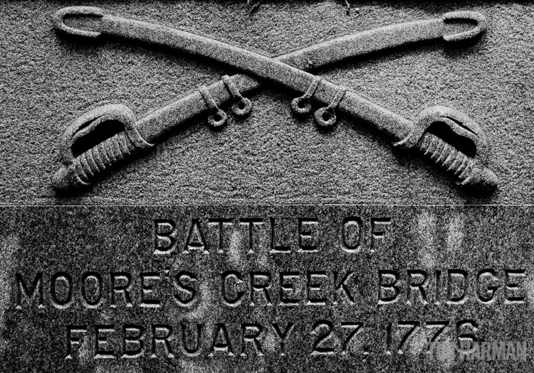
Struggles in the South
In early years, colonists won many battles in south
  Crushed Loyalist militia at Battle of Moore’s Creek (Wilmington)
  Saved Charles Town too
  British couldn’t gain control of the south and encouraged North Carolinians to fight for independence.
Brits underestimated Americans
  Changed their strategy
    Hard-hitting offensive
    Concentrated their efforts in south
      More loyalist support
      Major cities were port cities
        Use British navy to assist
Strategy works!
Notes:
Battle of Moore’s Creek Bridge-2012 FL Documentary Contest Winner (9:56)

Slide 44
Patriot Victories in the Carolinas
  Cornwallis Moves the british army north through NC
Sept. 1780- @ Battle of King’s Mountain
  Brit officer & 1,000 Loyalists try to defend it
  Patriots attack
    Force British retreat out of NC backcountry
    Victory brings new support for Colonials
Jan 1781- Colonials under Gen. Daniel Morgan defeat Brits @ Battle of Cowpens, SC
Reunite March 1781- to take on Cornwallis at the Battle of Guilford Courthouse
  Present-day Greensboro, NC
  Colonials forced to retreat, but…
  Losses so severe for Brits, Cornwallis forced to leave the Carolinas
Notes:
DisEd Rebel Victory @ King’s Mt. (4:03)
DisEd Cowpens: Decisive Defeat (3:53)
DisEd Guilford Courthouse (4:07)

Slide 45
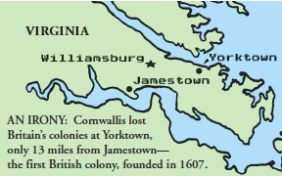
The Battle at Yorktown in 1781
Was a big one for the Americans
They traveled over 200 miles in 15 days
They met General Cornwallis & the British troops in Virginia
3 sets of troops were used to close in on the redcoats at Yorktown
The British were confused, low on supplies and many were sick

Slide 46
Surrender at Yorktown!!
The Americans trapped Cornwallis on the peninsula
He and his troops were surrounded on 3 sides by the Continental army
The French fleet arrives 6 hours before the British fleet and blocked his escape.
Cornwallis surrenders, and the war is OVER!

Slide 47
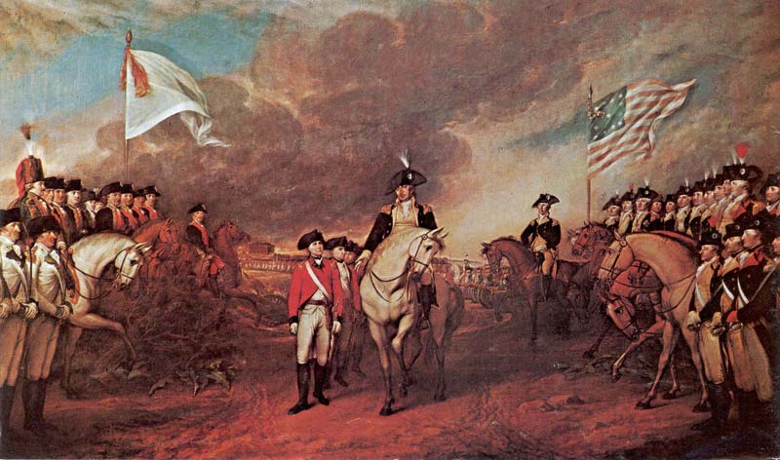
General Cornwallis surrenders to General Washington

Slide 48
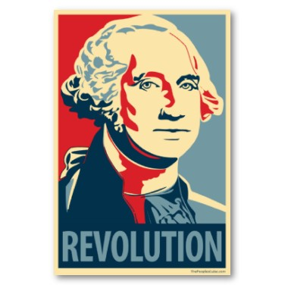
Why the Americans Won
How did they manage to win?
How defeat strongest military in world?
Patriots had several advantages…
  Fought on own land
  French and Spanish aid
    Soldiers, navy, generals, $$$
  Blocked Brit navy
  Brits could control cities, but not countryside
    Patriots knew terrain, and could hide easily
  Brave, impulsive generals
  Most important…
    It was the people’s cause
    Had personal interest in outcome
    Determination and spirit that could never be beaten

Slide 49
The Treaty of Paris 1783
Ended the American Revolution
“The American colonies hereby recognize…all lands east of Mississippi...”
– King George III
Treaty of Paris 1783

Slide 50
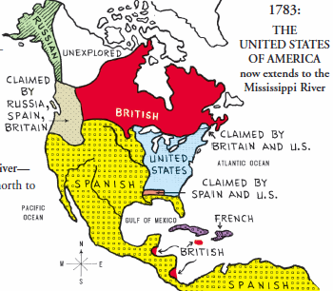
Treaty of Paris 1783

Slide 51
What did the U.S. gain?
INDEPENDENCE
Land from the Atlantic Ocean to the Mississippi River and from Canada to Florida (Ohio River Valley)
All redcoats were forced to leave the U.S.

Slide 52
Time to Finish Your newspaper
Take this time to finish any sections you missed as well as the following sections
“Colonies Gain Independence”
“Results of the Revolution”
Benedict Arnold
https://www.history.com/topics/american-revolution/benedict-arnold

