Slide 1
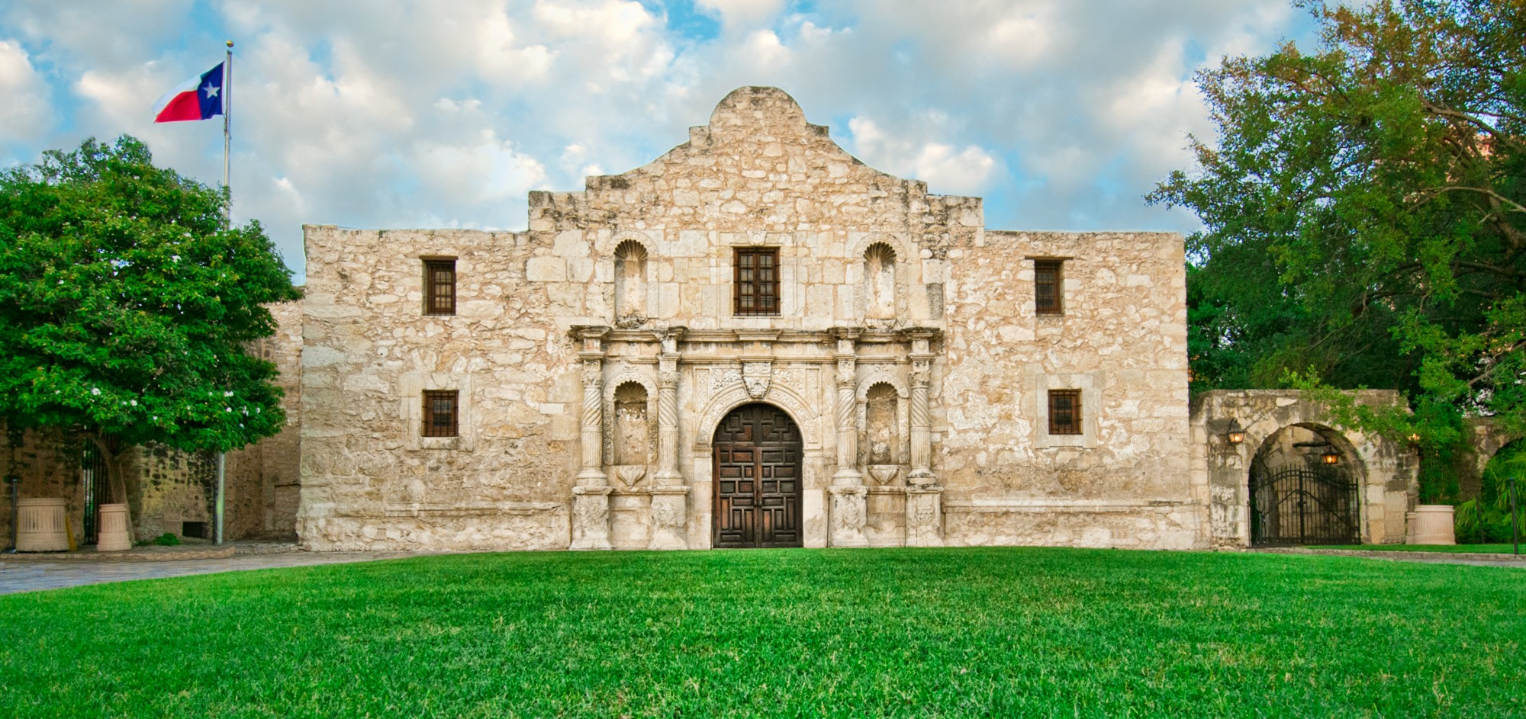
Texas Revolution and Mexican/American War

Slide 2
In 1821, Mexico won independence from Spain

Slide 3
Mexican Independence Changes Texas
American, Stephen Austin wanted to start a colony in Texas
The Mexican government told Stephen Austin his settlers would have to become Mexican citizens and members of the Roman Catholic Church, and learn Spanish.
Between 1821 and 1827, Austin attracted 297 families to his new settlement.
The success of Austin’s colony attracted more people toTexas from the United States.
By 1830, the population had swelled to about 30,000,with Americans outnumbering the Tejanos six to one.

Slide 4
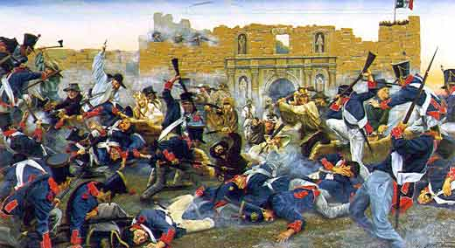
In 1829, the Mexican government closed the state to further American immigration.
Mexican president, General Antonio Lopez de Santa Anna sent more Mexican troops to Texas.
Texans began talk of breaking away from Mexico.
When Stephen Austin was jailed, the Texans did revolt.
Santa Anna led 6,000 troops to Texas to put down the revolt.

Slide 5
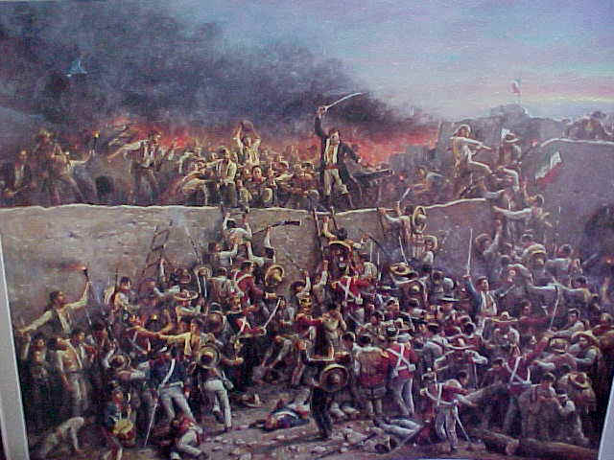
The Fight for the Alamo
The first battle between the Texans and Mexicans took place at on old mission that was used as a fort. It was called the Alamo.
There were only 183 Texans guarding the Alamo.
The Mexican army had 1,800 men.
The Texans held the Alamo for twelve days.
On the thirteenth day, Santa Annsa ordered his men to storm the fortress.
When it was over, all but five Texans were dead. The men not killed in the battle were executed by Santa Anna.
Texans were shocked by the slaughter at the Alamo and vowed to fight for their freedom.

Slide 6
Battle at San Jacinto
Santa Anna had over 300 more Texans executed at Golidad.
Texan general, Sam Houston gathered more troops, 800 in all.
It included Tejanos, American settlers, volunteers from the United States, and many free and enslaved African Americans.
They met Santa Anna at San Jacinto.
Their battle cry was, “Remember the Alamo!”
It was over in 18 minutes. More than half the Mexican army was killed.
Santa Anna was forced to sign a treaty giving Texas its freedom. With the Battle of San Jacinto,Texas was now an independent country.

Slide 7
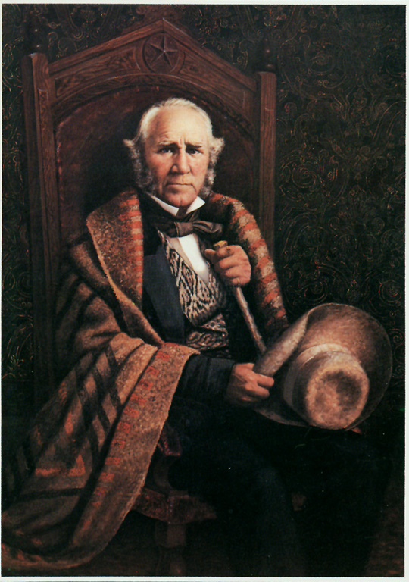
Lone Star Republic
In 1836, Texas declared itself The Lone Star Republic.
Sam Houston was elected president.
Some Americans wanted Texas to be part of the U.S.
Some people were afraid of Texas becoming a slave state, others of war with Mexico.
Both would eventually happen.

Slide 8
Annexation of Texas
Most Southerners/Democrats supported Texas’ annexation, Northerners/Whigs were opposed
1845, Republic of Texas voted to be annexed by the United States Congress approved
Texas became 28th state

Slide 9
War is Declared on Mexico
Began over dispute of southern boundary of Texas
U.S. claimed Rio Grande as southern border
Mexico claimed Nueces River as border
War declared in May of 1846
American troops took offensive
Expedition under Captain John Fremont moved into California
Group of American settlers had already proclaimed an independent Republic of California

Slide 10
War in Mexico
Treaty of Guadalupe Hidalgo ended war
Mexico gave up claim to Texas
Recognized Rio Grande as border with U.S.
Gave up New Mexico and California
United States paid Mexico $15 million

Slide 11
Acquisition of Territory
1763 – French and Indian War
1783 – Revolutionary War (Treaty of Paris)
1803 – Louisiana Purchase
1812 – Concrete Northeast Border (Treaty of Ghent)
1845 – Texas as 38th state
1846 – Oregon Treaty
1848 – Mexican Cession
1853 – Gadsden Purchase

Slide 12
