Slide 1
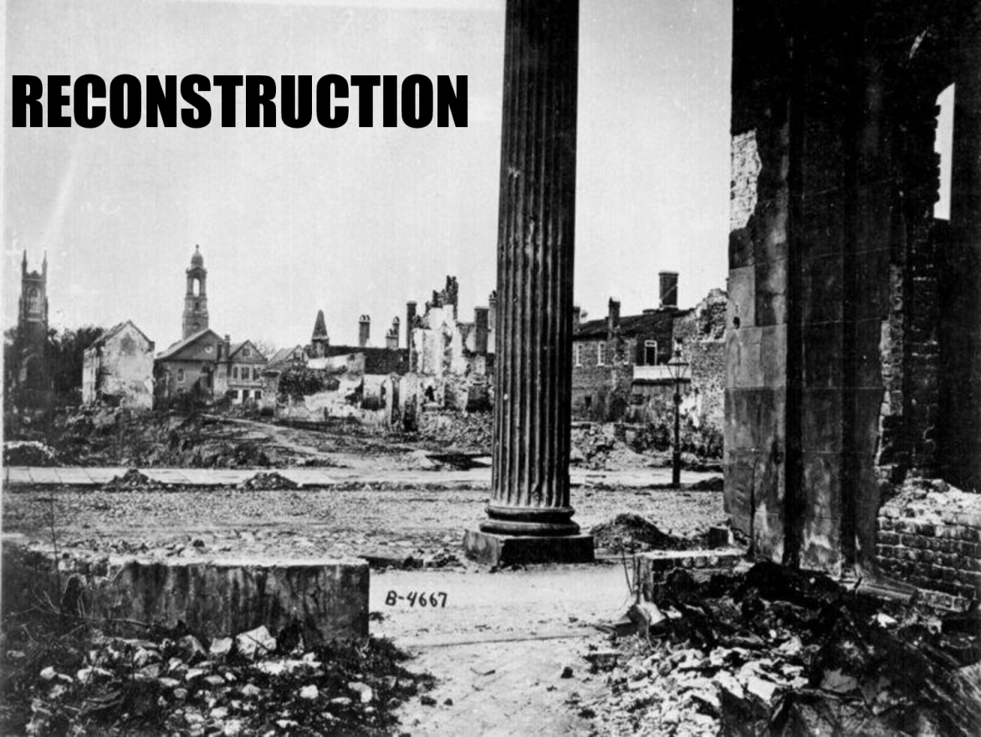
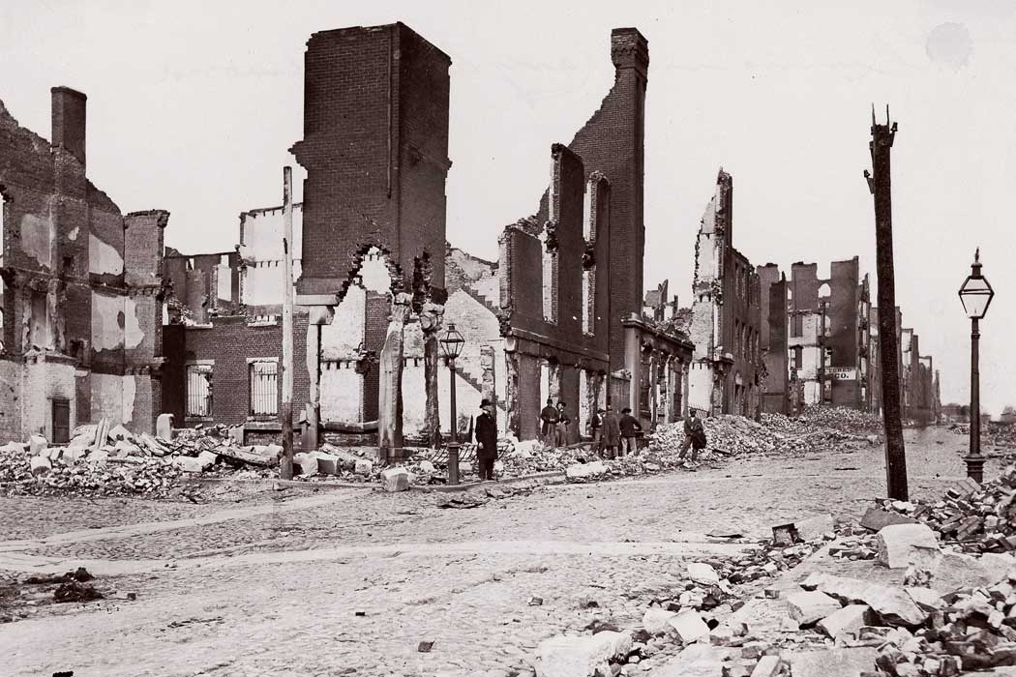
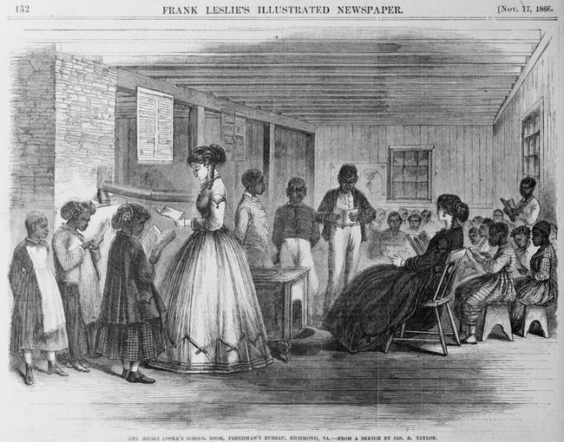
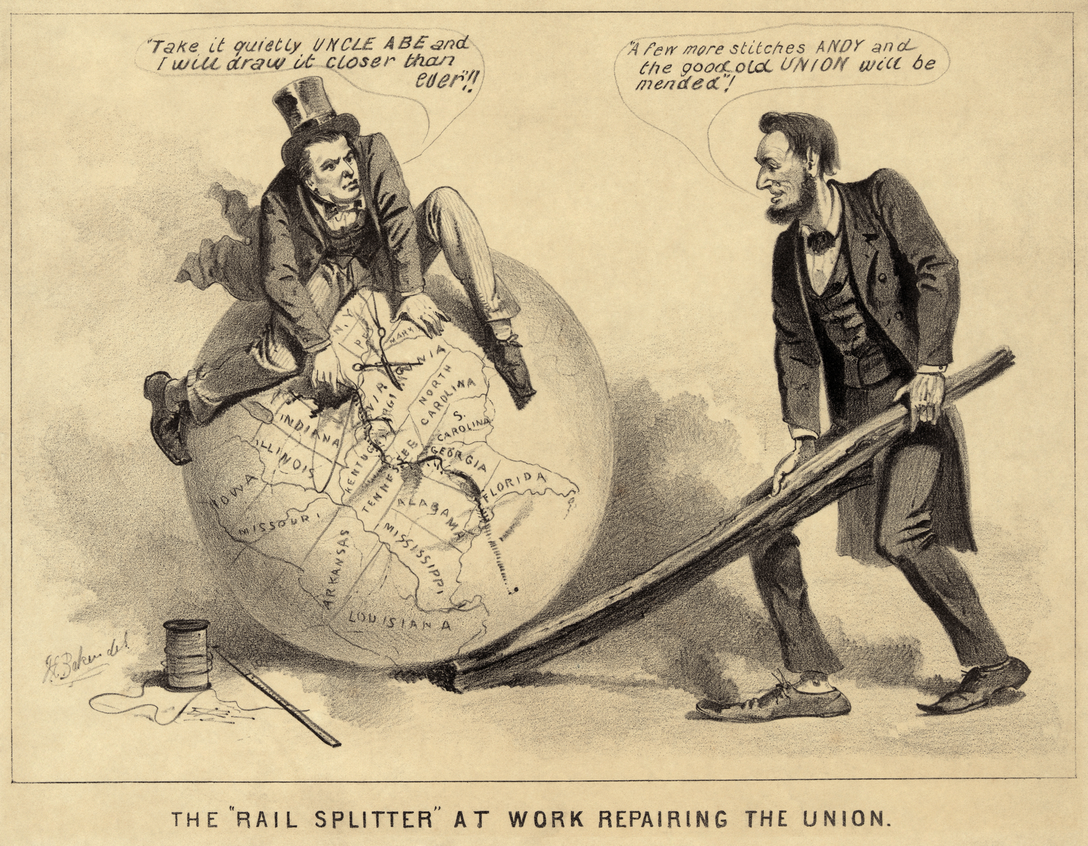
Reconstruction Era
1865-1877

Slide 2
Civil War is over….but….NOW WHAT??
War left South in ruins
Towns and cities were destroyed
Plantations burned
Roads, bridges, RR’s destroyed
Attempt to reunite nation left our leaders with many questions
Should southerners be punished or forgiven?
What rights should be granted to freedmen? (newly freed slaves)
Everyone agreed they needed to rebuild south
Disagreed bitterly how to do it

Slide 3
Lincoln’s Plan
“10% Plan”
* 10% of voters of state took oath of loyalty to Union… state form new gov’t (banning slavery)
* He believed punishing would serve no purpose… only delay healing of nation
* Offered amnesty, or a pardon to all white southerners (except Confed. Officers) willing to swear oath of loyalty to Union

Slide 4
A group in congress had a different plan
Group of “Radical Republicans “ in Congress thought Lincoln’s plan too nice
Began to create their own plan: The WADE-DAVIS BILL
1st- majority of whites had to swear allegiance
51% not 10%
2nd- Only those men could vote for reps in Congress
3rd- Former Rebels couldn’t hold public office or vote
4th- Had to adopt state gov’t that abolished slavery
Only when all conditions met…
They could be readmitted to Union
Lincoln’s plan was based on forgiveness and unity. Radical Republicans plan was based in punishment.

Slide 5
Congress and Lincoln did agree on one thing…
The Freedman’s Bureau
Played important role in helping newly freed blacks make the transition from slavery
Provided food, clothing, and medical aid
Est. schools and helped set up AA universities (HBC’s today)
Helped freedmen acquire land (abandoned or seized by Union army)
People from the North went to the south to help wherever they could
Very important in the advancement of Civil Rights!!!

Slide 6
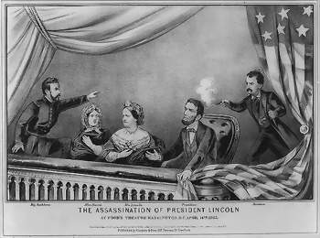
The assassination (murder) of President Lincoln
Ford Theatre- April 14, 1865- “Our American Cousin”
John Wilkes Booth An actor, Confederate sympathizer, and
confederate spy murders Lincoln during play.
*snuck into the private box of President Lincoln
*shot him in the back of the head
*jumped from the balcony to the stage and shouts “Sic Semper Tyrannous”, Latin for Thus Always to Tyrants and successfully escapes in the chaos. (some say he had help escaping)
*Lincoln is transported across the street in grave condition. He dies a few hours later.
*Booth is caught 12 days later on a farm in Virginia and shot to death.
*Booth was mastermind in plot to kill all high gov’t officials at same time. They were trying to restart the Civil War
*Assassination of Lincoln left questions unresolved when Andrew Johnson became president.

Slide 7
Review Questions
Define Reconstruction.
Compare and Contrast Lincoln’s plan for Reconstruction with the Wade-Davis Bill.
3. Explain the circumstances surrounding the assassination of President Lincoln. Who was the assassin? Where did it take place?
4. Explain what the Freedman’s Bureau was

Slide 8
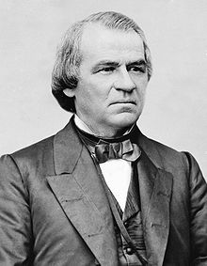
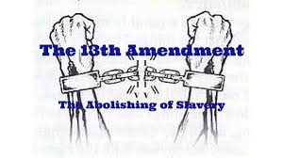
A new President
Andrew Johnson becomes president after Lincoln’s death in 1865
Democratic Senator from TN
Only southern senator to stay in Congress after secession
He now proposes yet another pan for Reconstruction:
10% of population swear allegiance to the Union
2) Each state withdraw secession
3) Ratify the 13th Amendment (abolish slavery)
Then he would forgive the South’s war debts AND let them have their own state governments
The south loved this plan …. Radical Republicans in congress thought this was way to nice

Slide 9
President Johnson vs Congress
Congress thought Johnson’s plan was too nice and wanted to south to be punished more
*Johnson was from Tennessee and most of congress was Northerners….they didn’t trust each other
Many Northern Congressmen upset w/ Johnson’s “Restoration”
South should be punished more
Final straw…
Southern states start passing Black Codes laws
Laws that strictly limited freedom of former slaves
blacks could not…
Own guns or meet after dark
Jailed w/o jobs
Only jobs allowed was farmer or servant
No voting

Slide 10
Congress takes charge
Congress Plan (Radical Republicans)
They hated Johnson’s Plan & made a plan of their own
1) Enlarged the “Freedmen’s Bureau”
agency to assist newly freed slaves & poor whites in the South
2) Passed Civil Rights Act of 1866
forbade states from passing discriminatory ‘Black Codes’
Johnson vetoed both
Republicans over-rode the vetoes and passed them anyway
also created the 14th Amendment
Makes the former slaves citizens with equal protection of the law

Slide 11
Johnson vs Congress
Johnson disapproved of Congress plans…
He vetoed everything, and ignored their overrides
Congress had had enough!
Feb. 1868- Congress votes to impeach , or charge Johnson w/ crimes
If found guilty, removed him from office
Vote takes place after trial and is allowed to remain as President by single vote!
Congress passes The ‘Reconstruction Act’
1) Divided the South into 5 military districts
2) States are required to accept the 13th and 14th Amendments
When they do this, they can become a state again

Slide 12
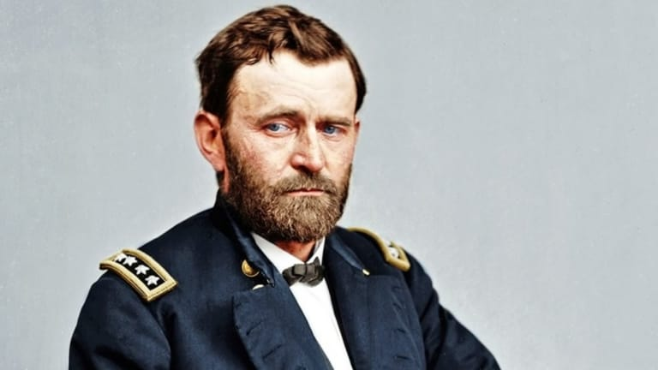
A new president
1868- Republicans help elect US Grant
They could work w/ him!
Encouraged Republicans to secure voting rts for all men
Feb. 1869- Congress passed the 15th Amendment
Says vote can’t be denied on “account of race, color, or former condition of servitude”
Former Confederate states had to sign it or they could not get their states back from military control
Also helped in North where freedmen where still not allowed to vote

Slide 13
African Americans in government
Blacks could now vote
Lots of states where more former slaves than former slave-owners
Never controlled the gov’t but…
held important positions in it
Nat’l Level- 16 black men served in H of Reps & 2 in the Senate b/t 1869-1880
Hiram Revels- AA Senator
Ordained minister; recruited 4 Union Army, started school in St. Louis4 AA’s, elected to Senate in 1870 by Missouri
Blanche K. Bruce- AA Senator
Former runaway; became teacher in Missouri, 1869 became Superintendent in Mississippi, elected to Senate in 1874

Slide 14
Still not equal…
Newly freed blacks also wanted land
Some got it from Freedmen’s Bureau
Most did not
Only option was sharecropping, where land was rented & tools, seeds, maybe even a shack 2 live in was given in exchange 4 percentage of harvest
After paying percentage…
Very little left 2 sell
Barely enough 2 feed family
To most…
This was barely better than slavery

Slide 15
Hate groups form in the south
Violence was common to blacks & anyone who supported them
Most done by secret societies trying to stop them from exercising their rights
Hoped to regain white power
Worst was KKK
Formed in 1866
Launched midnight rides
Burned homes, churches, schools
Killed many blacks & supporters…
Murdering 1,000’s!!!
Violence higher during election time; try to scare blacks from voting 4 change
KKK had support of many in South,
Justified actions as defense of their way of life

Slide 16
End of Reconstruction
Election of 1876
secret deal: If a republican (Rutherford B. Hayes) became President, the
North will leave the South alone
What happens?...Rutherford B. Hayes became president and reconstruction ends
1877- President Rutherford B. Hayes withdrew army from south (compromise of 1877)
South still scarred from war
*Most were poor
*Made little progress in farming (w/o slaves)
*Businesses & industries didn’t thrive
*Some gave up & moved north 4 better opportunities

Slide 17
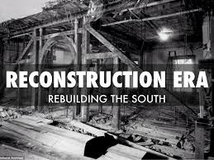
Review questions
5. Describe Andrew Johnson’s Reconstruction Plan. To which plan was it most comparable?
6. Who were the Radical Republicans? Describe 3 of their goals.
7. Of the 3 Reconstruction plans, which plan would the Radical Republicans support? Why?
8. Describe the 13th, 14th, and 15th amendments to the U.S. Constitution.
9. What were the Black Codes?
10. How were African Americans “kept down” in the post civil war society in the south? Give examples

