Slide 1
EDUCATION
Most people did not believe education was important. Government was supposed to to improve things, but it did not follow through with laws already in place. There were no public schools, only academies (private schools). Children were needed at home and on the farm.

Slide 2
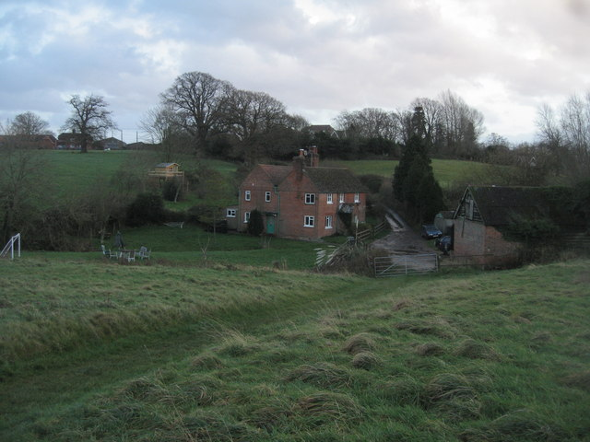
ISOLATION
People did not live close together. There are few roads. People want individualism--they want only to deal with own concerns--did not want people telling them what to do.

Slide 3
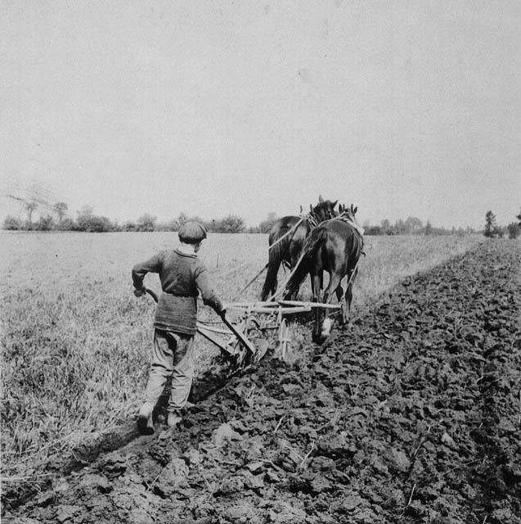
Farm Conditions
Farm conditions were poor. No attempts to make improvements. Serious lack of transportation and communication. Between 1815 and 1850 ⅓ of the population moved out of the state.

Slide 4
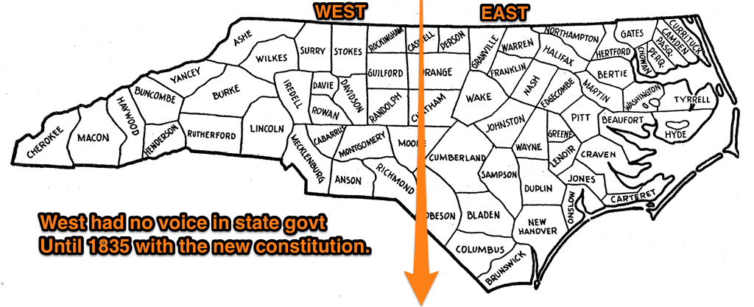
Bad Government
Representation in the state government was by county. Most counties are in the Eastern part of the state, therefore the East rules the government. Not fair!

Slide 5
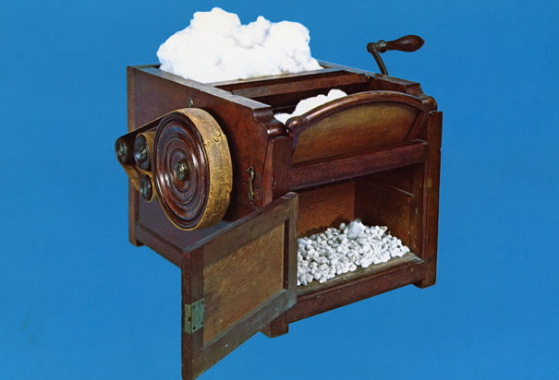
Economy
The cotton gin picks seeds out of cotton. This invention allowed slaves to produce 50% more cotton which means more slaves and more cotton. NC becomes an agricultural state with ¼ of the population as slaves. Land owners invest money in slavery rather than industry.

