Slide 1
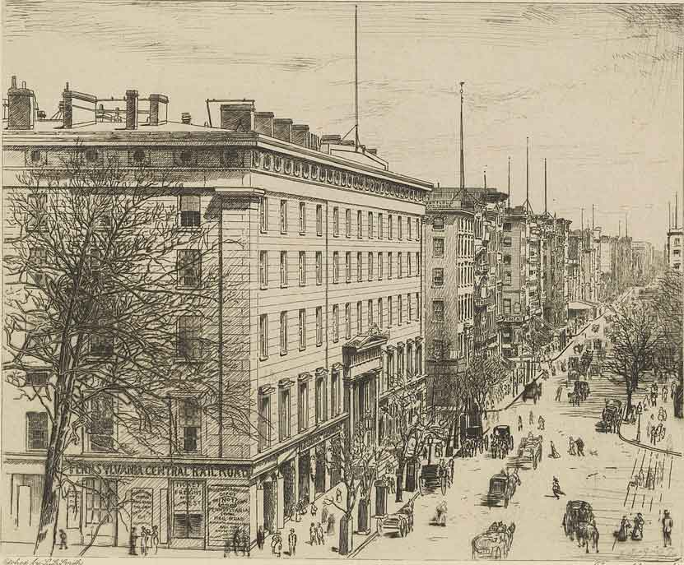
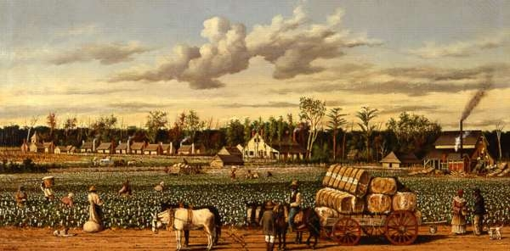
Life in the North vs Life in the South before the Civil War
The Antebellum Period 1830-1860

Slide 2
Guiding Question
What differences existed between ordinary Americans living in the North and those living in the South in the years before the Civil War?
These differences lead to the divide in our country that caused the Civil War.

Slide 3
The Antebellum Period
America’s economy began shifting.
in the north manufacturing grew in popularity with the Industrial Revolution
In the south, a cotton boom made plantations the center of the economy.

Slide 4
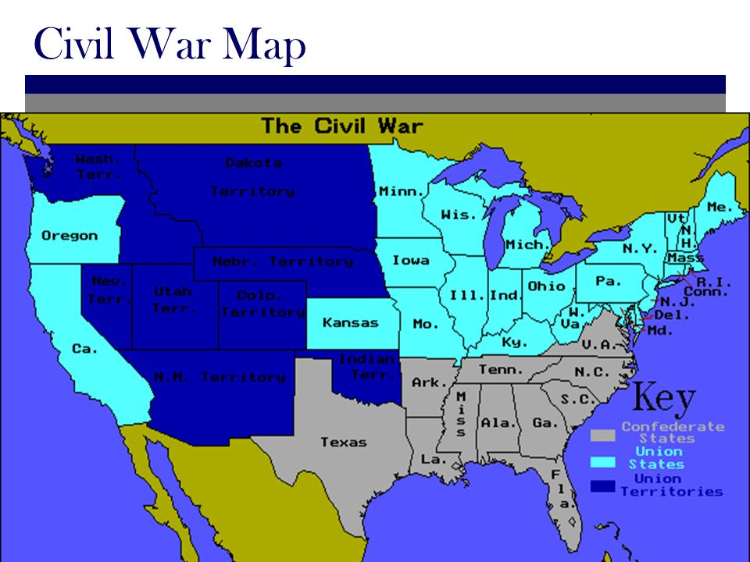
Northern States vs Southern States

Slide 5
Lets look at the major differences
Use your graphic organizer as we compare the North vs the South

Slide 6
North vs South
North
South
Climate and Geography
• Short growing season
• Clear, fast rivers
• Cities develop near rivers and bays.
• Cities develop as trading centers.
• People begin to use waterpower to run factories.
Climate and Geography
• Warm and sunny with long summers,
• Climate ideal for agriculture.
• Fertile soil ideal for growing crops.

Slide 7
North vs South
North
South
Population
• Huge population increase in the North between 1800 and 1860, mostly through immigration.
• Irish, German, and other Europeans mostly settle in North.
70% of the entire population of the United States lived in the northern states
Population
• 1/3 of the population were slaves.
• Most southerners lived on small farms.
• Only 1/4 of farmers owned slaves.
• Large farms called plantations were owned by the wealthy few who owned most of the slaves.

Slide 8
North vs South
North
South
Cities
• Cities develop in North as centers of trade.
• Factories were set up making textiles (cloth goods)
• Increase in factory work brought more people to live in the cities.
• Public education begun in cities for first time.
• Cities became important centers of art, culture, and education. Many city newspapers begun.
Cities
• Most southerners lived on farms.
• There were very few large cities.
• Plantations were self-sufficient and became like small towns.

Slide 9
North vs South
South
North
Economy
• The economy of the South was based on agriculture.
• Cotton, tobacco, rice, sugar cane, and indigo (a plant that was used for blue dye) were sold as cash crops.
• Cotton became the most important crop after Ely Whitney’s invention of the cotton gin.
• More slaves were now needed to pick the cotton.
• Slavery became essential to the South’s economy.
Economy
• The economy of the North was based on manufacturing.
• Many immigrants from Europe began working in factories and producing goods used by people in the North.
• Many factories began producing textiles (cloth) with the cotton grown in the South.

Slide 10
North vs South
North
South
Culture
• The culture of the North was determined by life in the cities.
• Both religion and education were organized.
• There were schools and churches in most towns.
• Very few boys, and almost no girls went on to secondary school.
• College was reserved for the wealthy.
Culture
• The culture of the South was determined by the upper class plantation owners and their families.
• Only children of plantation owners received any education.
• Small farmers had little or no education.
• The culture of the South revolved around plantation life.

Slide 11
North vs South
South
North
Transportation
• Canals were mostly in the North.
• The Erie Canal was a huge success.
• 70% of the country’s railroads were in the North.
• 30,000 miles of track was laid by 1850.
• Canals and railroads allowed northern businesses to grow.
Transportation
• The South was still dependent on the steamship.
• Railroads existed, but far less than in the North.

Slide 12
Day 2
Let’s look at the major inventions of the era that changed life in America
Use the back side of the graphic organizer from yesterday to learn about the major inventions

Slide 13
The Industrial North
The Industrial Revolution is the name for the birth of modern industry and the social changes that came with industrial growth.
Most of the industrial growth took place in New England and others parts of the northeast
    This region has fast-flowing streams which were used to power the factories
    By 1810: More than 60 textiles miles along streams in New England

Slide 14
inventions
the Lowell System…every aspect of production took place under one roof and employees lived in company-owned housing.
    The textile industry boomed in the city of Lowell, MA
    This system was used for the next several decades in factories across the North

Slide 15
Advancements in Transportation
Roads
  The National Road (Cumberland Road) was the first major road built in the US – built from 1811 to 1838 – Maryland to Illinois
  By 1840: A network of roads connected cities in the US, promoting travel and trade
. Canals
    1825: Erie Canal opened – connected Great Lakes with the Atlantic Ocean
    By 1840: More than 3,000 canals had been built in the Northeast

Slide 16
Advancements in Transportation
Steamboats
  Robert Fulton developed the first successful steamboat, the Clermont, in 1807
  Steamboats, or riverboats, made shipping faster and allowed larger amounts of goods to be shipped at one time
  By 1850: over 700 steamboats travelled up and down the Miss. River and other waterways
The “Iron Horse” (Trains)
  1830: Peter Cooper built the Tom Thumb, a tiny but powerful train (10 mph!!)
  Railroads allowed producers to ship goods across the country cheaper and faster

Slide 17
Other Inventions
    Steel plow: invented by John Deere – helped farmers especially in the Great Plains (tough grasses)
    Telegraph: perfected by Samuel Morse – sent first message in 1844…“What hath God wrought?” - benefited the North more than the South

Slide 18
Cotton and the South
Cotton changed life in the South, but only after the cotton gin made large-scale cotton production possible
  Invented by Eli Whitney in 1793 – removes the seeds from the cotton
  The cotton gin made removing the seeds from cotton 50 times faster than by hand
  the cotton still needed to be picked by hand. The demand for cotton roughly doubled each decade following Whitney’s invention.
  So cotton became a very profitable crop that also demanded a growing slave-labor force to harvest it.
  More cotton means more slaves needed

Slide 19
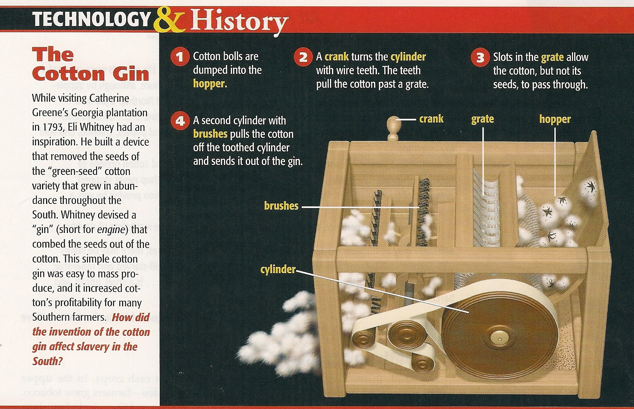

Slide 20
King Cotton
The booming textile industry of the North bought cotton to weave into clothing - England also wanted and bought the South’s cotton.
The number of cotton plantations began to increase in the South due to two factors:
    Development of the cotton gin (easier and faster)
    The demand for cotton from the North and from England
    **At one time the south provided 75% of the worlds cotton.

Slide 21
Slavery Expands
More and larger cotton plantations meant more labor was needed
  1810-1840: The number of slaves in the South doubled to nearly 2.5 million (1/3 of the South’s total population)
  More slaves = More cotton = More money
So, what impact did the cotton gin have on slavery??? It actually led to more slaves in the South.

