Slide 1
The Louisiana Purchase
“The greatest real estate
deal in history.”

Slide 2
How it came to be…
President Jefferson’s Administration, concerned when the “Louisiana Territory” was returned to France in 1800 offered to purchase the key port of New Orleans. Napoleon surprised the U.S with an offer to sell the entire territory for $15 million.

Slide 3
Louisiana Purchase: Notes
President Thomas Jefferson bought the Louisiana Territory from Napoleon Bonaparte of France for $15 million ($0.03 an acre) in 1803.
Meriwether Lewis was hired to explore the Territory. He took his friend William Clark.
Job: 1. Collect info about people, plants, and land of territory
2. Find a water route to the Pacific Ocean
Lasted 863 days, 7689 miles, cost $38,722.25 ($126,000,00 today)
Impact: DOUBLED SIZE OF US, left detailed maps of Territory for explorers

Slide 4
What we gained
Besides doubling the size of the country, the Unites states also:
increased America’s wealth of Natural Resources
Gave the U.S.A undisputed control of the Mississippi River

Slide 5
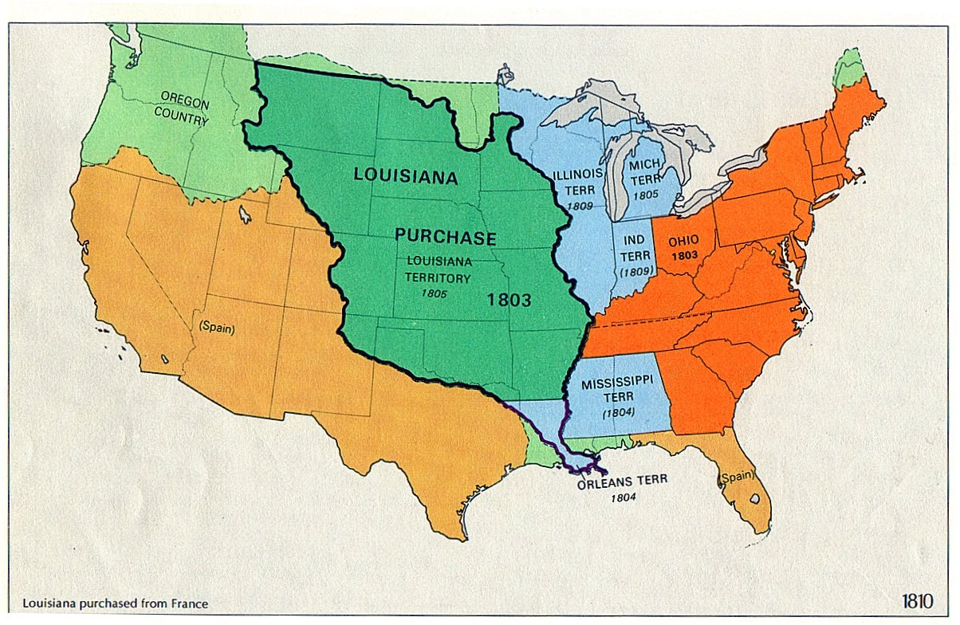
Louisiana Purchase

Slide 6
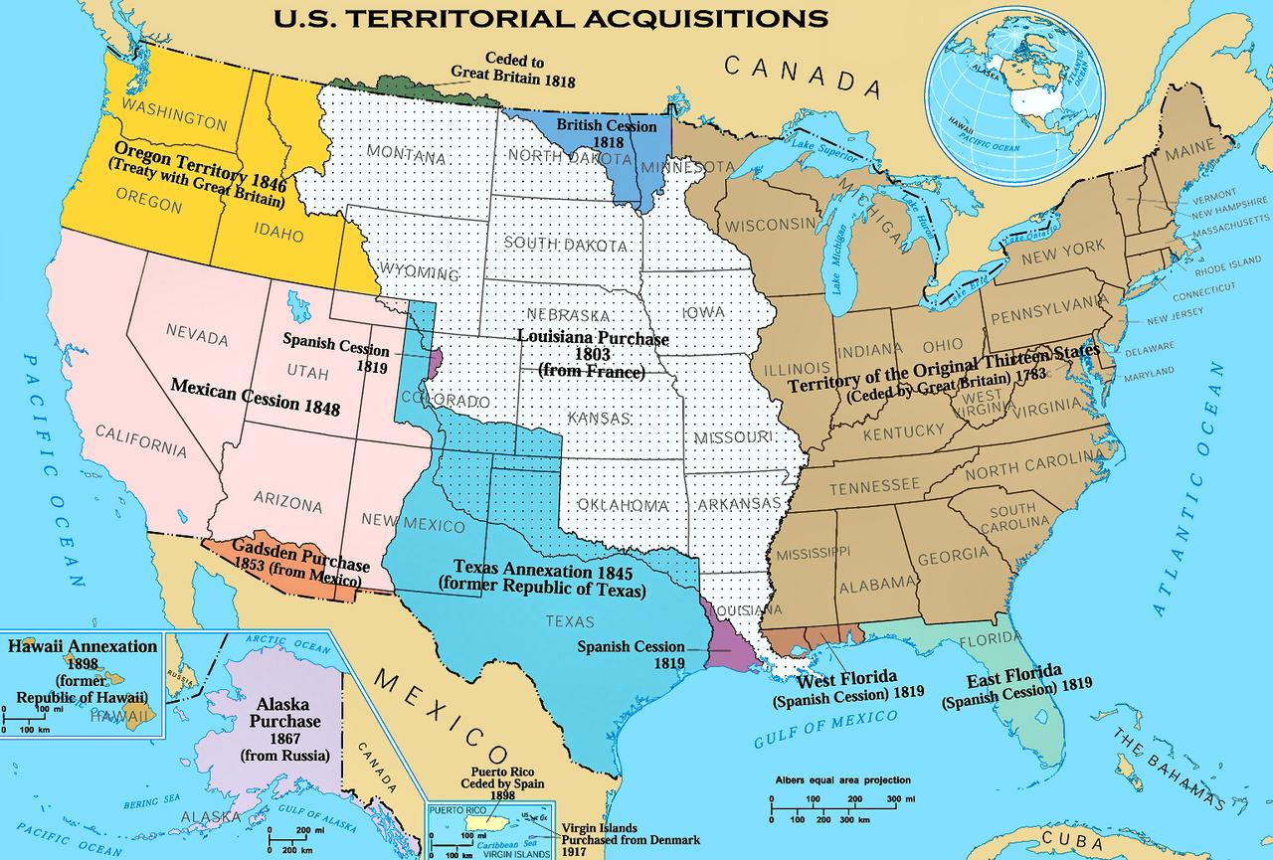

Slide 7
War of 1812
Causes of the War
Impressment
Britain and France were fighting a war in Europe
Britain began capturing American sailors and “impressing” them, or forcing them to work on British ships
By 1807, Britain had seized more than 1,000 American ships

Slide 8
War of 1812
British Navy began seizing American ships that were trading with France
British also began seizing U.S. sailors for the British Navy *IMPRESSMENT*
Rather than go to war, Jefferson issued an embargo
Embargo* suspended American trade
Thought it would hurt the British because they needed American food
Actually ended up hurting America more

Slide 9
War of 1812
James Madison won the election in 1812, and decided that there was no alternative to
Americans tried to invade Canada- unsuccessfully
British invaded the U.S. captured Washington and burned the Capitol and the White House
Americans won many of the major battles, both of them got sick of war and signed a peace treaty that changed no boundaries
The Treaty of Ghent – peace treaty that ended the war of 1812
Results of the war:
Britain and American became better allies
America gained respect from other countries

