Slide 1
Stopping the spread of Communism: Korean War and Vietnam

Slide 2
Proxy Wars
The major conflicts of the Cold War were Proxy Wars – *Regional conflicts where the US and USSR didn’t fight each other but supported certain sides in a war
Proxy wars generally took place because the US and USSR were afraid of a nuclear war on each other
wanted to protect either Communism or Democracy in certain places
Domino Theory – President Eisenhower’s that if one country falls to communism, its neighbor’s will follow

Slide 3
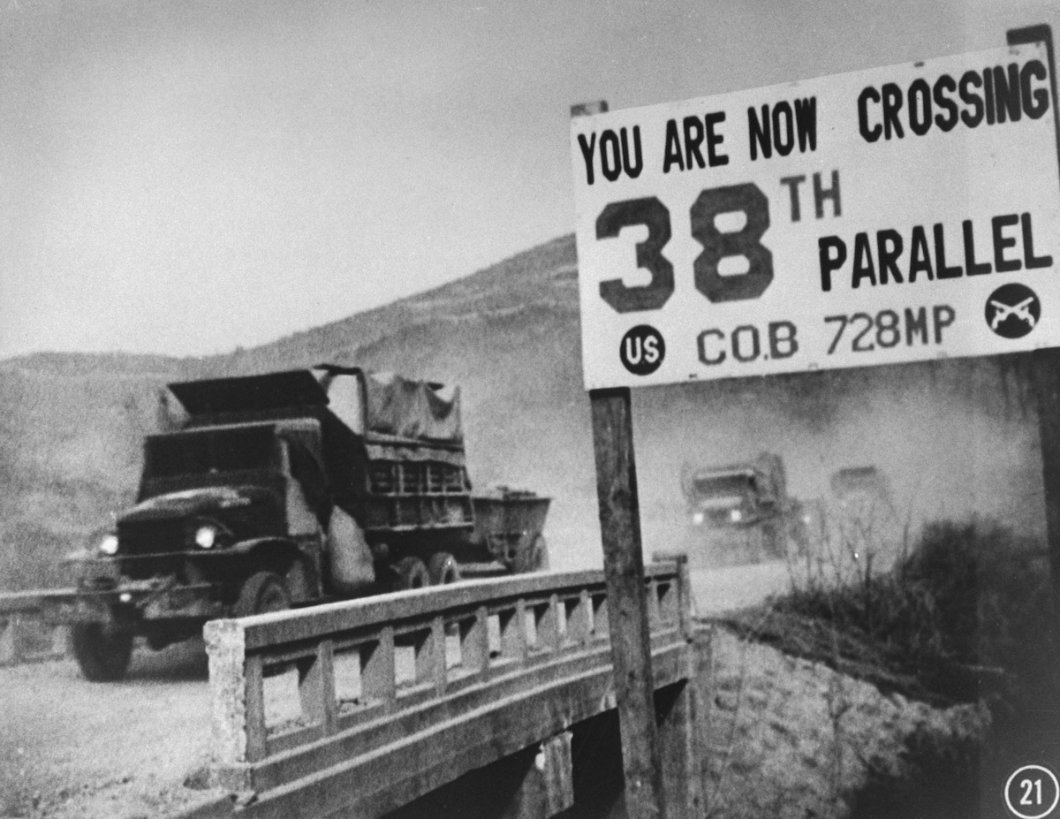
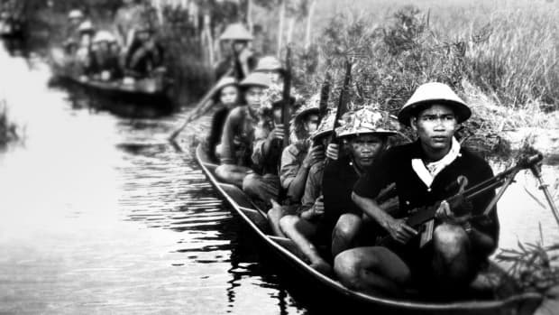
The two best examples of these Proxy Wars are :
Korean War (1950-1953)
Vietnam War (1955-1975)

Slide 4
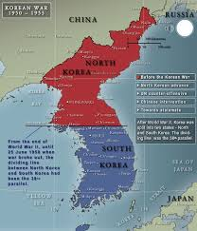
North Korea was communist – Supported by the USSR
North Korea crossed the 38th Parallel – line dividing North and South Korea – on June 25th
1950 and launched a surprise attack
President Truman’s Containment policy was put to the test

Slide 5
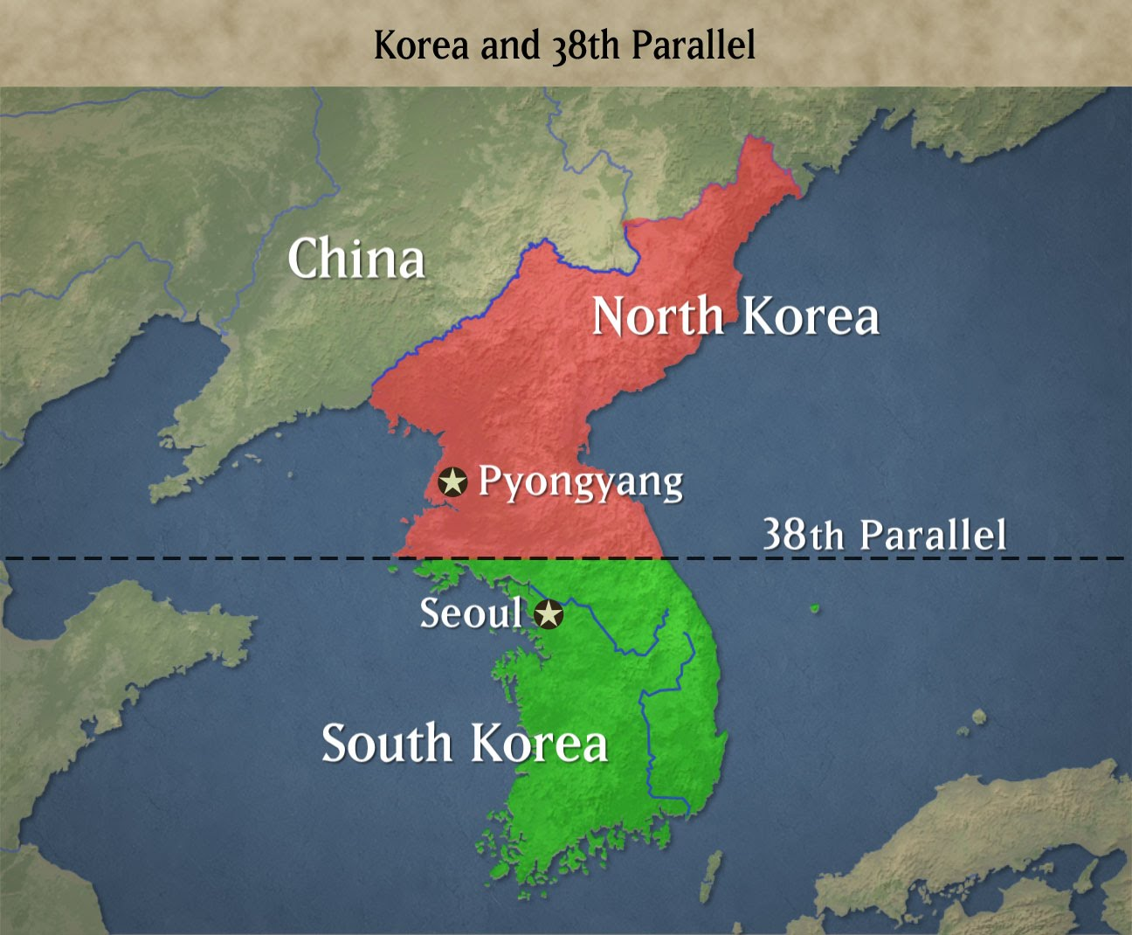
North Korea Quickly capture Seoul (capital of Dem. South)
US President Truman believes all a ploy by USSR
w/o Congress- Truman orders US troops to Korea
Necessary for containment of Communism (Truman Doctrine)
UN agrees & supplies some troops to assist

Slide 6
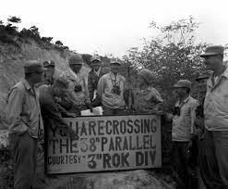
The United Nations supporting the South Korea army led by U.S. General Douglas MacArthur
By September, 1950 the North Korean army advanced and had overtaken most of the peninsula
MacArthur launched a surprise attack and pushed the forces back up north of the 38th Parallel
China (Communist) supplied 300,000 troops in October, 1950

Slide 7
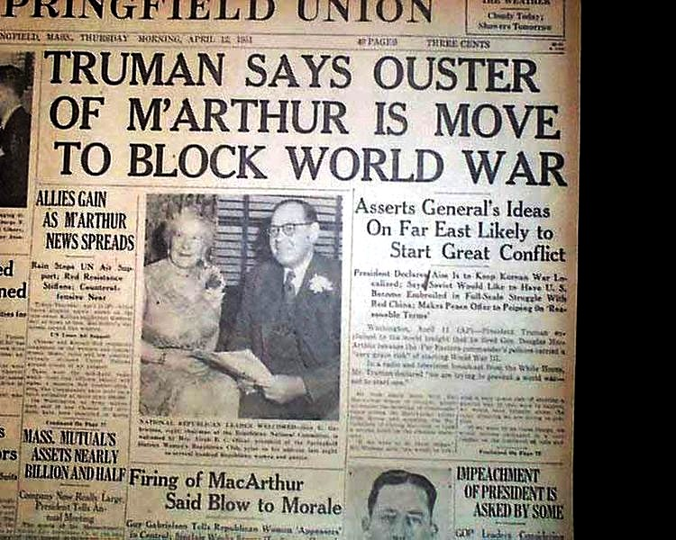
By January, 1951 China and North Korea had pushed UN forces back into South Korea
MacArthur wanted to drop the A-Bomb on China, President Truman didn’t – This was a huge dispute that resulted in MacArthur’s removal
By 1953, UN Forces took control of South Korea back and they agreed to stop fighting
The border was set back to where it started –
4 million soldiers and civilians had died

Slide 8
Viet Nam War

Slide 9
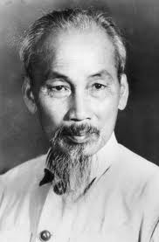
Origins of The Vietnam War
Vietnam was controlled by the French before and after WWII
After WWII, Ho Chi Minh led his Communist Party against the French Imperialists in Vietnam
After 9 years of fighting, the French surrender to Ho Chi Minh after their major defeat at Dien Bien Phu
The US had supported France because their policy of Containment and the Domino Theory

Slide 10
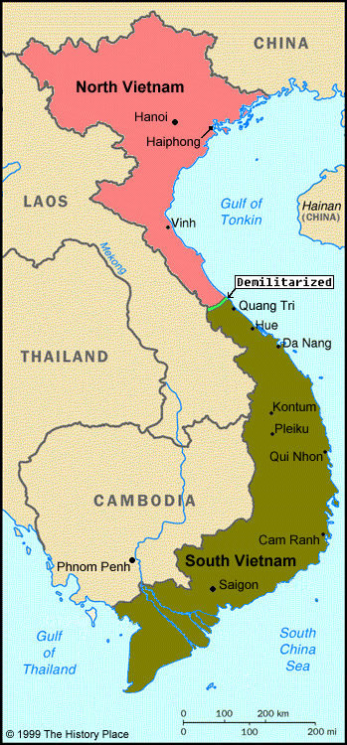
After the defeat of France, there was an international peace conference to decide what to do with Vietnam.
They divided the country at the 17th parallel
North Vietnam was controlled by Ho Chi Minh’s communist forces
In South Vietnam, the US and France set up an anti-communist government under the leadership of Ngo Dinh Diem

Slide 11
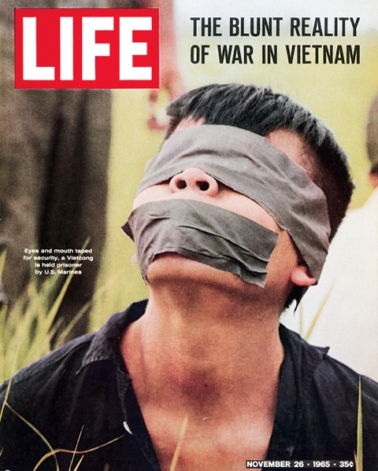
Turmoil in South Vietnam
Diem ruled South Vietnam as a dictator
A group of communist guerillas – Vietcong – took over a lot of areas in the South
Diem was assassinated by South Vietnamese Generals, but they weren’t like anymore than he was
It appeared that the Vietcong – backed by Communist North Vietnam – would takeover

Slide 12
The U.S. Involvement
The U.S. committed many more troops to Vietnam in 1964 after 2 U.S. boats had been hit in the Gulf of Tonkin
By 1968, The U.S. had committed over 500,000 troops
The U.S. faced 2 major difficulties:
Fighting guerillas in unfamiliar terrain
South Vietnamese government was becoming more and more unpopular
The US had to start bombing which made the South Vietnamese even more upset

Slide 13
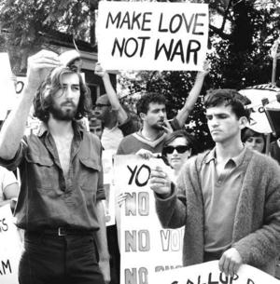
Unpopularity in the U.S.
Protests were very frequent in the U.S.
From 1969 to 1973, the U.S. executed President Nixon’s plan of Vietnamization – gradually pull troops out of Vietnam
In 1975, the North Vietnamese overran South Vietnam – 1.5 million Vietnamese and 58,000 Americans died
Vietnam remains communist but relations with the U.S. have been restored

Slide 14
Essential Questions…
Was the Cold War inevitable?
Should the United States have fought “limited wars” to contain communism?
Did the war in Vietnam change the American public’s view of the government

