Slide 1
The Industrial Revolution
Notes:
1

Slide 2
The Industrial Revolution was a period from the 18th to the 19th century where major changes in agriculture, manufacturing, mining, transportation, and technology.
Industrialization: a shift from an agricultural (farming) economy to one based on industry (manufacturing)

Slide 3
Key Terms
Industrialization – a shift from an agricultural economy (farming) to one based on industry (manufacturing)
Manufacturing – the use of machines, tools, and labor to make things for use or sale
Rural – farming or country life; villages (sparsely populated)
Urban – city life (densely populated)
Urbanization – the movement of people to cities
Tenement – a substandard, multi-family dwelling; usually old and occupied by the poor
Free market – a market in which there is no economic intervention and regulation by the state (govt)
Capitalism – private ownership of means of production
Socialism – society (not the individual) owns and operates the means of production

Slide 4
Causes of the Industrial Revolution
Agricultural Revolution – improved the quality and quantity of food
Farmers mixed different kinds of soil or tried new crop rotation to get higher yields
This led to a surplus of food = fewer people died from hunger = rapid growth in population
New technologies and new sources of energy and materials (e.g., James Watt’s steam engine became a key source of power)

Slide 5
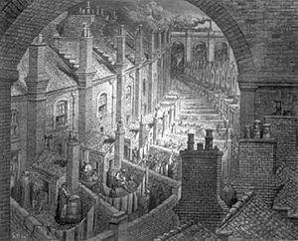
Push Factors: Where did all the people go?
Fewer worker needed on the lands
Cities grew – and GREW!!
Over London by Rail Gustave Doré c. 1870. Shows the densely populated and polluted environments created in the new industrial cities

Slide 6
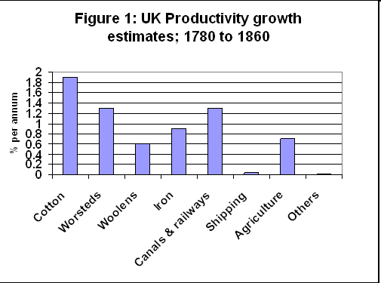
Growth of Industry
Growth of factories
As demand for cloth grew, inventors came up with new machines (e.g., flying shuttle, spinning jenny)
To house these new machines, manufacturers built the first factories
New machines and factories increased production
By the 1850s, factories began to be powered by coal and steam engines
Notes:
6

Slide 7
Factories and Factory Towns
Where employees worked
Major change from cottage industry
Had to leave home to work (travel to cities)
Working in a factory
No safety codes = dangerous work for all
Poor factory conditions (e.g., no heat or a/c, dirty, smelly, cramped)
Long workdays (12-14 hours)
Little pay (men compete with women and children for wages)
Child labor = kept costs of production low and profits high
Mind-numbing monotony (doing the same thing all day every day)
Owners of mines and factories exercised control over lives of laborers
Life in factory towns
Towns grew up around factories and coal mines
Pollution, poor sanitation, no health codes = sickness
Rapid population growth
Poor lived in crowded tiny rooms in tenements (multistory buildings divided into apartments)
Notes:
7

Slide 8
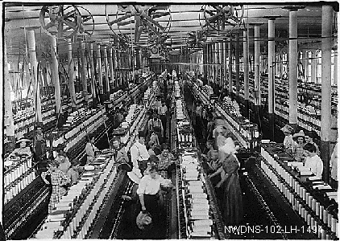
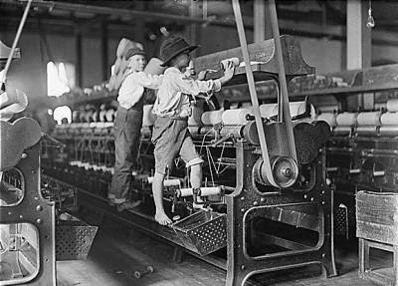
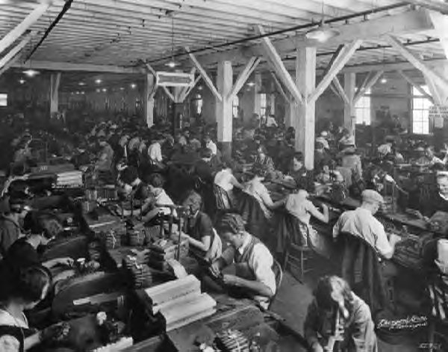
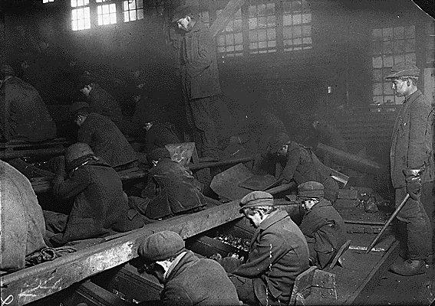
Conditions in Factories
Dangerous
Machinery
Monotony
Dirty
Cramped spaces

Slide 9
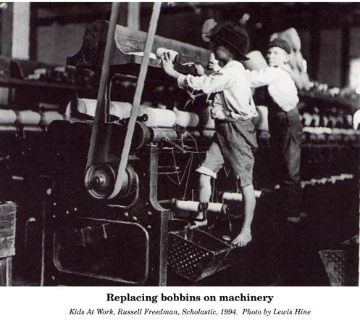
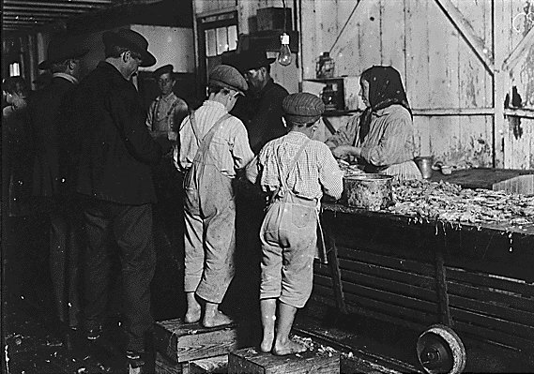
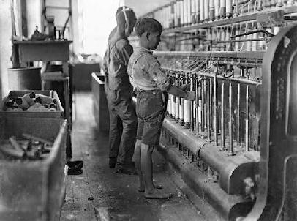
Child Labor
Young children
Long hours
Poor treatment
Dangerous conditions

Slide 10
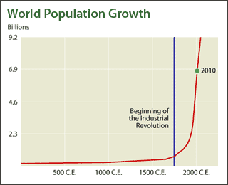
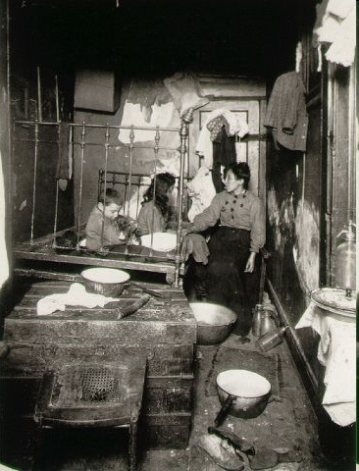
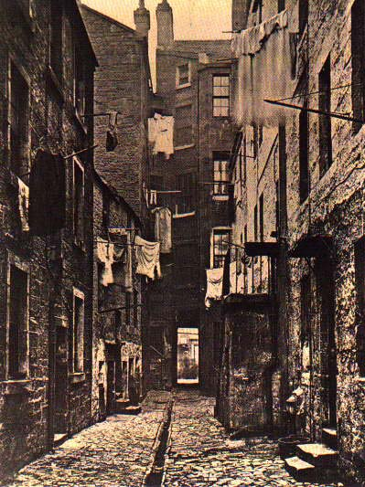
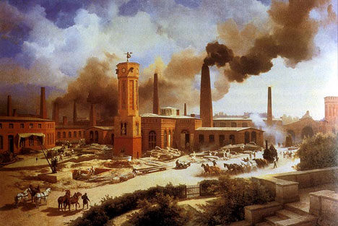
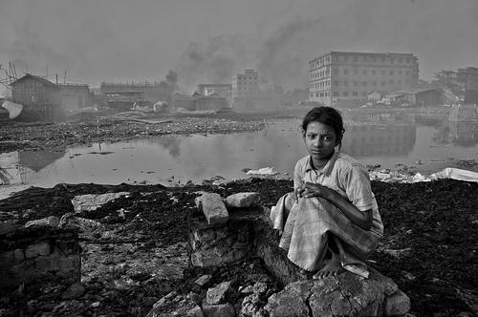
Life in Factory Towns
Rapid Population Growth
Cramped Tenements
Poor Sanitation
Pollution

Slide 11
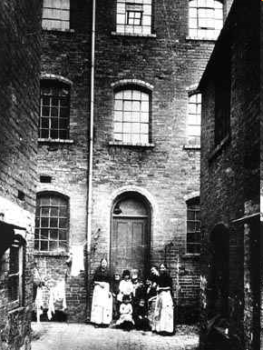
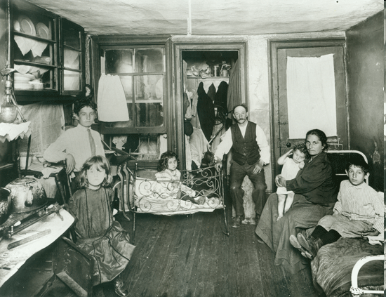
Housing
Tenement = a substandard, multi-family dwelling, usually old and occupied by the poor
Built cheaply
Multiple stories
No running water
No toilet
Sewer down the middle of street
Trash thrown out into street
Crowded (5+ people living in one room)
Breeding grounds for diseases
Pollution from factory smoke

Slide 12
Factories and Mass Production
The factory system changed the world of work;
Mass Production = the production of large amounts of standardized products, especially on assembly lines
Mass Production
Effects
Mass production began in U.S.
Elements:
Interchangeable parts
Assembly line
Production and repair faster and more efficient
Dramatic increase in production
Businesses charged less
Affordable goods
More repetitious jobs
Soon became norm
Notes:
12

Slide 13
Assembly Line
Workers on an assembly line add parts to a product that moves along the belt from one work station to the next
A different person performs each task along the assembly line
This division of labor made production faster and cheaper, lowering the price of goods
Mass production- demand up price down

Slide 14
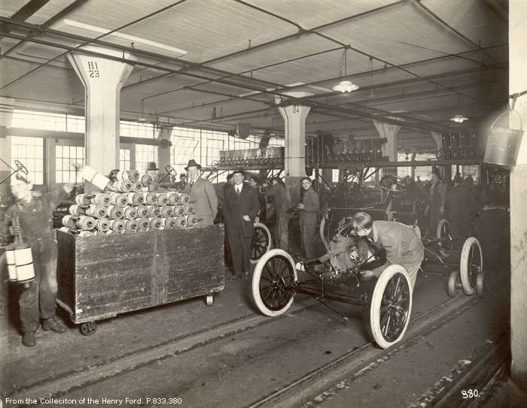
First Assembly Line: Henry Ford - Automobiles

Slide 15
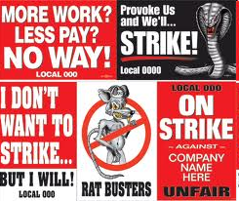
Rise of Labor Unions
Encouraged worker-organized strikes to demand increased wages and improved working conditions
Lobbied for laws to improve the lives of workers, including women and children
Wanted workers’ rights and collective bargaining between labor and management

Slide 16
New Ways of Thinking: Economic Patterns Capitalism vs. Socialism

Slide 17
Capitalism
Free-market economy: prices are determined by supply and demand
Profit goes to owners who invest in the business
Wages are paid to workers employed by companies and businesses

Slide 18
Effects of the Industrial Revolution

Slide 19
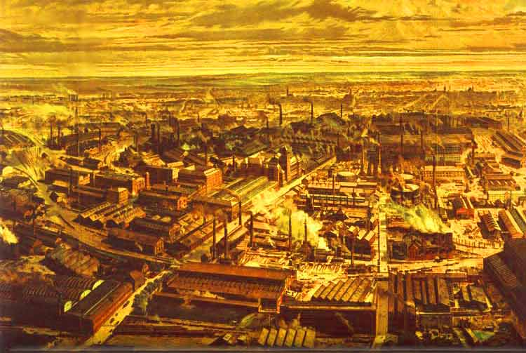
Positive Effects
Increased world productivity
Growth of railroads (faster and more efficient transportation of goods and people)
New entrepreneurs emerged (more money = more technology/inventions)
New inventions improved quality of life for many
Labor eventually organized (unions) to improve working conditions
Laws were enacted to enforce health and safety codes in cities and factories
New opportunities for women
Rise of the middle class – size, power, and wealth expanded
Social structure becomes more flexible

Slide 20
Negative Effects: Factory Life
Child labor used in factories & mines
Miserable (dirty, cramped) and dangerous (fingers, limbs, & lives lost) working conditions
Monotonous work with heavy, noisy, repetitive machinery
Long working hours – six days a week, with little pay
Rigid schedules ruled each day
Gas, candle & oil lamps created soot and smoke in factories
Diseases such as pneumonia & tuberculosis spread through factories
Notes:
20

Slide 21
Negative Effects: Labor Practices & Housing Issues
Labor unrest leads to demonstrations (sometimes violent)
Strikes take place
Women were paid less than men (were actually preferred)
Indentured workers
Employers had a more impersonal relationship with employees
Tenement housing was poorly constructed, crowded, and cold
Human and industrial waste contaminated water supplies – typhoid and cholera spread

Slide 22
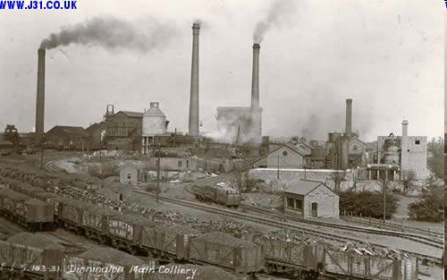
Negative Effects: Worldwide
Air pollution increased over cities and industrial areas
Technological changes eroded the balance of power in Europe
Contributed to the growth of imperialism and communism (Marx’s & Engels’ theories)
Produced weaponry that gave Western nations a military advantage over developing nations

Slide 23
Summary: Social Effects
Increase in population of cities
Women and children enter the workplace as cheap labor
Rise of labor unions
Introduction of reforms
Laws to protect children in the workplace
Minimum wage and maximum hour laws
Federal safety and health standards
Growth of the middle class
Increased production and higher demand for raw materials = growth of worldwide trade
Expansion of education
Women’s increased demands for suffrage

