Slide 1
The Great Depression
1929-1941

Slide 2
The Boom of the Roaring 20’s
Americans were optimistic about the future
Industries became more efficient
Americans bought products in record numbers
CREDIT

Slide 3
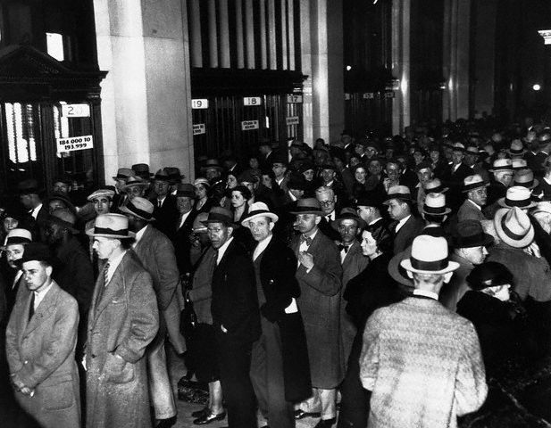
Causes of the Great Depression
Spark: 1. Stock Market Crash
Causes: 1. Overproduction
2. Bank Closings
Results: 1. Unemployment
2. Life Savings Lost

Slide 4

The Crash
Stock market crashed in 1929
  People stopped buying Products
  Products piled up
  Stocks fell
  October 23, due to quick drop stockbrokers began collecting
  People sell stocks but still can’t pay off debt
  Panic on October 24 “Black Thursday”
  Black Tuesday October 29 Investors sell stock of the most profitable companies
  Stock market Crashed

Slide 5
The Banks are next
After losing money in the stock market people began to with-draw their money from the bank
Banks did not have the money after losing big in the stock market
Not backed by federal government
Many banks closed
9,000 banks closed for good
After years of buying on CREDIT, people could not pay their debts

Slide 6
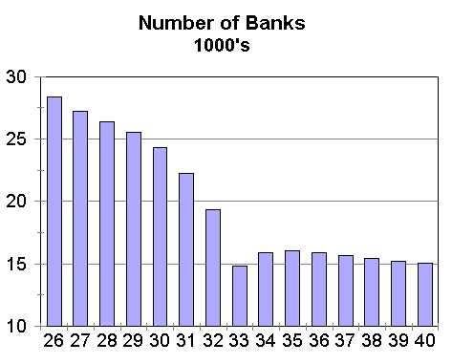
Banks Close
People Default on Loans
+
Banks have no money to give people
=
People Loose savings

Slide 7
1920’s Problems
Factories making Too Much, Farms growing too much
BANKS Have NO $$
PEOPLE LOST SAVINGS & JOBS
NO ONE TO HELP!
Factories Fire Workers (Don’t need them)
Farm Prices fall (Farmers can’t make $$)
Banks Close because they have no money: Loans have not been paid back, can’t give people their savings
Farmers & Factory Workers can’t pay back loans to Banks: DEFAULT!!

Slide 8
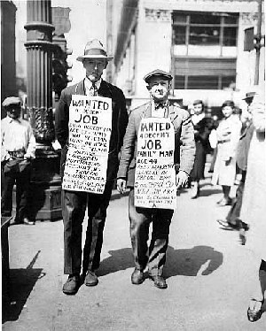
The Collapse
After losing money people could no longer buy products
No demand for products business went bankrupt
People lost their jobs
  25% unemployment
No money to pay back banks
  Lost their homes soon after

Slide 9
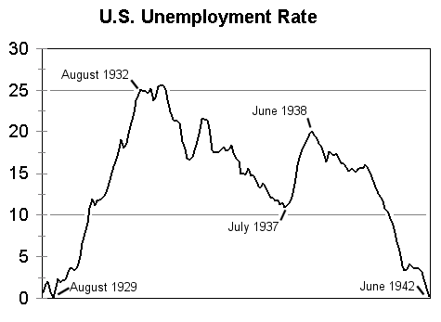
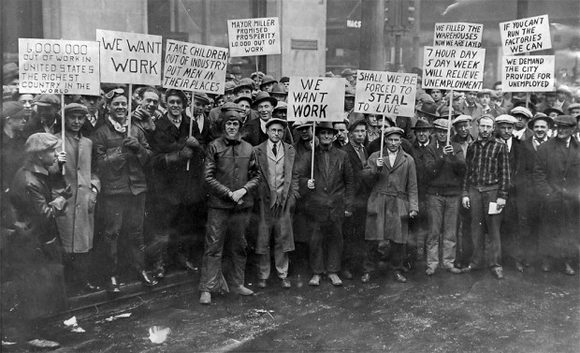

Slide 10
President Hoover
Hoover did not want to give out money scared people would become dependent
Hoover called a meeting of businessman
  Agreed to not drop wages
  Union agreed not to ask for raises
  Railroads were persuaded to invested 2 billion in repair and expansion
  Congress cut taxes to spend money on work programs

Slide 11
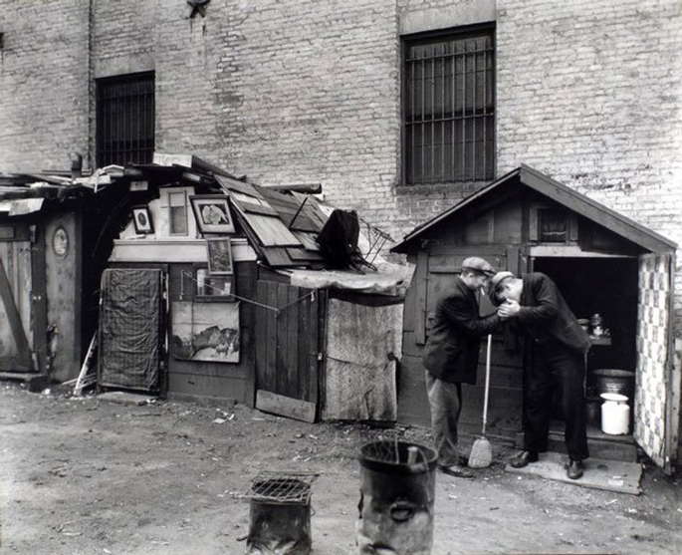
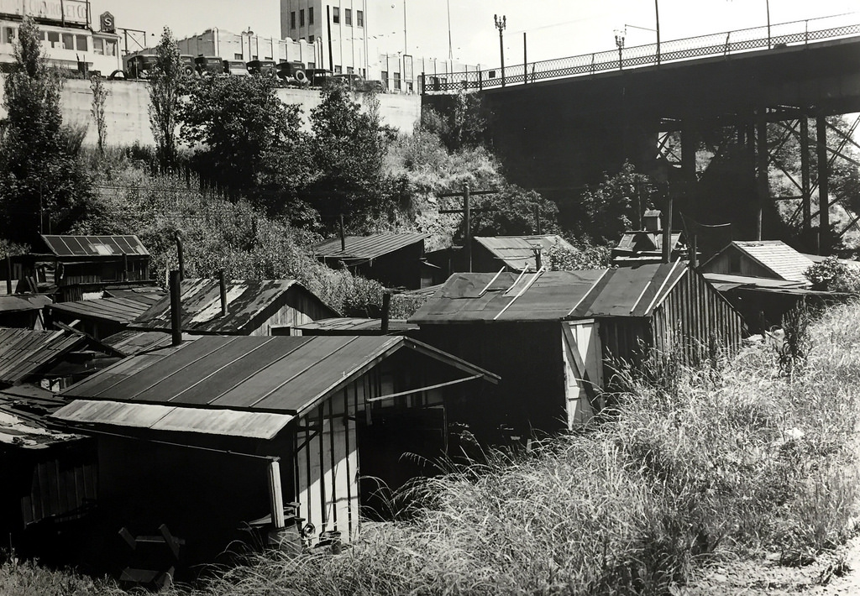
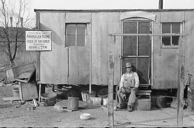
Hoover continued
Government put tariffs on imports hoping to increase profits
Government increased taxes to pay for work programs
  High prices and less money in economy
Hoover pushed government funding
Hoovervilles- collection of shacks for the newly homeless

Slide 12
North Carolina
1930-33 194 banks closed
Many lost their homes, business, and farms
Moved to cities looking for work
Textile, Furniture, and mills industries took huge hits
Many went hungry

Slide 13
Meanwhile in the Midwest part of the country …
The Dust Bowl
  The Midwest (Kansas, Nebraska, Oklahoma, etc) were experiencing a drought like they’ve never seen before
  Farmers lost their crops and lost their farms
This added to the problems and unemployment caused by the stock market crash

Slide 14
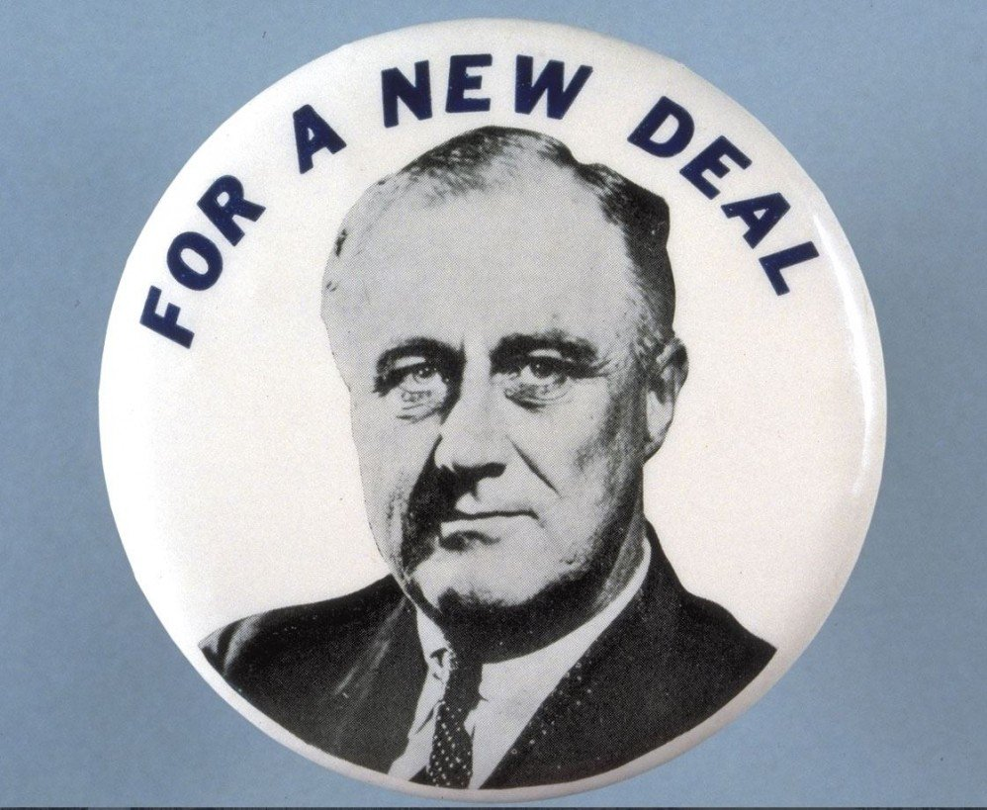
New Deal – President Roosevelt
Roosevelt took office under the promise of a New Deal
Fireside chats- made speeches over radio explaining his plans to get the U.S out of the Great Depression
1. Massive Reforms to prevent another depression
2. Relief for people without a job
3. recovery and a plan forward
Created the FDIC in which the government insured banks
1933 Emergency Banking act. National government had to step in to help

Slide 15
The Hundred Days
Period in which Congress and the President met and pushed through 15 bills
Known as the three “R’S”
  Relief for the hungry
  Recovery for agriculture and industry
  Reforms to change the economy

Slide 16
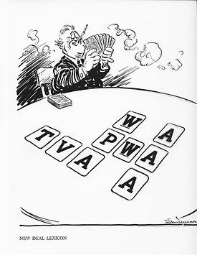
Roosevelt's alphabet
He set up many programs and laws to help America out of the great depression
Social-Security- paid for retirement and disabilities
Civilian Conservation Corps- planted trees, set up parks, and built bridges
Tennessee Valley Authority- built dams to provide power to southern states

Slide 18
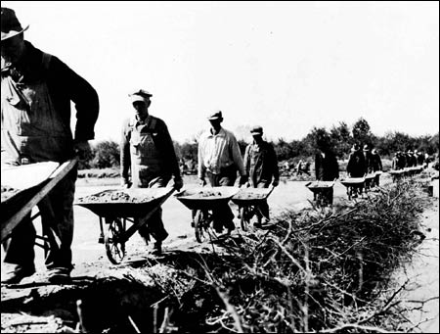
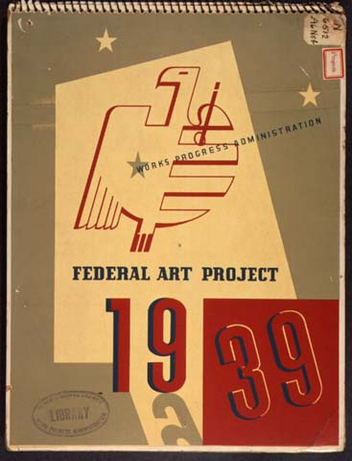
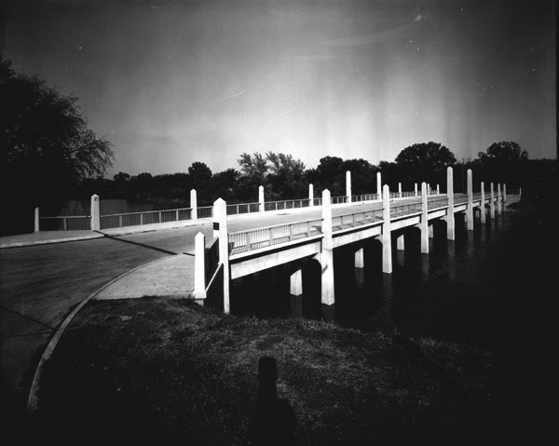
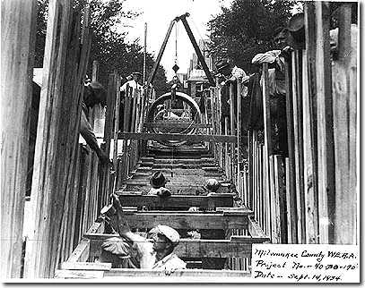
Fixing the Depression “New Deal”
D. Results- Did NOT end the Depression
1. Most of the Businessmen disliked New Deal
2. Gave country confidence
a. Ended banking crisis
b. Helped with some Jobs
c. Infrastructure (buildings, schools, bridges, electricity, artwork)

