Slide 1
Goal Setting
It’s time to start thinking about your future!
“Hard work beats talent when talent fails to work hard.”
- LeBron James

Slide 2
What’s Your Why?
what's Your WHY?

Slide 3
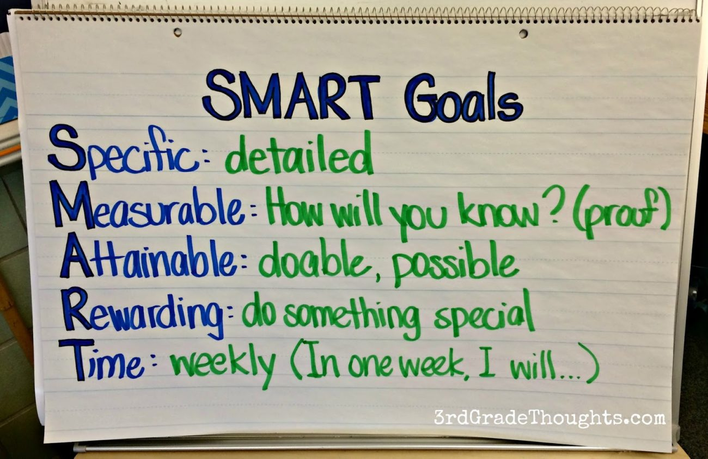
Your Turn
You need to complete both sides of this goal setting worksheet.
You will choose one Academic goal to write about and one personal goal to write about
Remember to make your goals SMART

