Slide 1
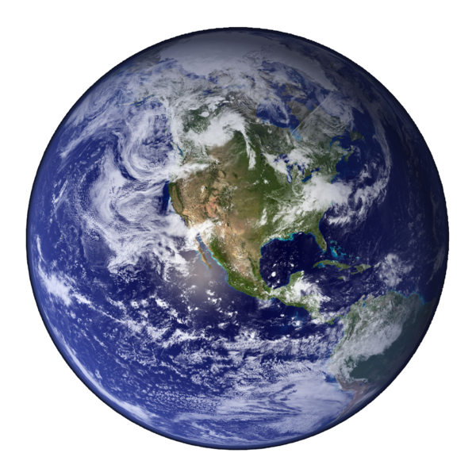
Basics of Geography

Slide 2
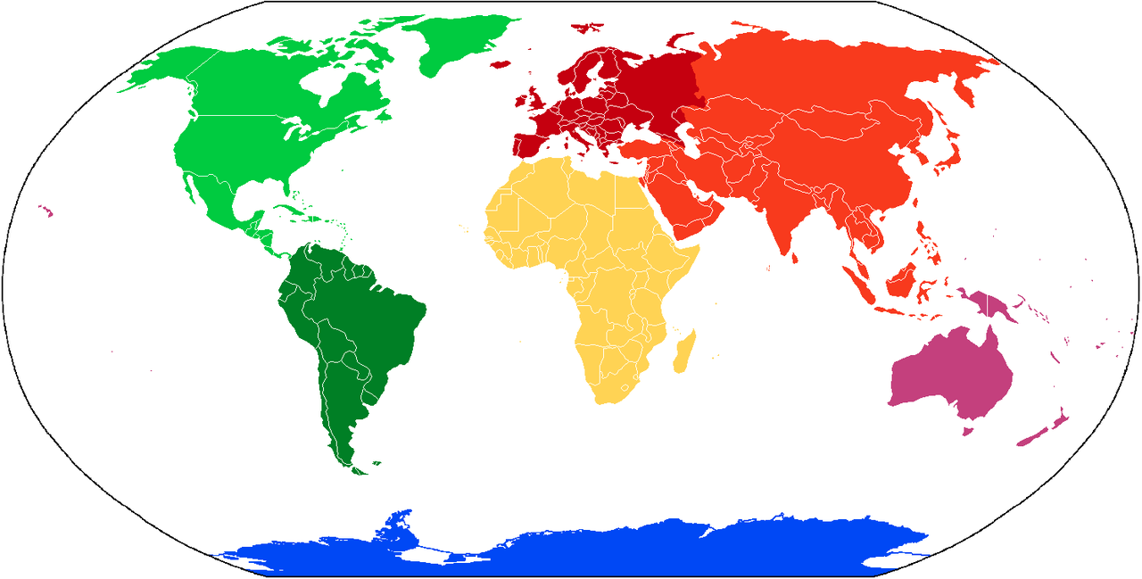
Location
Locations can be broken down by continent
Seven continents:
Africa
Antarctica
Asia
Australia
Europe
North America
South America
Notes:
Picture: "Continents vide couleurs" by User:Cogito ergo sumo - File:BlankMap-World.png. Licensed under Creative Commons Attribution-Share Alike 3.0 via Wikimedia Commons - http://commons.wikimedia.org/wiki/File:Continents_vide_couleurs.png#mediaviewer/File:Continents_vide_couleurs.png

Slide 3
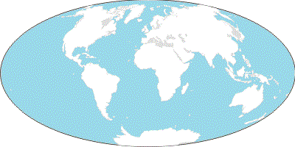
Continents and Oceans
Arctic Ocean
Eurasia
Europe
Asia
North America
Atlantic
Ocean
Pacific Ocean
Africa
Pacific Ocean
South America
Indian
Ocean
Australia
Southern Ocean
Antarctica

Slide 4
Lines of Latitude and Longitude
Arctic Circle
Tropic Circle
Prime Meridian
Equator
Tropic of Capricorn
Antarctic Circle

Slide 5
Physical and Political Maps
Physical Maps
Demonstrate landforms
EX: Mountains, lakes, rivers, oceans, deserts
Political Maps
Show government borders
EX: Countries, states, cities

Slide 6
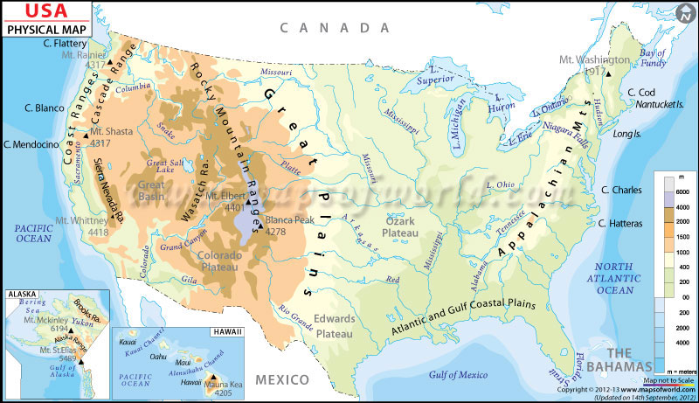
Physical Map example
What do you see? What don’t you see?

Slide 7
Political Map Example what do you see? What don’t you see? Compare and contrast the two types…

Slide 8
Another set of examples
Which type is this?
How about this one?

