Slide 1
Founding the 13 Colonies

Slide 2
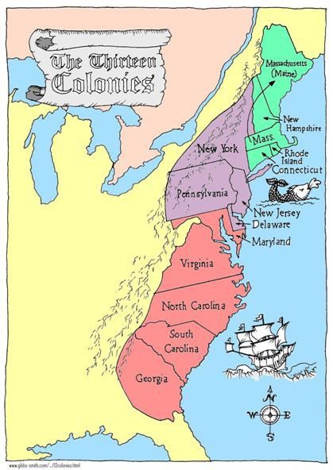
13 Colonies
New England: Massachusetts, New Hampshire, Rhode Island, Connecticut
MIddle: New York, New Jersey, Delaware, Pennsylvania
Southern: Maryland, Virginia, North Carolina, South Carolina, Georgia

Slide 3
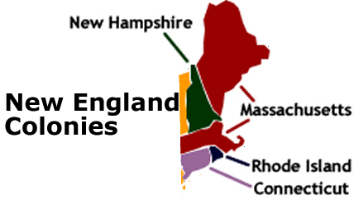
New England Colonies
Massachusetts
Rhode Island
Connecticut
New Hampshire

Slide 4
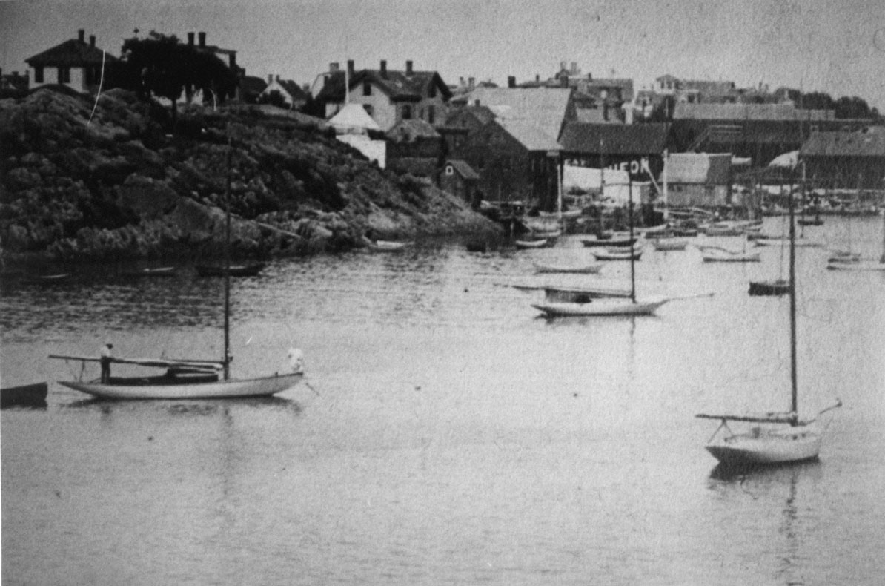
Economic Development of New England
Heavy reliance on the Atlantic Ocean
Fishing
Shipbuilding

Slide 5
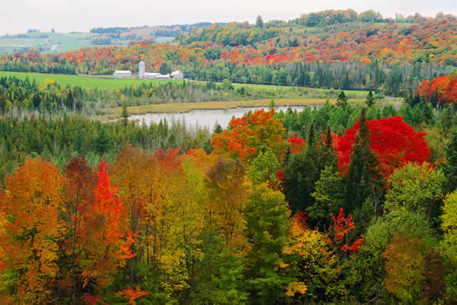
The People of New England
English settlers were the largest ethnic group.
Schooling was very important to New Englanders.
They believed that children should be able to read so they can read the Bible.
Massachusetts and New Hampshire passed a law about public education in 1647.
The law said every town with 50 families or more must have a school.

Slide 6
Plymouth Colony
The first successful colony in New England
Founded by Puritans
Puritans/Separatists were groups of people who did not agree with the Anglican Church in England.
In 1620 the Pilgrims left England and settled in Plymouth.
Created Mayflower compact to agree to be governed by laws.
William Bradford- Was elected Governor 1621-1656
The famous Thanksgiving of 1621

Slide 7
New England Colonies Statistics (fill in your G.O)
Colony Name | Date Founded | Reasons for founding | Leader/founder
Massachusetts | 1620 | Religious Freedom Pilgrims wanted democracy, too. | Pilgrims, Puritans (John Winthrop)
New. Hampshire | 1623 | To have better economic opportunities | John Mason
Rhode Island | 1636 | Religious and govt freedom from harsh rule of Puritans | Roger Williams
Connecticut | 1635 | Wanted more political and religious freedoms than Puritans allowed | Thomas Hooker

Slide 8
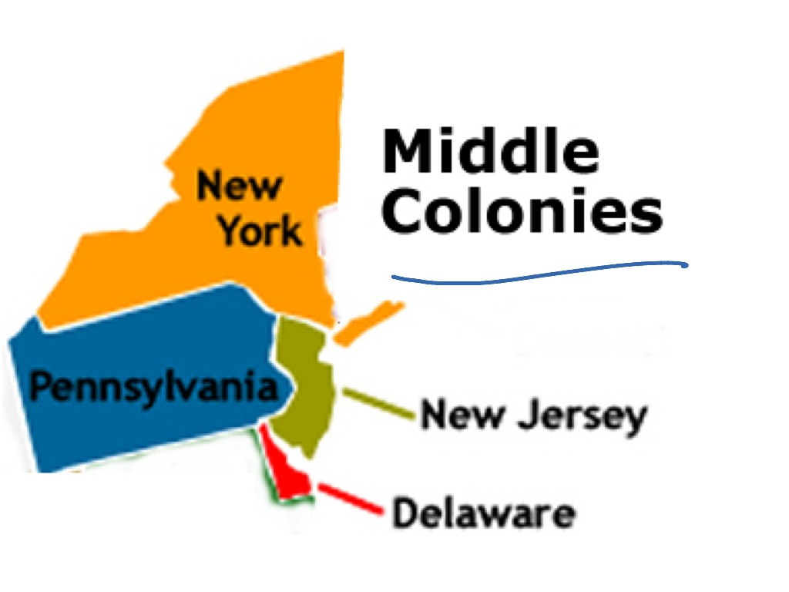
The Middle Colonies
New York
Pennsylvania
New Jersey
Delaware

Slide 9
Life in the middle colonies
Climate/Geography –
temperate in climate with warm summers and cold winters.
This area had good coastal harbors for shipping.
Climate and land were ideal for agriculture.
These colonies were known as the “breadbasket” because of the large amounts of barley, wheat, oats, and rye that were grown here.

Slide 10
church IN THE Middle Colonies
Religion –
Religion in the Middle Colonies was varied as no single religion seemed to dominate the entire region.
Religious tolerance attracted immigrants from a wide-range of foreign countries who practiced many different religions.
Quakers, Catholics, Jews, Lutherans and Presbyterians were among those religious groups that had significant numbers in the middle colonies.

Slide 11
$$$$$$$ in the middle colonies
Economy –
Mostly agricultural, farms in this region grew numerous kinds of crops, most notably grains and oats.
Logging, shipbuilding, textiles production, and papermaking were also important in the Middle Colonies.
Big cities such as Philadelphia and New York were major shipping hubs,
craftsmen such as blacksmiths, silversmiths, cobblers, wheelwrights, wigmakers, milliners, and others contributed to the economies of such cities.

Slide 12
Middle Colonies Statistics (fill in your G.O)
Colony Name | Date Founded | Reasons for founding | Leader/founder
New York | 1664 | Dutch wanted to make $. English took over to make $. | The Dutch Duke of York
Pennsylvania | 1682 | Offered religious freedom to all and rich farmland | William Penn (Quakers)
New Jersey | 1664 | Make money. Offered religious freedom, self-govt, | Lord Berkeley Sir George Carteret
Delaware | 1638 | To develop trade and agriculture, $ | Peter Minuit and the New Sweden Company

Slide 13
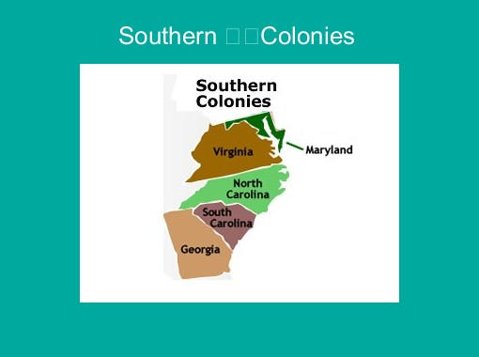
The Southern Colonies
Maryland
Virginia
North Carolina
South Carolina
Georgia

Slide 14
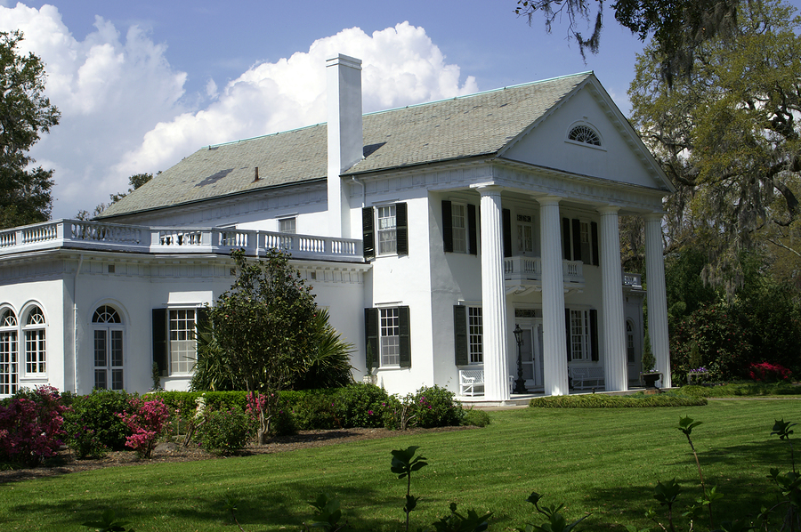
Economic Development of the South
Ideal for plantation crops like indigo, rice, and tobacco.
CASH CROPS
Plantations were largely self-sufficient, so very few large cities developed in the South.
Utilized Slaves to work the plantations
Warm/Hot climate with soil perfect for agriculture

Slide 15
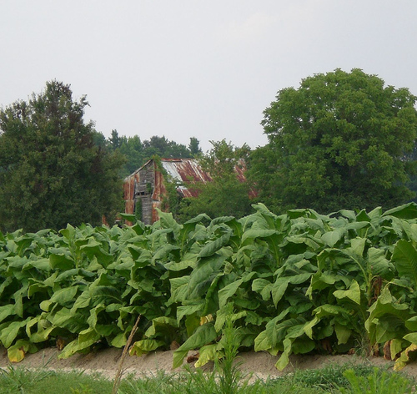
The Carolinas
Named for King Charles (Carolina Latin form of his name)
Governed by 8 proprietors.
North and South were split in 2 in 1719.
Indian wars and attacks by pirates (Blackbeard) made it hard to control.

Slide 16
Southern Colonies Statistics (fill in your G.O)
Colony Name | Date Founded | Reasons for founding | Leader/founder
Maryland | 1632 | to create a home for the catholics and to make $ | Cecil Calvert, Lord of Baltimore
Virginia | 1607 | to find gold/riches and make London Company wealthy | The London Company John Smith
North Carolina | 1663 (1729 split with South Carolina) | To make money by renting land to settlers | Eight Lords Proprietors
South Carolina | 1663 | To make money | Eight Lords Proprietors
Georgia | 1732 | Provided a place for English debtors to settle. | James Oglethorpe

