Slide 1
French and Indian War
Causes, Events, Effects

Slide 2
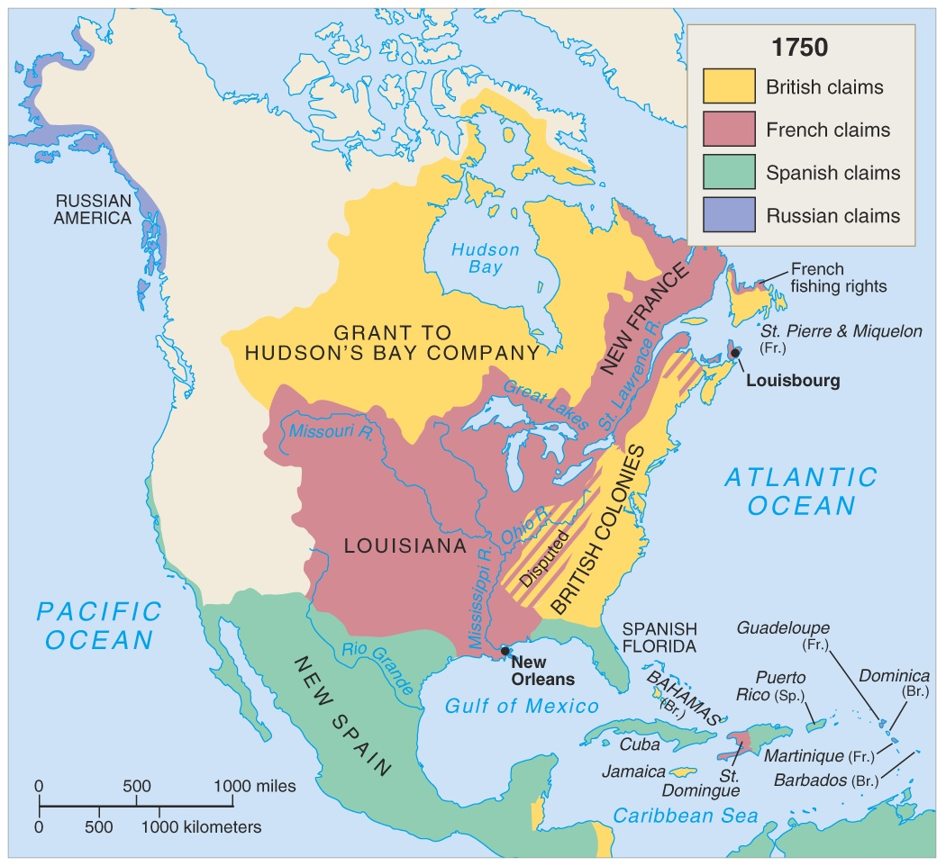
North America in 1750

Slide 3
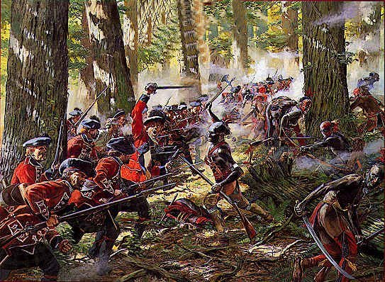
Definition
French and Indian War
Impact
Many colonists joined the British army to fight with their country
A conflict btwn England and France in North America over trading rights
Results
Reasons
France lost all territory in North America
The colonists were trading with the Indians and the French didn’t want to share their trade.
England and France were already at war in Europe.
New taxes are imposed on colonists to pay for war
Proclamation Line divides Colonial territory from Indian land

Slide 4
Despite Victory, Relations are Strained
British thought colonists did not provide enough support
War was long and costly
Britain had fought to protect them
Colonists shocked by the weakness of British military tactics
British would not allow colonial officers to lead their troops
French no longer held territory west of the Appalachians

Slide 5
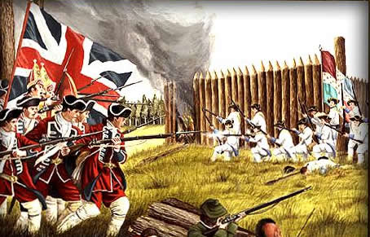
End of the War
How did the Treaty of Paris 1763 change the face of North America?
Do you think the British would have won the war without colonial support? Why?

