Slide 1
Exploration
Europe finds the New World

Slide 2
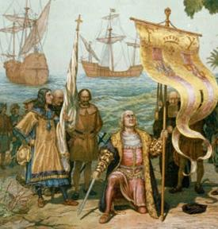
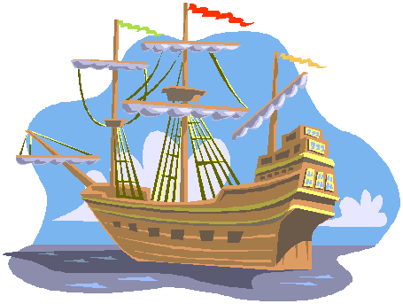

Slide 3
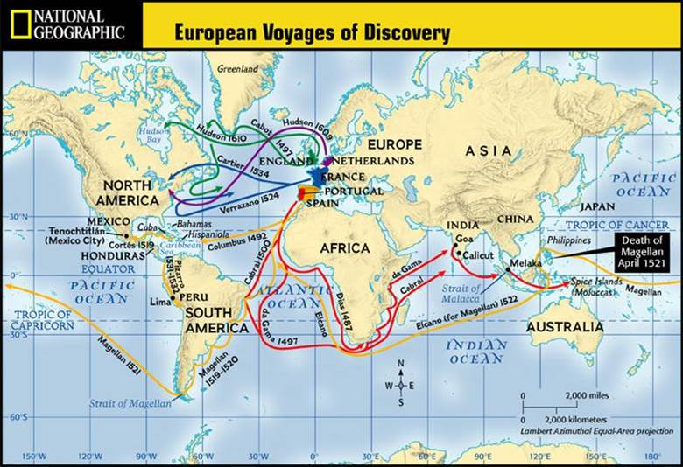
Is this map a primary or secondary source?

Slide 4
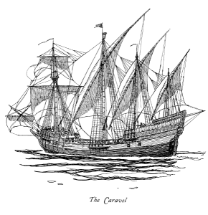
What were the new technologies that enabled explorations?
New and better ships
Triangle sails vs square sails
Compass, astrolabe, maps and other technologies
Notes:
8.2A Identify reasons for European exploration and colonization of North America.

Slide 5
Reasons for European Exploration
God: Many European countries wanted to spread Christianity and believed God would reward them for doing so.
Glory: People wanted to experience adventures and wanted to be viewed as celebrities. They want fame.
Gold: Tales of abundant gold lured many people. Kings/Queens would also reward explorers with riches if they discovered new land.
Competition: Leaders of countries wanted to have the largest empires and bragging rights over other countries.

Slide 6
The first G: God
As members of a universalizing religion, Europeans had always seen spreading Christianity as a good thing
Especially after the Reformation, competition will spring up
Colonization will become a race to convert native peoples to a particular brand of Christianity
Jesuits (Catholics) are some of the most active
Notes:
8.2A Identify reasons for European exploration and colonization of North America

Slide 7
The second G: Glory
focus on individual achievement
Also, individual kings wanted glory for their kingdoms, competition spreads
The Triumph of Fame, a Flemish tapestry from 1502.
Notes:
8.2A Identify reasons for European exploration and colonization of North America

Slide 8
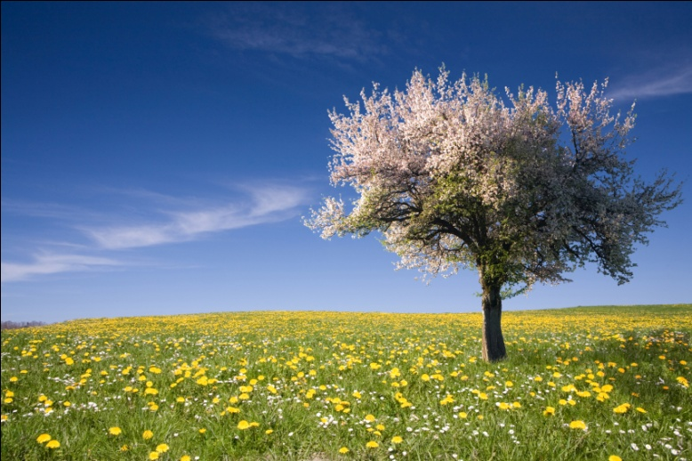
The 3rd G: Gold
WEALTH!!
mercantilism
1.Mercantilism is : Trade=money= power for the mother country
.The idea that there is only so much money in the world and we need top get our hands on it
Notes:
8.2A Identify reasons for European exploration and colonization of North America

Slide 9
Effects of European Exploration
Spanish Explorers claimed “New Spain” which is present day Mexico.
France set up Fur trade with the Native American in “New France which was Ohio River valley to the Mississippi River and up into Canada.
England (Great Britain) claimed the land along the Atlantic Ocean called it the thirteen colonies.

Slide 10
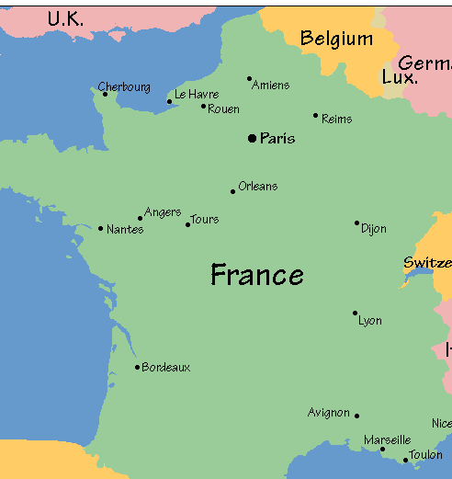
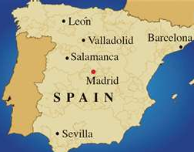
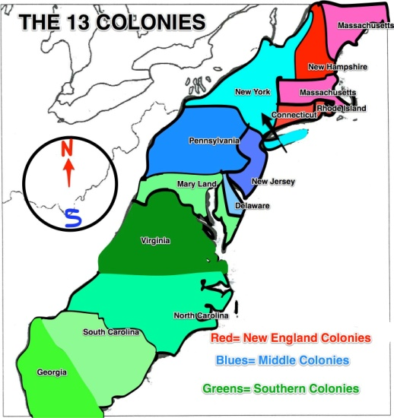
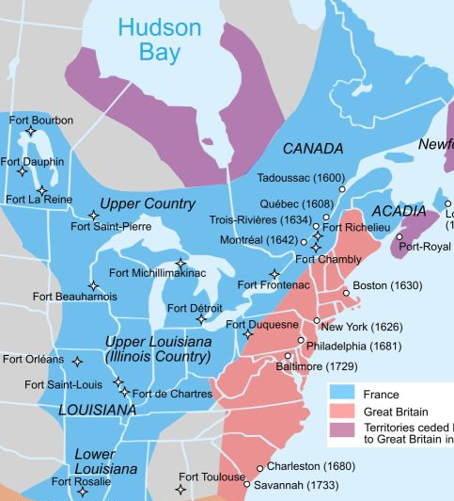
Major Powers Exploring
England/ Great Britain
France
Spain
as
as
Mexico, Texas, and the West Coast of U.S.
United States colonies along the East Coast
Ohio River Valley and Canada

Slide 11
Exploration led to colonization of the new world which shifted wealth and power away from Mediterranean region to the countries of Western Europe toward Spain, England and France.
Spain was enriched by American gold and silver
England rulers desired to stake a claim for lands and riches to match Spain’s wealth
France set up a fur trade with Native American to gain wealth.

Slide 12
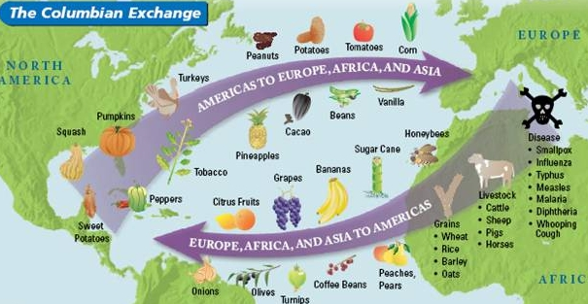

Slide 13
Mercantilism

