Slide 1
Exploration
Europe finds the New World

Slide 2
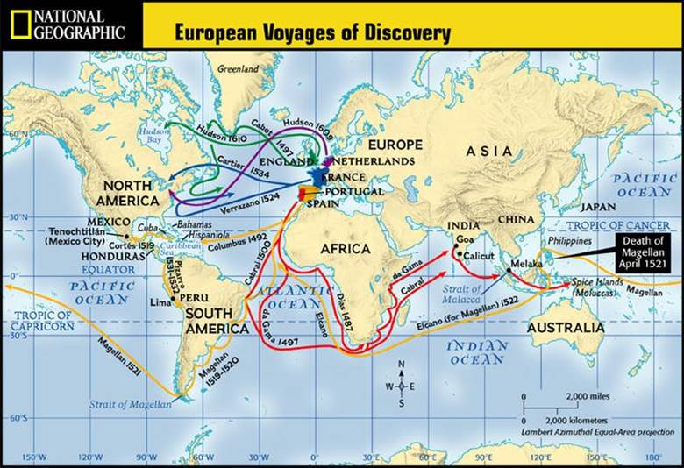
Is this map a primary or secondary source?

Slide 3
Reasons for European Exploration
God: Many European countries wanted to spread Christianity and believed God would reward them for doing so.
Glory: People wanted to experience adventures and wanted to be viewed as celebrities. They want fame.
Gold: Tales of abundant gold lured many people. Kings/Queens would also reward explorers with riches if they discovered new land.
Competition: Leaders of countries wanted to have the largest empires and bragging rights over other countries.

Slide 4
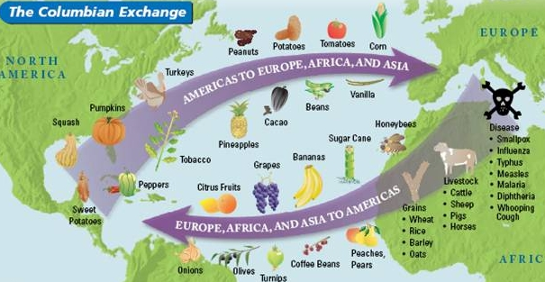

Slide 5
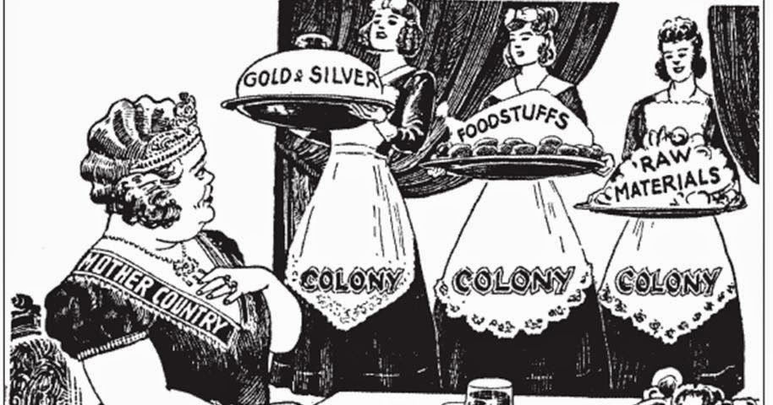
Mercantilism
1.Mercantilism is : Trade=money= power for the mother country

