Slide 1
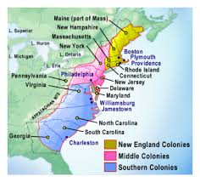
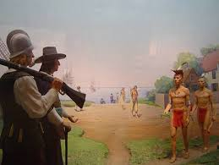
English Colonies in America

Slide 2
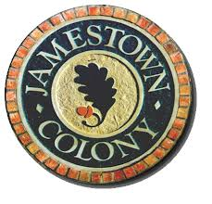
When did colonization Begin/End
The earliest English Colonies in America began in the 16th Century
The lost Colony of Roanoake was established in 1587
117 colonists led by Sir. Walter Raleigh
By 1590 all of the colonists had vanished. They were assumed to have died from disease, starvation, or indian attack
Jamestown 1607
James I issued a charter to the London Company
They landed in Cheaspeake Bay and traveled along the James river
Led by John Smith

Slide 3
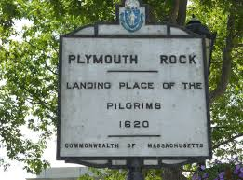
When did colonization Begin/End
New England Colonies
Plymouth 1620
Founded by Puritan Separatists seeking religious freedom
Natives taught them how to grow crops successfully
Middle Colonies
1680 Pennsylvania
Southern Colonies
Very agriculture driven
Carolinas split into north and south in 1729

Slide 4
What countries (geographical Region) were colonized and why?
Present Day United States of America
N.H., Mass., R.I., NY., NJ., Penn., DE, MD., VA., NC., SC., GA.,
Colonies were settled to Make $$$$$
Northern Colonies (Plymouth) were setteled by Colonists seeking religious freedom

