Slide 1
The Constitution
1787

Slide 2
Constitutional Convention
Delegates from all but RI meet in Philly in summer of 1787
RI doesn’t want to even discuss changes
b/c of unanimous clause, think nothing can be done w/o them
Delegates wanted freedom to voice honest opinions
Decided all discussions would remain secret!
The Constitutional Convention was called in order to make revisions to the Articles of Confederation
At the Constitutional Convention, representatives from each state begin to write a list of rules to replace the weak Articles of Confederation
Most delegates want a strong national government
However, they also wanted to have strong local governments

Slide 3
A plan to replace the AOC
After much debate two plans emerged as possible replacements for the Articles of Confederation.
1. The Virginia plan
Written by James Madison and the Virginia representatives at the meeting
2. The New Jersey Plan
Written by William Patterson of New Jersey

Slide 4
The Virginia Plan
Called for 3 branches of gov’t to ensure no one too much power
Legislative- write laws
Bicameral Legislature (CONGRESS)
2 houses
Reps based on population of states
Executive- enforce laws
Lead by chief executive
Judicial- interpret laws
Lead by high court
Plan leads to weeks of debate
Big states like it
More reps legislature
Small states don’t
Worried lg. states would end up ruling

Slide 5
The New Jersey Plan (small state plan)
NJ proposes alternate plan
Called for legislature only but w/…
1 state, 1 vote
Increased power for Congress to tax, & regulate trade
Very similar to Articles of Confederation w/ more power
all Treaties made and ratified under the authority of the United States shall be the supreme law of the respective States . . . and the Judiciary of the several States shall be bound thereby in their decisions, anything in the respective laws of the individual States to the contrary notwithstanding."

Slide 6
The Great Compromise
The Great Compromise combined these two plans creating our current legislature with two houses, one based on population and elected by the people and the other house allowing two senators per state being appointed by state legislatures.

Slide 7
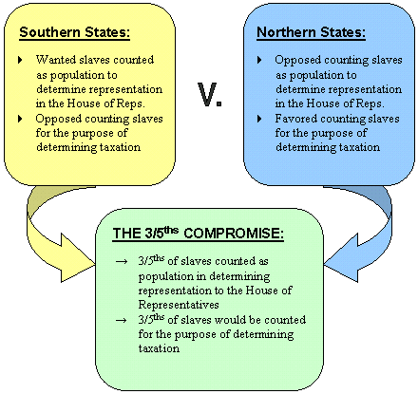
How do we determine population?
Once it was agreed upon that population would be a deciding factor for the House of Representatives in the legislature…..a big question needed to be answered….
WHAT DO WE DO ABOUT SLAVES??
South wants slaves counted for reps, but not for taxes
North argues can’t have it both ways
Enter the 3/5’s COMPROMISE
For every 5 slaves a person owned, they could
Count three of them toward population.

Slide 8
Next steps…….the states need to approve …
Anti-Federalists
Federalists
People who did want to ratify (approve) the Constitution
People such as George Mason and Patrick Henry
They knew they needed a stronger central government but thought the convention went to far!!
Weakening of the States- feared too strong central government would hurt individual rights, so the states power needed to be increased
No Bill of Rights- no protection of basic freedoms
President or King- fear that the President could easily act like a king
The Federalists supported the Constitution as it was.
People such as James Madison, Alexander Hamilton, and John Jay
The Federalists wrote the “Federalist Papers” to encourage states to approve the Constitution
Papers included 85 newspaper essays
For the Constitution to last, it had to have powers not given to the government under the Articles of Confederation

Slide 9
Creation of the Constitution
The Constitution needed 9 of the 13 states to approve it in order for it to become law
Both sides (the Federalists and the Anti-Federalists) tried to convince people their side was correct
After great debate, the states finally ratified the Constitution…only if there was a Bill of Rights

Slide 11
The Constitution
“We the People of the United States, in Order to form a more perfect Union, establish Justice, insure domestic Tranquility, provide for the common defence, promote the general Welfare, and secure the Blessings of Liberty to ourselves and our Posterity, do ordain and establish this Constitution for the United States of America”

Slide 12
How it is broken down…
PREAMBLE: Introduction to the Constitution; it lists the six basic principles for our government (text on previous slide)
ARTICLES: The articles laying out the framework for our government (seven)
AMENDMENTS: Changes made to the Constitution after the initial ratification

Slide 13
Guiding principles
These six principles are the ideas and standards that our government is based on and functions according to.
Popular Sovereignty (government gets its power FROM the PEOPLE)
Limited Government (protection of individual and states rights)
Separation of Powers (branches of government)
Checks and Balances (no one branch has too much power)
Judicial Review (supreme court reviews laws)
Federalism
With these in mind, why did the framers include the Preamble in the Constitution?

Slide 14
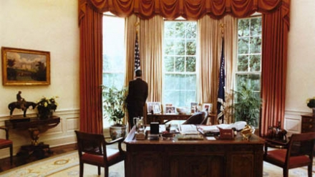
Popular soverenignty
People are the ONLY source of government’s power
“We the People…do ordain and establish”
Government’s power comes from the people, and the people have given government permission to govern by the constitution

Slide 15
Checks and Balances
Checks and balances is a way for the government to give each branch power over the other two
The idea is to keep one branch from becoming more powerful than the others and controlling government
Why would the framers want to ensure one branch did not become too powerful?

Slide 16
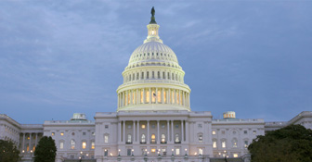
Limited Government
The idea that government is not all powerful and can be limited
Government can do only those things the PEOPLE have given it the power to do
States that government must obey the law
The entire Constitution is a statement of Limited Government

Slide 17
Judicial Review
Has the power of the courts to determine whether what government does is in compliance with what the Constitution says
Basically, if a case is brought to the courts questioning a law or some other government action, the court must look at the law and determine if it violates the Constitution
If it does, the courts declare it unconstitutional, and the law or action is thrown out and no longer in effect (Null and Void)

Slide 18
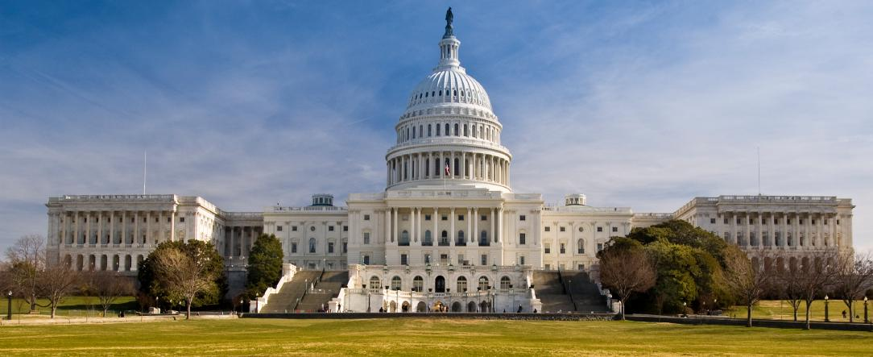
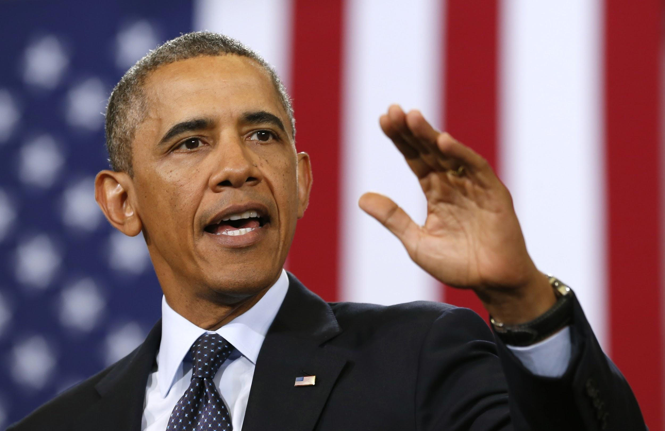
Articles of Constitution
Article I
Describes Legislative branch
Writes laws
Article II
Describes Executive branch
Enforces laws

Slide 19
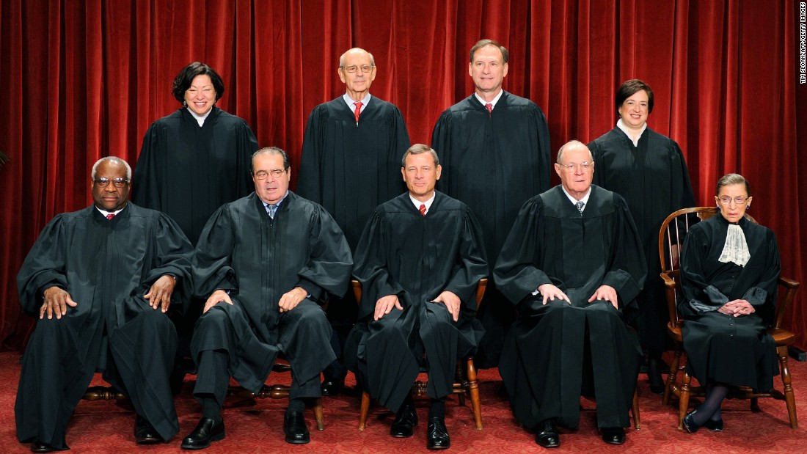
Article III
Describes Judicial Branch
Interpret the law
Article IV
States have the power to make and carry out their own laws

Slide 20
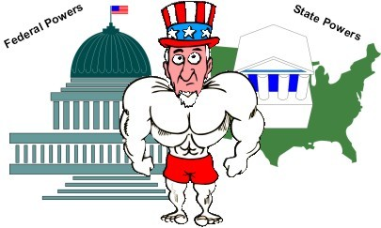
Article V
Amendments (changes) can be made
need ⅔ vote of Congress
An amendment is a change to the Constitution or clarification of something in the Constitution
Article VI
Constitution is the SUPREME LAW of the land

Slide 21
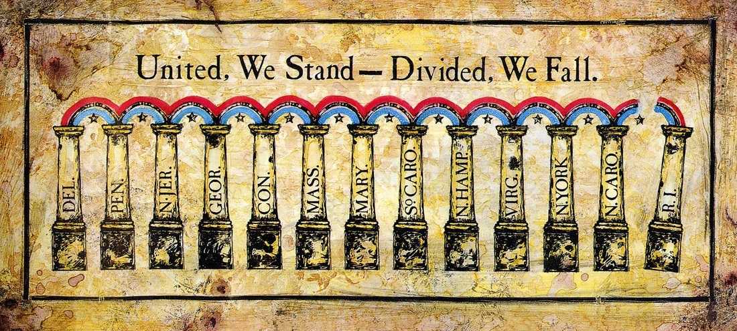
Article VII
Describes ratification (approval) process
9 of 13 states needed to ratify

