Slide 1

European Exploration
& Colonization
**Spanish**
**French**
**British**

Slide 2
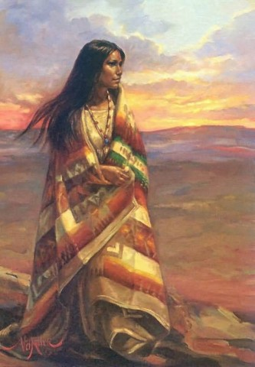

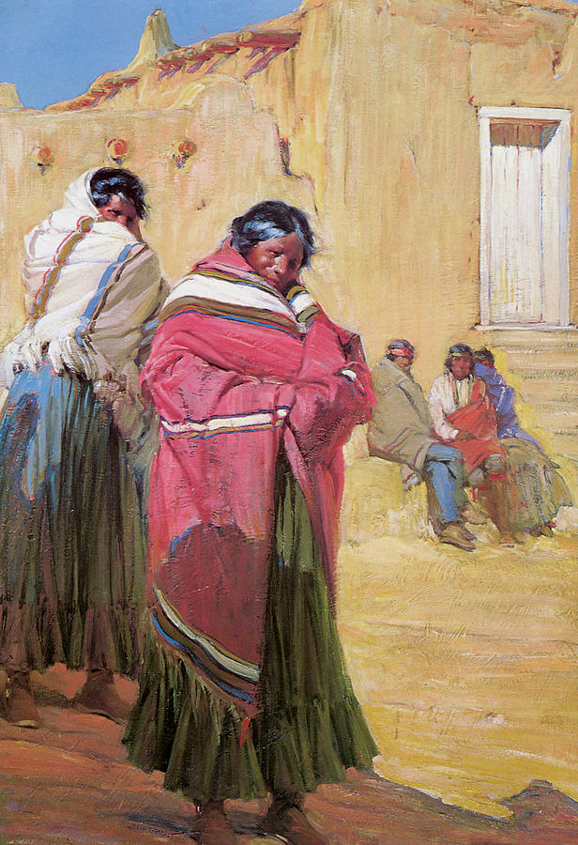
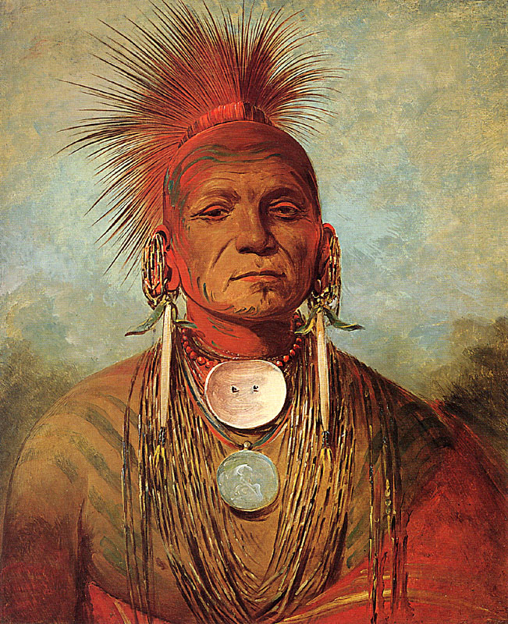
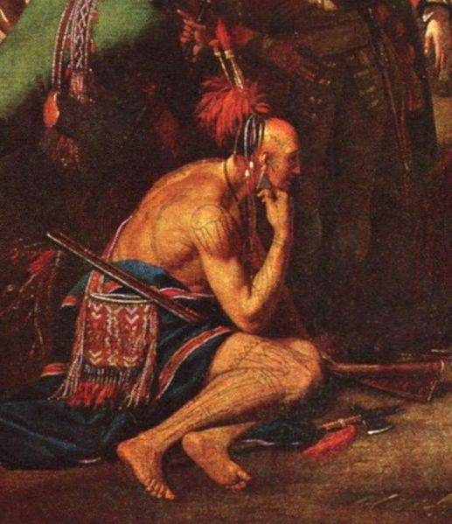
Review for Context:
Renn/Reformation/Exploration
      CHANGE!
      People started questioning tradition
      Causes of Exploration?
      European Explorers discovered the New World
      Columbian Exchange
      Mercantilism

Slide 3

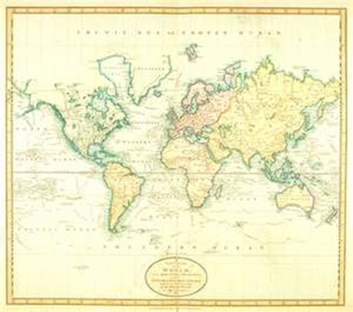
The Age of Exploration
The Age of Exploration was a time of discovery of new lands, innovations in cartography (map making) and trade, and the exchange of cultures and ideas from distant lands.

Slide 4
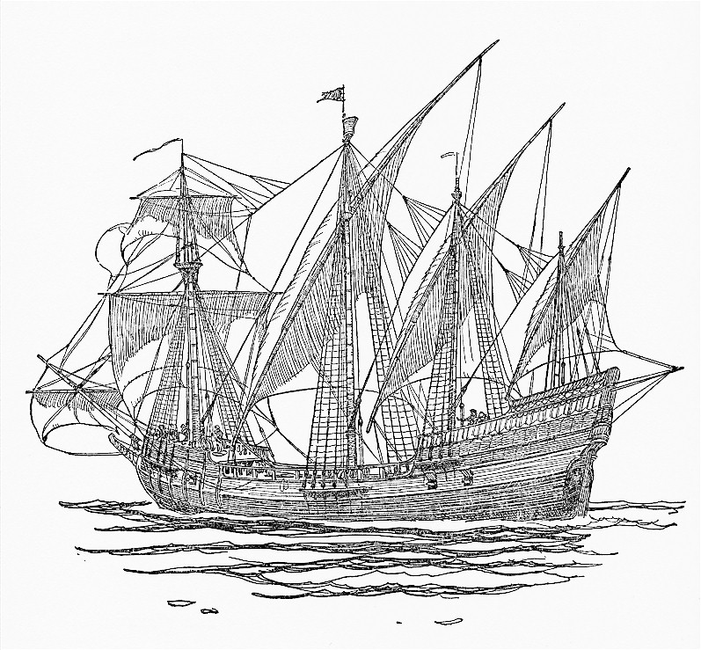
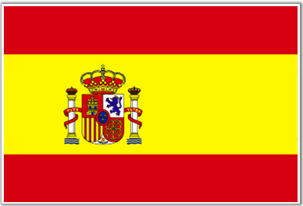
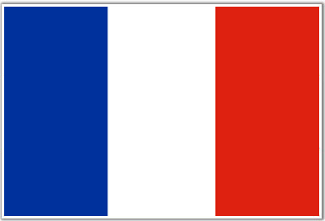


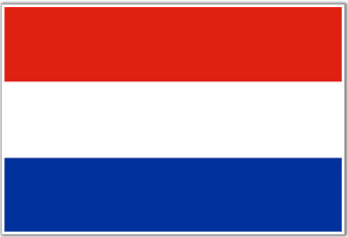
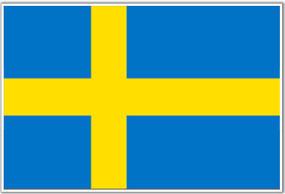
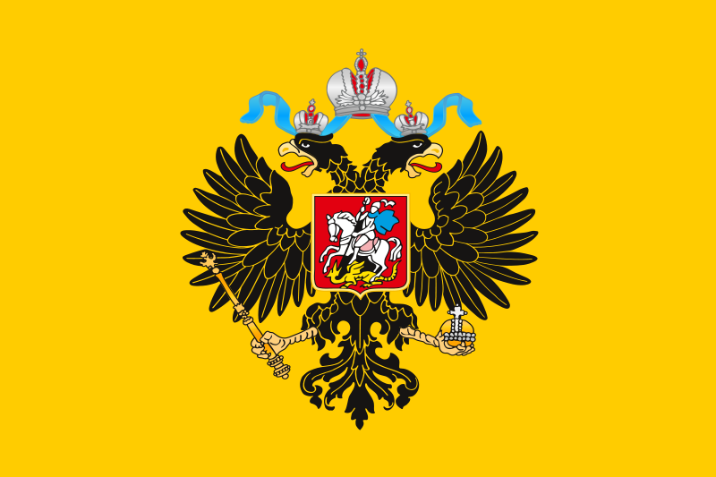
The Renaissance and the Age of Exploration
Spain
During the Renaissance, a desire for new trade routes to Asia led to an Age of Exploration:
  Led by Spain explorers found new trade routes, colonies, & people to Christianize
  Colonization in North America led to destruction of Native American culture, permanent settlements for Europeans, & wealth for these nations
Fleur de lys
France
Great Britain
Netherlands
Czar Russia
Sweden

Slide 5
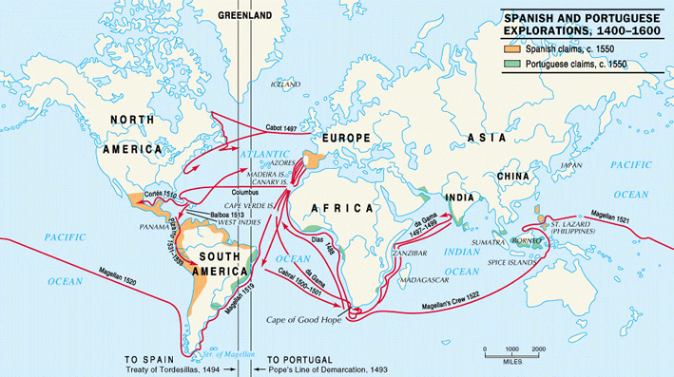
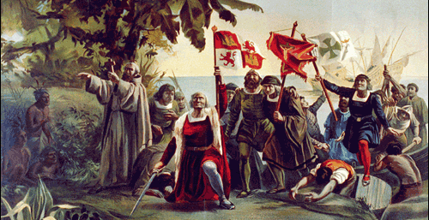
Four Key Explorers
Christopher Columbus “discovered” America looking for a westward route to India

Slide 6
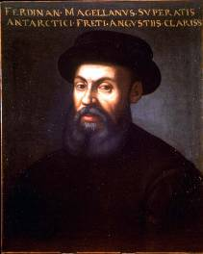
Four Key Explorers
Ferdinand Magellan led the first expedition to circumnavigate the globe

Slide 7
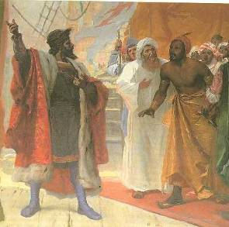
Four Key Explorers
Vasco da Gama “found” India by sailing around Africa

Slide 8
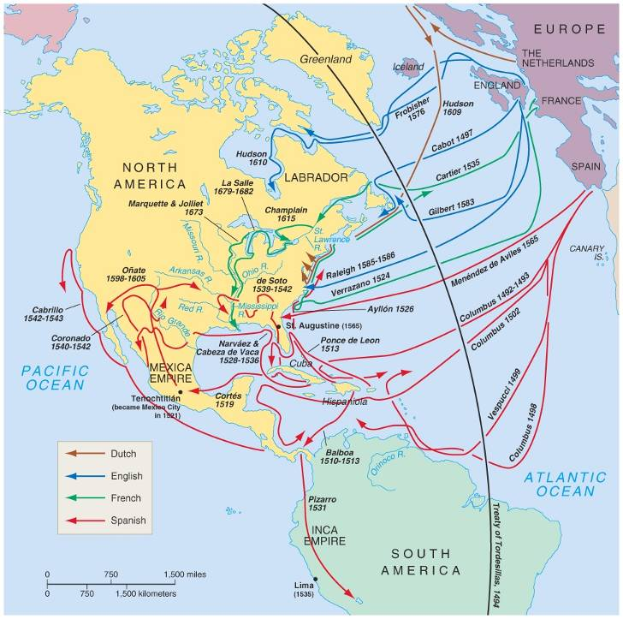
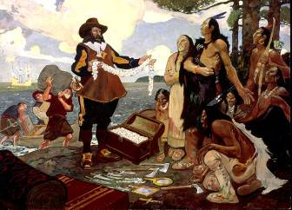
Four Key Explorers
Samuel Champlain founded Québec after failing to find a NW passage to India

Slide 9
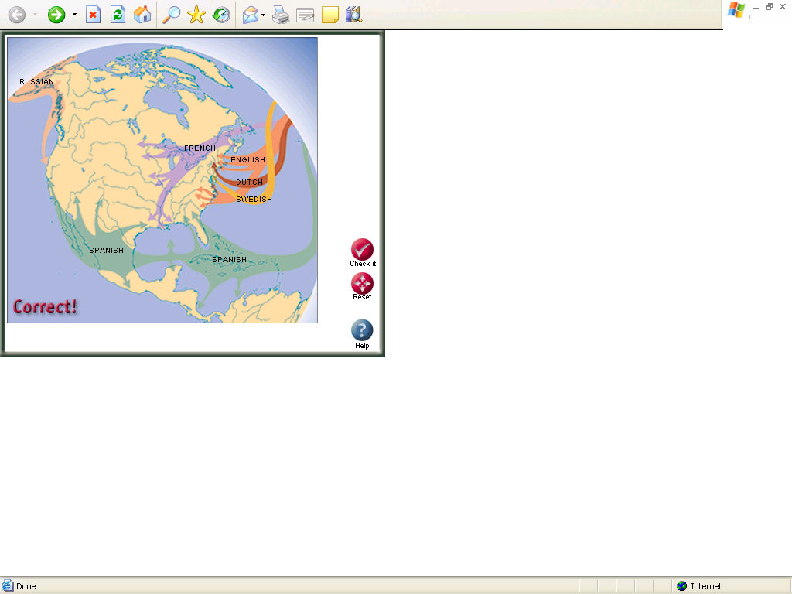
Exploration led to permanent European colonies
Spain
Fleur de lys
France
Great Britain
Netherlands
Czar Russia
Sweden

Slide 10
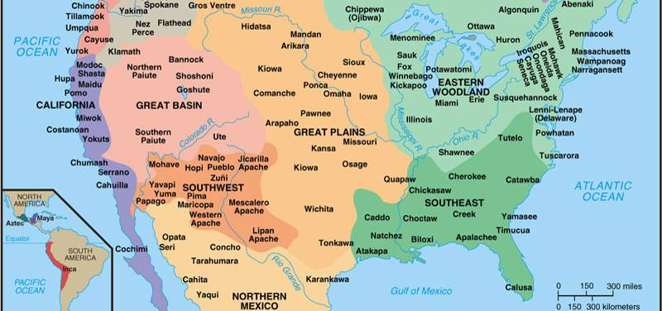
Before Columbus’ explored America in 1492, North America was dominated North American Indians:
America Before the Europeans
Before Columbus’ explored America in 1492, North America was dominated North American Indians:

Slide 11
The European Colonies
in America:
Spain
France
Great Britain
The MOTHER COUNTRIES
Spain
France
Great Britain
England

Slide 12
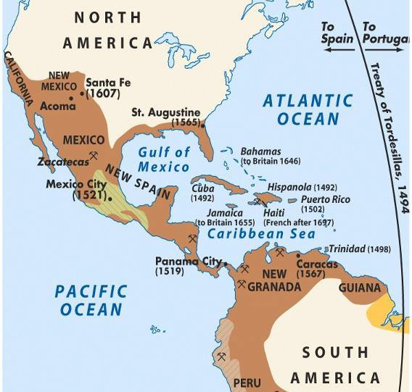
Spanish Colonies in North America
Spain
Fleur de lys
France
Great Britain
Netherlands
Czar Russia
Sweden

Slide 13
Spanish Colonies in North America
Motivations:
  After Columbus, Spain dominated Central & South America & the SE & SW sections of North America
  Spanish conquistadors explored in search of gold & silver
  Missionaries converted Native Americans to Catholicism
Spain
Fleur de lys
France
Great Britain
Netherlands
Czar Russia
Sweden

Slide 14
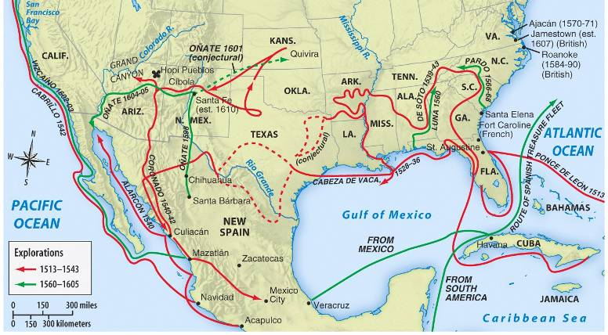
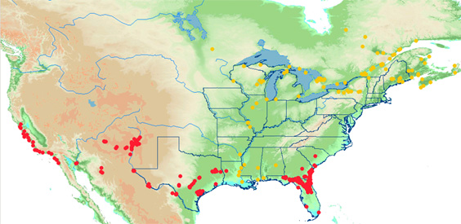
The Spanish government encouraged converting Native Americans & establishing missions

Slide 15
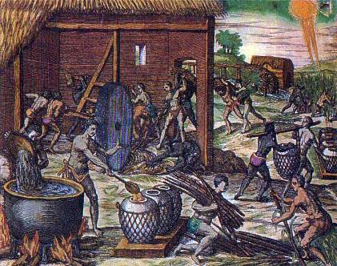

Spanish Colonies in North America
Government: Royal control
  Spanish colonies were funded & controlled by the monarch
  Viceroys were sent to the colonies to serve as governors
Economy: Desire for wealth
  Used Native American & African slave labor to mine gold & silver
  Built encomiendas (plantations) to farm cash crops
Spain
Fleur de lys
France
Great Britain
Netherlands
Czar Russia
Sweden

Slide 16
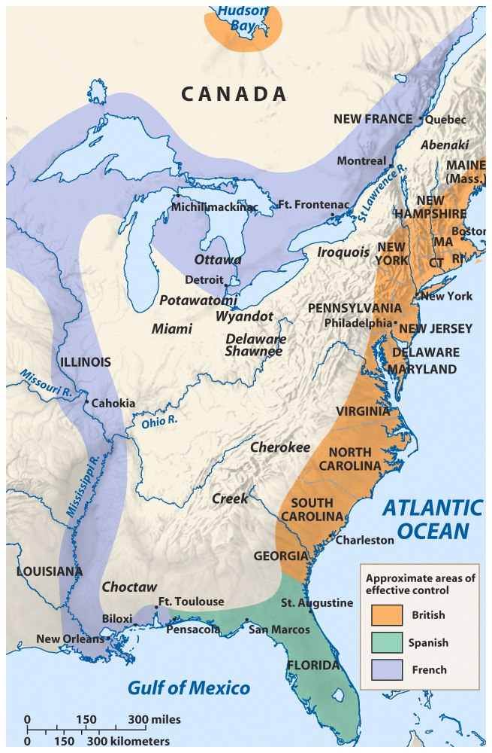
French Colonies in North America
Spain
Fleur de lys
France
Great Britain
Netherlands
Czar Russia
Sweden

Slide 17
French Colonies in North America
Motivations:
  After Champlain’s attempt to
  find a NW passage through Canada, he founded Québec
  The “French crescent” included Canada, the Mississippi River, & New Orleans
  Missionaries converted Native Americans to Catholicism
Spain
Fleur de lys
France
Great Britain
Netherlands
Czar Russia
Sweden

Slide 18
Like Spain, the French gov’t encouraged converting Native Americans & establishing missions

Slide 19
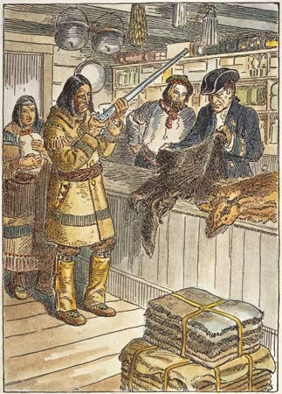
French Colonies in North America
Government:
  The French colonies were strictly controlled by royal governors
Economy: Desire for fur trade;
  Most French colonists profited from the fur trade, small-scale farming, or lumbering
Society: Because the French needed furs, they were the most friendly with the local Native Americans
Spain
Fleur de lys
France
Great Britain
Netherlands
Czar Russia
Sweden

Slide 20
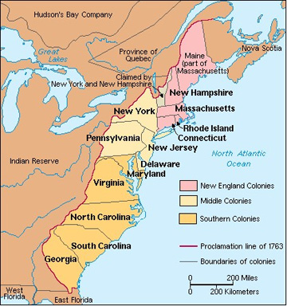
British Colonies in North America
Spain
Fleur de lys
France
Great Britain
Netherlands
Czar Russia
Sweden

Slide 21
British Colonies in North America
Motivations: Many different reasons
  Economic: Escape poverty or gain wealth from cash crop farming
  Religious: For religious freedom & to escape religious persecution
  Political: Fear during the English Civil War & Glorious Revolution
As a result, the British colonies
were very different from each other & were never very unified
Spain
Fleur de lys
France
Great Britain
Netherlands
Czar Russia
Sweden

Slide 22
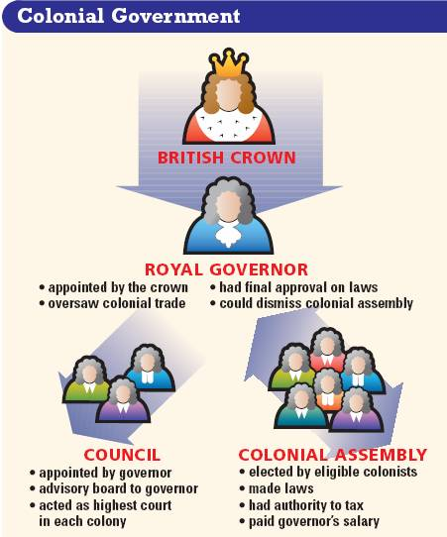
British Colonies in North America
Government:
  The colonies differed from the French & Spanish because the British gov’t had no desire to create a centralized empire in America
  Britain developed a policy called salutary neglect in which the colonists could create local laws & taxes in their colonial assemblies
  Royal governors were sent by the king, but they had little power
Spain
Fleur de lys
France
Great Britain
Netherlands
Czar Russia
Sweden

Slide 23
British Colonies in North America
Economy & Society:
  The societies & economies
  of the British colonies were dependent upon the reasons people settled
Spain
Fleur de lys
France
Great Britain
Netherlands
Czar Russia
Sweden

Slide 24
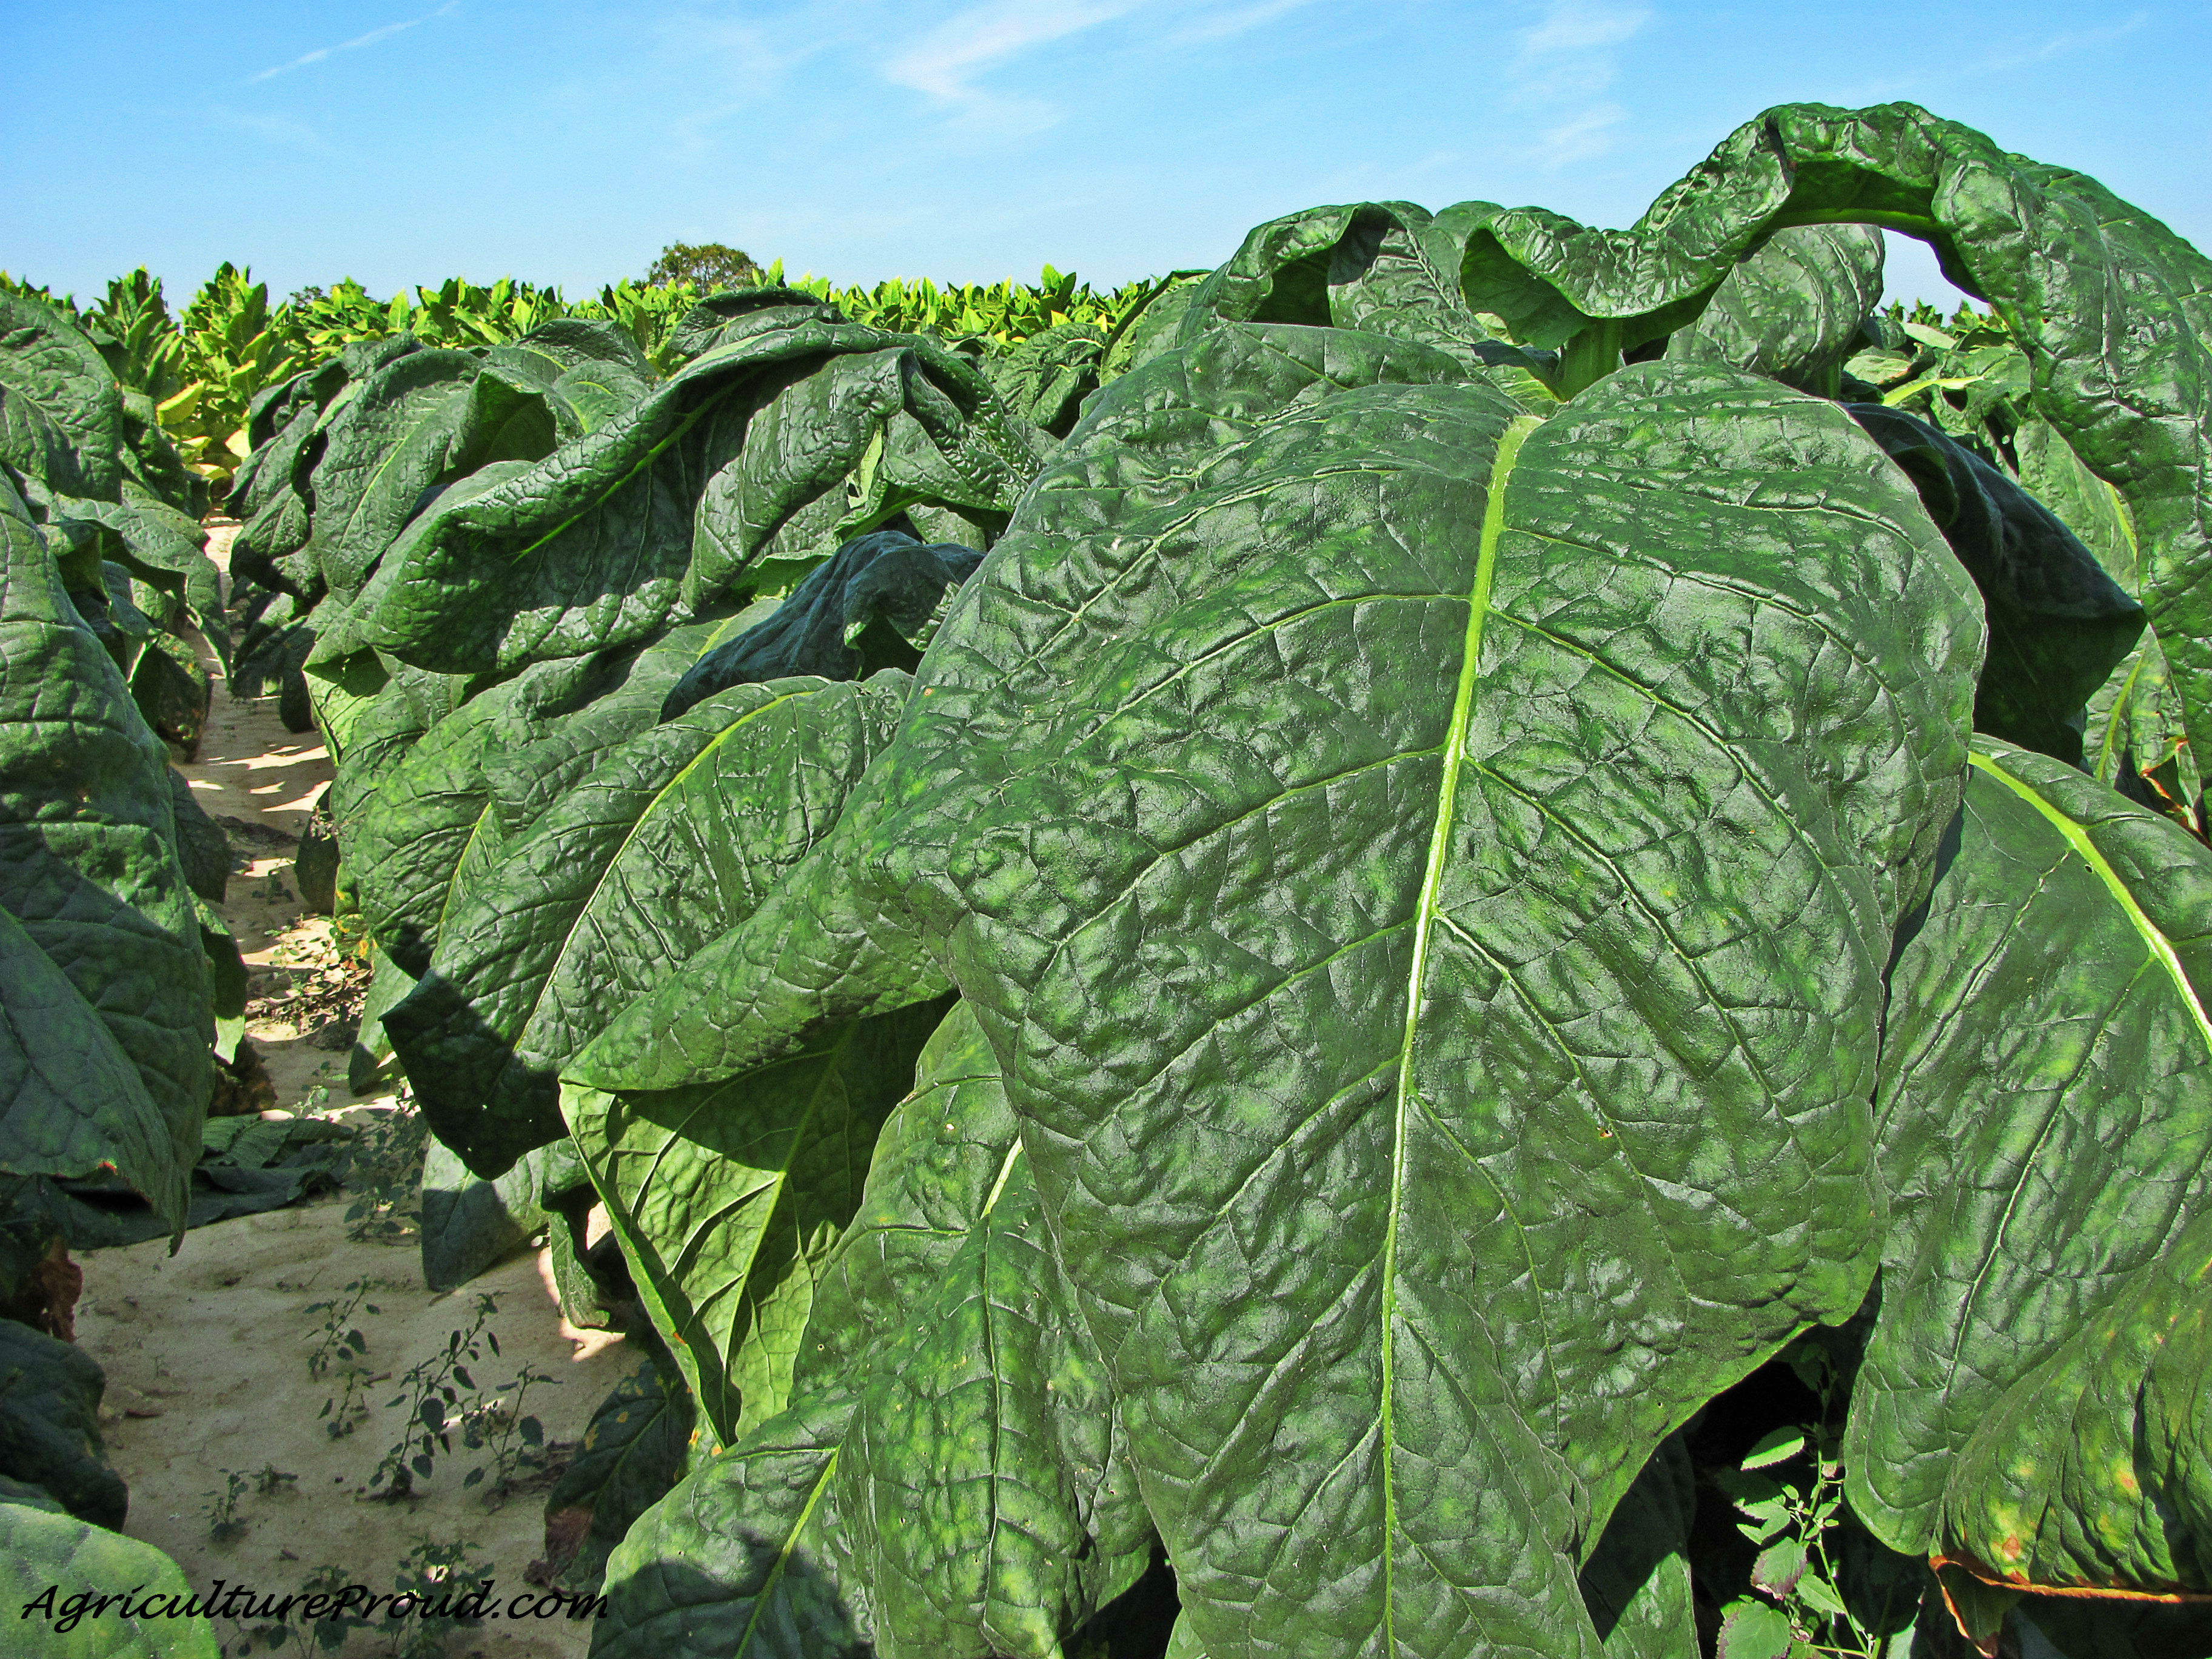

British Colonies in North America
Southern colonies, like Virginia, had cash crop economies, large gaps between rich & poor farmers, & slave labor
Spain
Fleur de lys
France
Great Britain
Netherlands
Czar Russia
Sweden

Slide 25
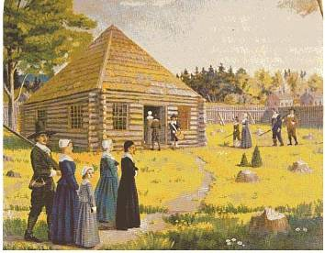
British Colonies in North America
New England colonies, like Massachusetts, were closely connected by religion & families & were mostly subsistence farmers
Spain
Fleur de lys
France
Great Britain
Netherlands
Czar Russia
Sweden

Slide 26
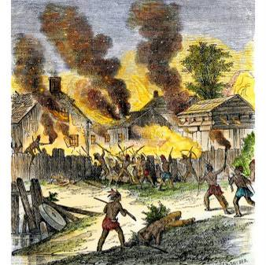
British Colonies in North America
Unlike the Spanish & French, the British colonists never made sweeping attempts to convert, marry, or trade with local Native Americans, although conflicts over land were common
Spain
Fleur de lys
France
Great Britain
Netherlands
Czar Russia
Sweden

