Slide 1
The Cold War 1945 – 1980’s (ish)

Slide 2
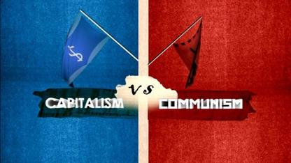
The Cold War
The Cold War – Tensions between the United States and the Soviet Union over the 2nd half of the 20th Century
Differences in ideologies:
The U.S. economic system – Capitalism – Means of production are privately owned an operated and there is free trade
The U.S.S.R. economic system – Communism – Means of production are controlled by the government, and there is no private property

Slide 3
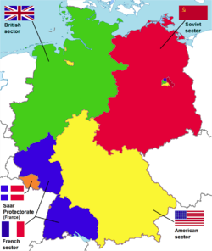
Post WWII Germany
Yalta Conference 1945
In closing months of WWII… Big 3 meet
Brits and US feel USSR still threat
Make a deal w/ Stalin
USSR would help in Pacific Theatre in exchange for…
Division of Germany into “4 Zones”
France, Great Britain, US, & USSR each control a quarter
Supposed to be temporary
Until “Democratic” elections occur and new German Gov’t can decide down future

Slide 4
Post War Goals
Soviet Goals
Spread Communism in other European countries
Using Eastern Europe for industry, new raw materials, and markets
American Goals
Encourage Democracy
Gain access to raw materials and new markets
Establish the Marshall Plan
After WWII, the U.S. was the richest and most powerful country in the world and only lost 400,000 people
The USSR had to rebuild – There was a lot of fighting done on their territory

Slide 5
Now everyone rushes to gain “Control” of territory in Europe
Stalin breaks Yalta promises for free elections
Takes Eastern Germany, Poland, Czech, Hungary, Romania, Yugoslavia, Bulgaria, & Albania
Forces them under Soviet Control
Est. Communist gov’ts in each
Creates an ‘Iron Curtain’ separating Eastern and Western Europe
Goal was to…
Intimidate the other nations into submission
Birth of the United Nations
Based on…
Wilson’s “League of Nations”
World governing body; a congress if you will

Slide 6
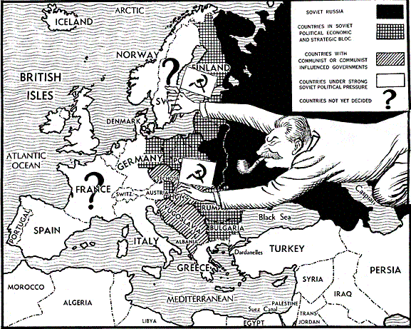
The Iron Curtain
The Iron Curtain – The division of Western Europe (Democratic) and Eastern Europe (Communist)
This phrase was coined by Winston Churchill in a 1946 speech

Slide 7
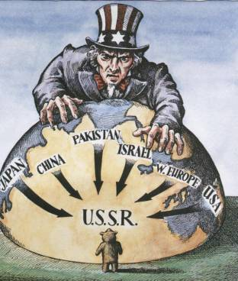
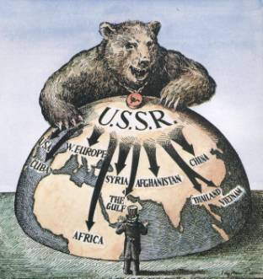
American Policy
President Truman adopted the policy of Containment – Block USSR influence and stop the spread of communism
1947 – Truman Doctrine – Supported countries that rejected communism – Provided $400 Million of aid to Turkey and Greece
1948 – Marshall Plan – $12.5 Billion program to rebuild countries of Western Countries – Aimed to promote democracy

Slide 8
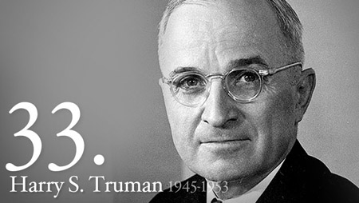
Truman Doctrine
“ I believe that it must be the policy of the United States to support free peoples who are resisting attempted subjugation by armed minorities or outside pressures.”
~US President Harry S. Truman-
Speaking to Congress in March 1947
The Truman Doctrine was
A commitment made by the United States to…
STOP the spread of Communism in any country that does not want it.
The USSR was imposing its’ Communist ideas on smaller, weaker nations

Slide 9
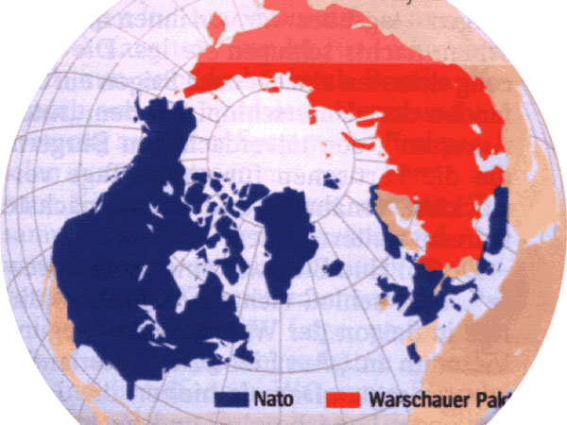
Alliances are made one again
NATO-
North Atlantic Treaty Organization
“an armed attack against one or more of the member nations shall be considered an attack against all.”
The Warsaw Pact
Soviet answer to NATO…
Same thing as NATO,
but a Communist version
Communist Alliance System
The United States and Russia are now clearly the two superpowers of the World

Slide 10
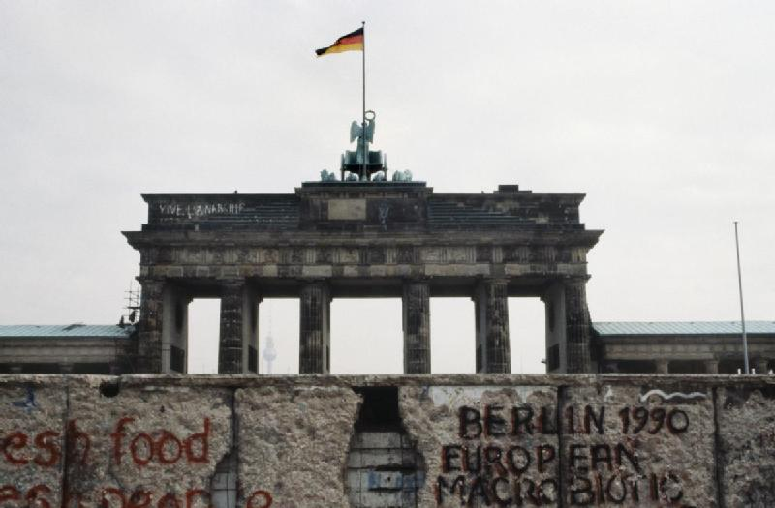
The Berlin Wall
The Berlin Wall was built in 1961 and divided East (Communist) and West (Democratic) Berlin
It was a great symbol of the Cold War
The wall prevented people from fleeing to either side of Berlin –
This increased tensions between Communist and Democratic countries in Europe

