Slide 1
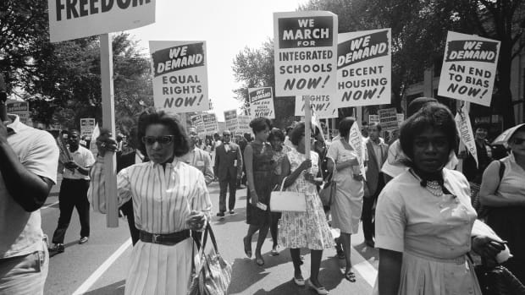
The Civil Rights Movement 1950’s and 1960’s

Slide 2
Background: How did we get here?
The Fourteenth Amendment = all citizens equal protection under the law.
The Fifteenth Amendment = the right to vote shall not be denied on the basis of race.
SO WHAT’S THE PROBLEM? EVERYONE IS EQUAL RIGHT??
Well … remember …
Plessy vs. Ferguson said separate institutions are okay if they are equal.
Jim Crow laws required that Blacks have separate facilities.
Poll taxes, literacy tests, etc

Slide 3
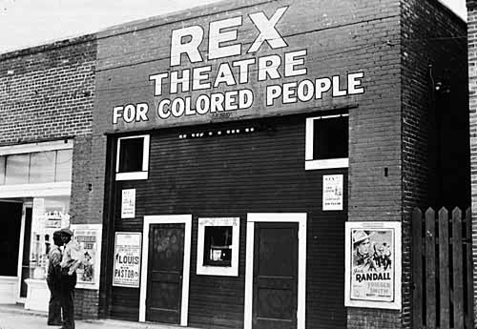
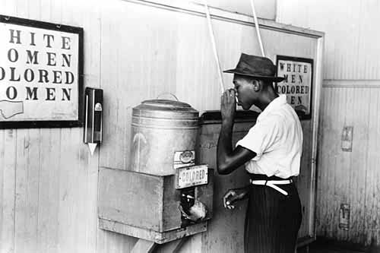
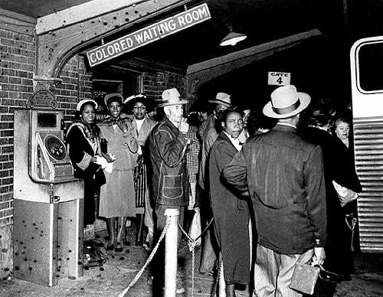
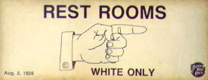

Slide 4
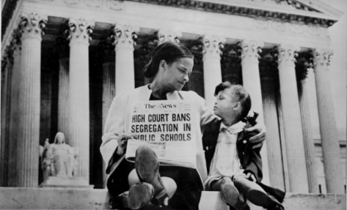
Separate IS NOT equal…
Brown vs Board of Education:
1954 Supreme Court case
ruled that racial segregation of children in public schools was unconstitutional.
one of the cornerstones of the civil rights movement.
helped establish the precedent that “separate-but-equal” education and other services were not, in fact, equal at all.

Slide 5
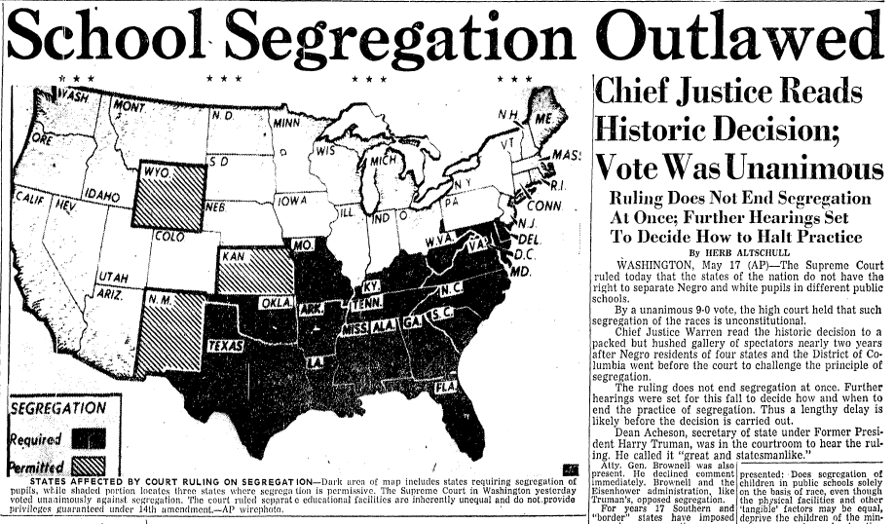

Slide 6
The story of Emmett Till … the tide is turning
In 1955, 13-year-old Emmett Till of Chicago was visiting his cousins in Mississippi.
Allegedly at a store he whistled at a white woman. That night, the woman's husband and his brother kidnapped Emmett, tortured him, shot him, and dumped him in the river.
His body was so disfigured that his mom only recognized him from a ring on his finger.
His mom decided to have an open casket to show the world the racism that was going on.
Emmett's death was one of the main motivations for the Civil Rights Movement. Many people who before were able to turn a blind eye to the discrimination and gruesome violence taking place in the South could no longer do it.

Slide 7
Meanwhile in Alabama 1955
A few months after Emmett Till, Rosa Parks was arrested in Alabama for refusing to move her seat on the bus. It was a violation of segregation laws
Following the arrest, she and other women from her church asked Martin Luther King, Jr., a relatively unknown pastor, to lead a bus boycott.
So many blacks refused to ride the bus that the system almost went bankrupt. Months later, buses were finally integrated.

Slide 8
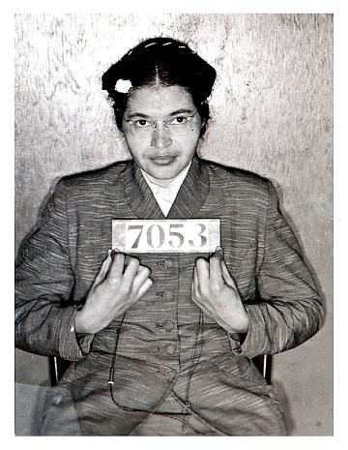
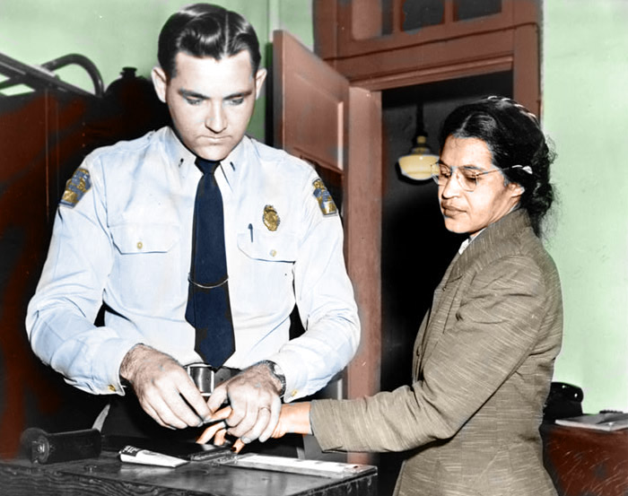
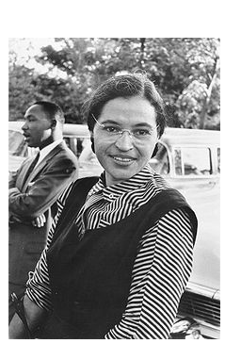
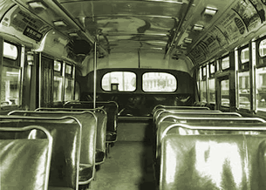

Slide 9
Little Rock - 1957
The Little Rock Nine were a group of nine black students who enrolled at all-white Central High School in Little Rock, Arkansas.
This was a test of Brown v. Board of Education.
On September 4, 1957, the first day of classes at Central High, Governor Orval Faubus called in the Arkansas National Guard to block the black students’ entry into the high school.
Later that month, President Dwight D. Eisenhower sent in federal troops to escort the Little Rock Nine into the school.

Slide 10
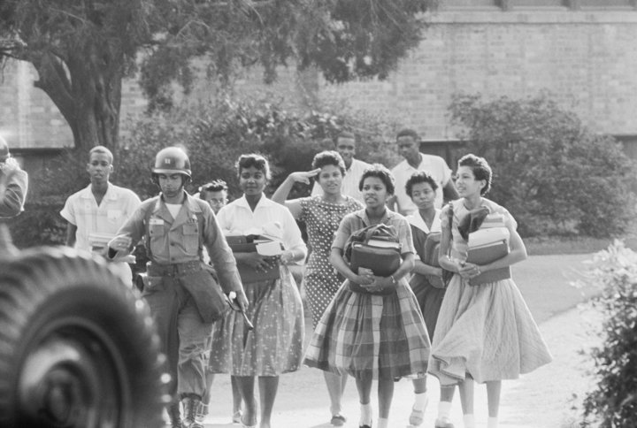
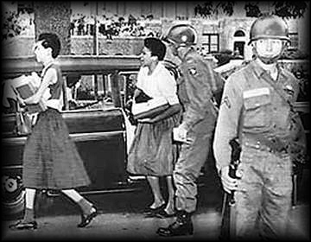
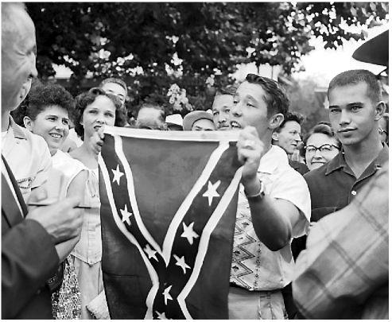
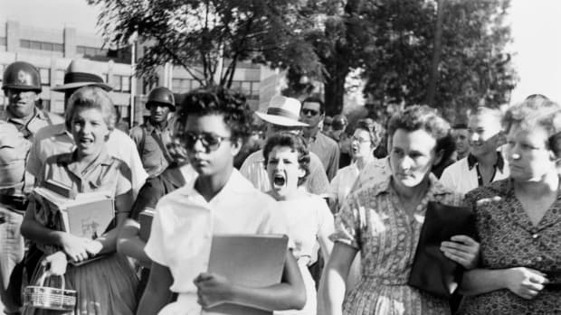

Slide 11
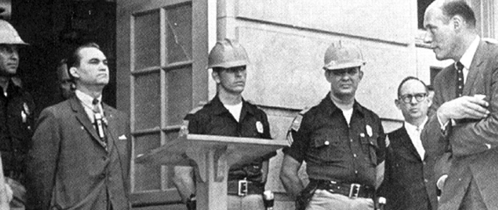
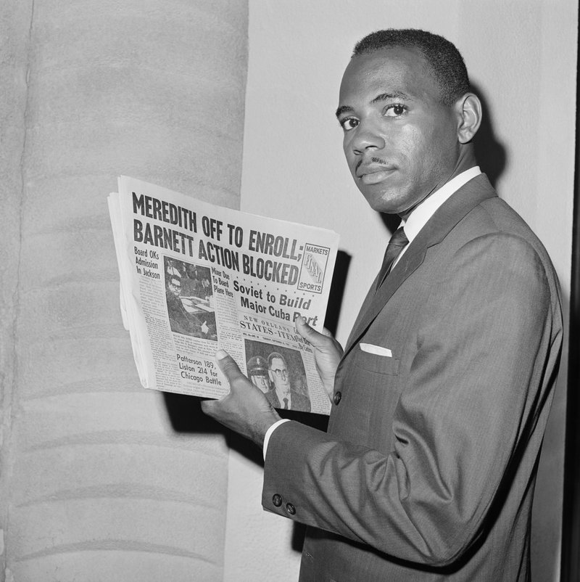
Colleges and Universities fight against desegregation as well
University of Mississippi (1962)
Federal court orders Mississippi to integrate
Gov and police stop James Meredith
Feds send troops and riots erupt… 2 killed
Meredith allowed to attend but troops need to protect him until he graduates.
University of Alabama (June 1963)
Gov. George Wallace vows “I will stand in the schoolhouse door” to stop integration
Feds send troops… Wallace backs down

Slide 12
Civil Rights Movement reaches a boiling point
Birmingham, Alabama (Spring 1963). Mlk targets Birmingham for next desegregation protests.
100’s arrested… including king. As expected….Protests turn violent and it was All caught on t.v cameras…
Police dogs attacking peaceful protests
Fire hoses used to knock protestors down Then the NAACP field secretary murdered…
Forces JFK. TO MAKE A CALL
Declares all Americans must be served in all public places and no discrimination in jobs
White America” saw 500 kids get arrested and attacked with dogs.

Slide 13
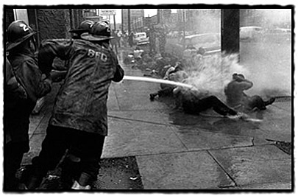
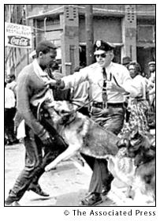
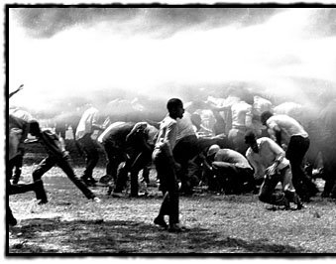
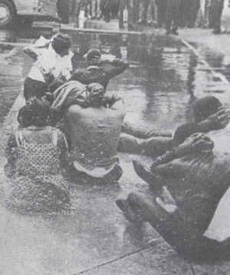

Slide 14
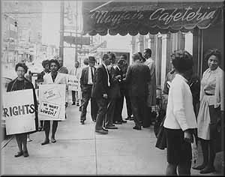
Sit ins
They were led by college students
Dress in your Sunday best.
Be respectful to employees and police.
Do not resist arrest, Do not fight back!
Remember journalists are everywhere!
Other students were ready to take your place if you had a class to attend.

Slide 15
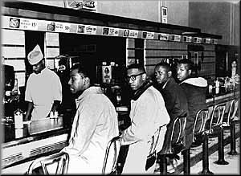
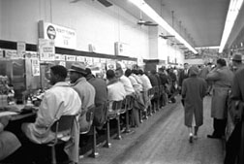
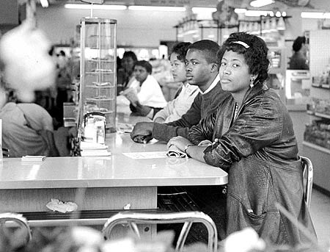
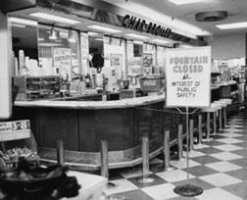

Slide 16
March on Washington – August 1963
President Kennedy wanted civil rights bill.
The event was highlighted by King's "I Have a Dream" speech in front of the Lincoln Memorial. August 28, 1963
The March on Washington was a massive protest march that occurred in August 1963, when some 250,000 people gathered in front of the Lincoln Memorial
Asking for equal rights, equal pay, etc.

Slide 17
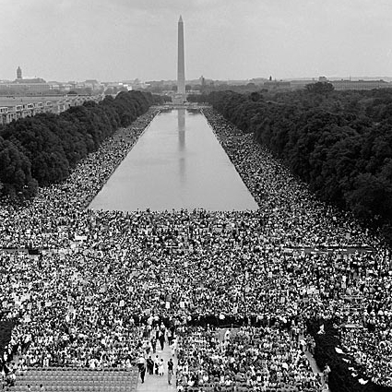
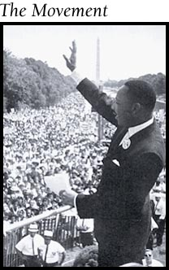
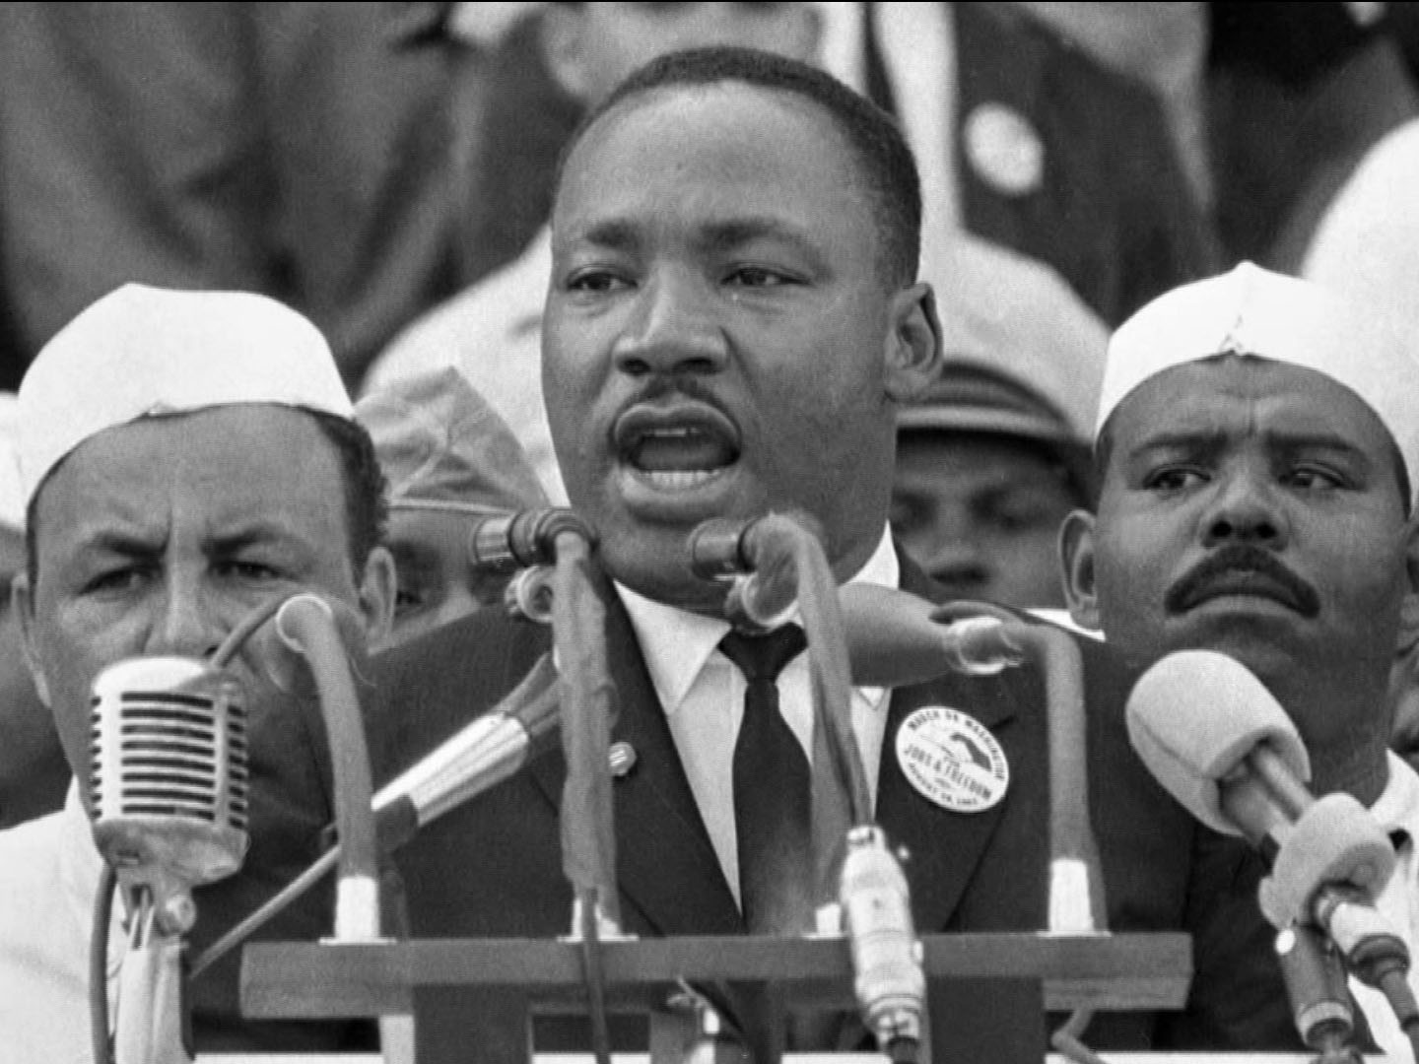
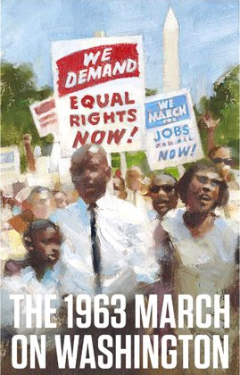

Slide 18
Freedom Summer and Freedom Riders 1964
Freedom Summer, also known as the Mississippi Summer Project
voter registration drive sponsored by civil rights organizations
the Freedom Summer workers included black Mississippians and more than 1,000 out-of-state, predominately white volunteers.
KKK, police, and state and local authorities carried out a series of violent attacks against the activists, including arson, beatings, false arrest and the murder of at least three people.
CORE volunteers, White and Black, got on buses and sat inter-racially on the bus.
They went into bus station lunch counters

Slide 19
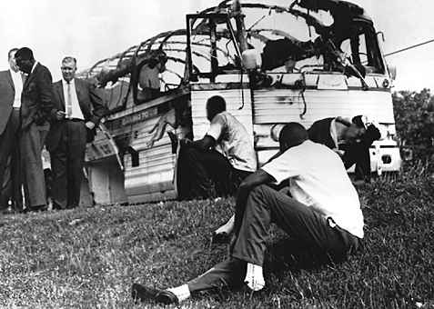
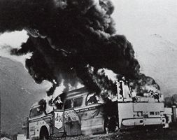
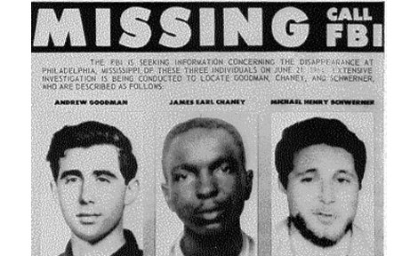
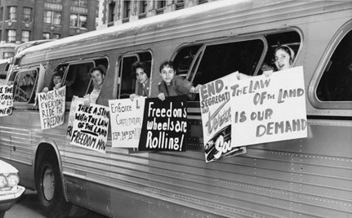
.

Slide 20
The laws finally change
Civil Rights Act of ’64
Banned segregation in public places
Voting Rights Act of ’65
banned the use of literacy tests
federal oversight of voter registration in areas where less than 50 percent of the non-white population had not registered to vote.
Civil Rights Act of ’68
prohibited discrimination concerning the sale, and rental of housing based on race, religion, national origin or sex.
24th Amendment bans poll taxes

Slide 21
MLK
April 4th 1968
Racial tension gets worse in Memphis, TN
Dr. Martin Luther king jr. assassinated
Assassin- James Earl Ray
Death sets off riots in 100+ cities
1,000’s attend funeral, millions watch on TV
Night before death says…
“God has allowed me to go up to the mountain, and I’ve seen the promised land. I may not get there with you. But I want you to know tonight, that we, as a people, will get to the promised land!”

Slide 22
