Slide 1
CALIFORNIA GOLD RUSH
(1848-1852)

Slide 2
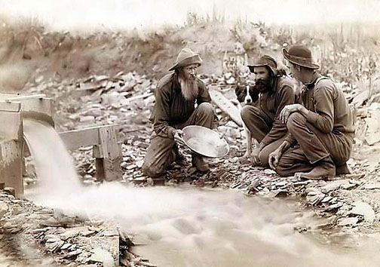
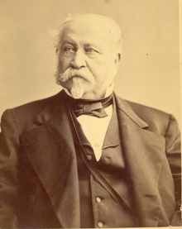
Discovery and the Forty-Niners
First gold discovered on John Sutter’s Mill, by James Marshall in 1848.
After news broke thousands flooded in to attempt to find gold by 1849.
Most forty-niners were young and male
John Sutter

Slide 3
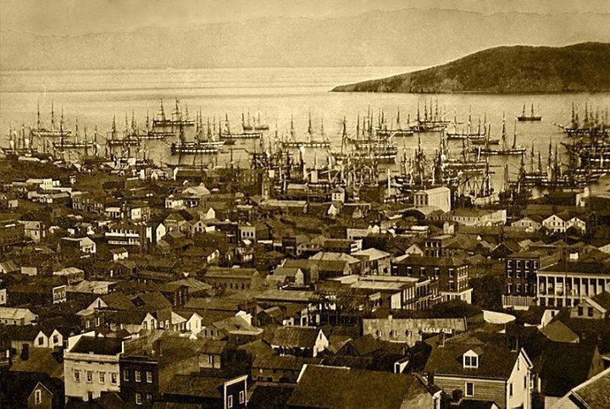
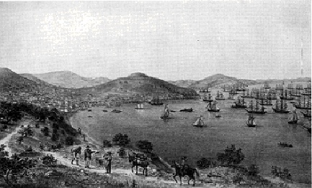
San Francisco
Travel hub between those traveling by sea to get to California gold country
April 1848 population: 850
December 1849 population: 25,000
Major growth
Culturally diverse
Lawlessness/ fighting
Illegal activities

Slide 4
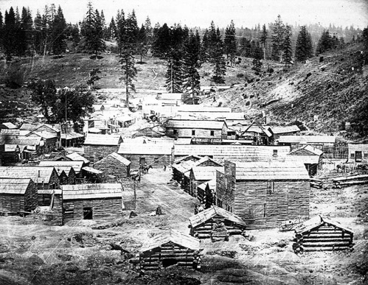
Life in the Mining Camps
There was “a row of canvas tents, [months later] there were two thousand men…and the streets were lined with drinking saloons and gambling tables.”
-Luzena Wilson, mining wife at Coyote Diggings camp
Fights over claim boundaries
Often took “justice” into their own hands

Slide 5
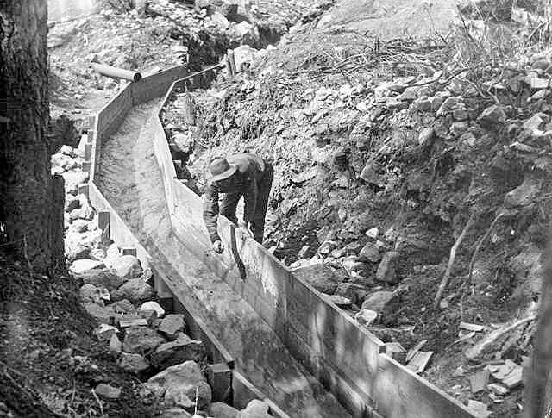
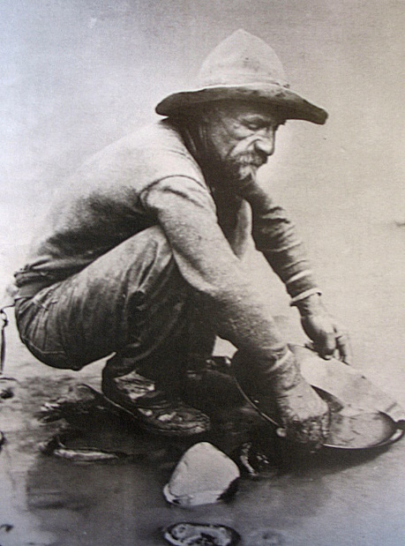
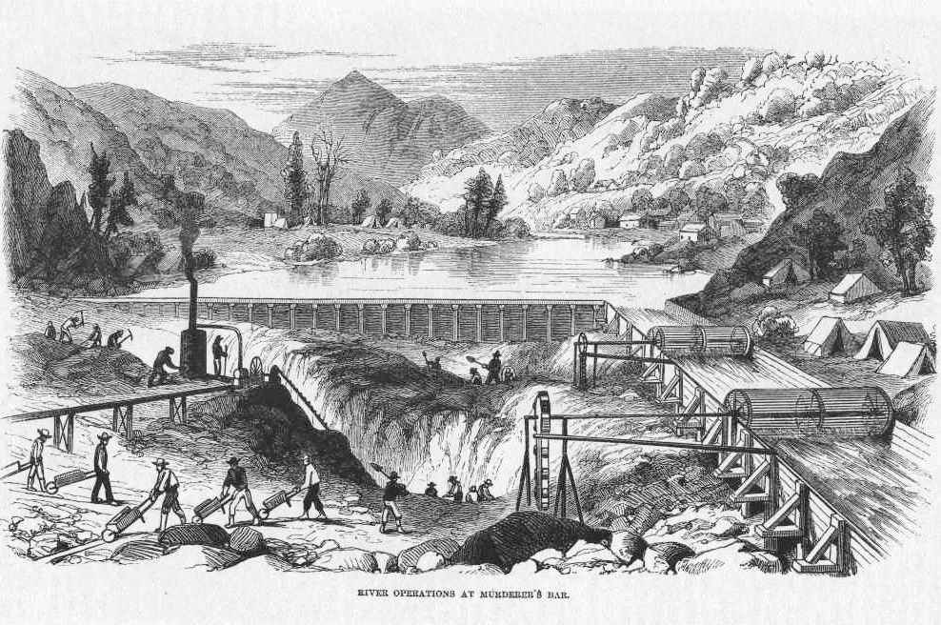
In the Field
Sluice for separation of gold from dirt with water
Excavating a river bed after the water has been diverted
Panning
Hard, tedious work
Long days (Approximately 16 hours) digging up mud, dirt, and stones while standing knee-deep in icy streams
“The day of quick fortune-making was gone. There are thousands of men now in California who would gladly go home if they had the money.” –Miner, 1851

Slide 6
Legacy
By 1852 the gold rush was over,
in that time 250,000 people flooded into California.
Positive Legacy | Negative Legacy
By 1850, California had enough people to become the first state in the far west Diverse group of both immigrants and emigrants Lots of economic opportunities | Native American population dropped drastically from warfare and disease (between 1848-1870 population went from 150,000 to 30,000) Many Californios lost their land to newcomers
Over $2 billion worth of precious metals were extracted during the Gold Rush
$81 million in gold was extracted by 1852 (then $45 million annually through 1857)

