Slide 1
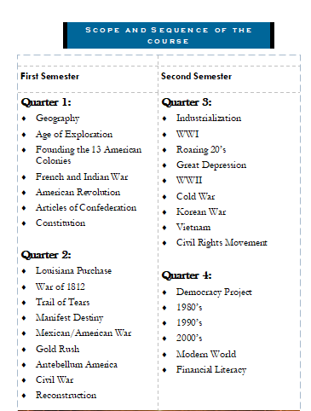
Warmup #1 8/28
Pick 3 of the below topics that we discussed yesterday and tell me what you know about those three topics.

Slide 2
WARMUP #2 8/30/19
Let’s see what you remember
1. Can you name all seven continents?
2. Can you name the five oceans?
3. What are lines of Latitude?
4. What are lines of longitude?
5. What line runs vertically down the center of the earth?
6. What line runs horizontally across the center of the earth?

Slide 3
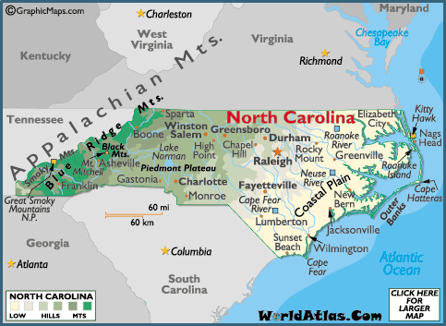
WARMUP #3 9/3/19
What is the difference between a physical and political map
2. Name 4 physical features on this map of North Carolina
3. Name 4 political features

Slide 4
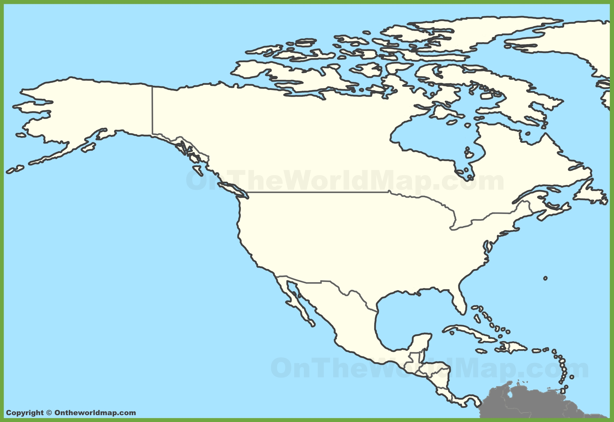
WARMUP #4 9/4/19
What body of water borders the United States to the EAST?
2. What two countries are the United States immediate neighbors?
3. Name any three physical features that you labeled on you US map

Slide 5
WARMUP #5 9/5/19
In your own words Tell me your definition of:
IDENTITY
What does Identity mean to you?
What are some components of Identity?
Who decides what our identity is?

Slide 6
WARMUP #6 9/6/19
What is the difference between a PRIMARY and SECONDARY source?
2. Identify each of these sources as either Primary or Secndary:
Our new American history textbook = ___________
Propaganda Poster from WWI = ____________
Front page of the newspaper from 9/11= ____________
Research paper I wrote in college about Pearl Harbor = ___________
3. List at least one more example of each.

Slide 7
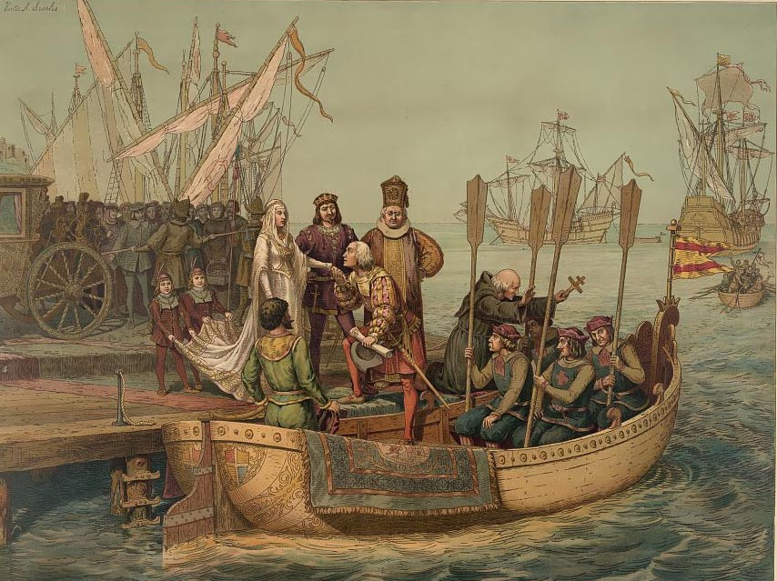
Wednesday 9/12/19 WARMUP #7
Describe the setting.
2. What people and objects are shown?
Who do you think was the audience for this image?
• What’s happening in the image?
-

Slide 8
WU #8 9/17/19
Mayflower Compact: Document signed by Pilgrims, Nov 21, 1620
“Having undertaken, for the glory of God, and advancement of the Christian faith, and honor of our King and Country, a voyage to plant the first colony in the northern parts of Virginia, do by these presents solemnly and mutually, in the presence of God, and one of another, covenant and combine ourselves together into a civil body politic, for our better ordering and preservation and furtherance of the ends aforesaid; and by virtue hereof to enact, constitute, and frame such just and equal laws, ordinances, acts, constitutions and offices, from time to time, as shall be thought most meet and convenient for the general good of the Colony, unto which we promise all due submission and obedience.”
Read the Document. Which of the following statements makes the best title for the document?
Advancing the Christian Faith
The First Colony
Developing the First Democracy

Slide 9
WU #9: Write the answers to the questions. 9/18/19
1. How were the colonies at Roanoke and Jamestown similar?
2. The purpose of the colonies was
A) provide free trade to the colonists
B) encourage Triangle Trade and the sale slaves
C) take land from the Spanish and establish new religions
D) make money for England
3. What is the term given for the system for question #2?

Slide 10
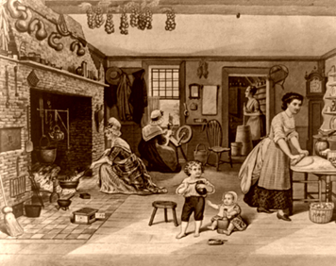
WU #10 9/19/19
1. Describe the people in the image.
2. List three activities happening.
3. Write a generalization statement about the image.

Slide 11
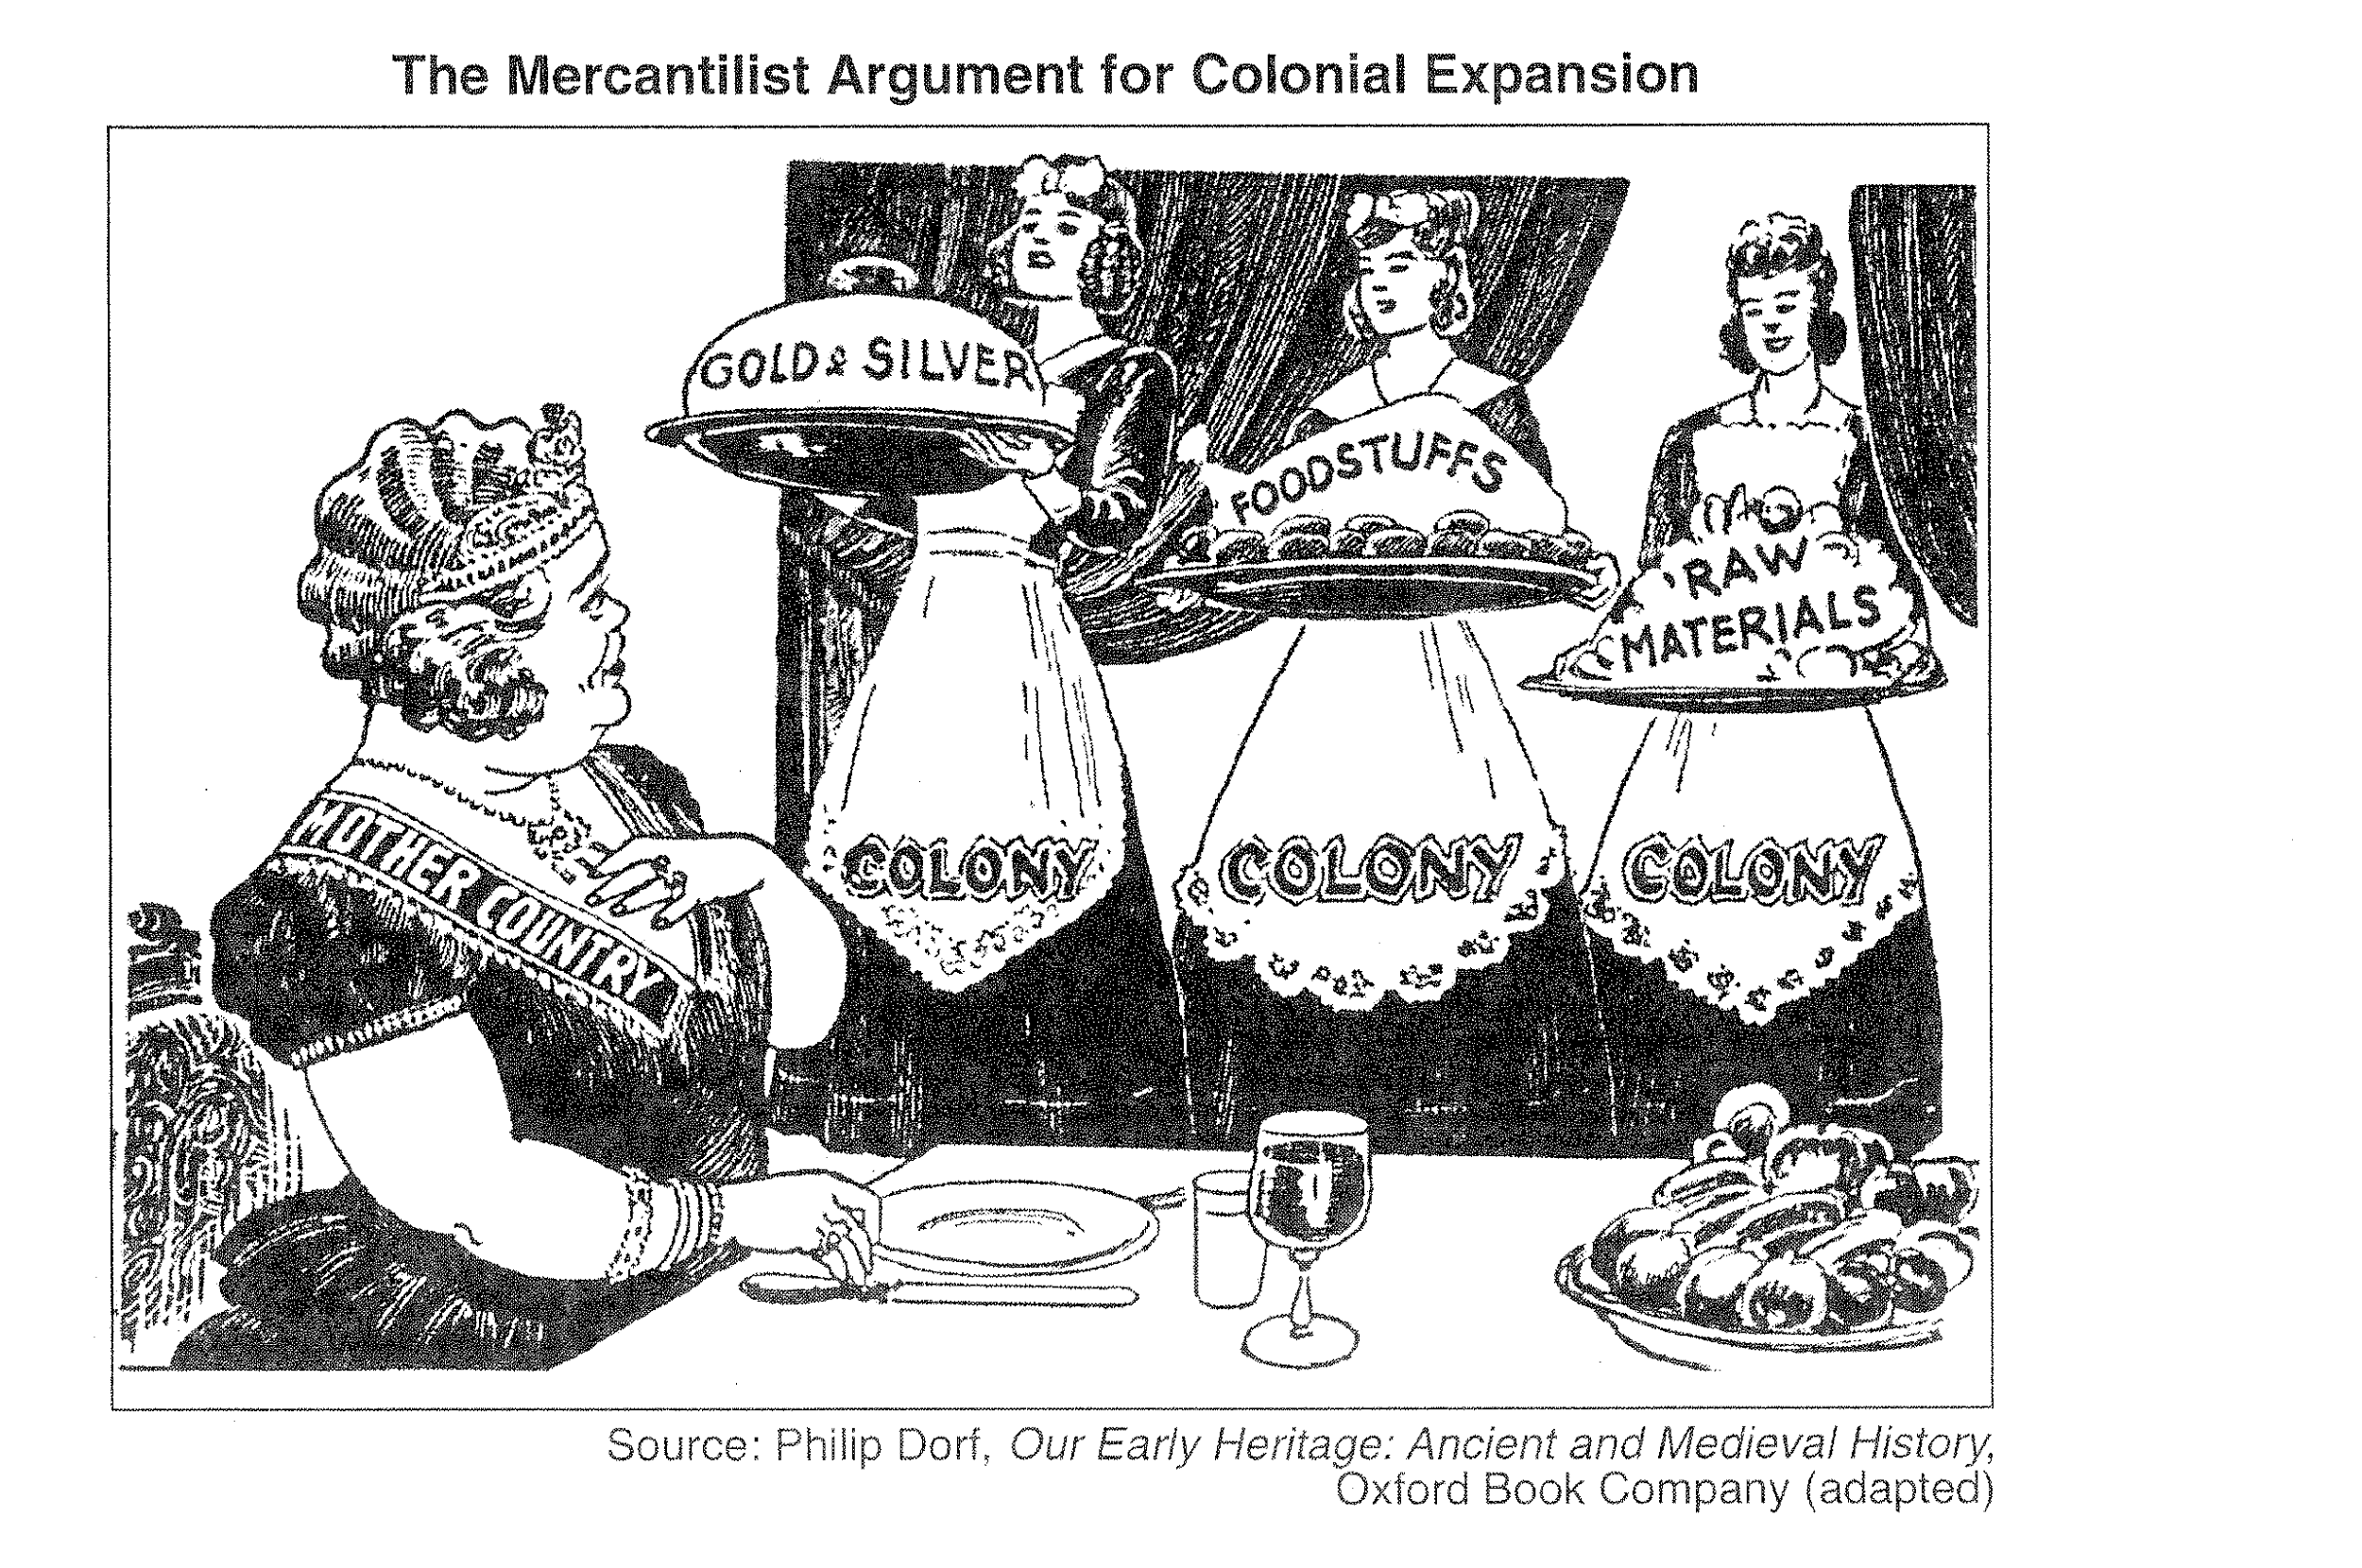
Warmup #7
Thursday
9/18/18
What words do you see in the cartoon?
-What people do you see?
-How would you describe the people?
-What is the main idea of this cartoon?

Slide 12
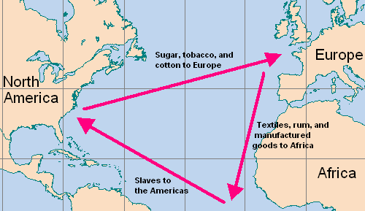
WARMUP #11 9/25/18
Triangle Trade
Leg 1: Ships from England would go to Africa carrying iron products, cloth, trinkets and beads, guns and ammunition. The ships traded these goods for slaves, gold and spices (pepper)
Leg 2: Ships from Africa would go to the American Colonies via the route known as the 'Middle Passage'. The slaves were exchanged for goods from the Americas, destined for the Slave Plantations
Leg 3: Ships from the Americas would then take raw materials back to England. The English would use the raw materials to make 'finished goods'
Who benefited from the transatlantic slave trade?
Why were slaves so important to the Southern economy?
What is the difference between an Indentured Servant and a Slave?

Slide 13
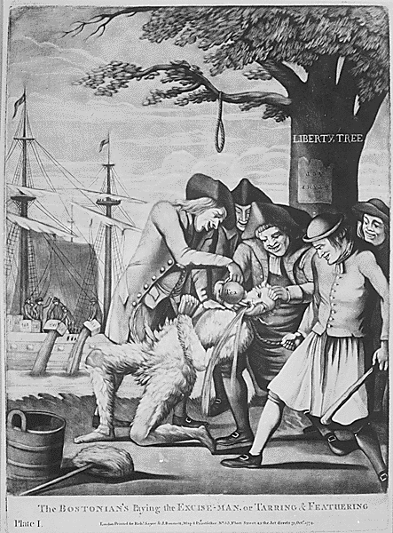
Warmup #12 10/4/18
1. What words do you see in the cartoon?
2. What is the historical context of this picture?
3. Who are the people in this cartoon?
4. How would you describe the people?
5. What action/actions are being represented?
6. Give this cartoon a title or caption.

Slide 14
Warmup #13 10/5/18
List two CAUSES of the American Revolution
People who supported the colonists and wanted war were called what?
People who supported the British and didn’t want war were called what?
What was the Boston Massacre?
Why is the Boston Massacre considered a major CAUSE of the American Revolution?

Slide 15
Patrick Henry’s famous speech March, 1775 14
Gentlemen may cry, “Peace! Peace!”—but there is no peace. The war is actually begun! The next gale that sweeps from the north will bring to our ears the clash of resounding arms! Our brethren are already in the field! Why stand we here idle? What is it that gentlemen wish? What would they have? Is life so dear, or peace so sweet, as to be purchased at the price of chains and slavery? Forbid it, Almighty God! I know not what course others may take; but as for me, give me liberty, or give me death!
What is he saying?
What is he telling his friends to do?
What is his mood?
The distinctions between Virginians, Pennsylvanians, New Yorkers, and New Englanders are no more…I am not a Virginian, but an American”

Slide 16
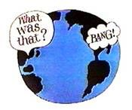
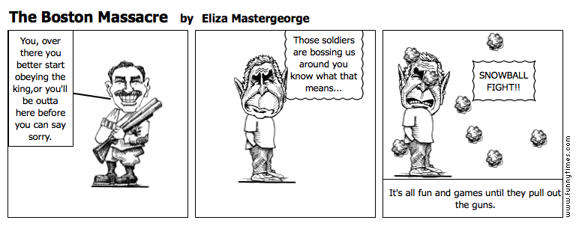
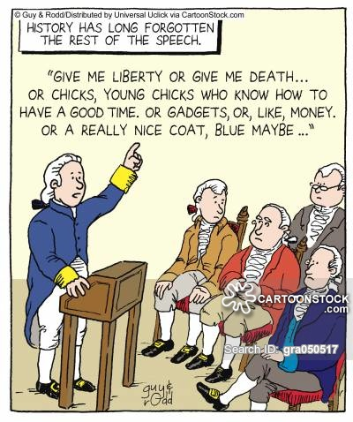
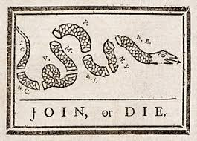
Warmup #15: 10/10/19
4
1
Identify the events that are associated with these pictures
3
2

Slide 17
Warmup #17 10/14/19
FIRST — That the king is not to be trusted without being looked after, or in other words, that a thirst for absolute power is the natural disease of monarchy.
SECONDLY — That the commons, by being appointed for that purpose, are either wiser or more worthy of confidence than the crown.
-Common Sense by Thomas Paine,1776
What was Thomas Paine’s main point in this excerpt from Common Sense?
A He recommended that Colonists remain loyal to the king.
B He thought the Colonists should rule themselves.
C He believed there should be multiple kings.
D He wanted Colonists to crown a new king

Slide 18
Warmup #18 10/15/19
Describe the five main parts of the Declaration of Independence
1.
2
3.
4.
5.
Who was the main author of the Declaration of Independence?
What date was it signed?

Slide 19
10/16/18 Warmup #19
And whereas the United States are engaged in a just and necessary war . . . against the King of England . . . and as the most practicable way for the troops of the United States to some of the posts and forts is by passing through the country of the Delaware nation, the [Delaware Indians], on behalf of themselves and their nation, do hereby [guarantee] and agree to give a free passage through their country to the troops aforesaid, . . . affording to said troops such supplies of corn, meat, horses . . . Treaty with the Delawares, 1778
According to the excerpt, in what way did the Delaware Indians contribute to the military efforts of the Colonists during the American Revolution?
A They allowed colonial troops to pass through their land and gave them aid.
B They manufactured weapons and machinery to sell to the colonial troops.
C They gave land to the Colonists to build military bases to use in the war.
D They allied with the colonial troops and served as soldiers in the war.

Slide 20
10/21/19 Warmup #20
List two advantages of the British Army
List two advantages of the Patriots
What country joined the war to help the patriots
What battle was the turning point of the war? Why?

Slide 21
10/22/19 Warmup #21
How did conflicts that developed from weaknesses in the Articles of Confederation affect the political development of the United States?
A They increased the power of the state governments.
B They accelerated the possible development of a monarchy.
C They prevented the government from developing a republic.
D They required the creation of a stronger national government.
List at least two weaknesses of the Articles of Confederation:
1.
2.

Slide 22
10/29/19 Warmup #22
If your. . . [President] be a man of ambition and abilities, how easy is it for him to render himself absolute: The army is in his hands, and if he be a man of address, it will be attached to him; and it will be the subject of long mediation with him to seize the first auspicious moment to accomplish his design.----Patrick Henry
Which statement exemplifies the Anti-Federalists’ point of view?
A The Constitution divided power equally among the branches of government.
B The Constitution gave too much power to the executive branch.
C The Constitution needed to increase the power of the legislative branch.
D The Constitution guaranteed the protection of individual rights.
Popular sovereignty is the political principle that all political authority within a society is derived from the will or consent of its people. Which idea is expressed in the concept of popular sovereignty?
A The most popular candidates represent the people.
B The federal government has supreme authority over the states.
C The power of the government comes from its citizens.
D The educated are uniquely qualified to control the political system.

Slide 23
11/7/19 Warmup #23
What does the term “Impressment” mean?
What were two results of the war of 1812
Why was the Louisiana Purchase significant?

Slide 24
11/14/19 Warmup #24
The following excerpt describes the weak economy of North Carolina during the early 1800s:
Cotton is now almost the only article which bears transportation. But . . . Even cotton will not long remain a source of profit in our present manner of [transportation]. The states of South Carolina, Georgia, Alabama, Tennessee, Louisiana, together with the Arkansas . . . are yearly filling up more and more with an enterprising population, who are pressing their production of cotton to a [large] extent. They possess navigable rivers, and they are acting upon the same policy of internal improvement as has been prosecuted by other states. --James Mebane and Dennis Heartt, August 1, 1828
Which obstacle did many North Carolinians believe prevented economic growth in North Carolina during these years?
A The cotton of North Carolina was of lower quality than the cotton of other southern states.
B The North Carolina government imported cotton and other goods from neighboring states.
C The soil in North Carolina was inadequate for the farming of high-profit crops like cotton.
D Government leaders failed to support investment in infrastructure like roads

Slide 25
11/18/19 Warmup #25
1. What is the phrase given to the idea that Americans should control all the land from the Atlantic Ocean to the Pacific?
2. What problems were Archie Murphey trying to solve?
3. What was the official name of the Trail of Tears?
4. Who was the president who created this policy?

Slide 26
Warmup #26 Tuesday, November 19th
1. How did the North and south differ in terms of Transportation in the mid 1800’s?
2. How were the economies of the North and South different?
3. What are two major inventions during this era?

Slide 27
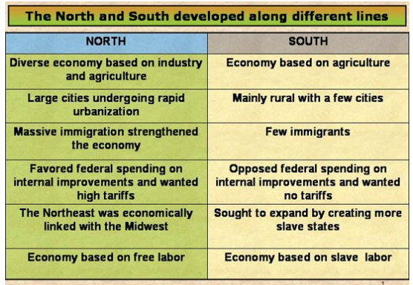
Warmup #27 Wed, 11/20/19
Based on the chart, what generalization can you make about the differences between the North and South prior to the outbreak of the Civil War?

Slide 28
Warmup #28 Monday, December 2nd
What was Abraham Lincoln trying to express when he said, “If I could save the Union without freeing any slave, I would do it; and if I could save it by freeing all the slaves, I would do it; and if I could save it by freeing some and leaving others alone, I would also do that."
The Southern states should be allowed to secede.
B. The preservation of the Union was the most important priority.
C. Slavery was immorral and should be abolished immediately.
D. To slavery issue could only be solved by war.

Slide 29
Warmup # 29 Dec 3rd
I beg you to let me be one to proceed to Federal Point, and frighten Lincoln out of his [wits], if possible and if the Governor’s prediction should prove untrue and war should actually be necessary, I should be happy to bear a part, humble though it be, in defense of my country. The flag raised today contained nine stars, the last two in honor of Virginia and North Carolina. This is probably the first flag raised, on which North Carolina has been numbered with the [seceding] states.
Letter from Edward H. Armstrong to Thomas G. Armstrong, April 20, 1861
According to Armstrong’s letter, what was the primary debate occurring among the citizens of North Carolina in 1861?
A whether to start a draft or not
B whether to secede from the Union or not
C whether to create a new flag or not
D whether to abolish slavery or not

Slide 30
Warmup #36 Dec 5
Warmup # 30 12/4/19 Passions were so strong over the issue of slavery in the territories because…
a. Northerners didn’t like blacks.
b. Southerners wanted to expand their farms.
c. Congress did not approve of popular sovereignty.
d. Both the North and South didn’t want the other side to gain more representation in Congress.
2. What did the Election of 1860 lead to?
a. Breckenridge became President.
b. Secession of slave states from the Union.
c. slave revolts in the South.
d. The Trail of Tears.

Slide 31
Warmup # 31 Tuesday, Dec 10th
What was the immediate cause of the election of 1860?
What was the first battle of the Civil War?
What was the name of the Union’s plan for the Civil War?
What was the name of the Confederate’s plan?
What did General Sherman do in the south?

Slide 32
12/11/19 Warmup #32
2. Where was gold first discovered in California?
3. What were the people called who went to California in search of Gold?
What was one positive outcome of the Gold rush in California?
1. In 1830, the U.S. government forced American Indians to leave their homes in the Southeast for new territory in the West. How did this forced migration, called the “Trail of Tears,” affect the development of the United States?
A At the expense of American Indians, more territory became available for white settlement.
B Trade increased between American Indians and the United States.
C There was a lasting peace between American Indians and the United States.
D Land disputes between the U.S. government and American Indians were resolved.

Slide 34
11/5/18 Warmup #24
That if any person shall write, print, utter . . . any false, scandalous and malicious writing or writings against the government of the United States, or either house of the Congress of the United States, or the President of the United States, with intent to defame the said government . . . then such person, being thereof convicted before any court of the United States having jurisdiction thereof, shall be punished by a fine not exceeding two thousand dollars, and by imprisonment not exceeding two years.
--Alien and Sedition Acts, 1798 Transcript Courtesy of the Avalon Project at Yale Law School
Based on the above excerpt, which statement explains an effect of passage of the Sedition Act?
A Public criticism of government was prohibited.
B It became more difficult for new immigrants to vote.
C The president gained new powers to deport foreigners.
D The First Amendment to the U.S. Constitution was protected.

Slide 35
Warmup #23 11/1/19
INQUIRY QUESTION FOR UNIT 2
1. How do perceptions of inequalities and a sense of being powerless often lead to struggles where a society demands change?
2. What causes conflict between two different cultures?
**AT LEAST THREE SENTENCES

Slide 36
Warmup #16: 10/10/18
What was the Mecklenberg Resolves?
What was the Halifax Resolves?
Describe Common Sense?
What was at lease one outcome of the Second Continental Congress?

Slide 37
11/13/18 Warmup #28
Summarize the ideas of Manifest destiny in your own words.
Are growing pains an inevitable part of development? Give at least two examples and explain

Slide 38
11/14/18 Warmup #29
1.What was the name of the Fort that the Americans used in the Texas Revolution?
2.What territories did the United States Gain after the Mexican/American War?

Slide 39
Warmup #31 Monday, November 19th
How did migration to the Western Territory help to develop the United States?
A Westward migration helped American Indians preserve their cultural identity.
B Westward migration created densely populated urban and suburban areas.
C Westward migration encouraged civil rights legislation for slaves.
D Westward migration expanded industry and the national economy.

Slide 40
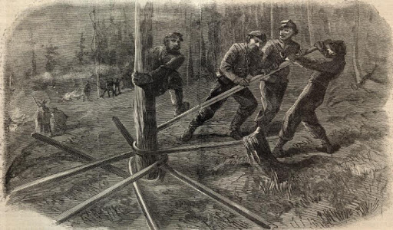
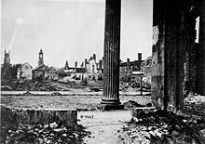
2/5 Warmup # 33
From your knowledge where are these pictures from?
Why was “reconstruction” necessary? (at least two reasons)
Predict three things that happen next.

Slide 41
Warmup #34 thursday, Feb 6th
Who are the ‘Freedmen”
What did Lincoln’s plan for reconstruction call for?
What did the Radical Republicans want?
What is “amnesty”
What was the Freedman's Bureau?

Slide 42
Warmup #35 tues, Feb 18th
Name four major inventions and who is responsible for those inventions?
What is the term for the movement of people from farms to cities?
What is a monopoly
What industry were the following men known for?
- John Rockefeller
- J.P. Morgan
- Andrew Carnegie
- Cornelius Vanderbilt

Slide 43
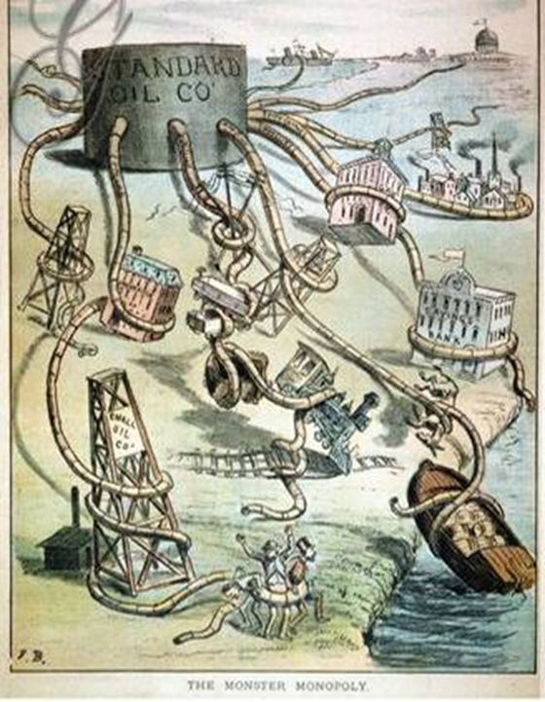
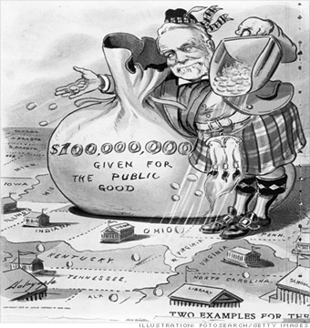
Warmup #36 Tuesday, Feb 25th
How does the political cartoon represent John Rockefeller's Standard Oil Company?
How is the artist characterizing Andrew Carnegie in the following political cartoon?

Slide 44
Warmup #37 Wed, Feb 26th
1. What is a Robber Baron?
Name TWO laws/regulations that were designed during the industrial revolution to protect employees
Describe what a Union is and how it can be effective
Name TWO significant inventions from the Industrial Revolution

Slide 45
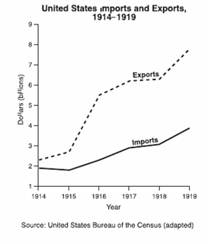
Warmup #38 thursday, Feb 27th
"It is our true policy to steer clear of permanent alliances with any portion of the foreign world;"
-President George Washington, 1796
How does this quote reflect the attitude of the United States position in World War I?
 |  | The United States entered World War I when fighting broke out in Europe.
 |  | The United States was neutral at the beginning of World War I.
 |  | The United States never engaged in military conflict during World War I.
 |  | The United States waited until they were invaded to enter World War I.
Which conclusion can be drawn from analyzing the graph above?
 | World War I cost the U.S. many billions of dollars.
 | World War I created an unfavorable balance of trade.
 | World War I was a significant benefit for the U.S. economy.
 | World War I caused the U.S. trade deficit to increase significantly.

Slide 46
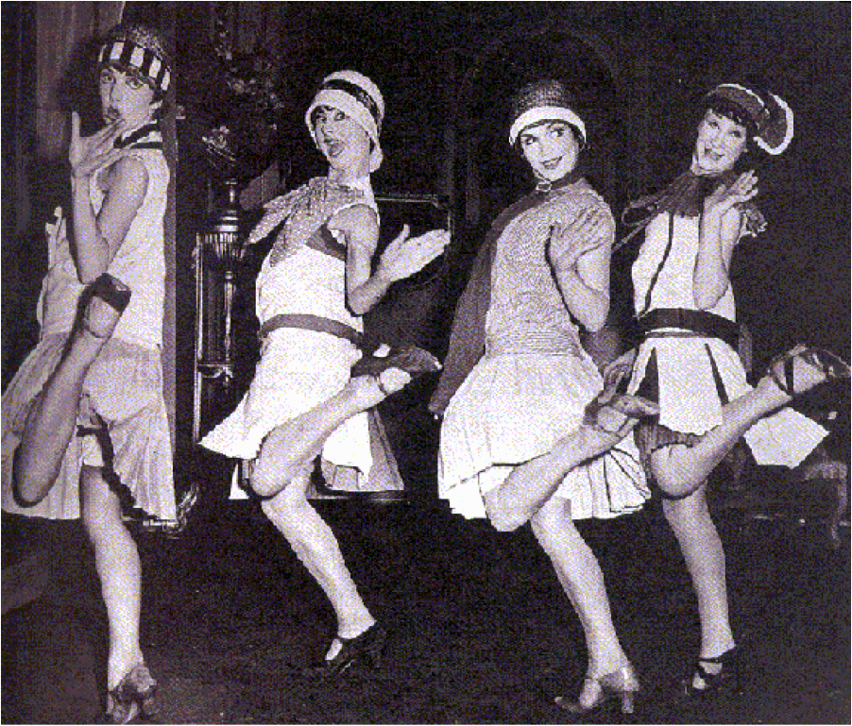
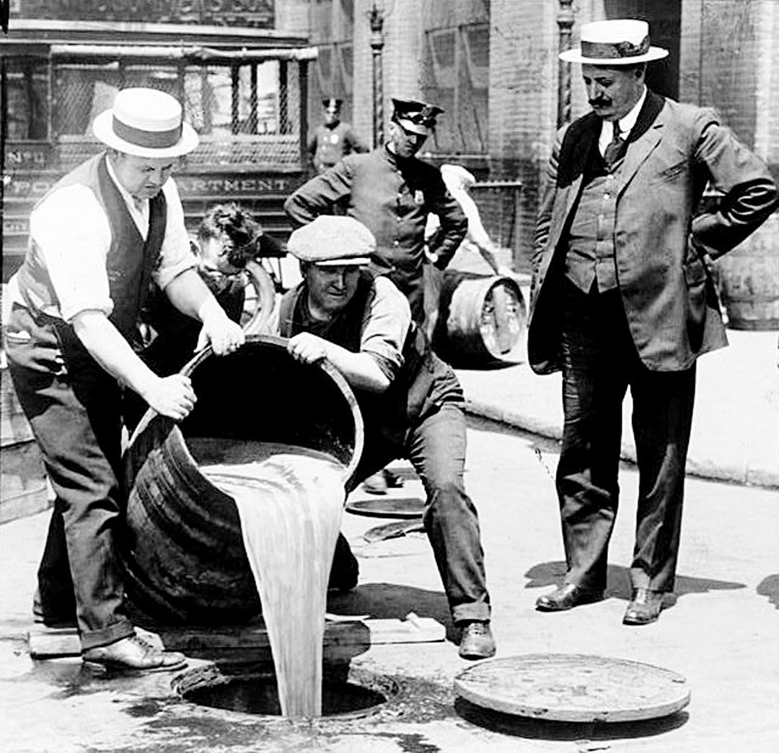
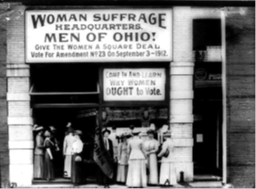
Warmup #39 Friday, Feb 29th
What is a flapper?
How did WWI lead to the prosperity of the 1920’s?
What was the 18th amendment?
What was the 19th amendment?

Slide 47
Warmup #40 Mon, March 2nd
How did North Carolina contribute to World War I?
A. producing textiles and establishing military training camps
B. building ships and developing nuclear weapons
C. providing military intelligence centers and tobacco production
D. building camps for prisoners of war and barbed wire production
Which statement accurately describes the Harlem Renaissance of the 1920s?
A. An organization created to promote African-American businesses.
B. A movement that to draw African-Americans back to the inner cities.
C. A relief program that provided jobs for African-American workers.
D. A period of achievement by African-American writers and artists

Slide 48
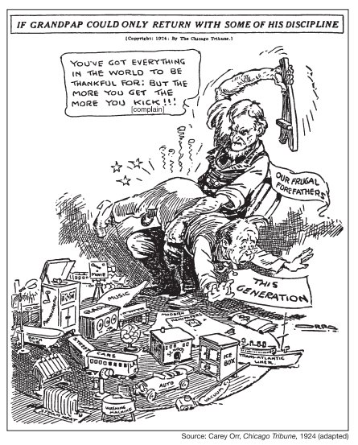
Warmup #41 Friday, 3/6/20
What is the previous generation’s views of the people in the 1920’s?

Slide 50
Warmup #38 Thursday, Feb 27th
What event started WWI?
Describe the Zimmerman Telegram
What does M.A.I.N. stand for?
Who were the Central Powers (Triple Aliance)?
Who were the Allied powers (Triple Entante)?

Slide 51
Warmup #47 Thursday, Feb 21st
What were two events or causes of the Great Depression?
What year did the stock market crash?
What percent did unemployment reach?
What was a Hooverville?

Slide 52
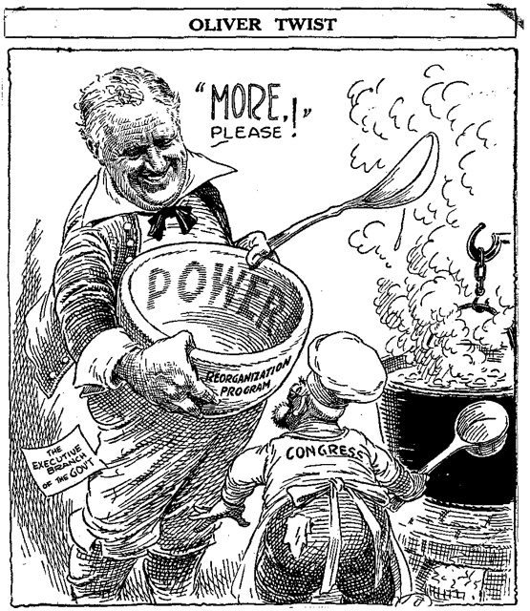
Warmup #48 Friday 2/22
Who do you see in this Picture?
What other words or phrases do you see?
What is happening?
NOW, answer the question below
What would be the best summary of the cartoon artist's argument regarding President Roosevelt's New Deal and the Reorganization Program?
 | A | The President is not expanding the power of the executive branch enough by asking Congress to pass only the Reorganization Program law.
 | B | The President wants to expand the power of the legislative branch of the government by asking Congress to pass his New Deal laws.
 | C | The President is expanding the power of the executive branch too much by asking for Congress to pass his New Deal laws, including the Reorganization Program.
 | D | The President is expanding the power of the executive branch too much by asking for Congress to feed the public during the Great Depression.

Slide 53
Warmup #49 2/25
In the 1920s, North Carolina was still very much a rural state. Half of its total population lived on working farms. Agriculture was its largest industry. But farmers’ income had declined steadily during the decade because of overproduction of cash crops, falling crop prices, rising farm costs, poor conservation practices, and other problems. When the stock market crashed on “Black Tuesday”—October 29, 1929—the hopes and dreams of many farm families crashed along with it.“
What was the economic impact of the Dust Bowl?
 | A | severe droughts and storms that caused the failure of many American farms
 | B | massive winds destroyed houses and factories in Jamaica
 | C | environmental factors led to increased spending on global warming research
 | D | mass migration of African-Americans to northern cities
What can you infer from this passage?
 | A | Farm families had savings to fall back on when they didn't make enough money from selling their crops.
 | B | Farm families had struggled to improve their financial situations without making much, if any, profit during the 1920s.
 | C | Poor crop sales during the 1920s finally improved on October 29, 1929.
 | D | Poor crop sales during the 1920s didn't stop farmers from making money during the 1930s.

Slide 54
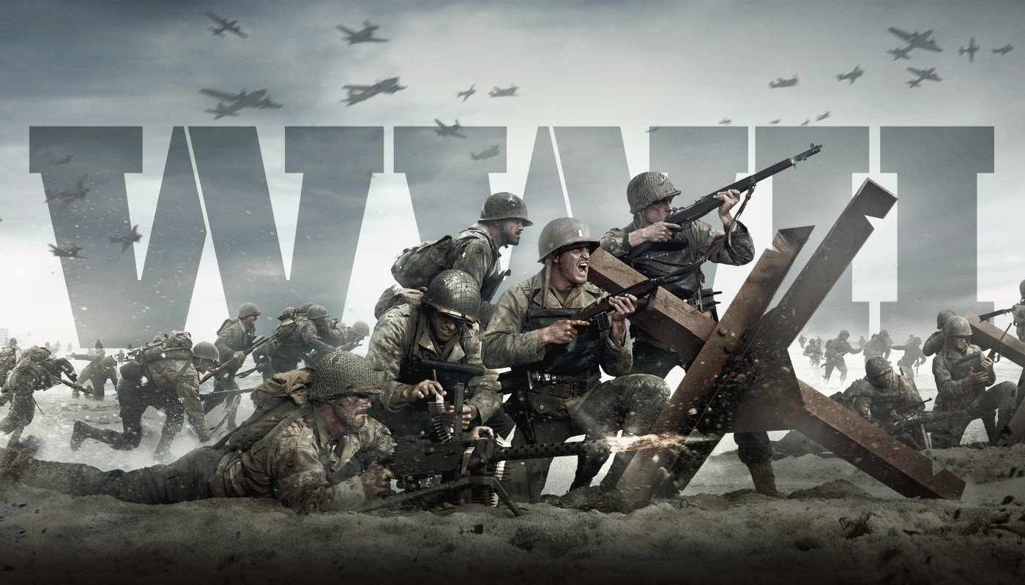
Warmup #50 Tuesday, Feb 26th
What were the FOUR causes of WWII
What THREE things did the Treaty of Versailles make Germany do?
What two countries did Hitler make alliances with?
What does appeasement mean?

Slide 55
1. Who were the Allied and Axis Powers in WWII and who changed sides? 2. What event started WWII? 3. what is blitzkrieg? 4. what was the Lend-Lease Act in 1941 5. What was D-Day? 6. What ended WWII?
Warmup #51 Tuesday, March 5th

Slide 56
1. What were the competing economic systems during the cold war? 2. What was the outcome of the Yalta Conference? 3. What was one American and one Russian goal at the end of WWII? 4. What was the Marshall Plan? 5. What was the Iron Curtain?
Warmup #52 Wed, March 6th

Slide 57
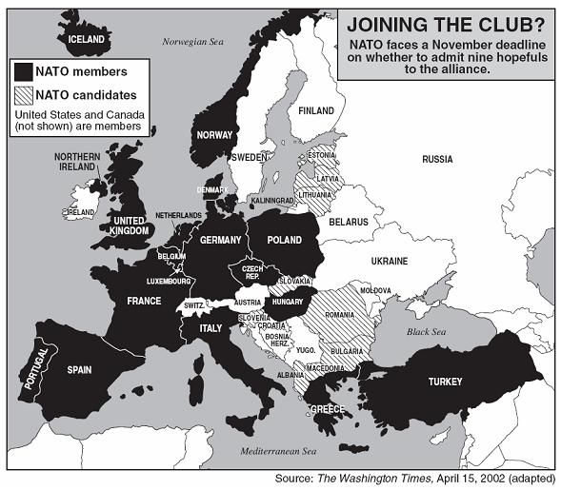
Warmup #53: March 7
What impact did the Soviet Union launch of Sputnik have on the United States?
 | A | United States will increase spending on science and math.
 | B | United States will end the Cold War.
 | C | Soviet Union will launch an invasion of the United States.
 | D | United States will send aid to Cuba.
Based on the map what impact has NATO had on the world since the Cold War?
 | A | Countries that use to be enemies of war now work together to keep the world at peace.
 | B | Most of the countries that are apart of NATO had been alliances before the Cold War.
 | C | NATO has not kept the world from having global issues.
 | D | The countries apart of NATO have escalated foreign issues with countries not associated with NATO.

Slide 58
This is an excerpt from U.S. Secretary of State Marshall’s speech explaining his plan for European recovery, June 5 1947:
“I need to say that the world situation is very serious… Europe must have a great deal of additional help, or face heavy economic, social, and political damage. This would have a harmful effect on the world at large. There are also possibilities of disturbances because of the desperation of the people concerned. The effect on the economy of the United States should be clear to all. So the United States should do whatever it can to help restore normal economic health to the world. Without this there can be no political stability or peace. Our policy is directed … against hunger, poverty, desperation and chaos (disorder). Its purpose is to revive a working economy in the world.”
Warmup #54: March 8
Which of the following statements describes the significance of the Cuban Missile Crisis?
 | A | It was the closest the Soviet Union and the U.S. came to actual war.
 | B | It gave Cuba a large arsenal to use against the United States.
 | C | The Soviet Union saved face by not backing down to U.S. demands.
 | D | It strengthened relations between the Soviet Union and the U.S.
Why did U.S. Secretary of State Marshall suggest this plan for European recovery?

Slide 59
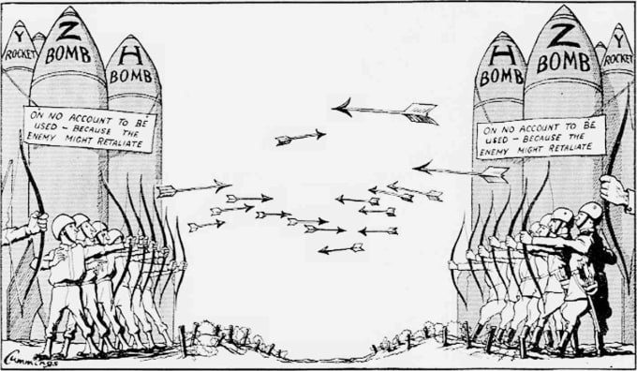
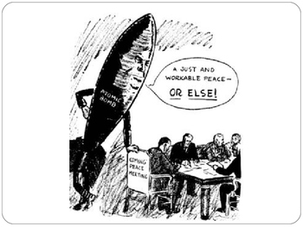
Warmup #55 Mon, March 11th
1. From what era are these political cartoons?
2. What do these political cartoons describe as the greatest global threat?
3. Write a caption for these pictures?
4. From the political cartoons what can you say about the feelings of Nuclear War?

Slide 60
1. Regional conflicts where the US and USSR didn’t fight each other but supported certain sides in a war was known as what? 2. What are two examples of these? 3. What was the main reason for the United States being involved in the Korean war and Vietnam war 4. What was the Domino Theory?
Warmup #56 Wed, March 14th

Slide 61
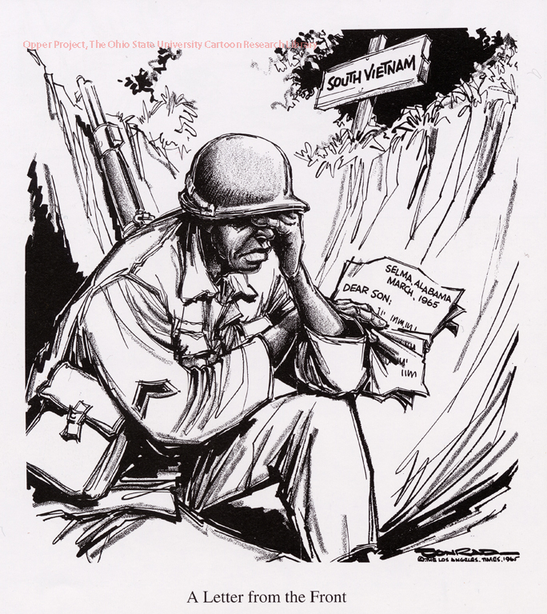
Warmup #57 Tues, March 19
"Today I have stood, where once Jefferson Davis stood, and took an oath to my people. It is very appropriate then that from this Cradle of the Confederacy, this very Heart of the Great Anglo-Saxon Southland, that today we sound the drum for freedom as have our generations of forebears before us done, time and time again through history. Let us rise to the call of freedom-loving blood that is in us and send our answer to the tyranny that clanks its chains upon the South. In the name of the greatest people that have ever trod this earth, I draw the line in the dust and toss the gauntlet before the feet of tyranny . . . and I say . . . segregation today . . . segregation tomorrow . . . segregation forever." - George Wallace, January, 1963 Inaugural Address
Who did Wallace consider to be tyranny?
Describe what you see in this picture
Where is this soldier?
What is happening back home in the U.S.
Describe why this picture is IRONIC
 | A | Black Panther Party members
 | B | white supremacists enforcing Jim Crow laws
 | C | freedom riders encouraging violence
 | D | government officials forcing desegregation

Slide 62
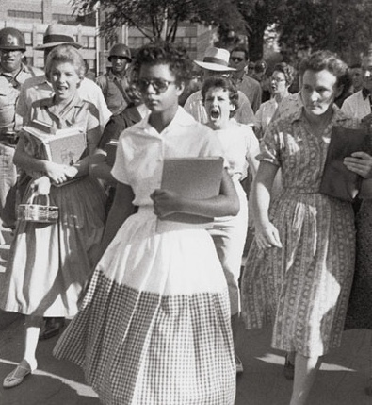
Warmup #58 Wed, March 20
“For those of you who are black – considering the evidence that there were white people who were responsible – you can be filled with bitterness, with hatred, and a desire for revenge. We can move in that direction as a country…or we can make an effort, as Martin Luther King did, to understand and comprehend, and to replace that violence, that stain of bloodshed that has spread across our land, with an effort to understand with compassion and love." - Robert F. Kennedy, eulogy for Dr. Martin Luther King Jr. 1968
What reaction to Martin Luther King Jr's assassination is Robert Kennedy trying to avoid?
 | A | non-violent protest that demonstrates compassion
 | B | political legislation that upsets southern leaders
 | C | violent protest that will hurt more people
 | D | peaceful marches that cause more lynchings
What do you see?
What is happening?
How would you feel?

Slide 63
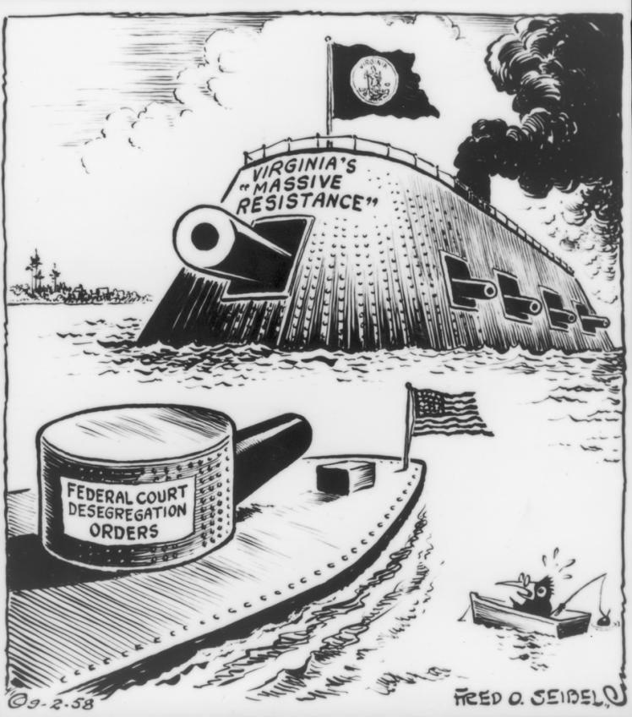
Warmup #59 Thursday, March 21
1. What happened with the Brown vs Board of Education supreme court case?
2. Explain the Montgomery Bus Boycott
3. What event is this cartoon describing?
4. Who were the Little Rock 9?
5. What was the Freedom Summer?

Slide 64
1. What is “Deregulation”? 2. Describe “Reaganomics” 3. What was the Iran-Contra affair? 4. What did Reagan tell Gorbachev? 5. What are a couple examples of the Culture Wars of the 1980’s?
Warmup #60 Tues, April 9th

