Slide 1
WARMUP #1 9/5/17
What is the difference between a PRIMARY and SECONDARY source?
2. Identify each of these sources as either Primary or Secndary:
Our new American history textbook = ___________
Propaganda Poster from WWI = ____________
Front page of the newspaper from 9/11= ____________
Research paper I wrote in college about Pearl Harbor = ___________
3. List at least one more example of each.

Slide 2
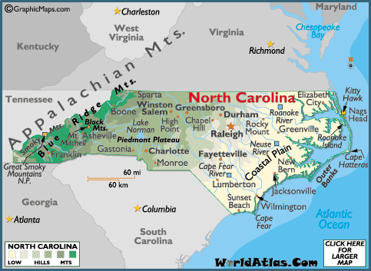
WARMUP #2 9/7/17
What is the difference between a physical and political map
2. Name 4 physical features on this map of North Carolina
3. Name 4 political features

Slide 3
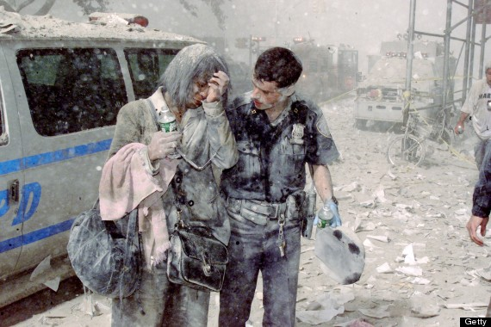
Monday, September 11th
WARMUP #3
List three objects that you see
Describe two actions
Who are these people
What other questions can you ask
To determine context?

Slide 4
WARMUP #4 9/13/17
What are the Two common slogans you see on the NC license plate?
2. What do those slogans mean?
3. In a ranking of all cities in the United States where do you think Charlotte is based on total population?
4. What is the Capital of North Carolina?
5. Why did it get that name?

Slide 5
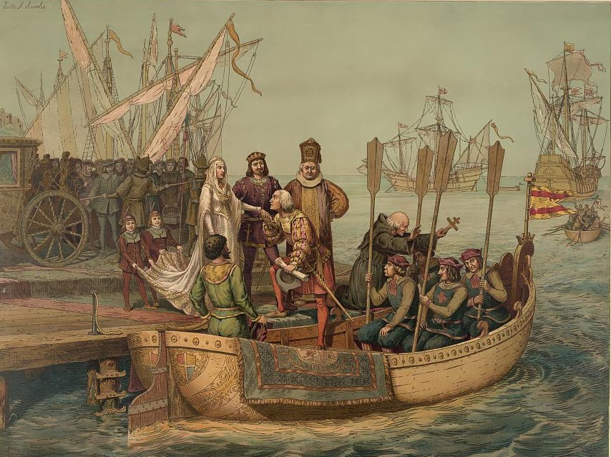
WARMUP #5 9/15/17
Describe the setting.
2. What people and objects are shown?
Who do you think was the audience for this image?
• What’s happening in the image?
-

Slide 6
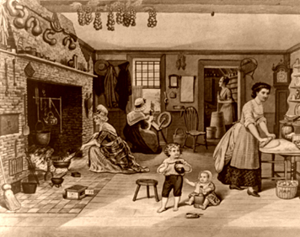
WU #6 9/19/17
1. Describe the people in the image.
2. List three activities happening.
3. Write a generalization statement about the image.

Slide 7
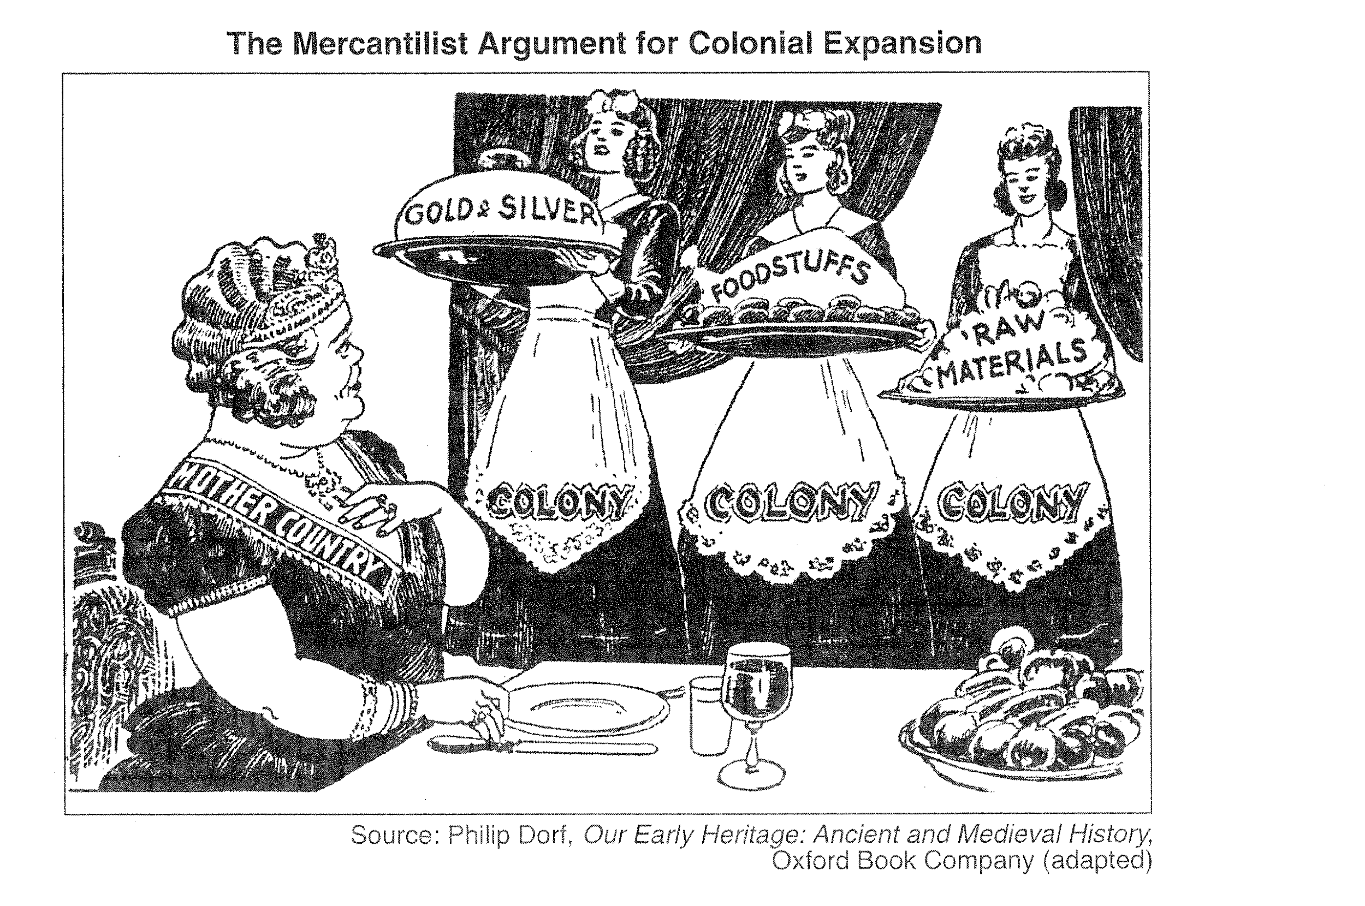
Warmup #7
9/25/17
What words do you see in the cartoon?
-What people do you see?
-How would you describe the people?
-What is the main idea of this cartoon?

Slide 8
WARMUP #8 9/26/17
Which statement explains the dominance of slavery in the coastal region of
colonial North Carolina?
A The first slaves to arrive in North Carolina were brought from other colonies.
B Rocky terrain coupled with a mild climate supported the establishment of
plantations.
C The climate was similar to a tropical climate, giving African slaves a better
chance at survival.
D Slave ships arrived at the ports of Wilmington, Edenton, and Bath.

Slide 9
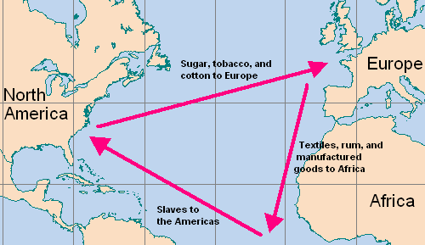
WARMUP #9 9/29/17
Triangle Trade
Leg 1: Ships from England would go to Africa carrying iron products, cloth, trinkets and beads, guns and ammunition. The ships traded these goods for slaves, gold and spices (pepper)
Leg 2: Ships from Africa would go to the American Colonies via the route known as the 'Middle Passage'. The slaves were exchanged for goods from the Americas, destined for the Slave Plantations
Leg 3: Ships from the Americas would then take raw materials back to England. The English would use the raw materials to make 'finished goods'
Who benefited from the transatlantic slave trade?
Why were slaves so important to the Southern economy? (Why did the South need slaves to make money?)

Slide 10
WU #10: Write the answers to the questions. 10/3/17
1. How were the colonies at Roanoke and Jamestown similar?
2. Why was North Carolina’s slave population smaller than other Colonies?
A) They had fertile soil B) They had very few good ports
C) They had large naval stores D) There were better jobs in the north
3. The purpose of the colonies was
A) provide free trade to the colonists
B) encourage Triangle Trade and the sale slaves
C) take land from the Spanish and establish new religions
D) make money for England
4. What is the term given for the system for question #3?

Slide 11
Warmup #11 10/5/17
1.Why did Native Americans not last as slaves for the Europeans?
2.How were Millions of slaves were brought into the colonies from Africa?
3.Why did NC not have as many slaves as the other southern colonies?
4.Where did most slaves in the southern colonies work?
5.What is the difference between an indentured servant and a slave?

Slide 12
1. Which of the following statements about colonial regions is correct?
Warmup #12 10/9/17
3. Which best explains the reason for a variety of products in different regions of the American colonies?
 | A | The New England colonies had a warm climate perfect for growing cash crops.
 | B | The Southern Colonies used slave labor to develop their plantation economy.
 | C | The economy of the Middle Colonies was based on subsistence farming and ranching.
 | D | The Southern Colonies were a melting pot of Separatist groups.
2. Why have famous Americans credited the writers of the Mayflower Compact with being the foundation of our United States Constitution?
 | A | Family structure and education
 | B | Political and social systems
 | C | Geography and climate
 | D | National origins and culture
 | A | It demonstrated why a monarchy was not effective.
 | B | It created a government that separated church and state.
 | C | It was a model for the democratic ideal of self-government.
 | D | It demonstrated why we should create a government approved by God.

Slide 13
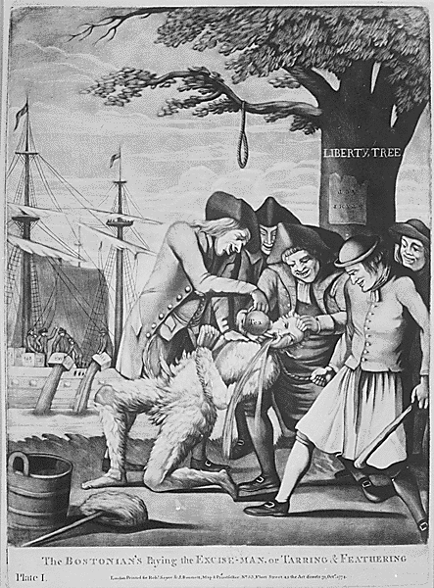
Warmup #13 October 17th 2017
1. What words do you see in the cartoon?
2. What is the historical context of this picture?
3. Who are the people in this cartoon?
4. How would you describe the people?
5. What action/actions are being represented?
6. Give this cartoon a title or caption.

Slide 14
Warmup #14 October 25th 2017
INQUIRY QUESTION FOR UNIT 2
How do perceptions of inequalities and a sense of being powerless often lead to struggles where a society demands change?
**AT LEAST THREE SENTENCES

Slide 15
12/5/17 Warmup #15
List two CAUSES of the American Revolution
People who supported the colonists and wanted war were called what?
People who supported the British and didn’t want war were called what?
List two reasons why the British had a perceived advantage in the War
List two reasons the Americans had an advantage
What battle was the turning point of the war and why?
What battle ended the war?

Slide 16
1/4/17 Warmup #16
How did conflicts that developed from weaknesses in the Articles of Confederation affect the political development of the United States?
A They increased the power of the state governments.
B They accelerated the possible development of a monarchy.
C They prevented the government from developing a republic.
D They required the creation of a stronger national government.
List at least two weaknesses of the Articles of Confederation:
1.
2.

Slide 17
1/8/18 Warmup #17
What is the difference between the Constitution and the Declaration of Independence?
What is the difference between Enumerated and Reserved powers?
How does the system of Separation of Powers and Checks and Balances work?
Describe Federalists and Anti-federalists

Slide 18
1/10/18 Warmup #18
Mrs. Blue wants to rewrite the school rules. She wants to get input from the students but she doesn’t know the best way to do that. Her ideas are:
** allow each class to have equal votes
** allow the largest classes to have more votes than smaller classes
** allow the honors classes to have more votes
** allow the 8th grader votes to count more than 6th or 7th grader votes
Which idea above would you choose? Why?

Slide 19
1/12/18 Warmup #19
If your. . . [President] be a man of ambition and abilities, how easy is it for him to render himself absolute: The army is in his hands, and if he be a man of address, it will be attached to him; and it will be the subject of long mediation with him to seize the first auspicious moment to accomplish his design.----Patrick Henry
Which statement exemplifies the Anti-Federalists’ point of view?
A The Constitution divided power equally among the branches of government.
B The Constitution gave too much power to the executive branch.
C The Constitution needed to increase the power of the legislative branch.
D The Constitution guaranteed the protection of individual rights.
Popular sovereignty is the political principle that all political authority within a society is derived from the will or consent of its people. Which idea is expressed in the concept of popular sovereignty?
A The most popular candidates represent the people.
B The federal government has supreme authority over the states.
C The power of the government comes from its citizens.
D The educated are uniquely qualified to control the political system.

Slide 20
1/22/18 Warmup #20
How would you define INEQUALITY?
What are some causes of INEQUALITY in America?
What are some examples of INEQUALITY in America?

Slide 21
1/30/18 Warmup #21
What does the term “Impressment” mean?
How did the war of 1812 highlight regional differences in the United States?
Why was the Louisiana Purchase significant?

Slide 22
2/1/18 Warmup #22
There were five main reasons that North Carolina had the nickname “Rip Van Winkle State” name THREE of them.
2. What problems were Archie Murphey trying to solve?

Slide 23
2/7/18 Warmup #23
We had nothing . . . after Captaine Smith’s departure, there remained not past sixty men, women and children, most miserable and poor creatures; and those were preserved for the most part, by roots, herbs, acornes, walnuts, berries, now and then a little fish. This was that time, which still to this day we called the starving time; it were too vile to say, and scarce to be believed, what we endured. . . .
Generall Historie of Virginia, John Smith, 1624
Based on the excerpt, how did the harsh environmental conditions affect the Jamestown Colonists?
A The harsh weather brought American Indians to help the Colonists.
B The harsh weather both reduced and destroyed the tobacco crops.
C The harsh weather convinced the settlers to return to their homeland.
D The harsh weather decreased the quality of life for the settlers by making it difficult to obtain enough food
A Declaration of Rights made by the Representatives of the Freemen of the State of North Carolina.
Section I. That all political power is vested in and derived from the People only.
Section II. That the people of this State ought to have the sole and exclusive Right of regulating the internal Government and Police thereof.
North Carolina Declaration of Rights, December 17, 1776
Which democratic ideal summarizes this excerpt from North Carolina’s original constitution?
A federalism C separation of powers
B rule of law D popular sovereignty

Slide 24
2/13/18 Warmup #24
The following excerpt describes the weak economy of North Carolina during the early 1800s:
Cotton is now almost the only article which bears transportation. But . . . Even cotton will not long remain a source of profit in our present manner of [transportation]. The states of South Carolina, Georgia, Alabama, Tennessee, Louisiana, together with the Arkansas . . . are yearly filling up more and more with an enterprising population, who are pressing their production of cotton to a [large] extent. They possess navigable rivers, and they are acting upon the same policy of internal improvement as has been prosecuted by other states. --James Mebane and Dennis Heartt, August 1, 1828
Which obstacle did many North Carolinians believe prevented economic growth in North Carolina during these years?
A The cotton of North Carolina was of lower quality than the cotton of other southern states.
B The North Carolina government imported cotton and other goods from neighboring states.
C The soil in North Carolina was inadequate for the farming of high-profit crops like cotton.
D Government leaders failed to support investment in infrastructure like roads

Slide 25
2/15/18 Warmup #25
That if any person shall write, print, utter . . . any false, scandalous and malicious writing or writings against the government of the United States, or either house of the Congress of the United States, or the President of the United States, with intent to defame the said government . . . then such person, being thereof convicted before any court of the United States having jurisdiction thereof, shall be punished by a fine not exceeding two thousand dollars, and by imprisonment not exceeding two years.
--Alien and Sedition Acts, 1798 Transcript Courtesy of the Avalon Project at Yale Law School
Based on the above excerpt, which statement explains an effect of passage of the Sedition Act?
A Public criticism of government was prohibited.
B It became more difficult for new immigrants to vote.
C The president gained new powers to deport foreigners.
D The First Amendment to the U.S. Constitution was protected.

Slide 26
Warmup #26 Feb, 26th
How did migration to the Western Territory help to develop the United States?
A Westward migration helped American Indians preserve their cultural identity.
B Westward migration created densely populated urban and suburban areas.
C Westward migration encouraged civil rights legislation for slaves.
D Westward migration expanded industry and the national economy.
How did the U.S. government respond to conflicts over slavery before the Civil War?
A by granting the right to vote to all citizens
B by granting all residents of a state citizenship
C by passing a series of compromises to appease citizens
D by protecting privacy rights and preventing illegal searches

Slide 27
Warmup # 27 3/12/18
I beg you to let me be one to proceed to Federal Point, and frighten Lincoln out of his [wits], if possible and if the Governor’s prediction should prove untrue and war should actually be necessary, I should be happy to bear a part, humble though it be, in defense of my country. The flag raised today contained nine stars, the last two in honor of Virginia and North Carolina. This is probably the first flag raised, on which North Carolina has been numbered with the [seceding] states.
Letter from Edward H. Armstrong to Thomas G. Armstrong, April 20, 1861
According to Armstrong’s letter, what was the primary debate occurring among the citizens of North Carolina in 1861?
A whether to start a draft or not
B whether to secede from the Union or not
C whether to create a new flag or not
D whether to abolish slavery or not

