Slide 1
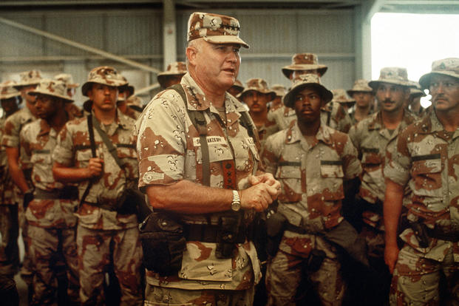
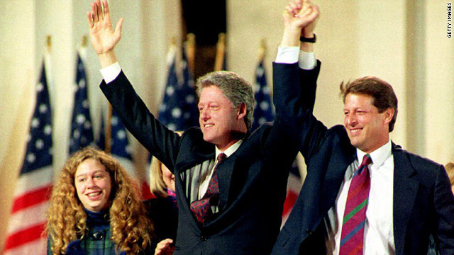
1990’s

Slide 2
Problems in the Persian Gulf
Operation Desert Shield 1991
Iraq- controlled by Saddam Hussein Invades oil rich Kuwait
United States fear he will invade Saudi Arabia next
UN send hundreds of thousands of troops in to protect
Under control of US Gen. Norman Shwartzkopf
Operation Desert Storm
Iraq refused to leave Kuwait and US drops the hammer
Laser guided missiles destroy military and civilian targets
After 6 weeks Iraq still won’t back out!
Send in the troops
After only 100 hours Kuwait is liberated
Saddam signs a cease fire and pulls his troops out
Prez approval rating soared over 90%!!!
Notes:
Persian Gulf War: Timeline of Operation Desert Storm 5:00

Slide 3
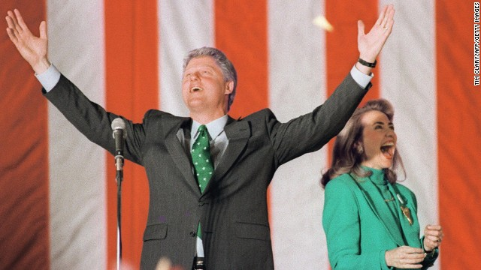
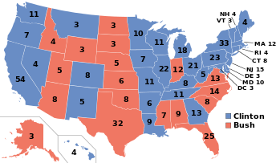
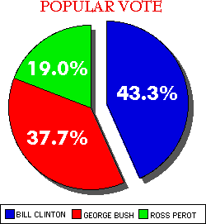
Election of ‘92
Republican Candidate was President Bush
Bush’s popularity soared after Desert Storm…
But a poor economy hurt his re-election chances
Democrats nominated Arkansas Gov. Bill Clinton
Focused on economy and reducing unemployment
Many did not want Bush or Clinton…
A grassroots movement started backing H. Ross Perot
Clinton wins with 43% of the votes!
Becomes 1st POTUS born after WW2
Notes:
SNL Sketch- (10:43)

Slide 4
A “New Democrat”: 1992-2000
Arkansas Gov.
Working class, single parent household
Charismatic
Opposed Vietnam War
New Democrat
Fiscally conservative
Socially moderate
Multilateralism

Slide 5
Main Issues and Events
Tried to allow gays and lesbians to openly serve in the military
Failed. Cultural conservatives and military leaders opposed it. “Don’t ask, don’t tell.”
Tried to reform health care system to benefit the poor and uninsured.
Failed. Pharmaceutical industry, doctors, republicans opposed it.
Balance the Budget.
Succeeded. Returned taxes on the rich back to previous levels. Cut spending. Increased tax credit for low income families
Gun Control
Brady Bill of 1993
Background checks on handguns
Banned 19 kinds of “assault weapons”
Provided 100,000 additional police officers nation wide

Slide 6
“Contract with America”
1994 Congressional Elections
Newt Gingrich
Speaker of the House
Welfare “Reform”
Balanced Budget
More prisons & harder sentences
Defense spending
End abortion

Slide 7
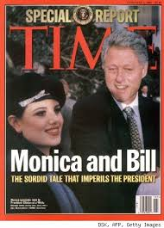
Clinton wins again… but…
Republicans hoped to regain the White House in ’96
But… things were good!
Low unemployment, healthy economy, fixing crime issues.
Clinton easily beats Rep. Bob Dole
Then troubles come for Bill
1998- A scandal emerges with an Affair with an intern- Monica Lewinski
Bill denies all allegations
Evidence suggests it happens
Uh oh, that means he lied under oath!
He becomes 2nd president to be impeached
Congress agreed he lied, but was this enough to fire him???
12 Feb 1999 Congress votes…
Bill survives the impeachment process!
Notes:
Bill & Monica (5:35)

Slide 8
The biggest thing to come out of the 90’s …
https://www.youtube.com/watch?v=1UStbvRnwmQ

