Slide 1
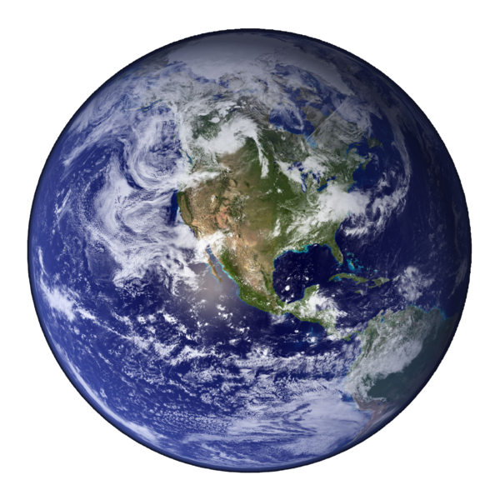
Introduction to World Geography

Slide 2
Introduction
Welcome to world geography!
In this lesson we will be going over some basic concepts relating to world geography
Notes:
Background: By Mdf (Own work) [Public domain], via Wikimedia Commons

Slide 3
Introduction
In this lesson:
Location
People
Flags
Area Comparison
Physical Geography
Forms of government
History
Government leaders
Government organizations
Economy
Culture
Interesting information
Notes:
Background: By Mdf (Own work) [Public domain], via Wikimedia Commons

Slide 4
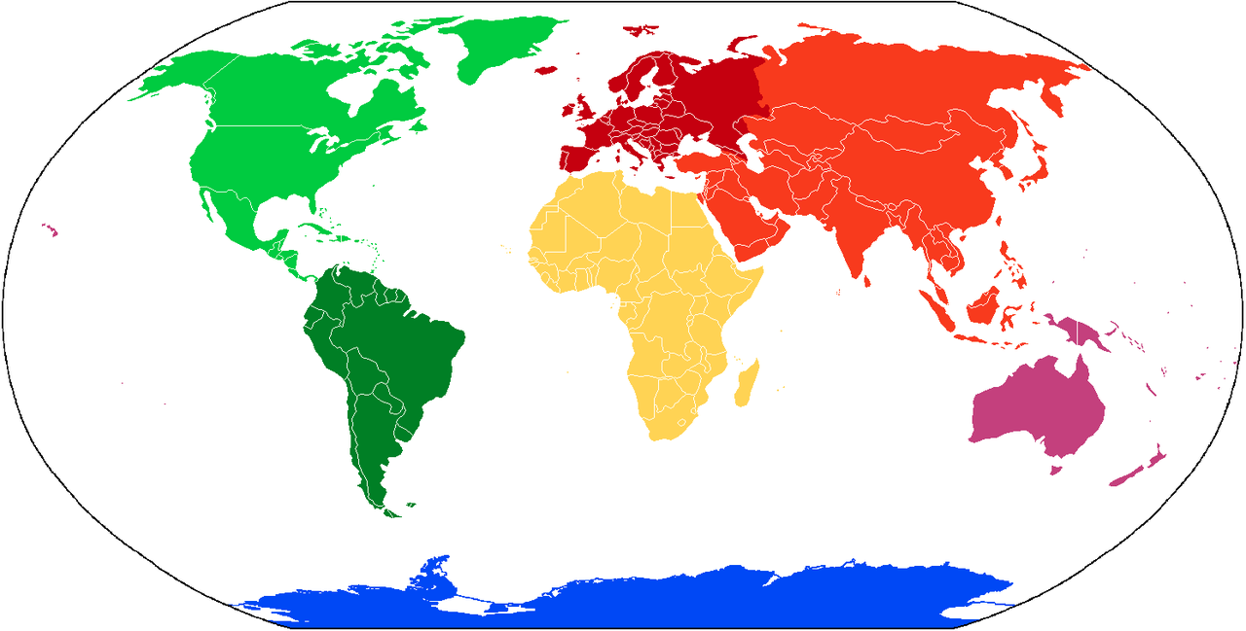
Location
Locations can be broken down by continent
Seven continents:
Africa
Antarctica
Asia
Australia
Europe
North America
South America
Notes:
Picture: "Continents vide couleurs" by User:Cogito ergo sumo - File:BlankMap-World.png. Licensed under Creative Commons Attribution-Share Alike 3.0 via Wikimedia Commons - http://commons.wikimedia.org/wiki/File:Continents_vide_couleurs.png#mediaviewer/File:Continents_vide_couleurs.png

Slide 5
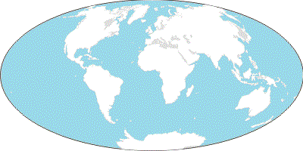
Continents and Oceans
Arctic Ocean
Eurasia
Europe
Asia
North America
Atlantic
Ocean
Pacific Ocean
Africa
Pacific Ocean
South America
Indian
Ocean
Australia
Southern Ocean
Antarctica

Slide 6
Lines of Latitude and Longitude
Arctic Circle
Tropic Circle
Prime Meridian
Equator
Tropic of Capricorn
Antarctic Circle

Slide 7
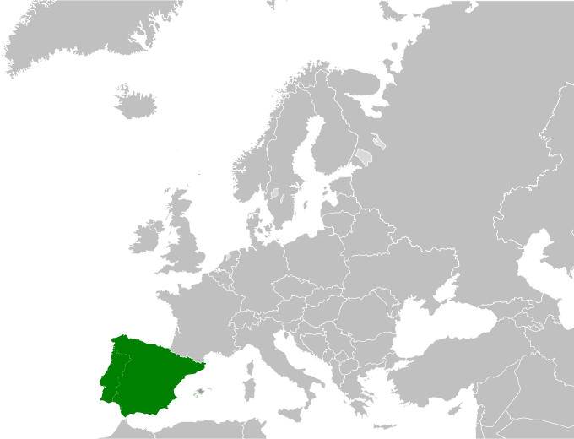
Location
Locations can be broken down further within continents
Example – Spain is on the Iberian Peninsula in Western Europe
Notes:
Map: "Iberian map europe" by derivative work: BBird (talk) BBirdBlank_map_europe.svg: - Blank_map_europe.svg. Licensed under Public domain via Wikimedia Commons - http://commons.wikimedia.org/wiki/File:Iberian_map_europe.svg#mediaviewer/File:Iberian_map_europe.svg

Slide 8
People
When learning about new countries, it is important to learn the capital and largest city of each country
Often they are the same city
Background: Palace of Westminster in London, the United Kingdom’s capital and largest city
Notes:
Background: by Daniel Bron (Own work) [CC-BY-SA-3.0 (http://creativecommons.org/licenses/by-sa/3.0)], via Wikimedia Commons

Slide 9
People
Population– how many people live in each country?
Example – United States:
Population: 318,892,103 (July 2014 est.)
World rank: 3rd most populous country
Background: Times Square in New York City
Notes:
Picture: http://pixabay.com/en/times-square-new-york-nyc-broadway-232812/

Slide 10
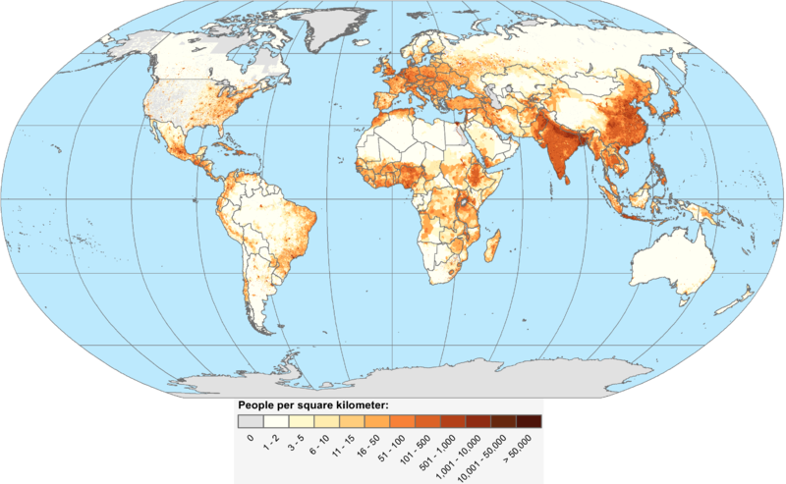
Five Most Populous Countries
All are July 2014 estimates
1. China
1,355,692,576
2. India
1,236,344,631
3. United States
318,892,103
4. Indonesia
253,609,643
5. Brazil
202,656,788
World population density map
Notes:
Map: By CIESIN (Center for International Earth Science Information Network), Columbia University [CC-BY-3.0 (http://creativecommons.org/licenses/by/3.0)], via Wikimedia Commons

Slide 11
Physical Geography
Physical geography relates to the natural environment
Physical geographic features can include, but are not limited to:
Deserts
Forests
Lakes
Mountain ranges
Plateaus
Rivers
Notes:
Background: by Rdevany (This is a digital photograph that I took) [GFDL (http://www.gnu.org/copyleft/fdl.html) or CC-BY-SA-3.0 (http://creativecommons.org/licenses/by-sa/3.0)], via Wikimedia Commons

Slide 12
Physical and Political Maps
Physical Maps
Demonstrate landforms
EX: Mountains, lakes, rivers, oceans, deserts
Political Maps
Show government borders
EX: Countries, states, cities

Slide 13
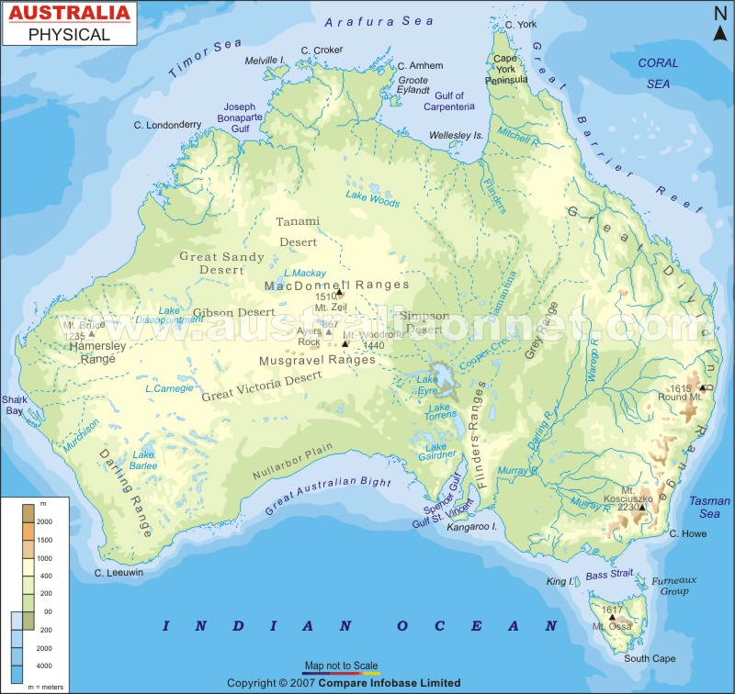
Physical
Features

Slide 14
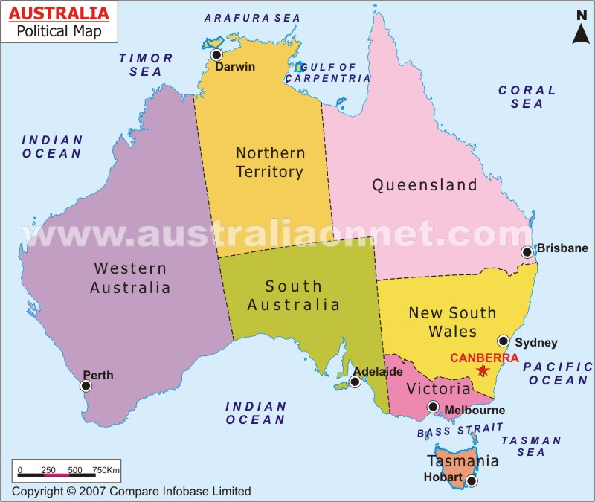
Political
Map

