Slide 1
The Scientific Revolution vs The Catholic Church

Slide 2
The Scientific Method
By the early 1600s, a new approach to science had emerged, known as the Scientific Method.
Scientific Method –method used to confirm findings and to prove or disprove a hypothesis.
Scientists observed nature, made hypotheses, or educated guesses, and then tested these hypotheses through experiments.
Unlike earlier approaches, the scientific method did not rely on the classical thinkers or the Church, but depended upon a step-by-step process of observation and experimentation.

Slide 3
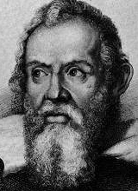
Galileo Galilei
Galileo Galilei was an Italian astronomer who built upon the scientific foundations laid by Copernicus and Kepler.
Galileo also discovered that objects fall at the same speed regardless of weight.

Slide 4
Galileo Galilei
Galileo’s discoveries caused an uproar because like Copernicus, Galileo was contradicting Ptolemy.
The Church was against Galileo because it claimed that the Earth was fixed and unmoving.
When threatened with death before the Inquisition in 1633, Galileo recanted his beliefs, even though he knew the Earth moved.
Galileo was put under house arrest, and was not allowed to publish his ideas.

Slide 5
Conflicts between scientists and the church.
The new field of science was putting forth ideas that conflicted with the teachings of the church.
One such theory was that the earth revolved around the sun, not that the sun revolved around the earth, as the church taught.
Church officials believed that when scientific theories contradicted the church, they weakened the church.
The church feared that people might start to doubt the key elements of their faith.

Slide 6
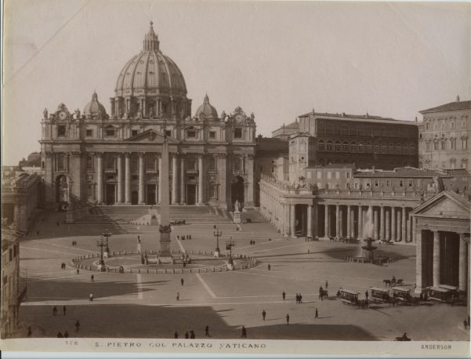
Science vs. the Church
Prior to Scientific Revolution, the Catholic Church was the authority for society.
Publication of new scientific books challenged the Bible and Church teachings.
The Church’s political, social, and economic authority were brought into question

Slide 7
Science vs. the Church
Consequences of controversy
Galileo forced to recant his teachings and excommunicated from the Church
* The Catholic Church ordered Galileo to abandon his ideas! WHY?
His discoveries threatened the Biblical concept of the universe – humans were no longer at the center and God was no longer in a specific place.

