Slide 1
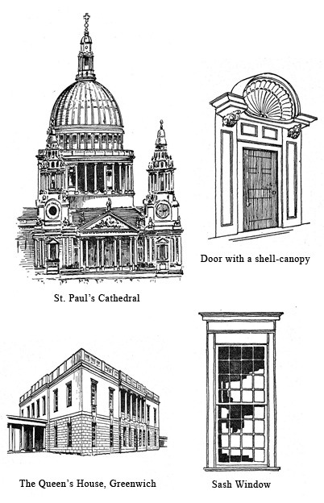
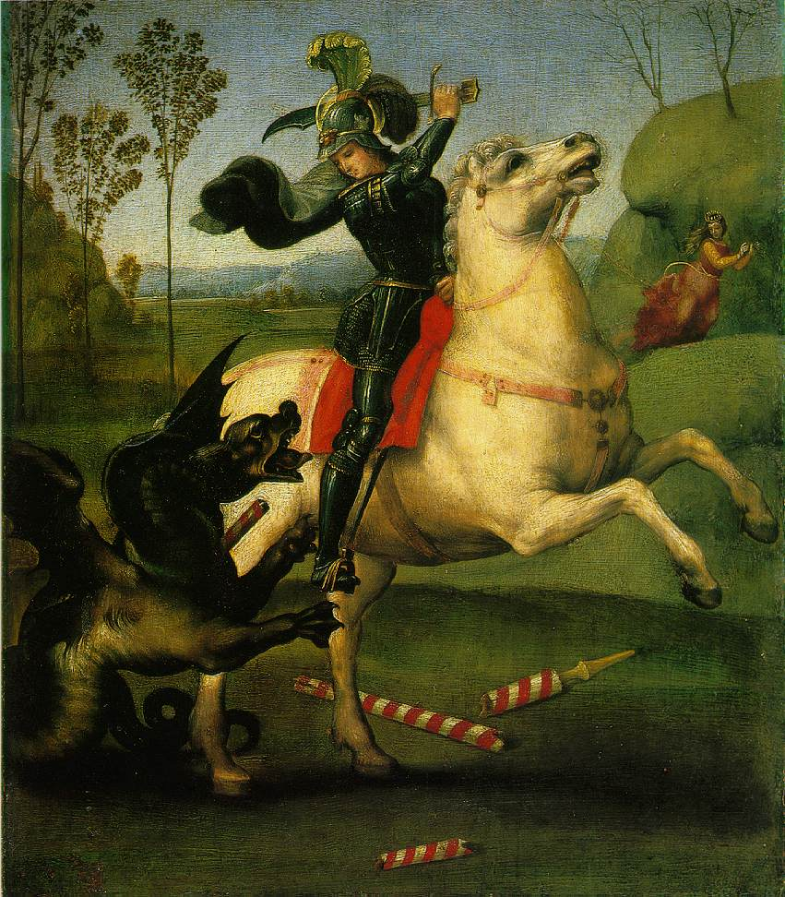
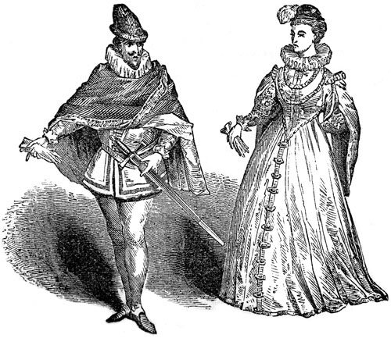
~ late 14th century through the early 16th century ~

Slide 2
Renaissance
“Re-Birth”
An Era most famous for its development of Thinking and Art. (music, literature, etc)
Created an explosion of artistic and intellectual creativity all throughout Europe

Slide 3
Humanism
The major characteristic of Renaissance:
Humanism: the major cultural movement during the renaissance that changed the focus to the human mind and placed value on individual thinking and beliefs.

Slide 4
Overview
As trade with the East increased, Europeans rediscovered the classical knowledge of ancient Greece and Rome.
These ideas caused a struggle in Christianity known as the Reformation.
The Renaissance and Reformation were very similar in that they both encouraged people to question tradition.**
This led to the era known as “The Renaissance”
In Italy the growth of wealthy trading cities and new ways of thinking helped lead to a rebirth of the arts and learning.
Renaissance ideas soon spread beyond Italy to northern Europe by means of trade, travel, and printed material, influencing the art and ideas of the Europe and later the rest of the world.

Slide 5
Silk Road
The Silk Road stretched from China to the Mediterranean Sea.

