Slide 1
Chinese Communist Revolution
Global History Unit #6

Slide 2
Two Chinas

Slide 3
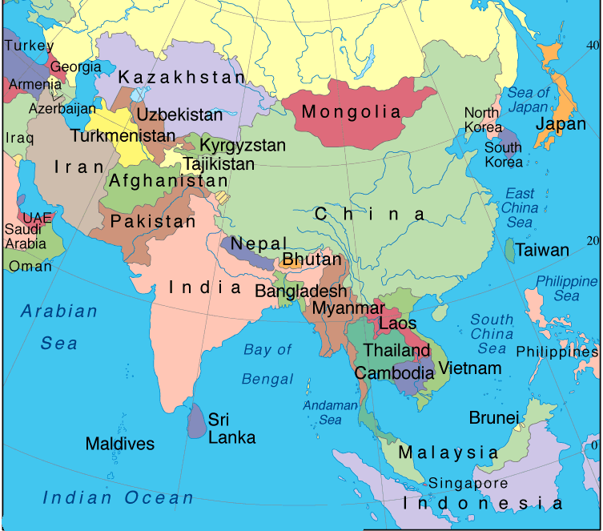
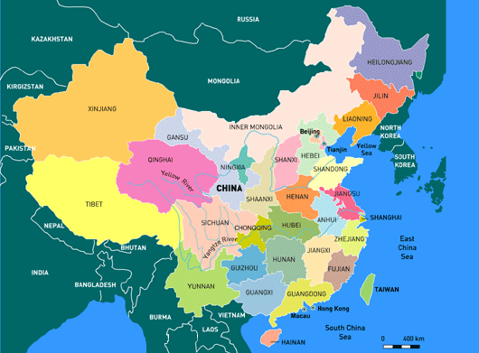
Map of China and Taiwan

Slide 4
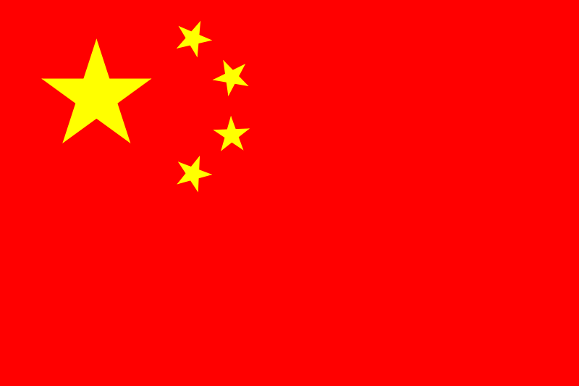
VS
Today, China is the most populous nation in the world.
There are technically 2 Chinas:
The People’s Republic of China-a communist state on the Asian mainland.
Taiwan, aka the Republic of China-is a small island that today is one of the Asian Tigers. It has a non-communist government.

Slide 5
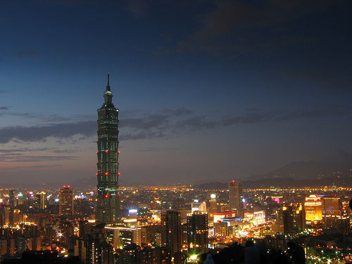
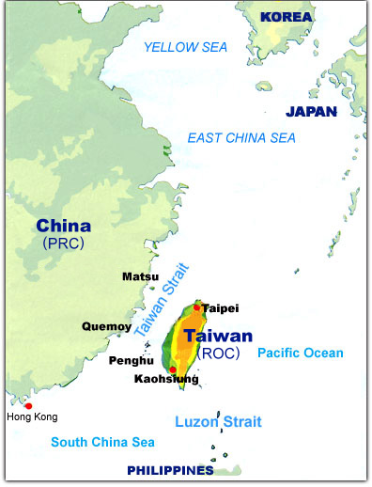
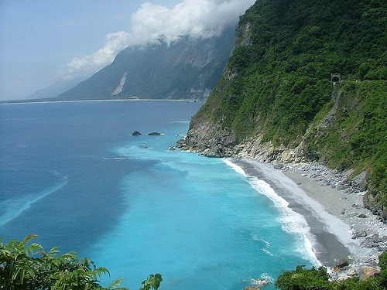
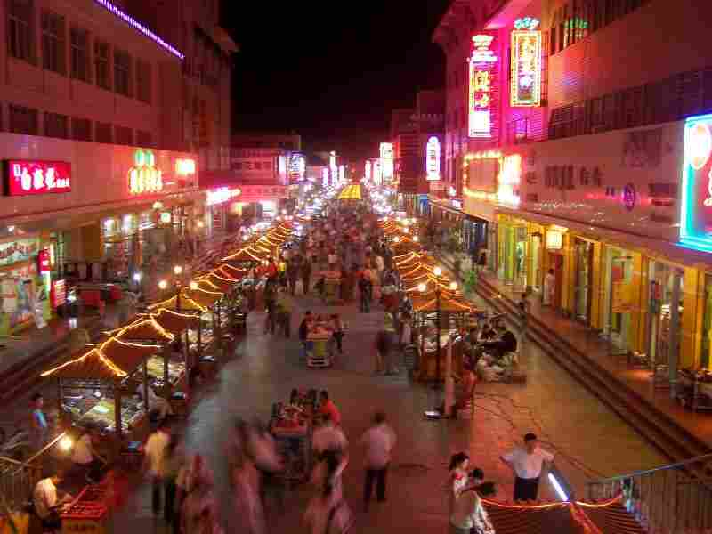
The People’s Republic of China still considers Taiwan a part of China proper.
Efforts to re-unite the 2 Chinas have sometimes led to tension because Taiwan values its independence.

Slide 6
Communist Rise To Power 1936-1949

Slide 7
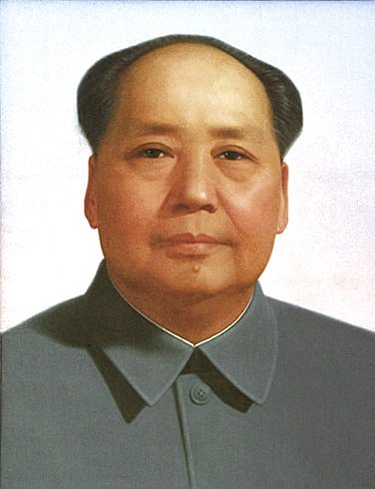
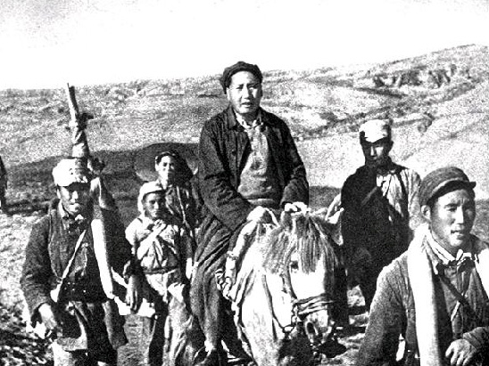
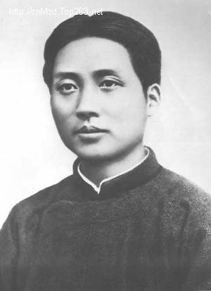
Mao Zedong emerged as the leader of the Communists in the 1930s.
Along with 100,000 of his followers, Mao fled the Guomindang, or the anti-communist Nationalist Party, forces in 1934 in a retreat known as the Long March.

Slide 8
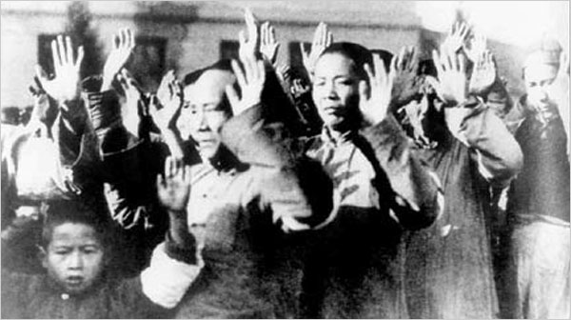
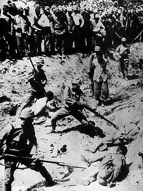
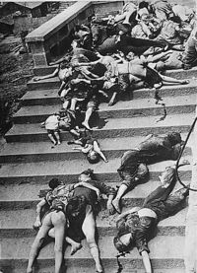
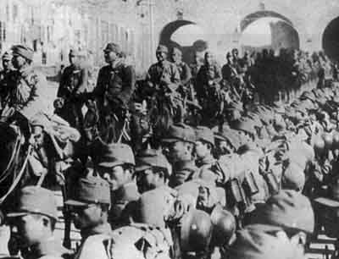
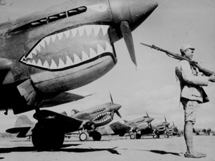
Mao set up a base camp in northern China with about 20,000 survivors of the march.
In the years that followed, the Communists, the Guomindang, and Japanese invaders battled for control of China.

Slide 9
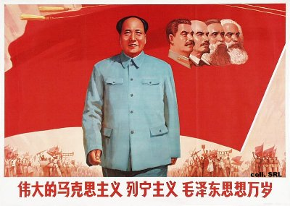
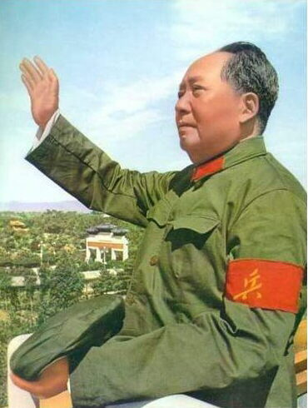
After World War II, China’s civil war continued.
Finally, in 1949, Mao’s Communists were victorious in defeating the Guomindang forces.
The followers of the Nationalist Party fled to the island of Taiwan.

Slide 10
Communism Under Mao Zedong

Slide 11
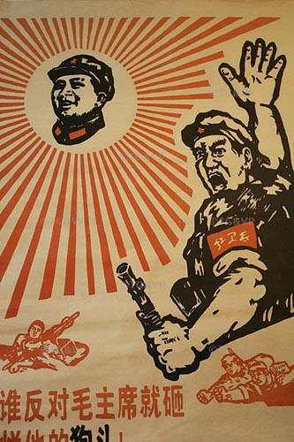
The Communists set up the People’s Republic of China (PRC) in 1949.
They wanted to transform China from an agricultural society into a modern industrial nation.
Under communism, literacy increased, old landlord and business classes were eliminated, and rural Chinese were provided with health care.

Slide 12
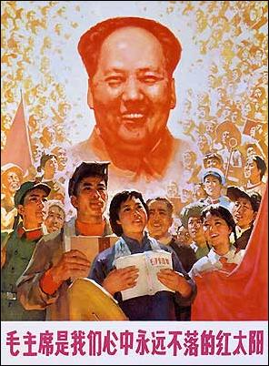
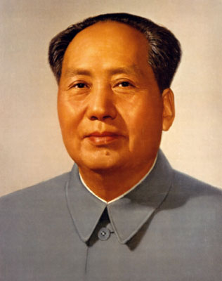
However, Mao set up a one-party dictatorship that denied people basic rights and freedoms.

Slide 13
The Great Leap Forward

Slide 14
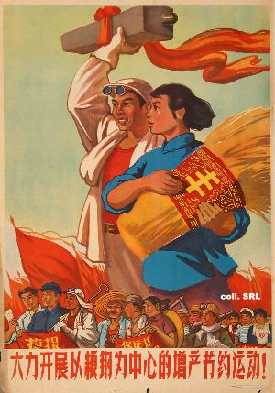
In 1958, Mao launched a program called the Great Leap Forward.
He called on the people of China to increase agricultural and industrial output.
To make farms more productive, he created communes, groups of people who live and work together.

Slide 15
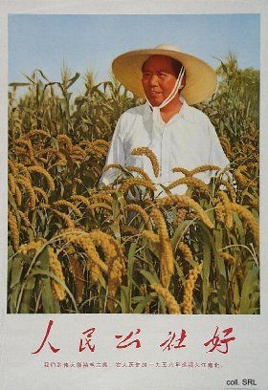
The Great Leap Forward ultimately failed.
Commune-based industries turned out poorly made goods.
At the same time, agricultural output declined.
Bad weather added to the downturn, creating widespread famine.

Slide 16
The Cultural Revolution & The Red Guard

Slide 17
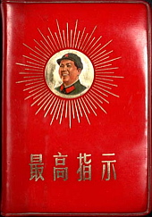
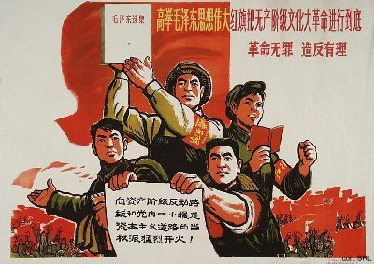
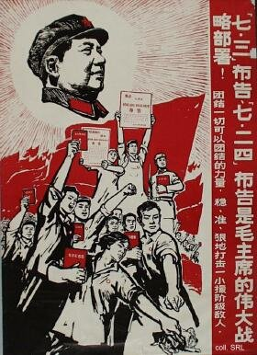
In 1966, Mao launched the Cultural Revolution to renew people’s loyalty to communism and establish a more equitable society.
Mao feared that revolutionary peasants and workers were being replaced by intellectuals in running the country.

Slide 18
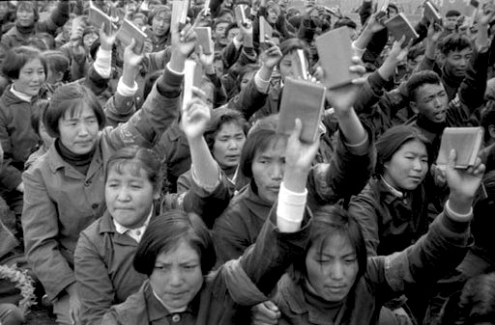
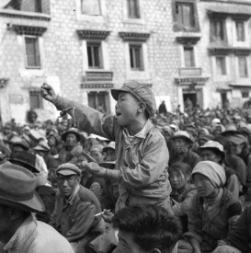
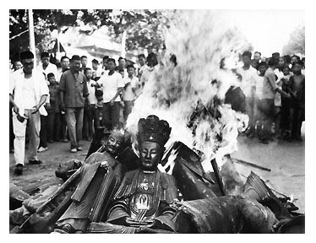
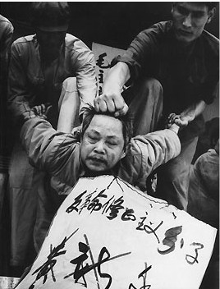
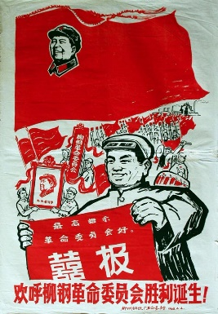
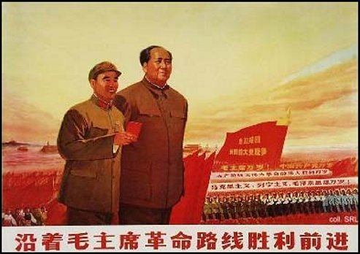
He shut down schools and universities throughout China and urged Chinese students to experience the revolution for themselves.
Students formed groups of fighters called the Red Guards.
They attacked professors, government officials, and factory managers, many of whom were exiled or executed.

Slide 19
United States Recognition of Communist China

Slide 20
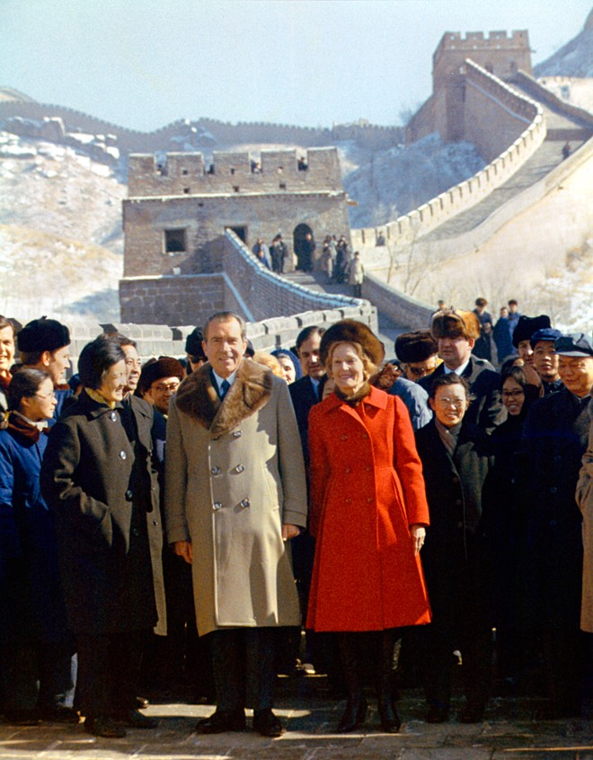
Due to the fears of communism during the early stages of the Cold War, the United States refused to recognize the People’s Republic of China.
By the 1970s, however, this situation was changing.
China won admission into the United Nations in 1971 and President Richard Nixon visited Mao Zedong in Beijing in 1972.

Slide 21
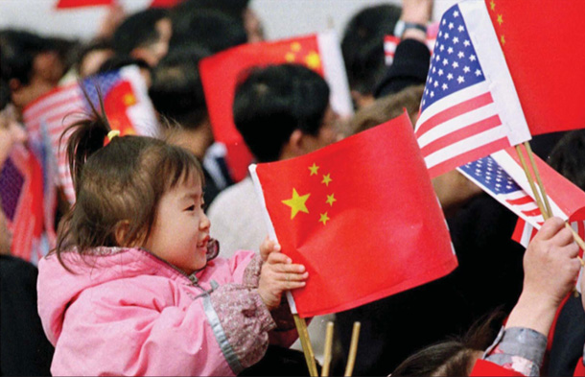
Finally, in 1979, the United States officially recognized the People’s Republic of China.

Slide 22
Communism Under Deng Xiaoping

Slide 23
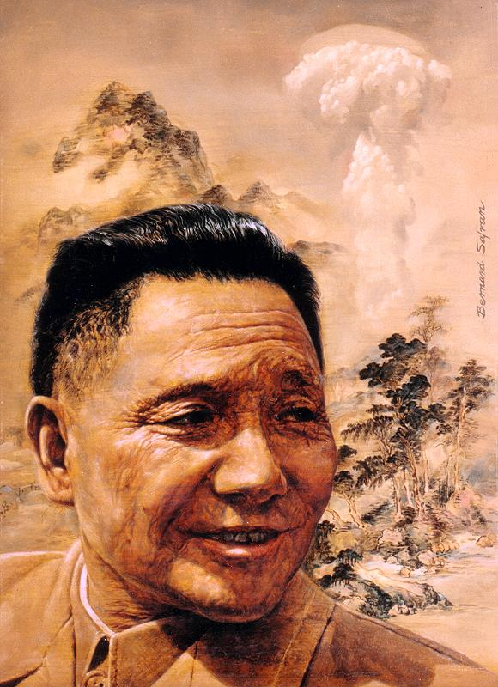
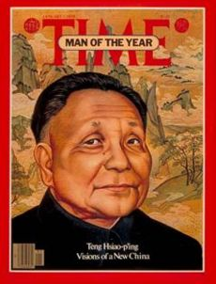
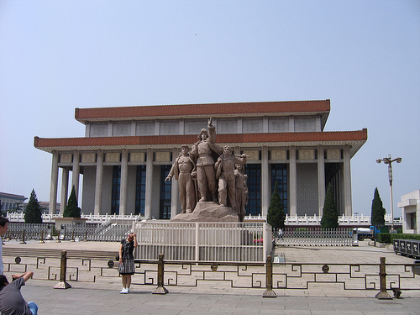
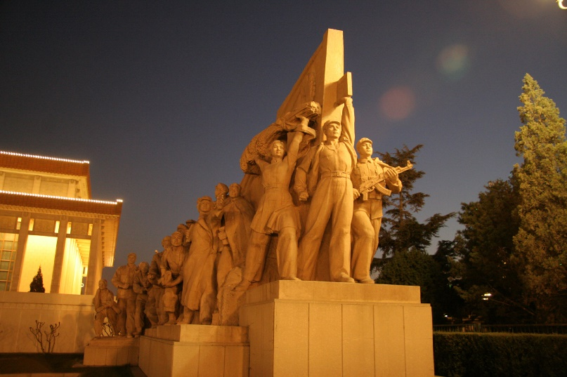
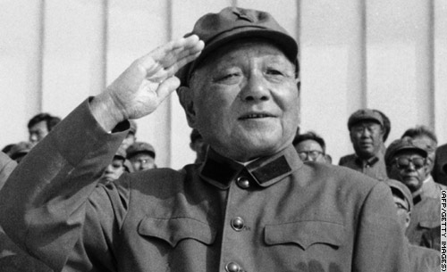
In 1976, Mao Zedong died and Deng Xiapong took control.
His leadership would bring more economic freedom but little political change.

Slide 24
Economic Reforms: The Four Modernizations

Slide 25
To make China a more modern country, Deng promoted foreign trade and more contact with western nations.
He also introduced the Four Modernizations.
These were concentrated into four areas:
1. Farming-methods were modernized and mechanized
2. Industry-was upgraded and expanded
3. Science and Technology-were promoted and developed
4. Defense-systems and military forces were improved

Slide 26
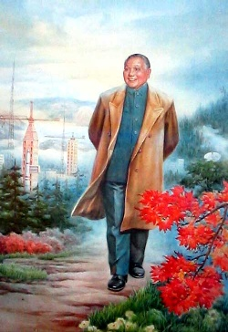
Limited Privatization
Deng eliminated Mao’s unpopular communes.
He allowed land to be leased to individual farmers.
This system increased agricultural output.
The government also allowed some private businesses to produce goods and offer services.

Slide 27
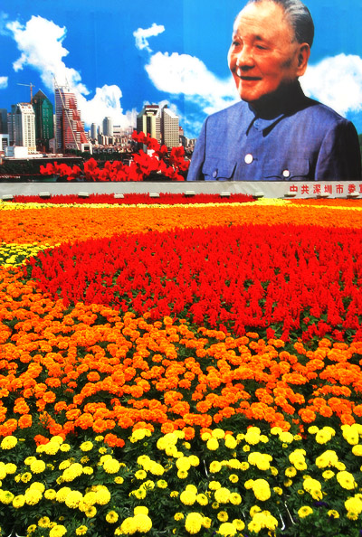
Foreign Investment
Deng also welcomed foreign technology and capital.
The government set up special enterprise zones where foreigners could own and operate businesses.

Slide 28
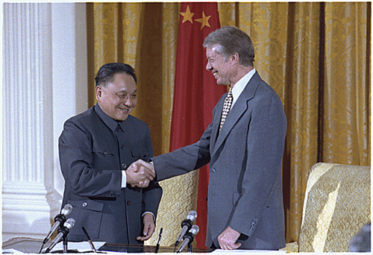
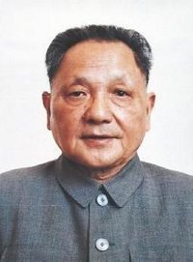
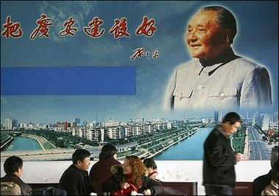
Results of Economic Reforms
Deng’s policies had both positive and negative results.
The economy grew, and some Chinese enjoyed a better standard of living.
Foreign relations and trade improved.
Crime and corruption grew, however, and the gap between rich and poor widened.

Slide 29
Tiananmen Square

Slide 30
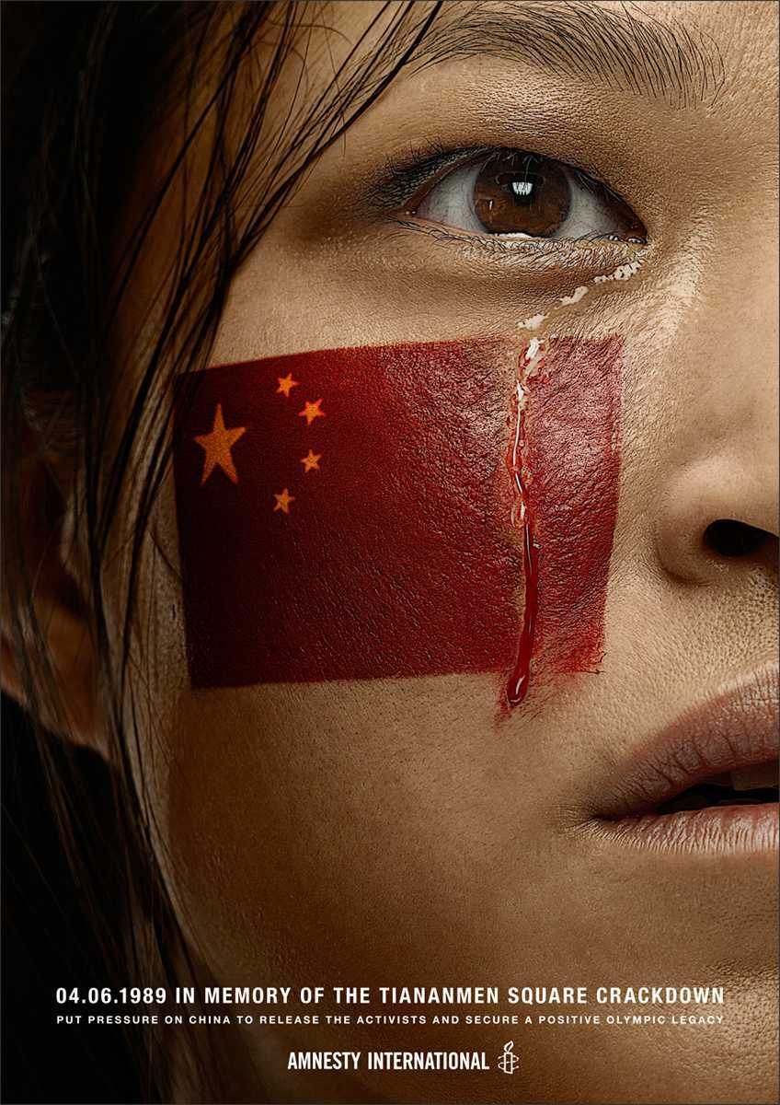
The government was willing to grant economic reforms but not political ones.
In May 1989, demonstrators in Beijing occupied Tiananmen Square, demanding more rights and freedoms.
When they refused to disperse as ordered, the government sent in troops and tanks.

Slide 31
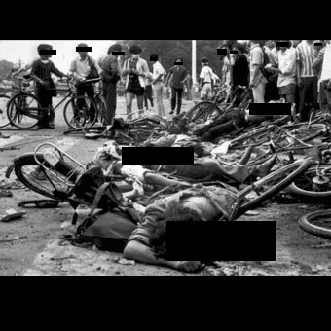
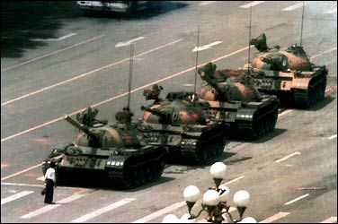
Thousands of Chinese were killed or wounded.
The incident showed how important it was for China’s communist leaders to maintain control.
During the 1990s efforts were made to force China to end human rights violations.
However, to date, these efforts have had limited effects.

Slide 32
Return of Hong Kong

Slide 33
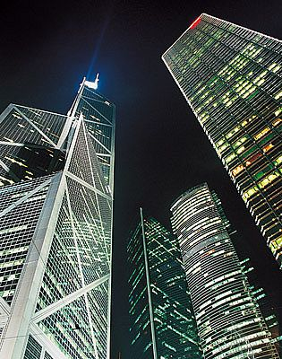
In 1842, Britain had gained the island of Hong Kong, off the northern coast of China.
In the 1980s, Britain and China decided that Hong Kong would return to Chinese rule in 1997.
China agreed not to change Hong Kong’s social or economic system for 50 years and to allow the island a degree of self-rule.

Slide 34
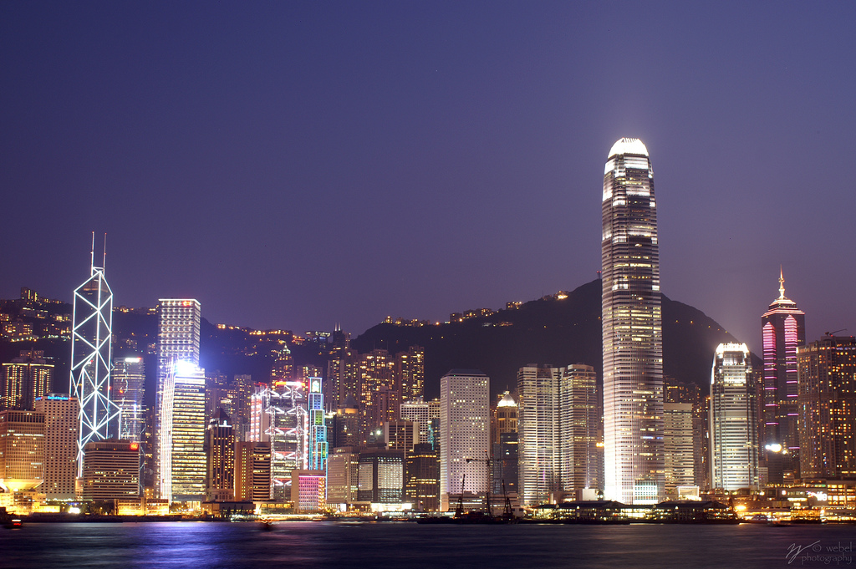
The island was officially turned over to China on July 1, 1997.

Slide 35
The Role of Women: Communist China Compared To Dynastic China

Slide 36
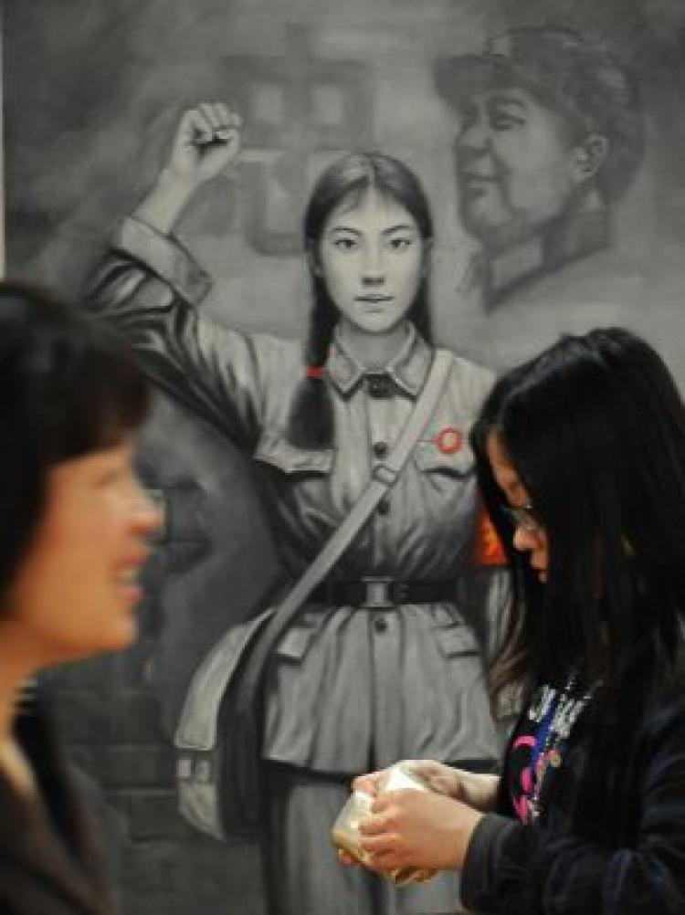
Traditionally, in Dynastic China, women were treated as inferior to men.
The only role for a woman was that of a wife.
In Communist China, however, women gained some rights.
Under the new Chinese constitution, women won equality under the law.

Slide 37
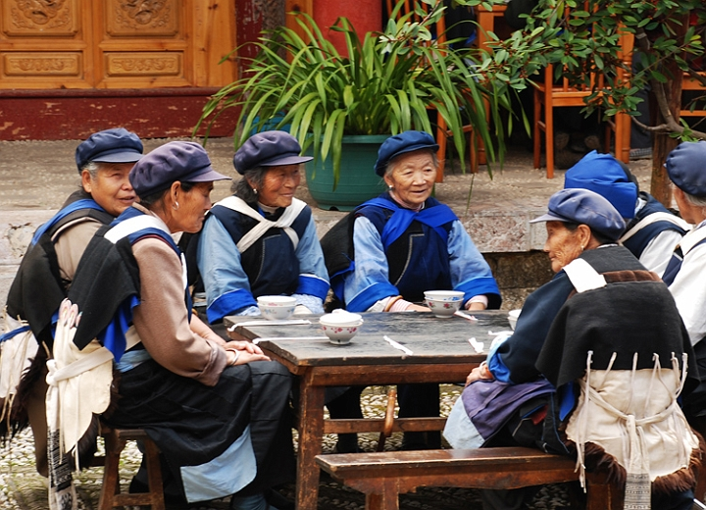
They now were expected to work alongside men on farms and in factories.
However, only a few women had top jobs in government and commonly were not paid the same as men for doing the same work.

Slide 38
SUMMARY
The Communists, under Mao Zedong, rose to power in China after World War II. Their appeal to peasants and to women, their superior army, and lack of support for the Nationalists led to victory for the Communists. The communist government severely restricted the rights and freedoms of most Chinese. Later leaders, such as Deng Xiaoping, allowed free market reforms but little political freedom. Violations of human rights in China have often made relations with China and the United States difficult.

