Slide 1
Martin Luther: The Protestant Reformation
The Protestant Reformation
1300 – 1570 CE
1
Notes:
1

Slide 2
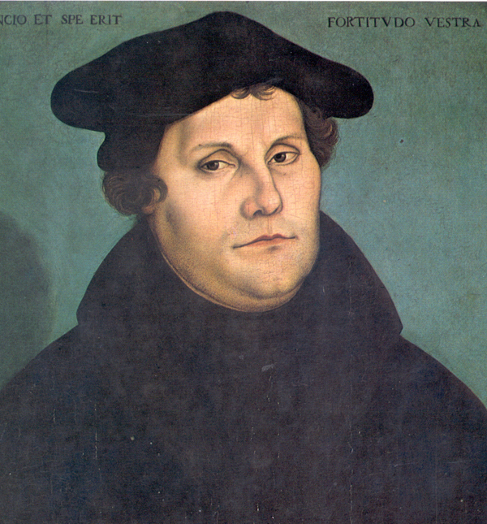
Martin Luther
Notes:
2
Martin Luthe,r by Lucas Cranach the Elder; source: http://upload.wikimedia.org/wikipedia/commons/6/61/Luther46c.jpg

Slide 3
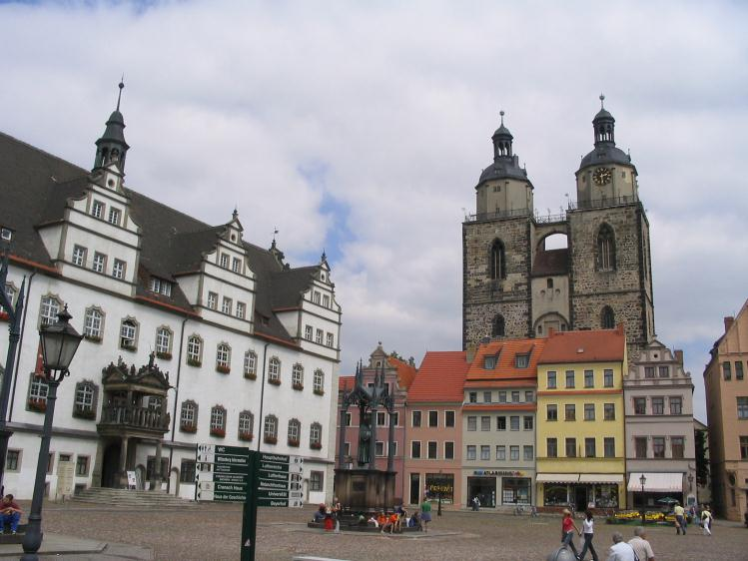
Who was Martin Luther?
Born in Germany in 1483.
After surviving a violent storm, he vowed to become a monk.
Sparked a religious revolt know as the Protestant Reformation
Died in 1546.
Notes:
3
Market square in modern Wittenberg; source: http://upload.wikimedia.org/wikipedia/commons/b/b0/Wittenberg_Market_square.JPG

Slide 4
Definitions
Protest
To express strong objection
Reform
To improve by correcting errors
Notes:
4

Slide 5
Problems in the Church
Corruption
Political Conflicts
No one is allowed to question the tradition of the church
Notes:
5

Slide 6
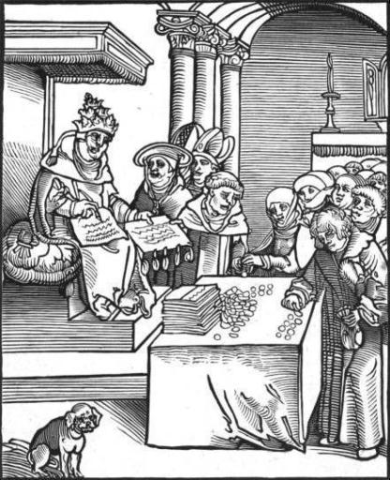
Corruption
The Church raised money through selling indulgences.
The church was getting too RICH
It was a crime for anyone other than a priest to interpret the bible
Notes:
6
Woodcut of the pope selling indulgences, from Passionary of the Christ and Antichrist. Source: http://upload.wikimedia.org/wikipedia/commons/6/6a/Antichrist1.jpg.
Plenary indulgence; inscription on the left transept of the Basilica of St. John Lateran, Rome. © Marie-Lan Nguyen / Wikimedia Commons. Source: http://en.wikipedia.org/wiki/File:Indulgence_San_Giovanni_in_Laterano_2006-09-07.jpg

Slide 7
Advantages of Buying Indulgences Go Directly to Heaven!
Do not go to Hell!
Do not go to Purgatory!
Get through Purgatory faster!
Do not pass Go!
Notes:
7

Slide 8
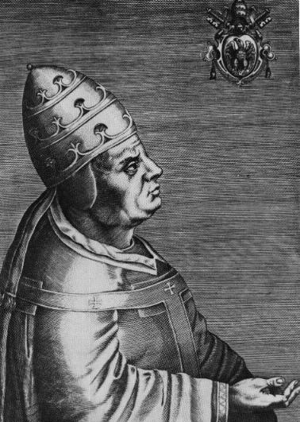
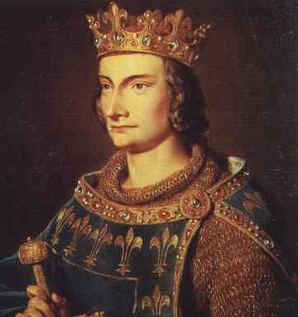
Political Conflict
KINGS AND QUEENS
POPES
Notes:
8
King Philip IV of France (ruled 1285 – 1314); source: http://en.wikipedia.org/wiki/File:Philippe_IV_Le_Bel.jpg
Pope Urban VI (reigned 1378 – 1389); source: http://en.wikipedia.org/wiki/File:Urbanus_VI.jpg

Slide 9
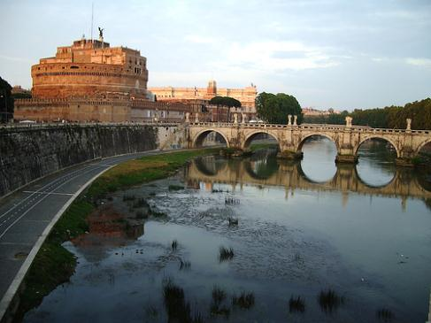
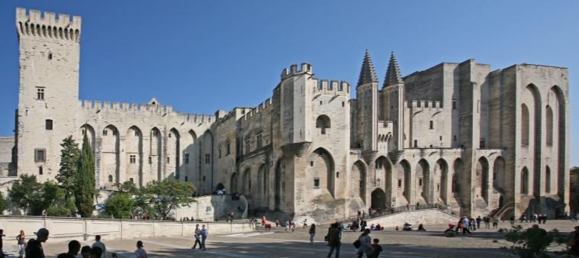
Papal Schism
Rome
Avignon
In 1301, the king tried to tax the French clergy.
The pope threatened to excommunicate the king and so was arrested. He was later released.
The next pope, Clement V, moved the headquarters of the Church from Rome to Avignon in southern France.
Many people felt that the French kings controlled the Church.
Notes:
9
Rome and the Tiber river, photo by Dana M. Johnson; source: http://upload.wikimedia.org/wikipedia/commons/c/ca/Castel_D%27Angelo_from_across_the_Tiber.jpg.
Avignon; photo by Jean-Marc Rosier; source: http://upload.wikimedia.org/wikipedia/commons/d/db/Avignon%2C_Palais_des_Papes_by_JM_Rosier.jpg

Slide 10
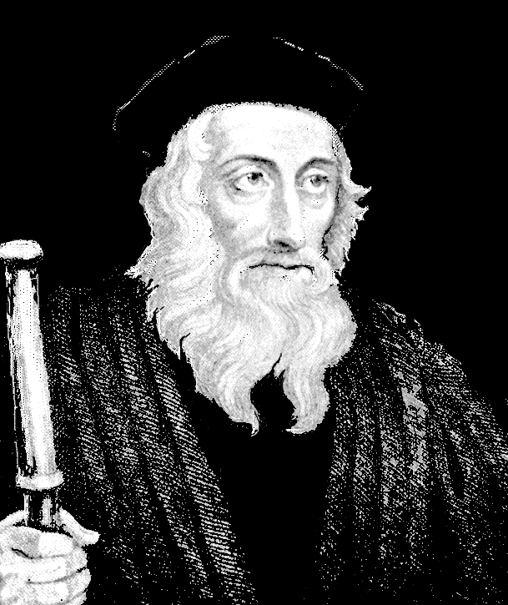
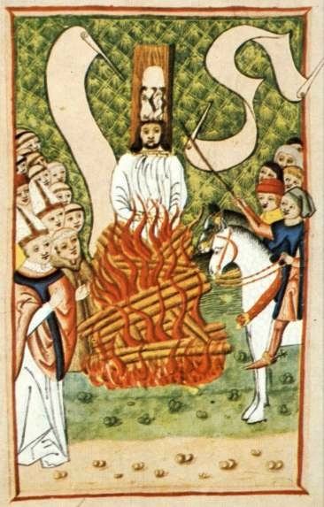
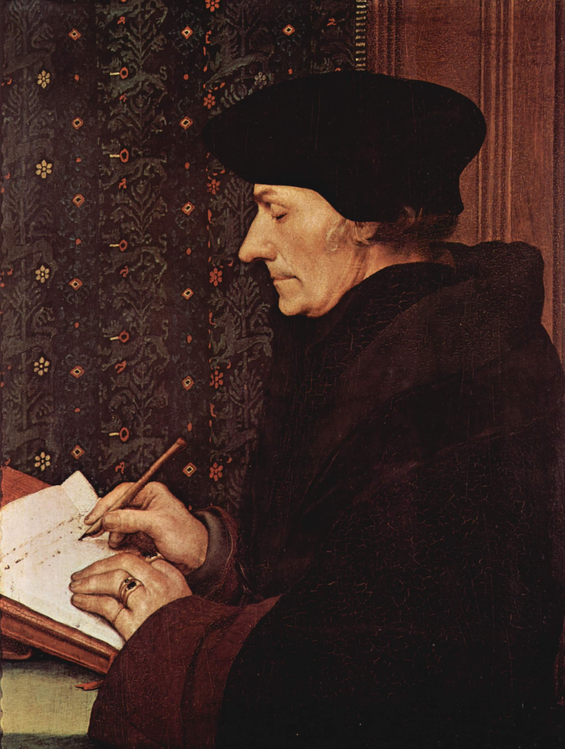
Calls for Reform
John Wycliffe (1330-1384)
Questioned the authority of the pope
Jan Hus (1370-1415)
Criticized the vast wealth of the Church
Desiderius Erasmus (1469-1536)
Attacked corruption in the Church
Notes:
10
John Wycliffe, © John M. Kennedy; source: http://upload.wikimedia.org/wikipedia/commons/3/3e/Jwycliffejmk.jpg.
Jan Hus at the stake; source: http://upload.wikimedia.org/wikipedia/commons/b/b0/Jan_Hus_at_the_Stake.jpg.
Erasmus by Hans Holbein the Younger; source: http://upload.wikimedia.org/wikipedia/commons/8/89/Hans_Holbein_d._J._047.jpg

Slide 11
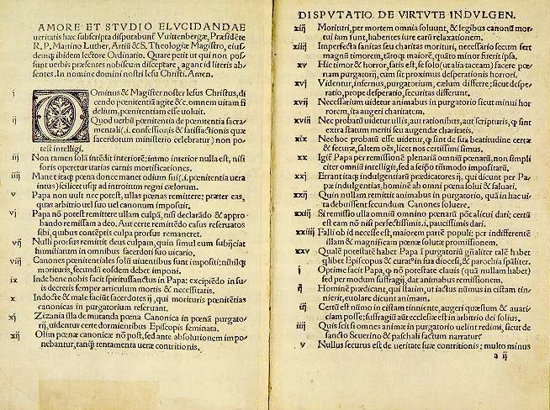
Luther Looks for Reforms
Luther criticized Church practices, like selling indulgences.
He wanted to begin a discussion within the Church about the true path to salvation.
He nailed his Ninety-Five Theses, or arguments, to the door of Wittenberg cathedral for all to see.
Notes:
11
Luther’s Ninety-Five Theses; source: http://upload.wikimedia.org/wikipedia/commons/8/81/95Thesen.jpg

Slide 12
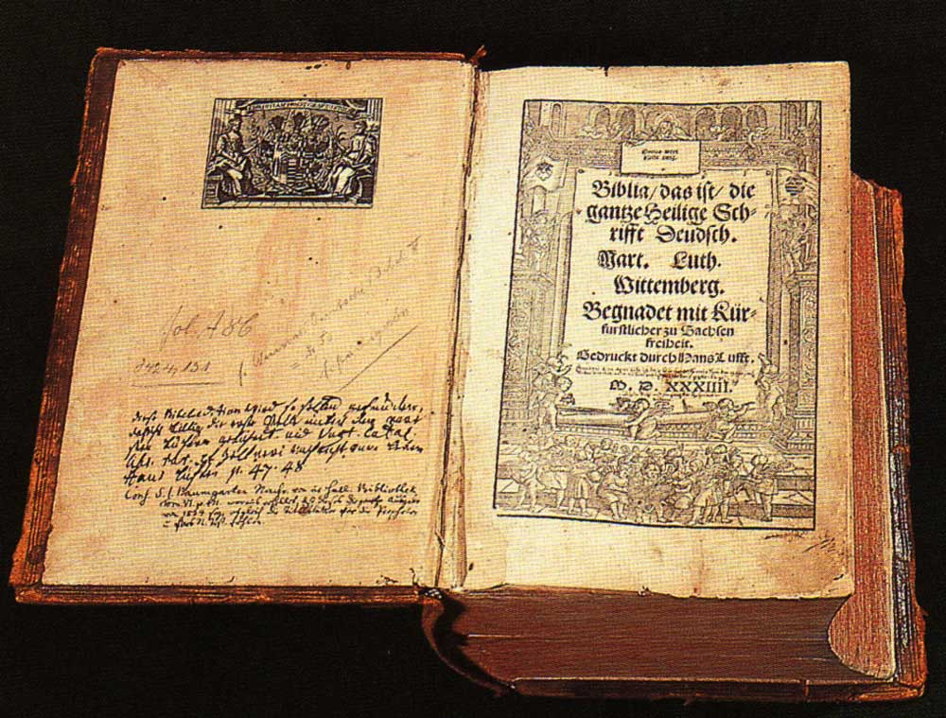
Protestant Teaching: Justification by Faith Alone
The Bible is the only source of truth.
People can read and understand the Bible themselves.
Salvation comes only through faith in Christ.
Luther’s Bible
Notes:
12
Luther’s Bible; source: http://upload.wikimedia.org/wikipedia/commons/0/03/Lutherbibel.jpg

Slide 13
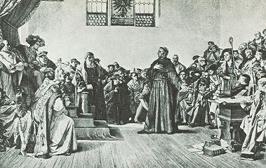
Excommunication
Pope Leo X demanded that Luther recant 41 of his Ninety-Five Theses.
Luther was brought before the Diet of Worms.
In January 1521, Luther was excommunicated from the Church.
Notes:
13
Luther before the Diet of Worms; source: http://upload.wikimedia.org/wikipedia/commons/1/1d/Diet_of_Worms.jpg

Slide 14
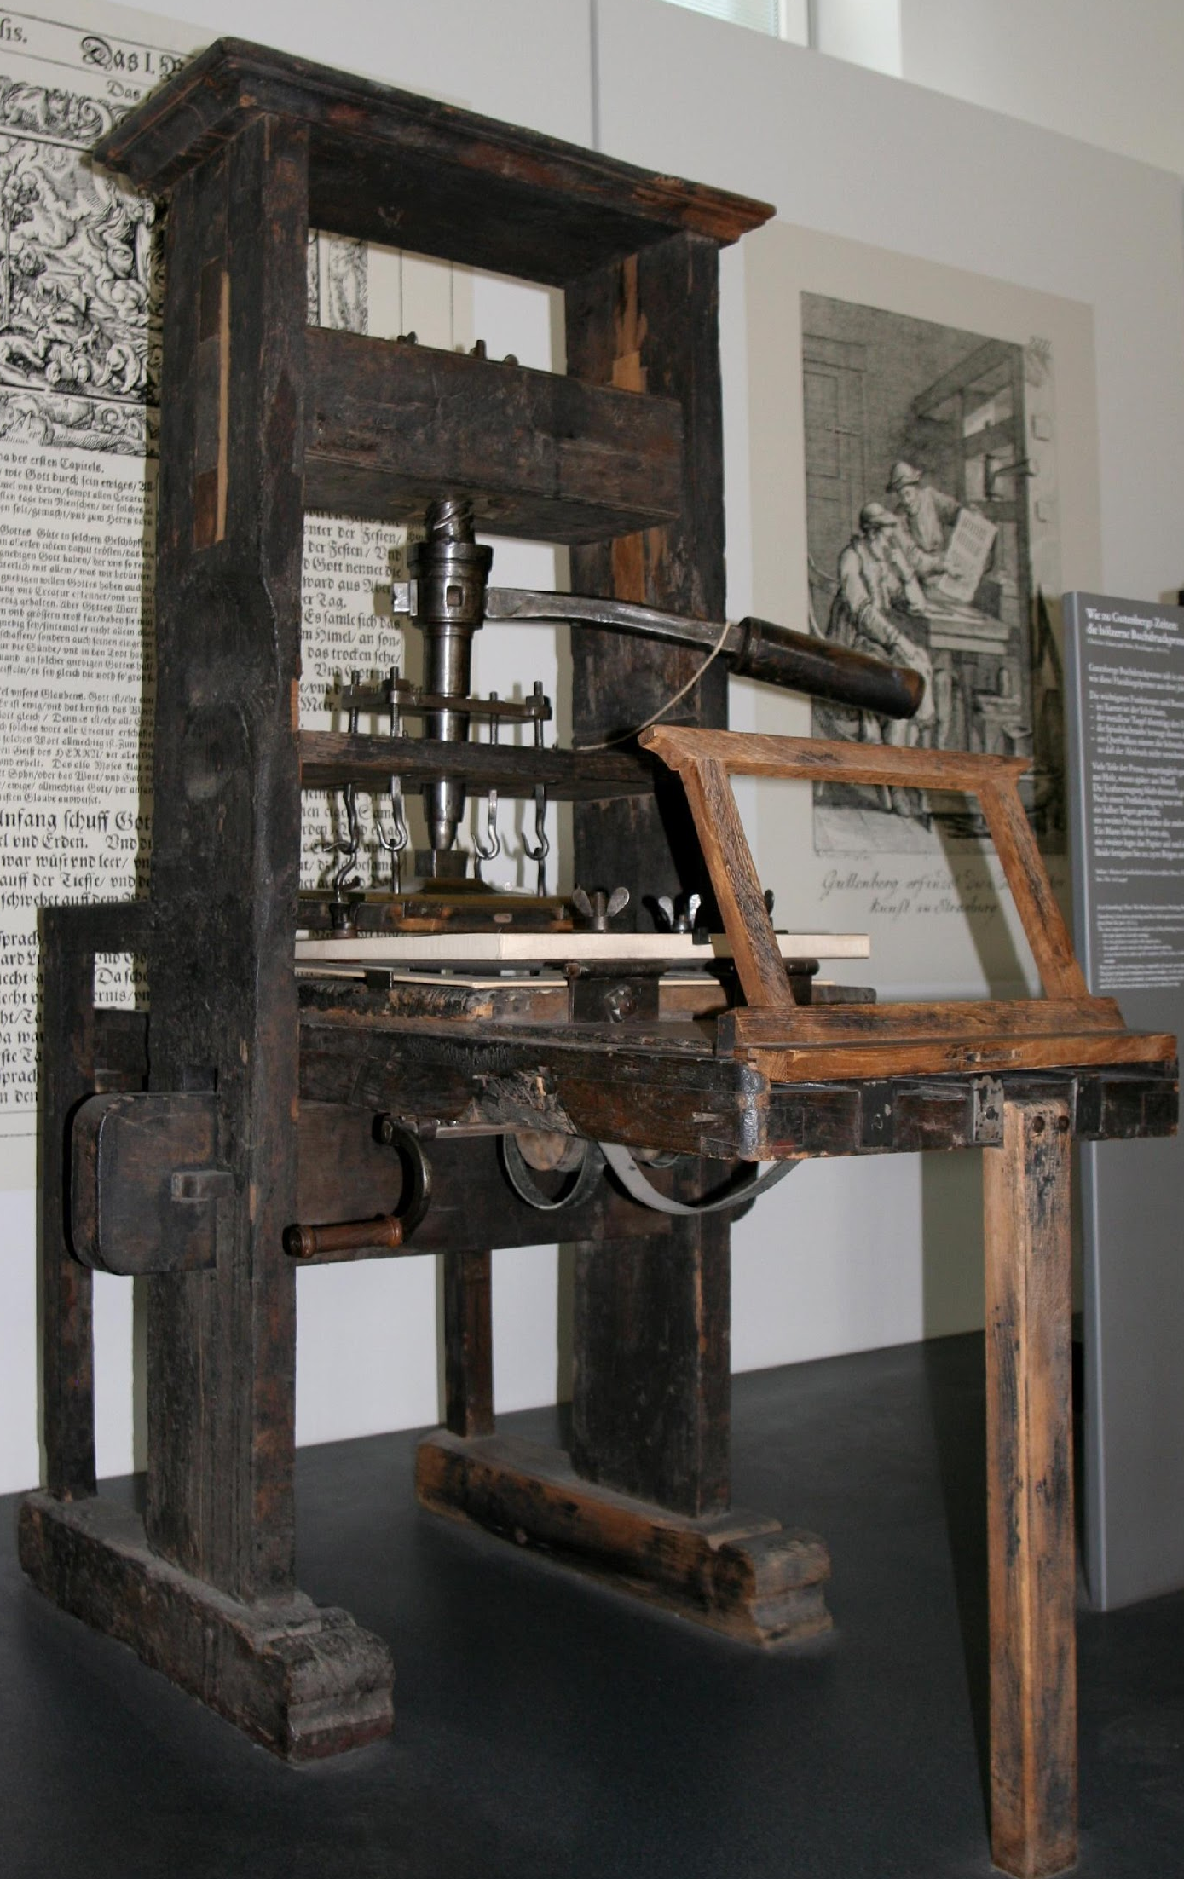
The Printing Press
Luther’s ideas spread quickly with the help of the printing press.
Luther’s supporters distributed copies of his speeches and essays far and wide.
Millions of people sided with Luther against the Roman Catholic Church.
Notes:
14
Printing press; source: http://upload.wikimedia.org/wikipedia/commons/1/17/Handtiegelpresse_von_1811.jpg

Slide 15
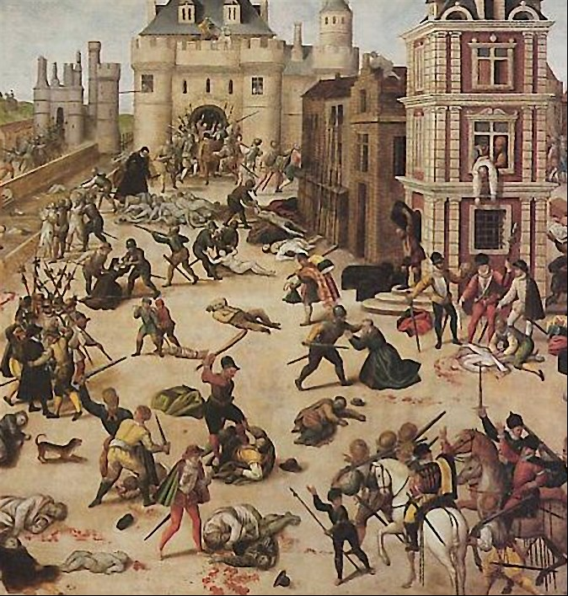
A New Church
Luther soon had many followers.
His supporters began to organize a new Christian denomination.
Several German princes supported Luther.
Lutherans and Catholics fought each other.
The first wars ended with the Treaty of Augsburg, but fighting in Europe over religion continued to the mid-seventeenth century.
Saint Bartholomew’s
Day massacre
Notes:
15
Saint Bartholomew’s Day massacre, by François Dubois; source: http://upload.wikimedia.org/wikipedia/commons/8/8d/Massacre_saint_barthelemy.jpg

Slide 16
Lutheranism
Luther’s followers disagreed with many of the teachings of the Catholic Church.
They rejected the authority of Church councils and the pope.
Reading the Bible was the only way to learn how to lead a good life.
Luther translated
the Bible into
German
Notes:
16
Luther’s Bible; source: http://upload.wikimedia.org/wikipedia/commons/0/03/Lutherbibel.jpg

Slide 17
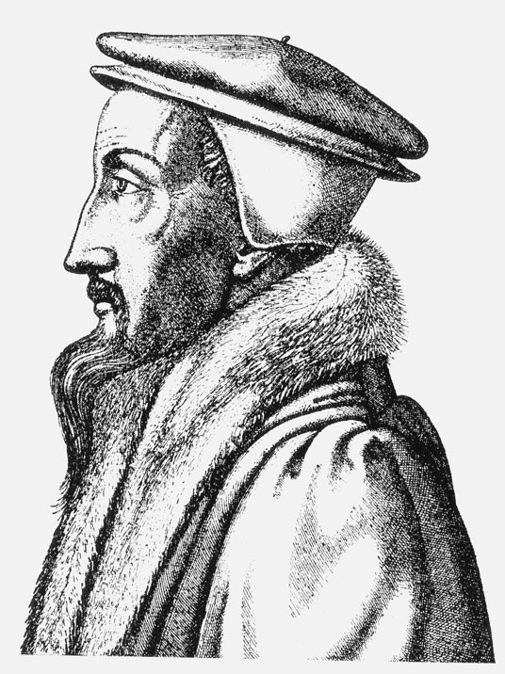
Results of the Reformation.
Created a split in the church between the Catholics and the Protestants
France and Switzerland:
John Calvin preached the idea of “predestination” and that some people had been chosen by God for salvation.
England:
King Henry VIII refused to recognize the Roman Catholic Church and started a new church, the Church of England.
Notes:
17
John Calvin; engraving by René Boyvin; source: http://upload.wikimedia.org/wikipedia/commons/7/7b/Calvin_1562.jpg.
Henry VIII (ruled 1509 – 1547) by Hans Holbein the Younger; source: http://upload.wikimedia.org/wikipedia/commons/8/8a/Hans_Holbein_d._J._074.jpg

Slide 18
The End
18

