Slide 1
Imperialism and Nationalism

Slide 2
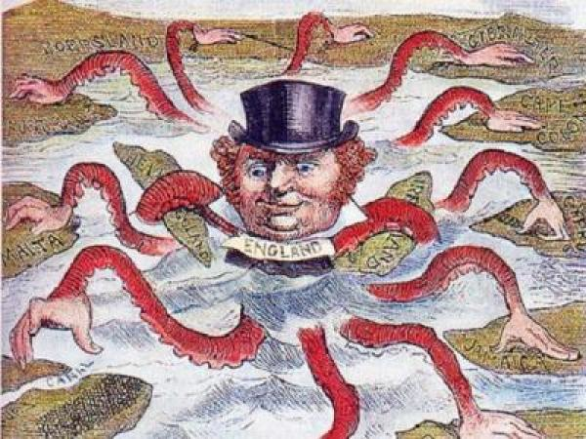
Imperialism
Establishing ________ over ______________ and ______________; the domination by one country of the political, economic, or cultural life of another country or region.
control
Foreign lands
Foreign people

Slide 3
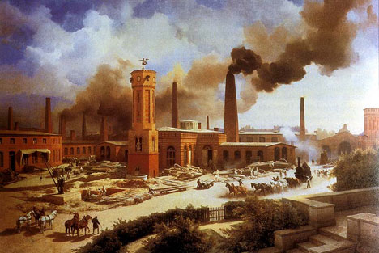
Motives for Imperialism
The needs of _______________ during the 1800’s in Europe and the United States was a major reason for imperialism
________________
_______________
________________
Industrial Revolution
Natural Resources
New Markets
Cheap Labor

Slide 4
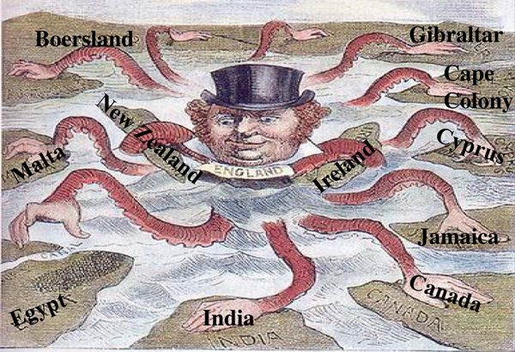
Motives for Imperialism
_______________– applied Darwin’s idea of survival of the fittest to social issues
Supporters believed it was natural for stronger nations to ___________ weaker ones
Social Darwinism
control

Slide 5
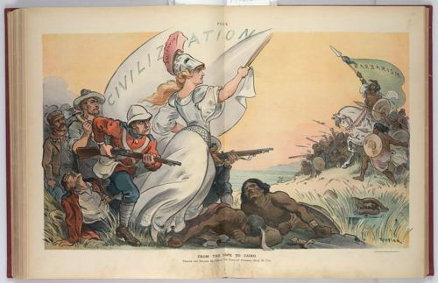
Motives for Imperialism
Rudyard Kipling’s poem __________________expressed the idea that Europeans had a ______ to introduce the benefits of their __________to non-European peoples.
“The White Man’s Burden”
duty
civilization

Slide 6
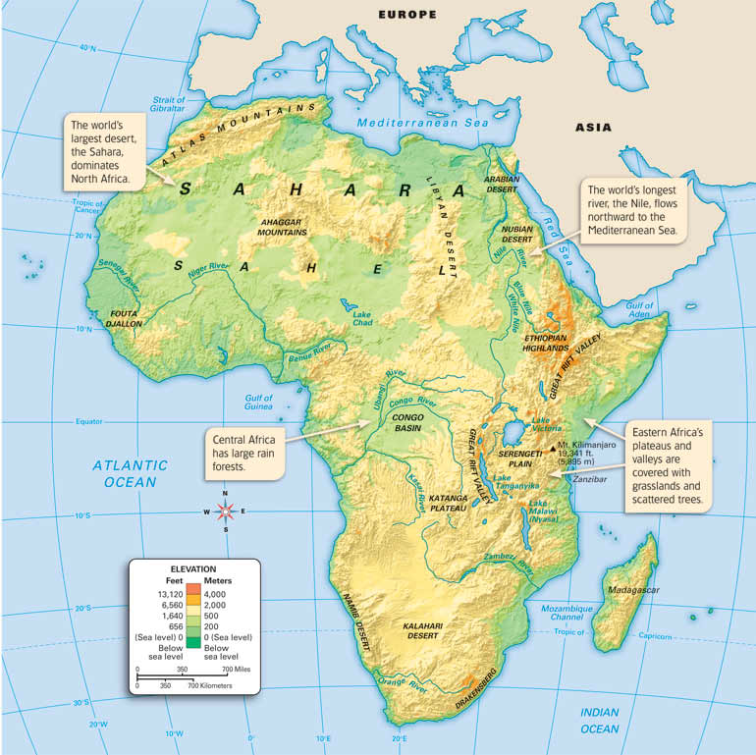
Imperialism in Africa
Africa’s ___________ (physical) barriers (waterfalls, rapids, highlands, steep cliffs, deserts) delayed ___________________of central Africa.
__________of Belgium established a trade colony in the _______ which sparked the interest of other _________ nations in Africa
Geographic
European colonization
King Leopold
Congo
European

Slide 7
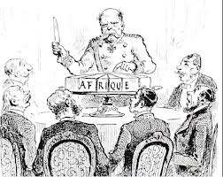
Imperialism in Africa
European leaders held the _____________in order to determine how Europeans would divide up of Africa
Established __________ based primarily on territorial claims of __________.
did not consider impact on African ethnic groups or cultures
Berlin Conference
borders
Colonial rulers

Slide 8
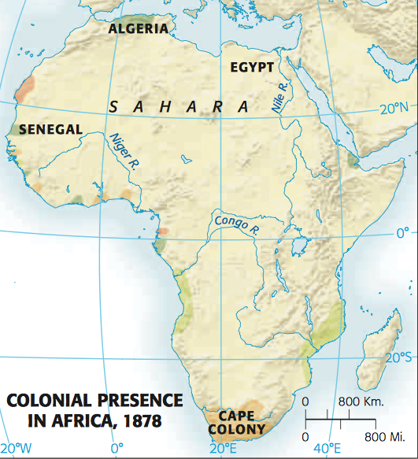
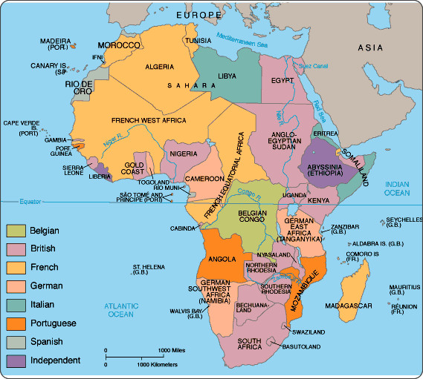

Slide 9
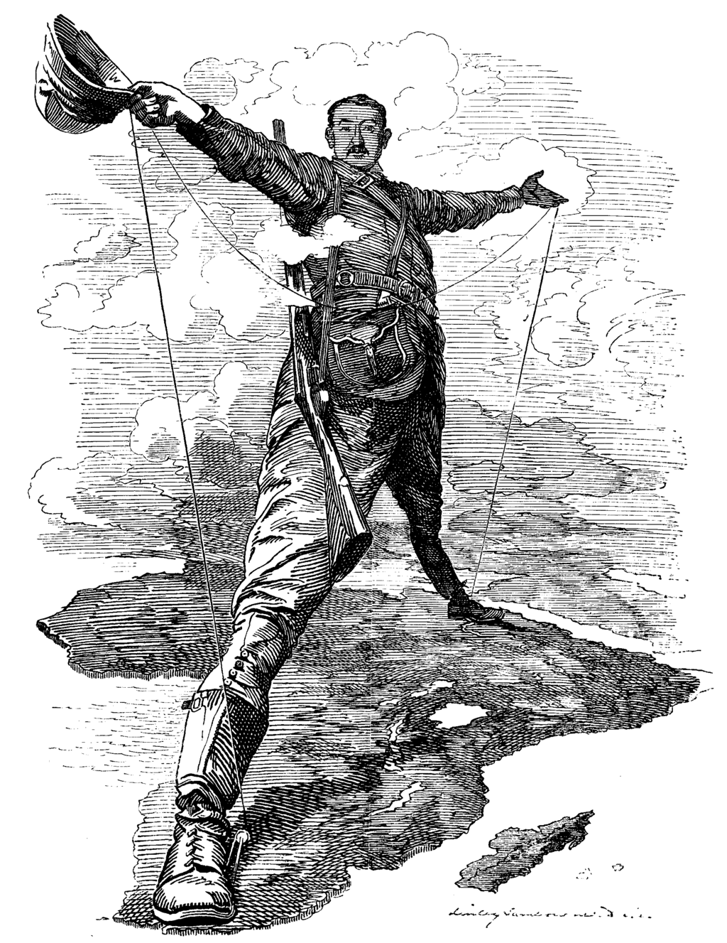
Imperialism in Africa
Cecil Rhodes
_____________was a strong supporter of British imperialism in Africa
_________and the Zulu’s attempted to resist imperialism in Southern Africa
were defeated because of the British armies superior military technology
Shaka Zulu

Slide 10
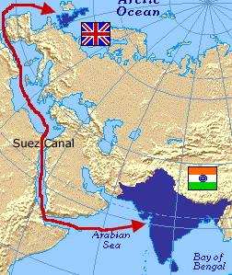
Imperialism in Africa
British and French tried to gain control over Egypt because of its _________ location
The Suez Canal
Strategic

Slide 11
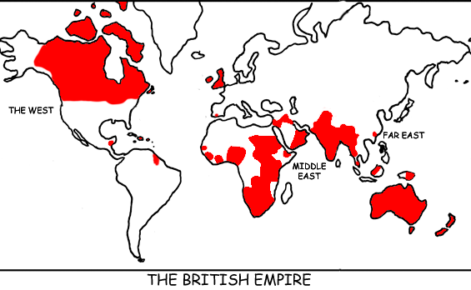
Imperialism in India
The _________________grew wealthy and powerful conducting _______ with India
The slogan “The Sun never sets on the British Empire” was developed during the Age of Imperialism
British East India Company
Trade

Slide 12
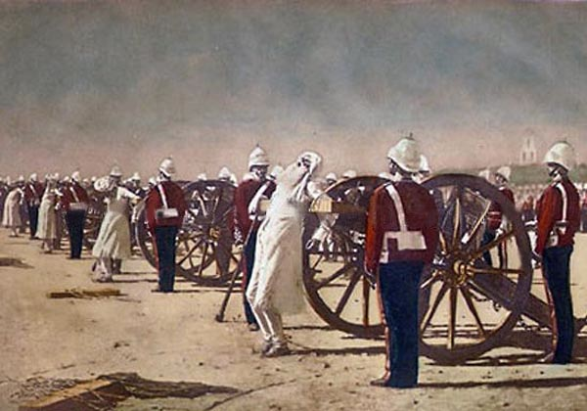
Imperialism in India
__________was rebellion of Indian soldiers employed by the British East Company
British demanded the Sepoys follow rules that went against their ______ and _________ religious beliefs
British crushed the rebellion
British established ____________over India after the Sepoy Mutiny
Sepoy Mutiny
Hindu
Muslim
Direct Control

Slide 13
Imperialism in China
European colonialism in Asia was successful (in the late 1800s) because Europe was able to dominate military and commercial relations with Asia.

Slide 14
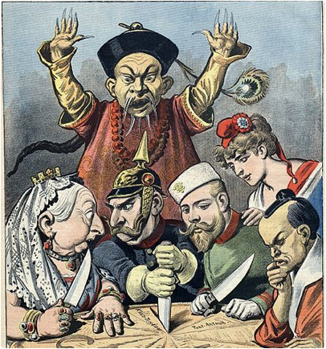
Imperialism in China
A ________________ is an area in which an outside power claims exclusive trading privileges.
During the 19th century, European nations established spheres of influence in _______ mainly to gain commercial (trade) advantages.
Sphere of Influence
China

Slide 15
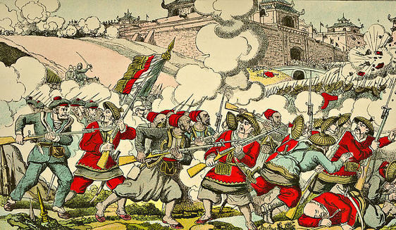
Imperialism in China
The ____________was a rebellion of Chinese peasants against the Qing Dynasty rulers in China which weakened China
Taiping Rebellion

Slide 16
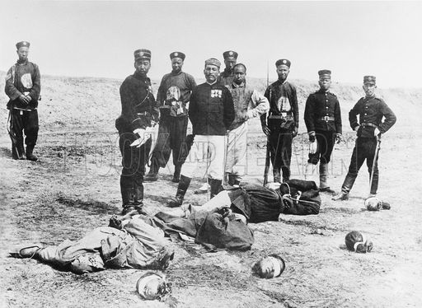
Imperialism in China
The ____________ was an unsuccessful attempt to attempt to drive foreign influence out of China
The Righteous Harmonious Fists started the rebellion
The Rebellion was crushed by European nations, Japan, and the United States
Boxer Rebellion

Slide 17
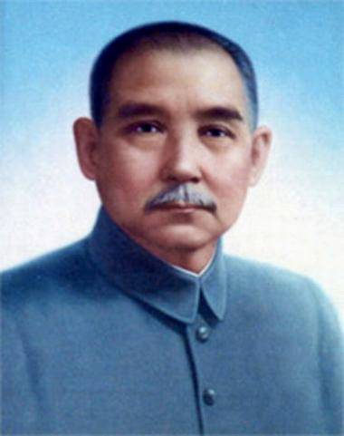
Imperialism in China
_____________was a nationalist leader who led movement to replace the Qing dynasty and restore Chinese rule in China
Sun Yat-Sen (Yixan)

Slide 18
Nationalism
NATIONALISM is a feeling of pride in and devotion to one's country
Develops among people who may share:
common language
history
set of traditions
goal
Being controlled by foreign powers

Slide 19
Nationalism
Nationalism also causes people to join together to choose their own form of government, without outside interference
Self determination
Sovereignty
Autonomy
Independence

Slide 20
Nationalism
Once Nationalism exists, Militarism is surely soon to follow
Militarism: the policy of maintaining a large armed force that is prepared for war
Nationalism Militarism Nationalism

Slide 21
Nationalism
Propaganda: information, especially of a biased or misleading nature, used to promote a political cause or point of view.
Facism: an authoritarian and nationalistic right-wing system of government and social organization.

Slide 22
Nationalism
NATIONALISM + Militarism = Facism
How do all these puzzle peicesfit together?
Nationalism, Imperialsim, Militarism, Facism…

Slide 23
Nationalism
Nationalism can be a unifying force
Unification of Germany
Unification of Italy
Nationalism can be a force that tears apart empires
Austria-Hungary
Ottoman Empire

Slide 24
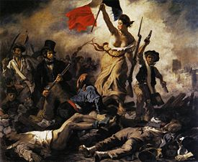
Nationalism in Europe
The French Revolution and Napoleon’s Conquests inspired nationalistic feelings among the French people

Slide 25
Nationalism in Europe
Nationalistic feelings arose in areas of Europe that were conquered by Napoleon
Groups of conquered people often unite to drive out a foreign conqueror

Slide 26
Events Influenced by Nationalism
Breakup of Austria-Hungary
Breakup of Ottoman Empire
Indian Independence Movement
Formation of Indian National Congress
Formation of Muslim League

