Slide 1
the French Revolution

Slide 2
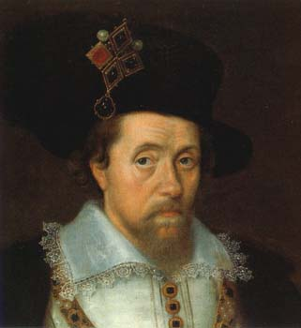
Absolutism
Absolute monarchs didn’t share power with a counsel or parliament
“Divine Right of Kings”
Similar to the modern idea of Dictatorship
King James I of England
Notes:
The period lasting roughly from 1600 to 1800 is often referred to as the Age of Absolutism. Monarchs during this time exercised complete authority and did not share power with a council or cabinet.
Absolutism was tied to the concept of “Divine Right of Kings”—the idea that monarchs had been appointed by God and were responsible only to God. Thus, no one could question their judgment. Historians often identify James I of England as one of the first absolutist rulers. Not only did James believe that monarchs should hold total power (a belief that led him to clash with Parliament on several occasions), but he also wrote extensively about the Divine Right of Kings. In his work The True Law of Free Monarchies, he stated that “Kings are called gods…because they sit upon God his throne in the earth and have the count of their administration to give unto him.”

Slide 3
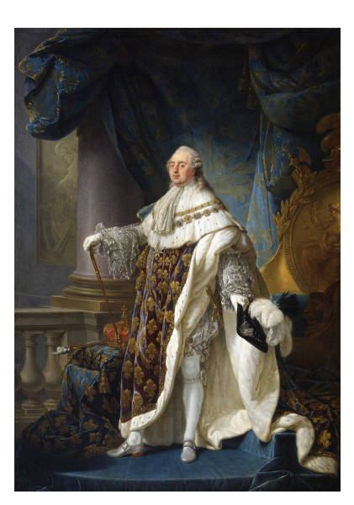
Absolute Monarchy with Weak Monarch
King Louis XVI
Incapable of making decisions
Preferred own interests instead of court interests
Heavily influenced by wife, Maria Antoinette

Slide 4
Financial Difficulties
Need for tax reform
Nobles didn’t want to pay taxes. They never had to before.
Peasants and bourgeoisie were upset because they paid all the taxes
Government had large debts with heavy interest
Extravagant spending on courts
Over ambitious wars

Slide 5
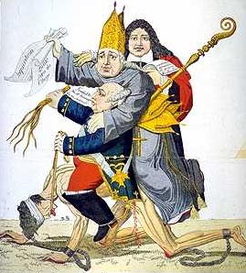
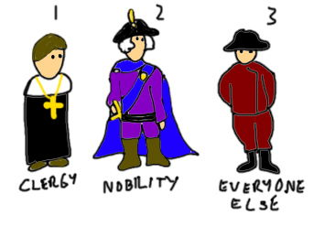
Population Divided Into 3 Estates
1st Estate: Clergy (church officials)
.5% of population
2nd Estate: Nobility (aristocracy, rich people)
1.5% of population
3rd Estate: Everyone Else (peasants, upper middle class)
98% of population

Slide 6
Sent Aid and Supplies to American Revolution
France is introduced to revolutionary ideas
A republic is superior to a monarchy
Take up arms against tyranny
Liberal freedoms for all men
No taxation without representation

Slide 7
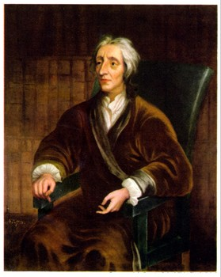
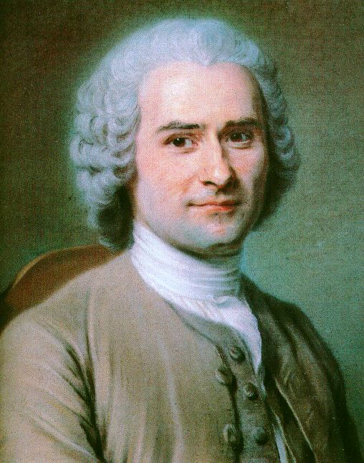
The Enlightenment
New ideas about society and government
The social contract
John Locke
Jean-Jacques Rousseau
Notes:
The Enlightenment was a period of intellectual ferment that gave rise to a range of new theories about society, government, philosophy, economics, and religion. The concepts of liberty, equality, and democracy were becoming popular through the writings of thinkers such as John Locke, Jean-Jacques Rousseau, and Thomas Paine. Enlightenment philosophers and writers attacked the aristocracy and the monarchy, drawing much of their inspiration from the concept of the social contract.
The social contract was a feature of the writings of both Locke and Rousseau. It stated that a ruler rules at the behest of the people. If a ruler is unjust, according to the social contract, then the people have the right and the duty to replace that ruler.

Slide 8
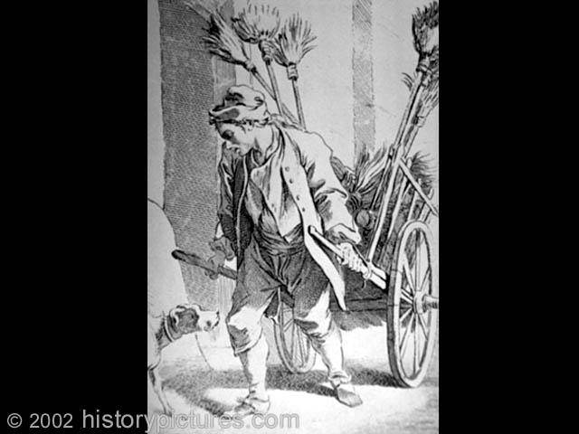
The Third Estate
Taxation
Crop failures
Price of goods went too high for the peasants to afford
Notes:
The Third Estate had long labored under an obsolete tax code that placed the majority of France’s tax burden upon its shoulders. With this heavy debt already a drain on their purse, bad weather in the 1780s caused widespread crop failures that resulted in grain shortages which pushed the price of bread, the staple of the French diet, too high for most peasants to buy. This would prove to be another factor leading to a revolution.

Slide 9
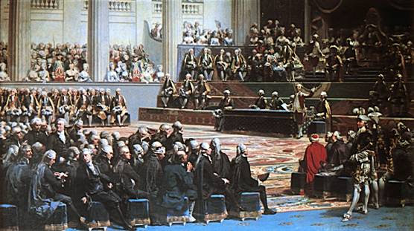
The Estates General
One vote per estate
Clergy and nobility usually joined together to outvote the Third Estate
Met in Versailles in May 1789
Voting controversy
A meeting of the Estates General
Notes:
Each estate had one vote in the Estates General, despite the fact that the First and Second Estates only represented three percent of the population of France. In addition, since the first two estates always voted together, if the Third Estate disagreed with them there was little it could do with its single vote.
When the Estates General convened in Versailles in May 1789, the First and Second Estates had about 300 delegates each, while the Third Estate had about 600 delegates. A controversy over voting arose almost immediately, as the Third Estate demanded that rather than having one vote per estate, each delegate be given a vote. This would have allowed the Third Estate the opportunity to gain a majority. The king, however, rejected this proposal.

Slide 10
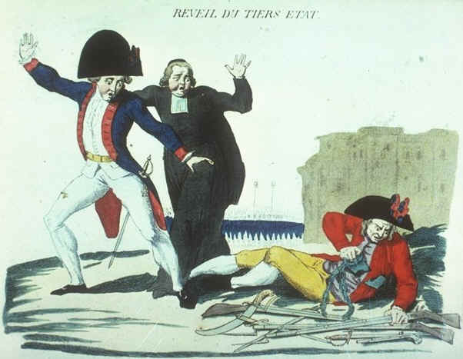
The National Assembly
The Third Estate took action and established its own government
On June 17, 1789, the National Assembly was formed
Notes:
After weeks of frustrating debate over voting, the representatives of the Third Estate declared themselves the “National Assembly” and claimed that they were France’s true representative body. They invited members of the other estates to join them, and some members of the clergy and aristocracy did so. The National Assembly was inspired by the influential Abbé Sieyes, who had earlier published a pamphlet that proclaimed the Third Estate and the nation were one.

Slide 11
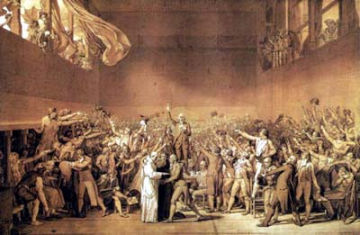
Confrontation With the King
Louis XVI ordered the Third Estate locked out of the National Assembly’s meeting hall
The Tennis Court Oath
The king ordered the third estate to disperse, they refused
Artist Jacques Louis David’s depiction of the Tennis Court Oath
Notes:
Louis ordered that the National Assembly be locked out of its meeting place. He continued to insist that the estates meet separately and that the National Assembly be disbanded. The National Assembly responded by moving to a nearby tennis court, where they vowed not to leave until France had a constitution. This “Tennis Court Oath” gained the Assembly popularity among the working class and poor, and they even drew some of the more open-minded clergy and nobles to their side as well.
On June 27th, the king reversed his position and ordered the first two estates to join the National Assembly. He also decided to call French troops into Paris to try to keep a lid on the volatile situation.

Slide 12
Third Estate Triumphs
The King was unwilling to use force and eventually ordered the first and second estates to join the new National Assembly.
The third estate had won.

Slide 13
The National Assembly
The new National Assembly created the historic and influential document The Declaration of the Rights of Man, which stated the principle that all men had equal rights under the law.
This document has remained the basis for all subsequent declarations of human rights. (Compare The Universal Declaration of Human Rights).

Slide 14
Conditions in Paris
Conditions were poor in Paris for the common people.
The price of bread was high and supplies were short due to harvest failures.
Rumors spread that the King and Queen were responsible for the shortages
Then French troops marched to the capital.
Rumors spread quickly among the already restless mobs that the King was intending to use them against the people.
The dismissal of the Finance Minister Necker, who was popular with the third estate, ignited the spark.

Slide 15
The Storming of the Bastille
On July 14, 1789, the mob, joined by some of the King's soldiers, stormed the Bastille.
The commander of the Bastille, de Launay, attempted to surrender, but the mob would not accept it.
He was killed as they poured through the gates.
No guard was left alive.

Slide 16
The King’s Return to Paris
Under pressure from the National Guard, the King also agreed to return to Paris with his wife and children.
It was the last time the King saw Versailles.

Slide 17
The Execution of Louis XVI
The constitutional monarchy put in place by moderate revolutionaries gave way to a radical republic.
The National Convention decided to put Louis on trial for his crimes.
Although his guilt was never an issue, there was a real debate in the Convention on whether the king should be killed.
They voted for his execution.
On January 23, 1793 Louis Capet went to the guillotine in the Place de la Concorde, where a statue of his predecessor, Louis XV, once stood.
At the scaffold he said "I forgive those who are guilty of my death."

Slide 18
The Reign of Terror
After the death of Louis in 1793, the Reign of Terror began.
Marie Antoinette led a parade of prominent and not-so-prominent citizens to their deaths.
The guillotine, the new instrument of egalitarian justice, was put to work.
Public executions were considered educational. Women were encouraged to sit and knit during trials and executions.
The Revolutionary Tribunal ordered the execution of 2,400 people in Paris by July 1794. Across France 30,000 people lost their lives.

Slide 19
Watch Committees
The Terror was designed to fight the enemies of the revolution, to prevent counter-revolution from gaining ground.
Most of the people rounded up were not aristocrats, but ordinary people.
A man (and his family) might go to the guillotine for saying something critical of the revolutionary government.
Watch Committees around the nation were encouraged to arrest "suspected persons, ... those who, either by their conduct or their relationships, by their remarks or by their writing, are shown to be partisans of tyranny and federalism and enemies of liberty" (Law of Suspects, 1793).

Slide 20
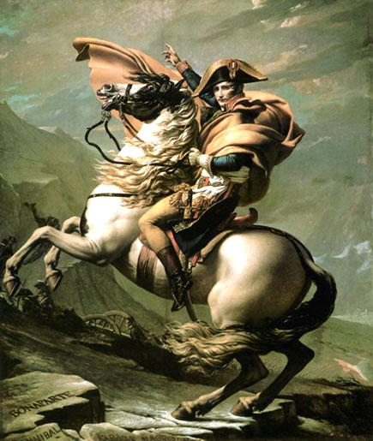
Napoleon Bonaparte
The French people supported Napoleon
They thought he would provide stability
Popularity rises after victories over the Austrians
Conflict with Britain
1799 Coup d’etat
The Consulate
Notes:
Napoleon’s victories over the Austrians in Italy forced an end to the war and allowed France to gain extremely favorable terms in the subsequent peace treaty. Napoleon’s achievements made him a national hero.
He next received command of an army training to invade England. Napoleon, however, felt an invasion might not be the best strategic move and decided instead to strike at British colonial possessions and attempt to take Egypt. French troops moved in and assumed control of the country; however, the British navy under Admiral Horatio Nelson destroyed the French fleet at Abukir Bay in 1799, leaving Napoleon stranded in Egypt.
Meanwhile back in France, the Directory was becoming more and more unpopular because of widespread corruption and its inability to solve the country’s economic problems. With the Directory on shaky ground, Napoleon saw an opportunity to seize power. He abandoned his troops in Egypt and returned to France. On November 9, 1799, with the support of the army in France, he executed a successful coup d’état and overthrew the Directory. The French Revolution was over.
A new government called the Consulate was put into place. The Consulate was in theory a republican form of government headed by three consuls, of which Napoleon was first consul. He quickly took complete control of the entire government. In 1802, Napoleon was made consul for life.

Slide 21
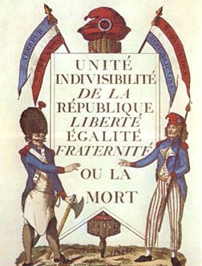
Legacies of the French Revolution
End of absolutism
Power of nobles ended
Peasants became landowners
Nationalism
Enlightenment ideals
Notes:
As is the case with all historical events, opinions may vary on their significance or impact. What is agreed upon is that the Revolution brought an end to absolutism in France. Even when the monarchy was restored, it was not absolutist in nature. With the abolition of feudal privileges, the nobles lost their power and eventually their lands. The peasants and middle class came to possess land for the first time, and France became a nation of small landowning farmers.
The Revolution and the foreign wars associated with it also gave the French people a strong sense of national identity. Loyalties had shifted from a king or queen to the nation. This “nationalism” that began in France was spread by revolutionary and Napoleonic armies to the rest of Europe. The struggle for national liberation became one of the most important themes of 19th- and 20th-century European and world politics.
The Declaration of the Rights of Man was an outstanding example of the expression of Enlightenment ideals concerning freedom, equality, and rights. These ideals, along with the notion of equality before the law, would provide the basis for reform movements and new political philosophies in the 19th century.

