Slide 1
Wed, sept 6th
WARMUP #1
Lets see how much you know!
How many of the 7 continents can you name?
How many of the 5 oceans can you name?
What direction is Latitude?
What direction is Longitude
What continent is the largest based on land size?

Slide 2
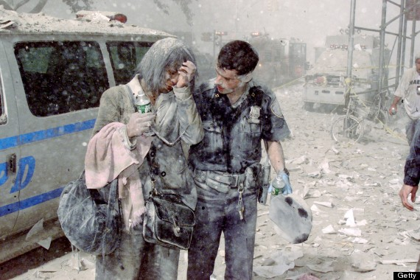
FRIDAY, September 8th
WARMUP #2
List three objects that you see
Describe two actions
Who are these people
What other questions can you ask
To determine context?

Slide 3
Tuesday, September 12th
WARMUP #3
In your own words define these two terms:
PROTEST
REFORMATION

Slide 4
MOnday, September 18th
WARMUP #4
1. What is this Device?
2. What was it used for?
3. Why is it so important to the protestant Reformation?

Slide 5
wednesday, September 20th
WARMUP #5 9/20/17
Tell me at least two things I need to know about Martin Luther and/or the Protestant Reformation
2.Tell me anything/everything you may know about the Renaissance

Slide 6
Warmup #6 9/26/17
1.What was a major result of the Protestant Reformation?
2. What was Martin Luther’s main reason for writing his 95 Thesis?
3. What do you predict will happen next in Europe as a result of the Protestant Reformation?

Slide 7
Monday, October 2nd
WARMUP #7
In your own words write a definition of the word:
“EXPLORE” (at least two complete sentences)

Slide 8
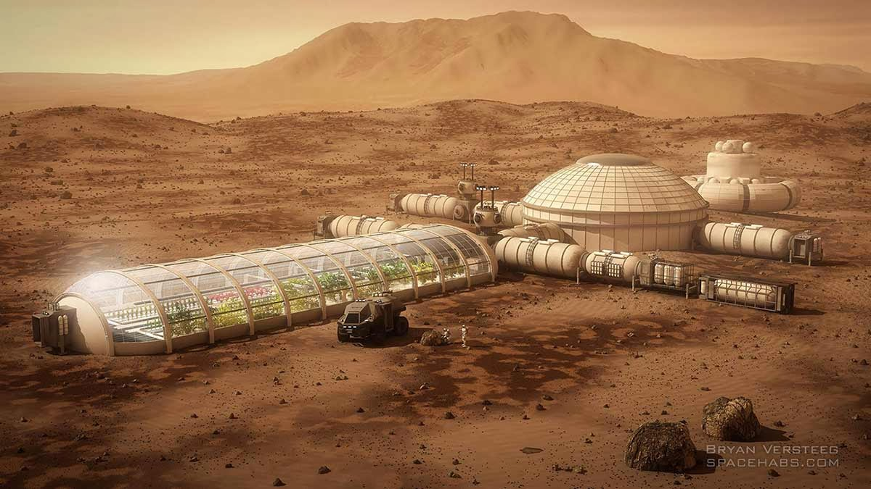
Wednesday, OCT, 4th Warmup #8
Beginning in 2026, crews will fly on one way missions to Mars to begin building a settlement for colonization.
Why would people move to Mars?
What supplies would people need to survive?
If each trip to Mars is one way, how do you think people will get their necessary supplies?

Slide 9
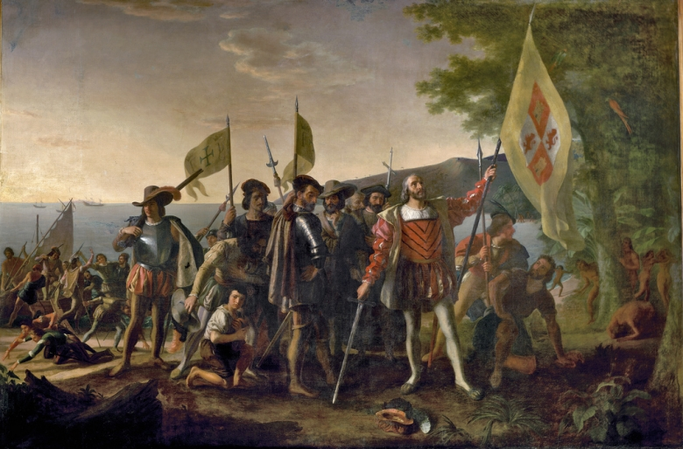
Friday, October 6th WU #9
1. List four objects you can identify.
2. Who do you think these people are?
3. What do you think is happening in this painting?

Slide 10
Tuesday, October 10th. Warmup #10
1. | Which of the following best summarizes the theory of mercantilism?
A. | Mercantilism granted independence as soon as possible.
B. | Mercantilism was considered an economic burden for the colonial power.
C. | Mercantilism focuses on acquiring markets and trading materials to help the mother country make money.
2. | What is an example of cultural diffusion?
A. | Europeans and natives sharing and exchanging cultural views
B. | the spreading of disease like smallpox
C. | an economic system designed to tax peasants
D. | a spreading of religion resulting in the loss of native belief systems
3. | How did the Columbian Exchange change the lives of Europeans?
A. | Many were shipped to South America as Slaves.
B. | African products were widespread and bought by most of the population.
C. | Diseases from Asia came and devastated Europe’s population.
D. | New crops from the Americas changed their diet.

Slide 11
Thursday, October 16th
WARMUP #11
There were FOUR major motivations for exploration, what were they (explain all four)
Who Were the three main countries competing in the exploration race?

Slide 12
Thursday, October 16th Warmup #12
What were the areas of the new world that each of the mother countries conquered?
Spain? _________________
England? ____________________
France?____________________

Slide 13
10/20/17
NO WARMUP TODAY
Sit with a group of 2 or 3 ppl (NOT 4) that you want to work with on a group poster project
DO NOT come to me with your GRASP assignment yet
I WILL COME AROUND WHILE YOU ARE WORKING TO COLLECT YOUR GRASP

Slide 14
Tuesday, October 24th
WARMUP #13
In your own words write down your definition of the word
REVOLUTION

Slide 15
Tuesday, October 31st
WARMUP #14
Are we currently experiencing any kind of Revolution in our society today?
If yes, explain
If not, what do you predict will be the next global revolution?

Slide 16
Friday, Dec 8th
WARMUP #15
Go back through your notes and answer the following the questions
What is the scientific method?
What is the difference between geocentric and heliocentric theory?
The age of enlightenment is also know as what?
What were the ideas of Thomas Hobbes?
What is a social contract?

Slide 17
Tuesday, Dec 12th
WARMUP #16
What do you know about the American Revolution?
Do you know who fought in the war?
Do you know what the Declaration of Independence is?
Do you know what the Constitution is?

Slide 18
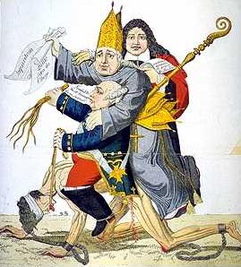
Wed, January 3rd WARMUP #17
Write down at least FIVE things that you see in this political cartoon

Slide 19
Friday, Jan 5th
WARMUP #18
Tell me three key details of the American Revolution
Tell me three key details of the French Revolution
Tell me three things both revolutions have in common

Slide 20
Tuesday, Jan 9th
WARMUP #19
Who lead the Haitian Revolution?
Who lead the Mexican Revolution?
From were did these Latin American countries get their inspiration to declare their independence?

Slide 21
Thursday, Jan 11th
WARMUP #20
Describe the differences between the ideas of Thomas Hobbes and John Locke.
What is the difference between a political Revolution and Intellectual Revolution?

Slide 22
Tuesday, January 23rd WARMUP #21
List 3 objects/things you see.
Describe 2 actions.
What do you think is the main idea/main action of this image?

Slide 23
Monday, January 29th WARMUP #22
Review your notes and answer the following questions:
What is “Urbanization”
What is “Tenement housing”
Describe working conditions in the early days of factories
Describe the assembly line
Describe two positive and two negative effects of the Industrial Revolution

Slide 24
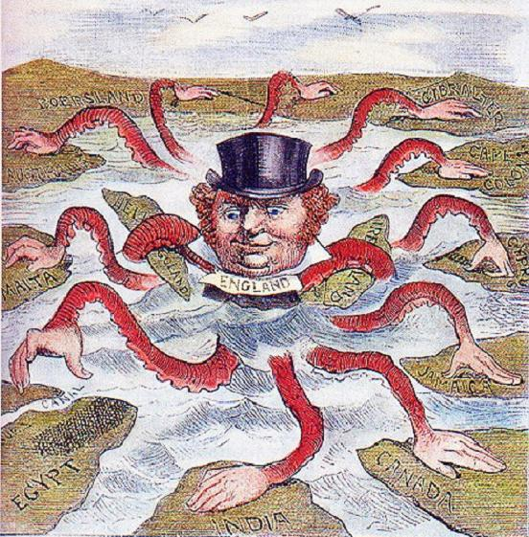
Friday, Feb 2nd WARMUP #23
What objects or symbols do you see?
What action is taking place?
What message is this cartoon trying to convey?

Slide 25
Monday, Feb 12th Warmup #24
Mercantilism was an economic theory and practice used by Europeans in the seventeenth and eighteenth centuries to increase the wealth of a nation or empire. This was done by acquiring gold and silver and maintaining a favorable balance of trade, in which a country exported more than it imported. How did mercantilism encourage European countries to colonize both the Americas and Africa?
A Europeans wanted new navigational technologies.
B Wealthy European merchants wanted to build their own empires.
C New labor forces were needed to work large plantations in the New World.
D European countries needed raw materials to produce manufactured goods.
1. What is your definition of Imperialism?
2. What continent was the first to be imperialized by European countries?
3. What does the term “social Darwinism” mean?
4. What European country imperialized the most territory in Africa?

Slide 26
Friday, Feb 16 Warmup #25
During the Italian Renaissance, artists and thinkers rediscovered classical knowledge and art. As part of that process some artists, particularly Leonardo da Vinci, began to challenge the explanations for the natural world offered by the Church. How did Renaissance art influence modern society?
A Artists lost importance once they began to challenge social norms.
B Intellectuals began to explore scientific explanations for the world.
C Art became the only way through which to question society.
D Monarchs became the only people who could gain access to knowledge. REL

Slide 27
Monday, Feb 19 Warmup #26
. . . reason . . . teaches all mankind, who would but consult it, that being all equal and independent, no one ought to harm another in his life, health, liberty, or possessions.
Second Treatise on Civil Government by John Locke, 1689
Which concept of the Enlightenment would the passage most likely support?
A Truth can be discovered through reasoning and logic.
B Humankind can and should improve over time.
C People have a right to equality and freedom.
D What is natural is also reasonable

Slide 28
Warm Up#27
What were the Main Causes of WWI: (hint: think about the “ism’s)
2. Who were the members of the Triple Entente?
3. Who were the members of the Triple Alliance?
4. Name two significant technological advancements that were used in WWI.

Slide 29
3/9/18 Warm Up #28
Match the Dictator with the country
Dictators: Country:
Adolf Hitler
Benito Mussolini
Joseph Stalin
Francisco Franco
Hideld Tojo
Italy
Soviet Union
Germany
Japan
Spain
Notes:
NOTE- MYRIAM SAID IT’S NICEEE

Slide 30
Warmup #29 March 13th
1. What action (treaty) ended WWI?
2. What country was forced to take the “blame” of WWI?
3. What is another name for Dictatorship?
4. What does the term ‘Blitzkrieg” mean?
5. Who were the members of the Allied Powers?
6. Who were the members of the Axis Powers?

Slide 31
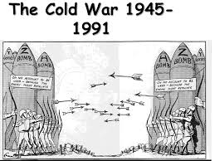
Warmup #30 4/9/18
What objects or symbols
do you see?
2. What action is taking place?
3. What message is this
cartoon trying to convey?

Slide 33
Friday, October 28th
WARMUP #14
List two of the scientists we took notes on last class and write down at least two important facts about them.

Slide 34
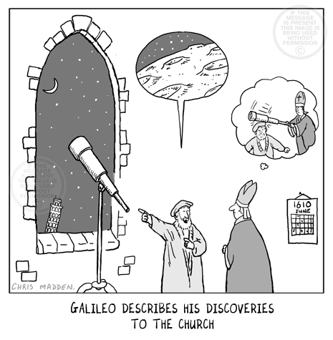
Wed, November 2nd
WARMUP #15
Based on what you know about the scientific revolution:
Who are the people in this picture?
How would you describe this picture?
What is the “big idea” that the cartoonist is trying to convey

Slide 35
Friday, November 4th: warmup #16
How do we as Americans elect our President?
Do you know what the term “Electoral College” means?
Who are the four presidential candidates?
How will we know on election night who won?
How many senators are there from each state?

Slide 36
Wed, November 9th: warmup #17
Tell me your thoughts on the election last night.

Slide 37
Monday, November 14th
WARMUP #18
In today’s modern world tell me at least three people you would consider to be enlightened thinkers, AND WHY.

Slide 38
1. Who said that if Government is not protecting the rights of the citizens then it should be overthrown? 2. Who believed in a separation of powers in government? 3. Who believed that citizens needed strong rules and laws to protect them for themselves and each other?
Wed, November 16th WARMUP #19

Slide 39
Fri, November 18th WARMUP #20
Why did the ruling class (Kings and Queens) in Europe feel threatened by the enlightened thinkers?
Cite at least two thinkers that we studied in your answer.

Slide 40
Dec. 5th WU #21
This is an excerpt from a pamphlet titled “Common Sense” written by Thomas Paine in 1776. Why does he say England and the Colonies should split?
“I have heard it asserted by some, that America would have flourished under her former connection with Great Britain, and that the same connection is necessary towards her future happiness, and will always have the same effect. Nothing can be more fallacious that this kind of argument. We may as well assert, that because a child has thrived upon milk that it is never to have to have meat; or that the first twenty years of our lives is to become a precedent for the next twenty. But even this is admitting more than is true, for I answer roundly, that America would have flourished as much, and probably much more, had no European power had anything to do with her.”

Slide 41
Write down at least two reasons the Colonists were unhappy with Britain and wanted to declare independence.
Dec 7. WARMUP #22

Slide 42
Why do some people say that Thomas Paine was the biggest influence for the American Revolution?
Dec. 9th WARMUP #23

Slide 43
tues, December 13th WARMUP #24
Write down at least FIVE things that you see in this political cartoon

Slide 44
1.Why was the American Revolution a CAUSE of the French Revolution? 2. What do you predict will happen in France and Europe as a result of the French revolution?
Dec. 21st WARMUP #26

Slide 45
1. Write down two enlightenment thinkers and their core beliefs 2. What were the three estates in France? 3. What was one major cause of the American Revolution?
Thursday, January 5th WARMUP #27

Slide 46
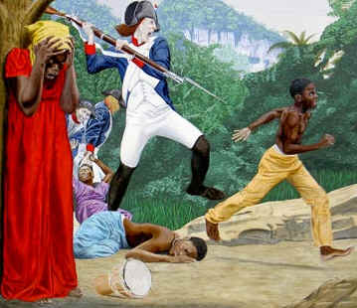
Wednesday, January 11th WARMUP #28
List 3 objects/things you see.
Describe 2 actions.
What do you think is the main idea/main action of this image?

Slide 47
Thursday, January 25th WARMUP #29
List 3 objects/things you see.
Describe 2 actions.
What do you think is the main idea/main action of this image?

Slide 48
Warmup #30
1. What's the difference between Urban and Rural?
2. What is Urbanization
3. What was a negative effect of the Industrial Rev.?
4. What was a positive effect of the Industrial Rev.?
5. Define Tenement housing.

Slide 49
Thursday, Feb16th WARMUP #31
What objects or symbols do you see?
What action is taking place?
What message is this cartoon trying to convey?

Slide 50
Warmup #32 Feb, 22nd
1. What is your definition of Imperialism?
2. What continent was the first to be imperialized by European countries?
3. What does the term “social Darwinism” mean?
4. What European country imperialized the most territory in Africa?

Slide 51
Warmup #33 Feb, 28th
1. How does propaganda relate to nationalism?
2. What is militarism?
3. What is Nationalism?
4. What is Fascism?

Slide 52
Warmup #34 March, 8th
In ten years I see myself doing ___________________________.
In order to achieve that goal I need to do the following thing
*
*
*
*

Slide 53
Warm Up#35 March 10th
What were the Main Causes of WWI: (hint: think about the “ism’s)
2. Who were the members of the Triple Entente?
3. Who were the members of the Triple Alliance?
4. Name two significant technological advancements that were used in WWI.

Slide 54
3/20/17 Warm Up#36
Match the Dictator with the country
Dictators: Country:
Adolf Hitler
Benito Mussolini
Joseph Stalin
Francisco Franco
Hideld Tojo
Italy
Soviet Union
Germany
Japan
Spain
Notes:
NOTE- MYRIAM SAID IT’S NICEEE

Slide 55
Warmup #37 March 24th
1. What action ended WWI?
2. What country was forced to take the “blame” of WWI?
3. What is another name for Dictatorship?
4. Who were the members of the Triple alliance?
5. Who were the members of the Triple Entente?

Slide 56
Warmup #38
What objects or symbols
do you see?
What action is taking place?
What message is this
cartoon trying to convey?

Slide 57
Warmup #39 April 24th
1. Describe the difference between Capitalism (democracy) and Communism (socialism)
2. What was the Iron Curtain?
3. Describe the Containment Policy
4. What was the Truman Doctrine?
5. What was the Domino Theory?

Slide 58
40

Slide 59
Warmup #41
Britain lost some of its oldest colonies after the American Revolutionary War. After this loss, British leaders were interested in expanding their empire. They looked to Asia, Africa, and the Pacific to expand their colonies. Britain also increased its empire after defeating Napoleonic France. How did England’s desire to expand its empire affect the global economy?
A England transformed the international arts by selling many plays and dramas about its dreams for an empire.
B England achieved its global empire by becoming the leading exporter of finished goods worldwide.
C England exploited its natural resources to win the global competition for land on all continents.
D England colonized various territories and regions around the world

Slide 60
Warmup #42
Can we doubt (remembering that many more individuals are born than can possibly survive) that individuals having any advantage, however slight, over others, would have the best chance of surviving and of [reproducing] their kind? . . . This preservation of favorable variations and the rejection of injurious variations, I call Natural Selection.
----Charles Darwin, The Origin of Species, 1859
Based on the excerpt, how might a social Darwinist explain societal divisions?
A The upper class willingly sacrifices its own well-being to help the lower class.
B The upper and lower classes work together to ensure the success of both groups.
C The social classes are divided equally to ensure equal access to existing economic opportunities.
D The upper class better adapts and thrives within modern societies than the middle and lower classes.

Slide 61
Warmup #43
… reason, which is that law teaches all mankind, who would but consult it, that being all equal and independent, no one ought to harm another in his life, health, liberty, or possessions.
--Second Treatise on Civil Government by John Locke, 1689
Which concept of the Enlightenment would the above passage most likely support?
A Truth can be discovered through reasoning and logic.
B Humankind can and should improve over time.
C People have a right to equality and freedom.
D What is natural is also reasonable

